Slide 1
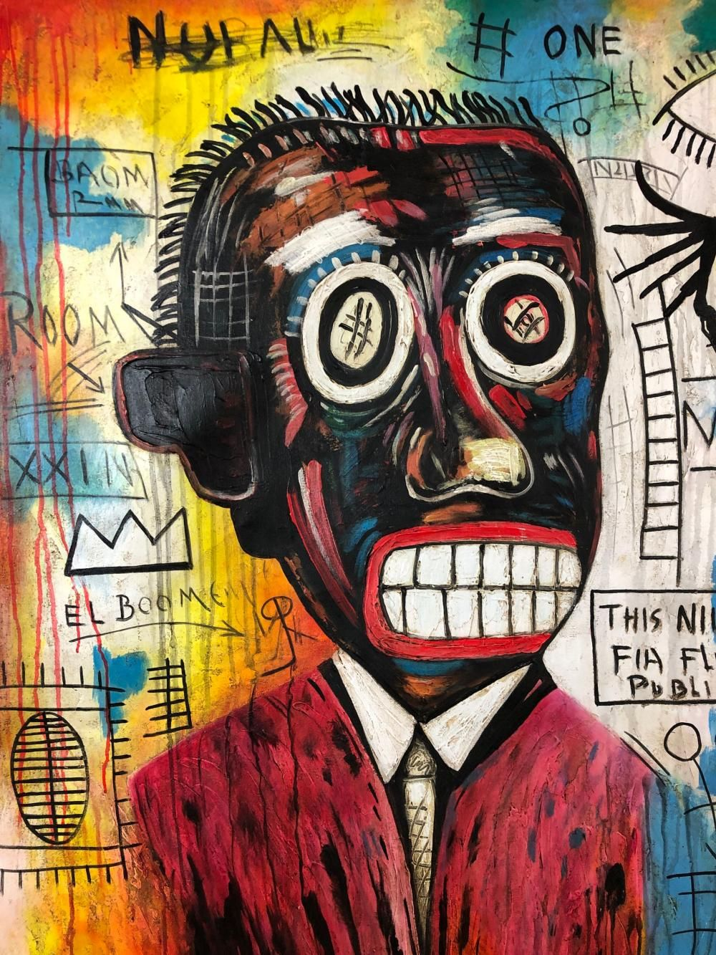
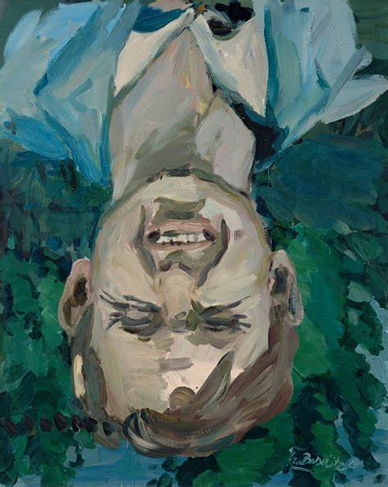
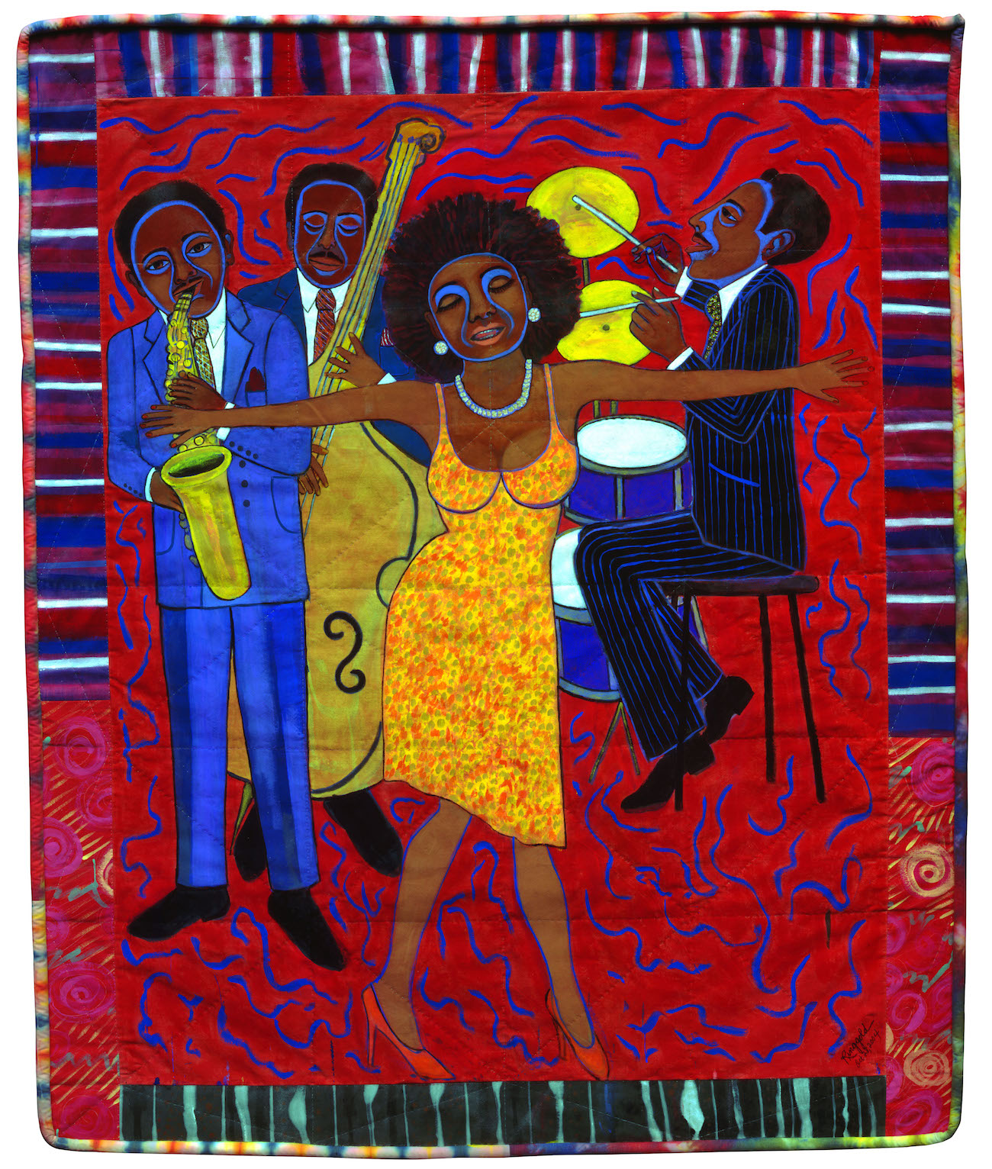
Identifying story-telling through color

Slide 2
Georg baselitz
What colors do you see?
What do the colors mean?
Is the image realistic?
Why or why not?
Why is the painting upside down?
Georg Baselitz, Somebody Stole My Broken Heart

Slide 3
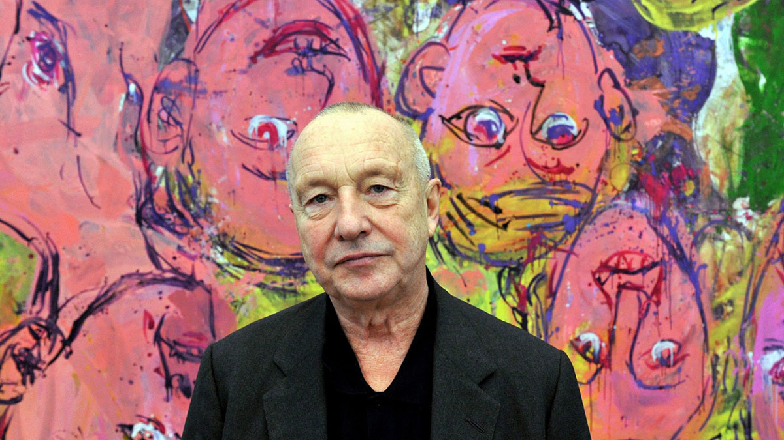
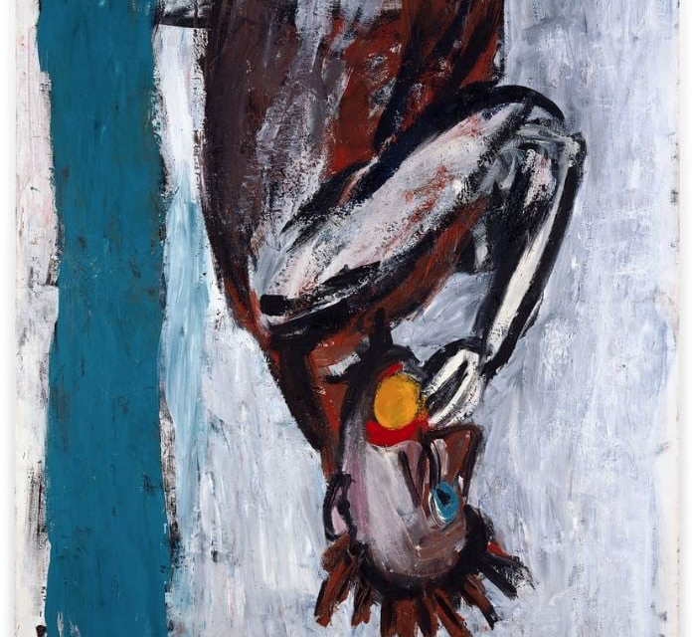
Georg Baselitz
Georg Baselitz's Neo-Expressionist art conveys intense emotional turbulence, often reflecting raw, primal feelings.
His works challenge conventional beauty by distorting figures, suggesting inner conflict and the darker aspects of human nature.
Through bold, aggressive brushstrokes and fragmented compositions, Baselitz expresses a deep sense of existential angst and psychological complexity.

Slide 4
Faith ringgold
Do the emotions in the title match the visuals?
What colors do you see?
What do the colors mean?
Do the brushstrokes make the piece feel still or moving?
Why?
Faith Ringgold, Somebody Stole My Broken Heart

Slide 5
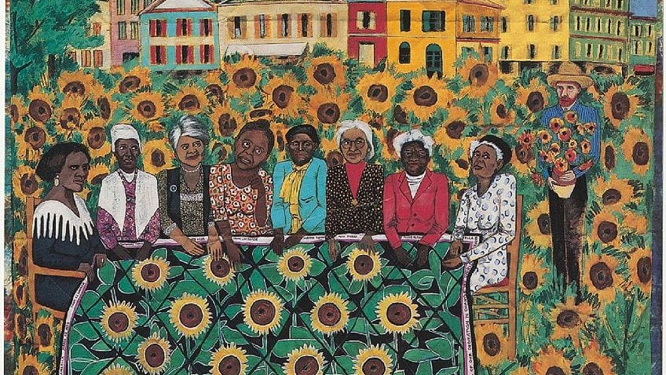
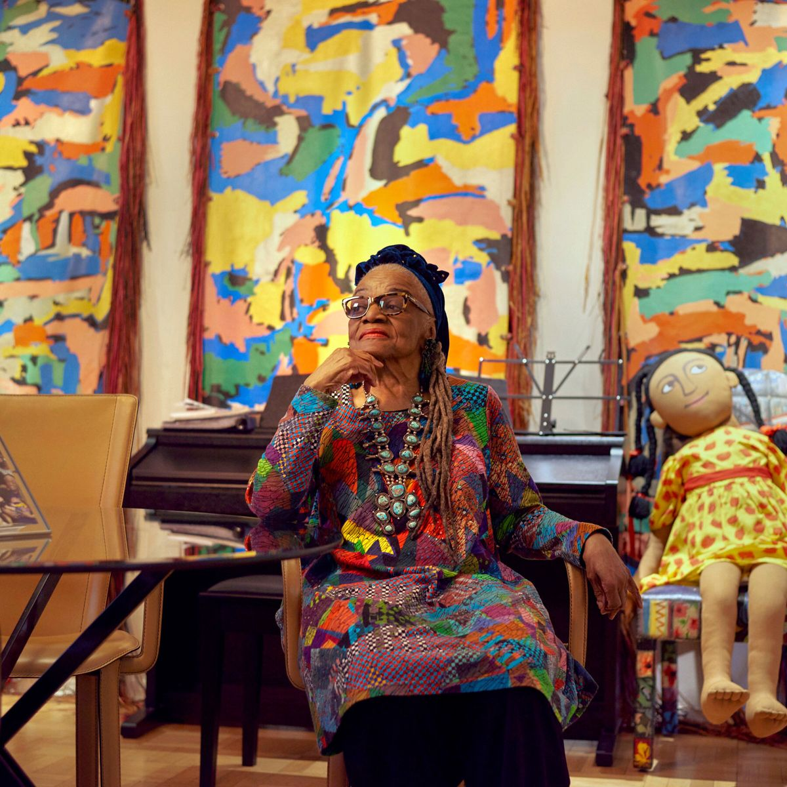
Faith ringgold
Faith Ringgold uses bright, vivid colors to bring warmth and life to her storytelling, often reflecting themes of African American history and culture.
Her bold color choices enhance the emotional impact of her quilts and paintings, making her narratives of identity, community, and struggle visually powerful and engaging.

Slide 6
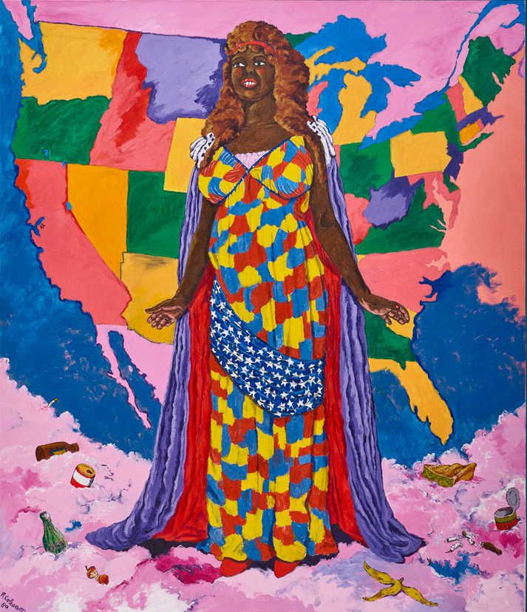
Robert Colescott
Given the title, what could the piece be about?
What could the depiction of the statue of liberty as a woman of color mean?
How do the colors used reinforce this idea?
Do the colors create a sense of chaos or harmony?
Does this reinforce the artist’s message?
Robert Colescott, Colescott's Statue of Liberty

Slide 7
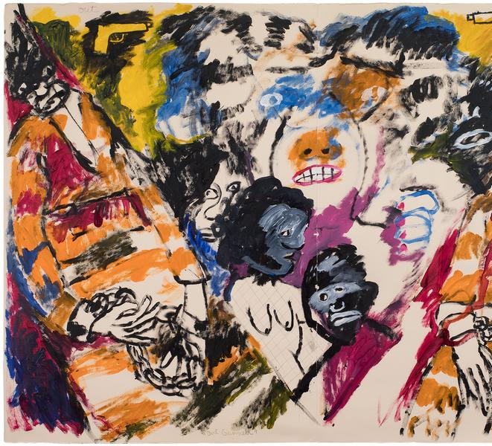
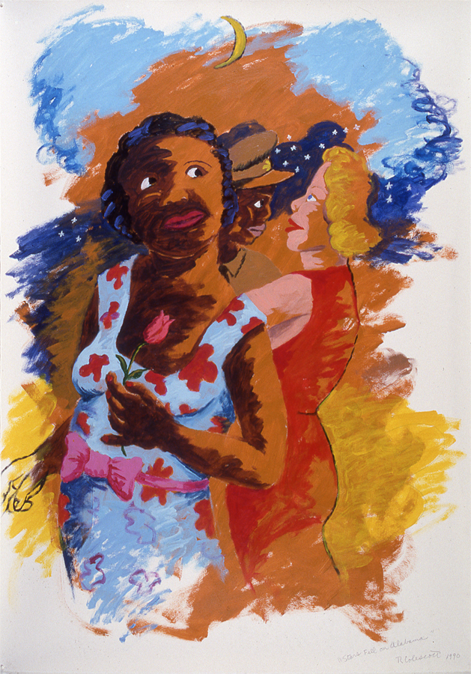
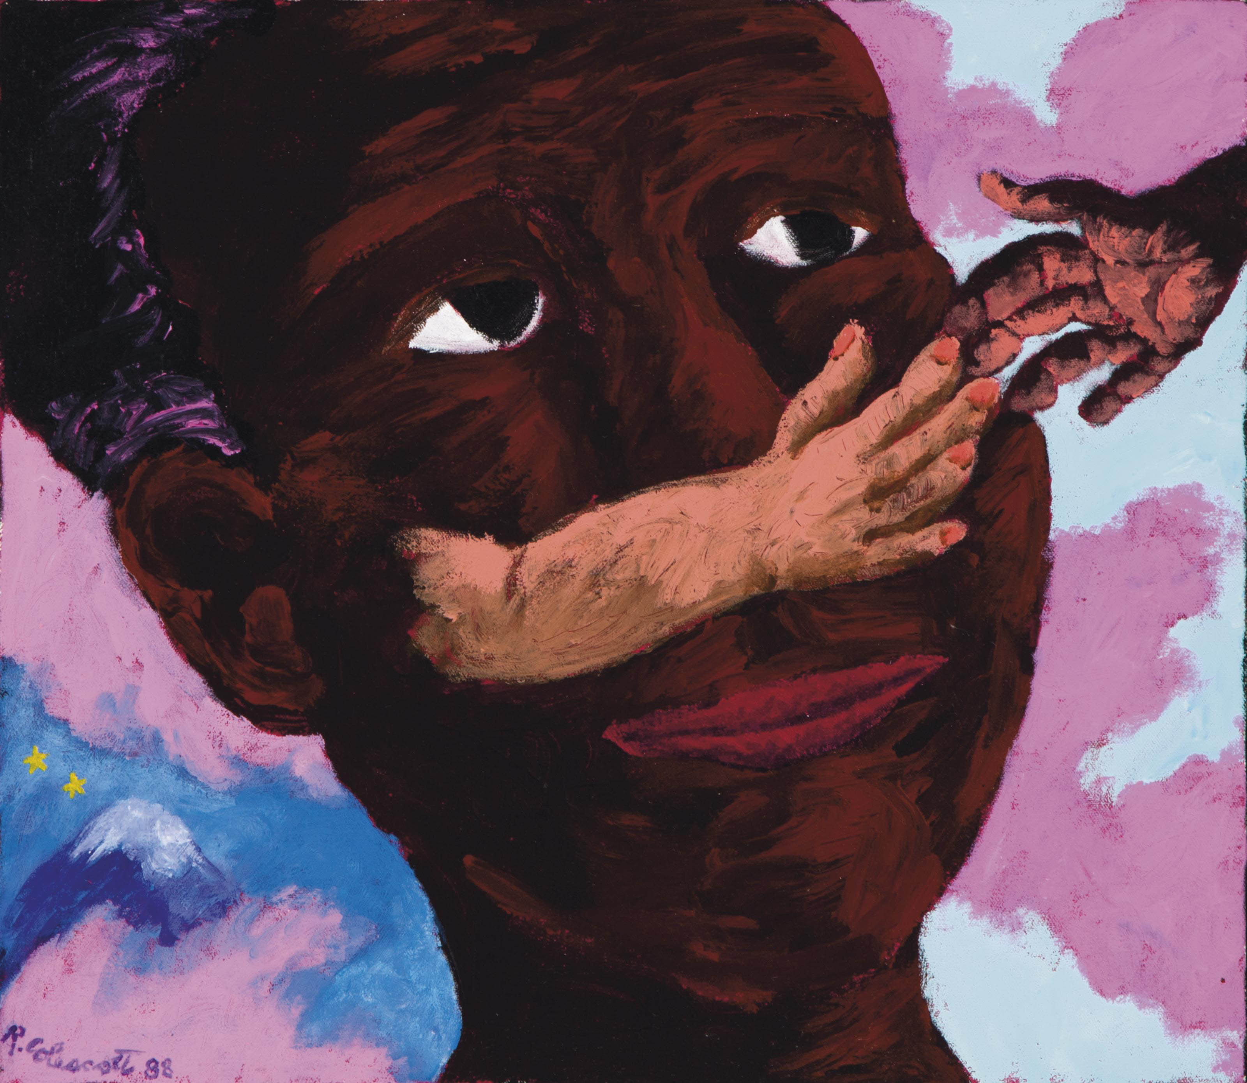
Robert Colescott
Robert Colescott's use of color is bold and vibrant, drawing attention to his satirical depictions of race, gender, and history.
His exaggerated, often cartoonish color palette adds emotional depth to his work, amplifying the social critiques embedded in his imagery.

Slide 8
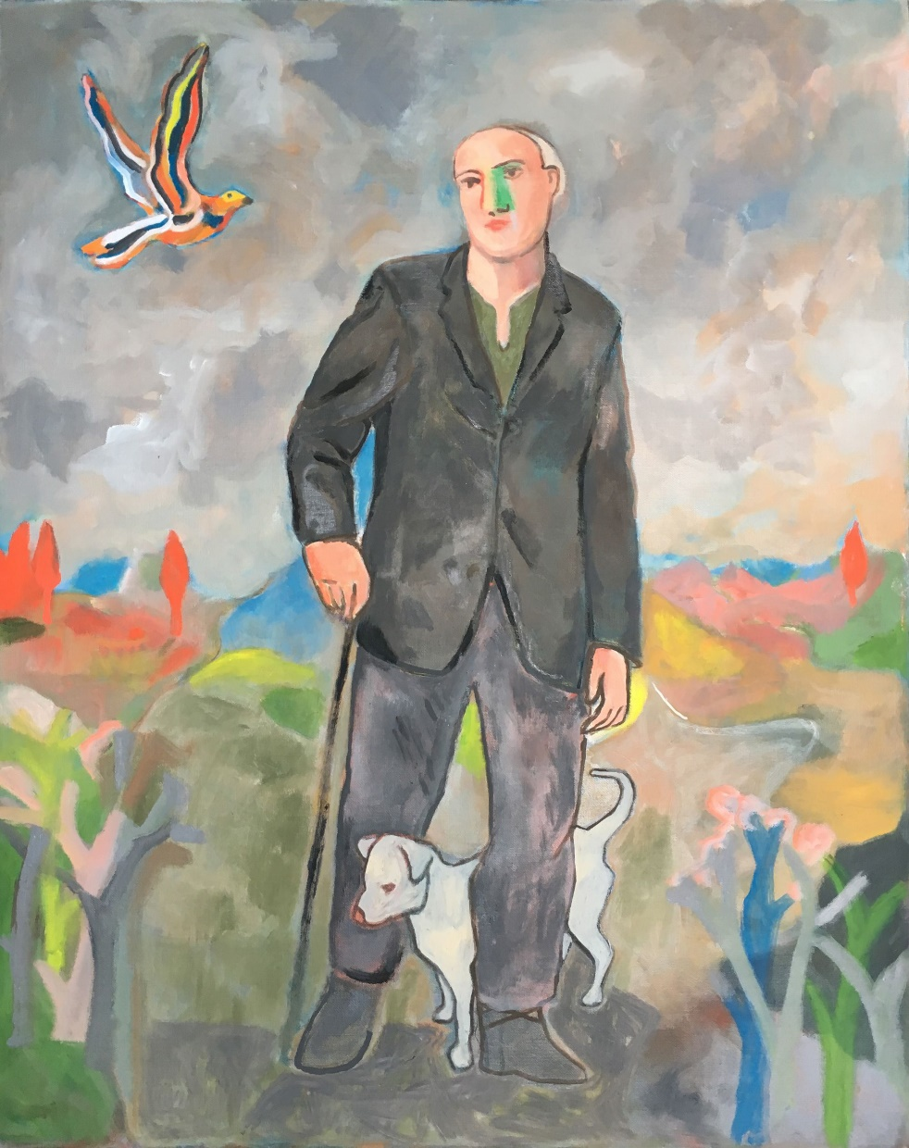
Sandro chia
Based on color, what is the mood of the piece?
What might the contrasting vivid and dull colors communicate?
Does the meaning of “wayfarer” influence this?
How does color draw attention to specific objects?
Does this make them more or less important?
Sandro Chia, The Wayfarer with His Cane Dog

Slide 9
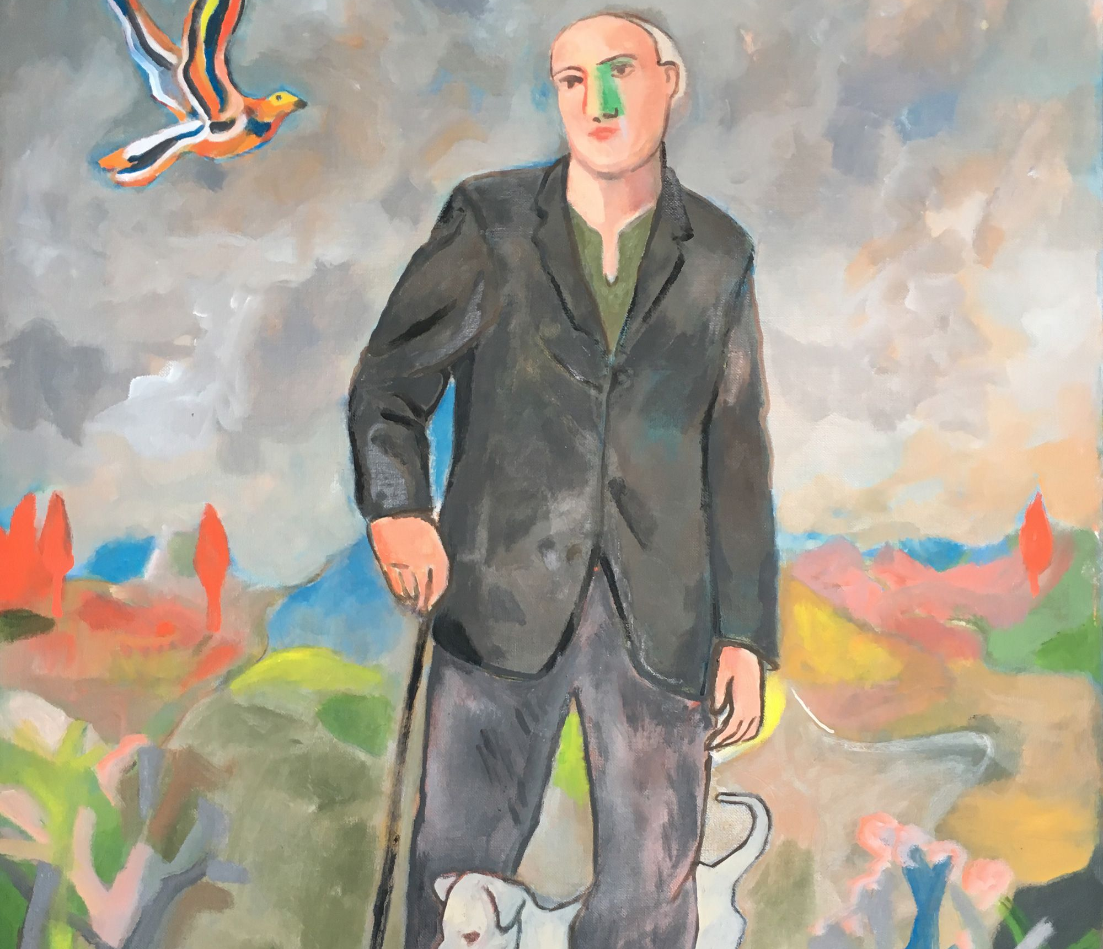
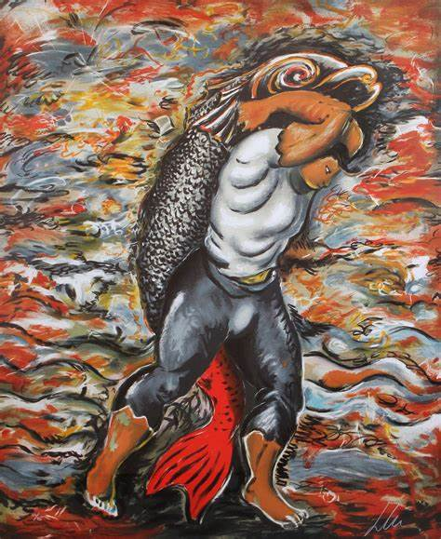
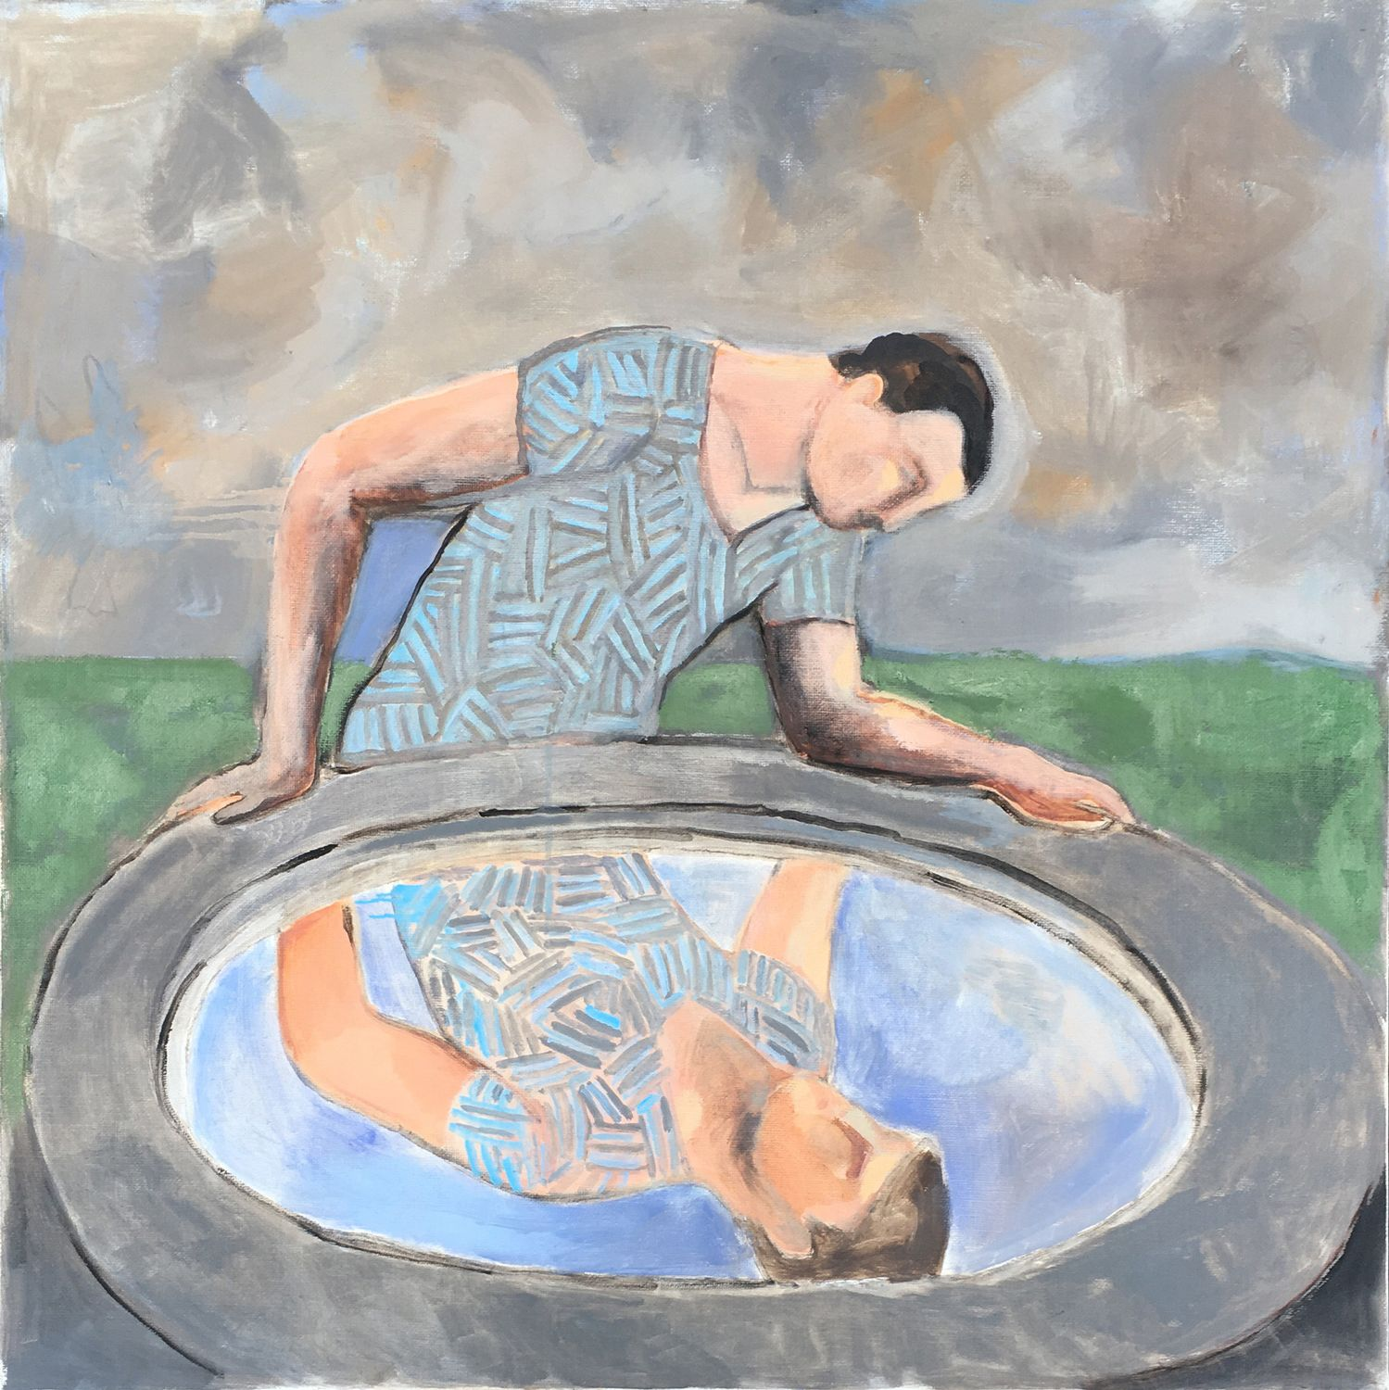
sandro chia
Sandro Chia's Neo-Expressionist artwork radiates a sense of vitality and exuberance, often blending irony with bold, dynamic forms.
His vibrant use of color and exaggerated figures evoke emotions ranging from playfulness to introspection, reflecting a layered exploration of human experience.

Slide 10
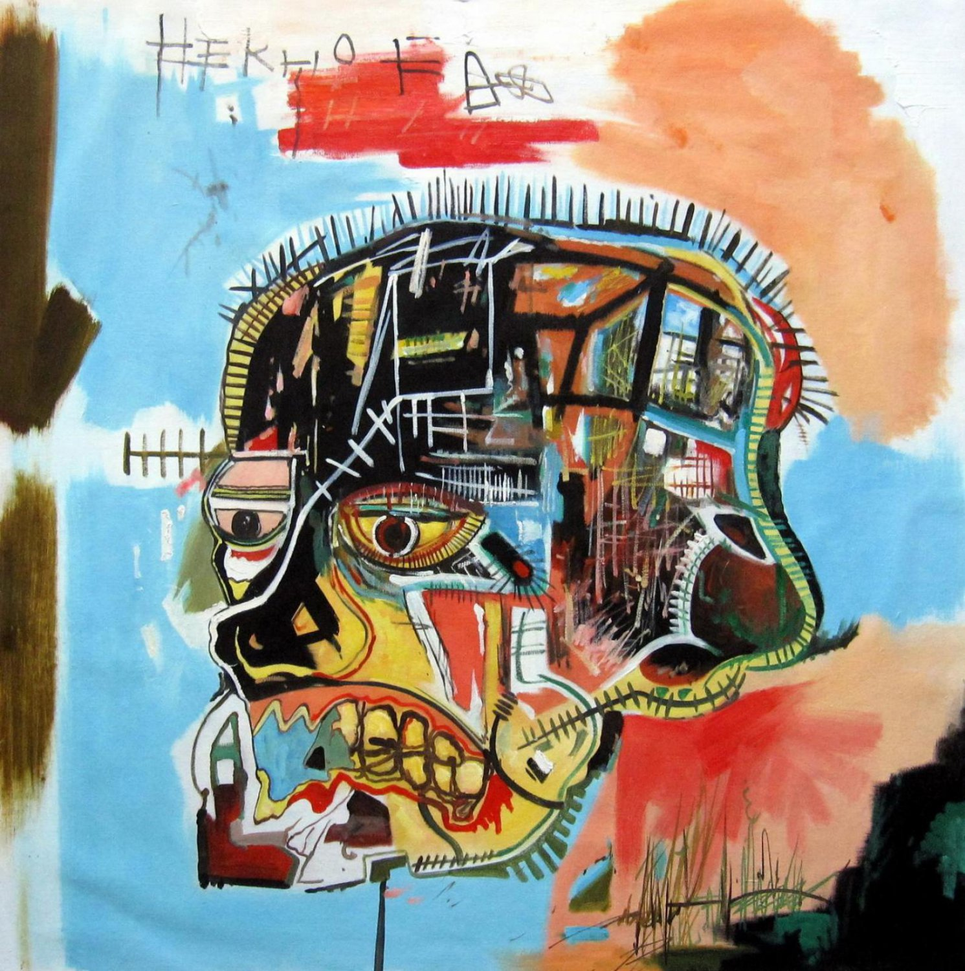
Jean-Michel Basquiat
What colors do you see?
Are the colors blended or un-blended?
What does this communicate?
Pick a word to describe the piece.
Jean-Michel Basquiat, Untitled (Skull)

Slide 11
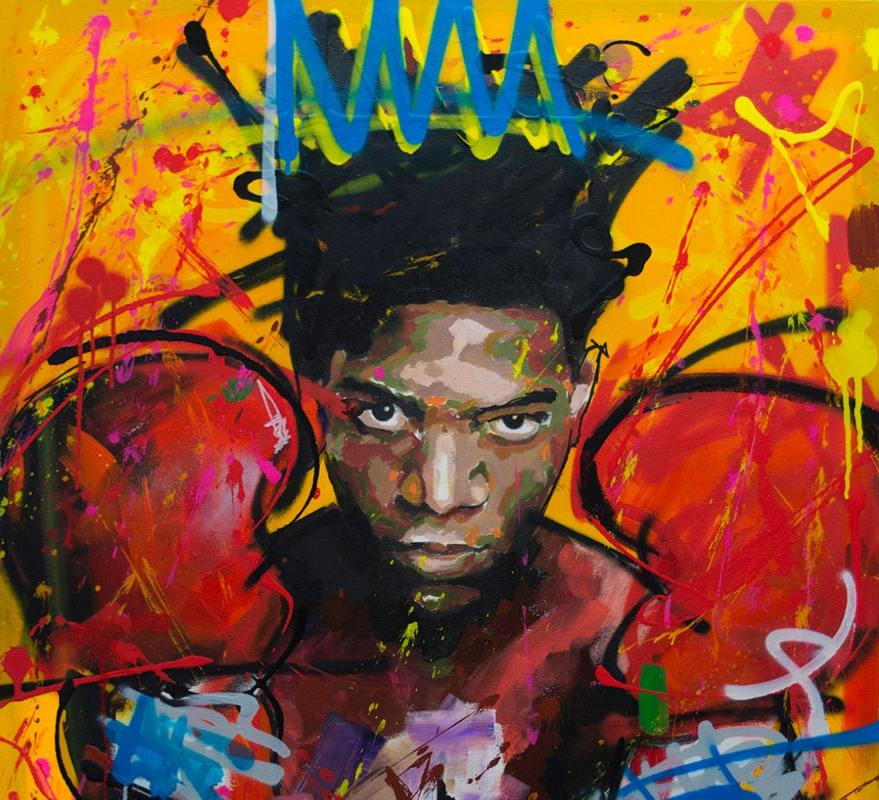
Jean-Michel Basquiat
Jean-Michel Basquiat's Neo-Expressionist art is charged with raw energy, exploring themes of identity, struggle, and empowerment.
His use of chaotic imagery and bold colors reflects a mix of anger, defiance, and vulnerability, confronting issues like race, inequality, and personal turmoil.

