Slide 1

The Elements of Art
The building blocks of making artwork

Slide 2
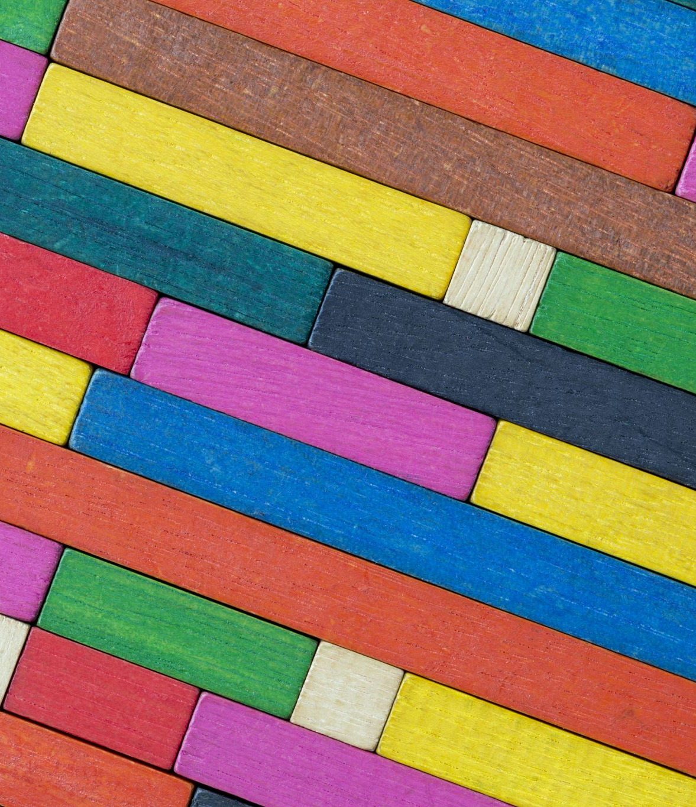
What are the elements of art?
The elements of art are the building blocks of every piece of art.
They are:
Color
Value
Line
Shape
Texture
Form
Space

Slide 3

Color

Slide 4
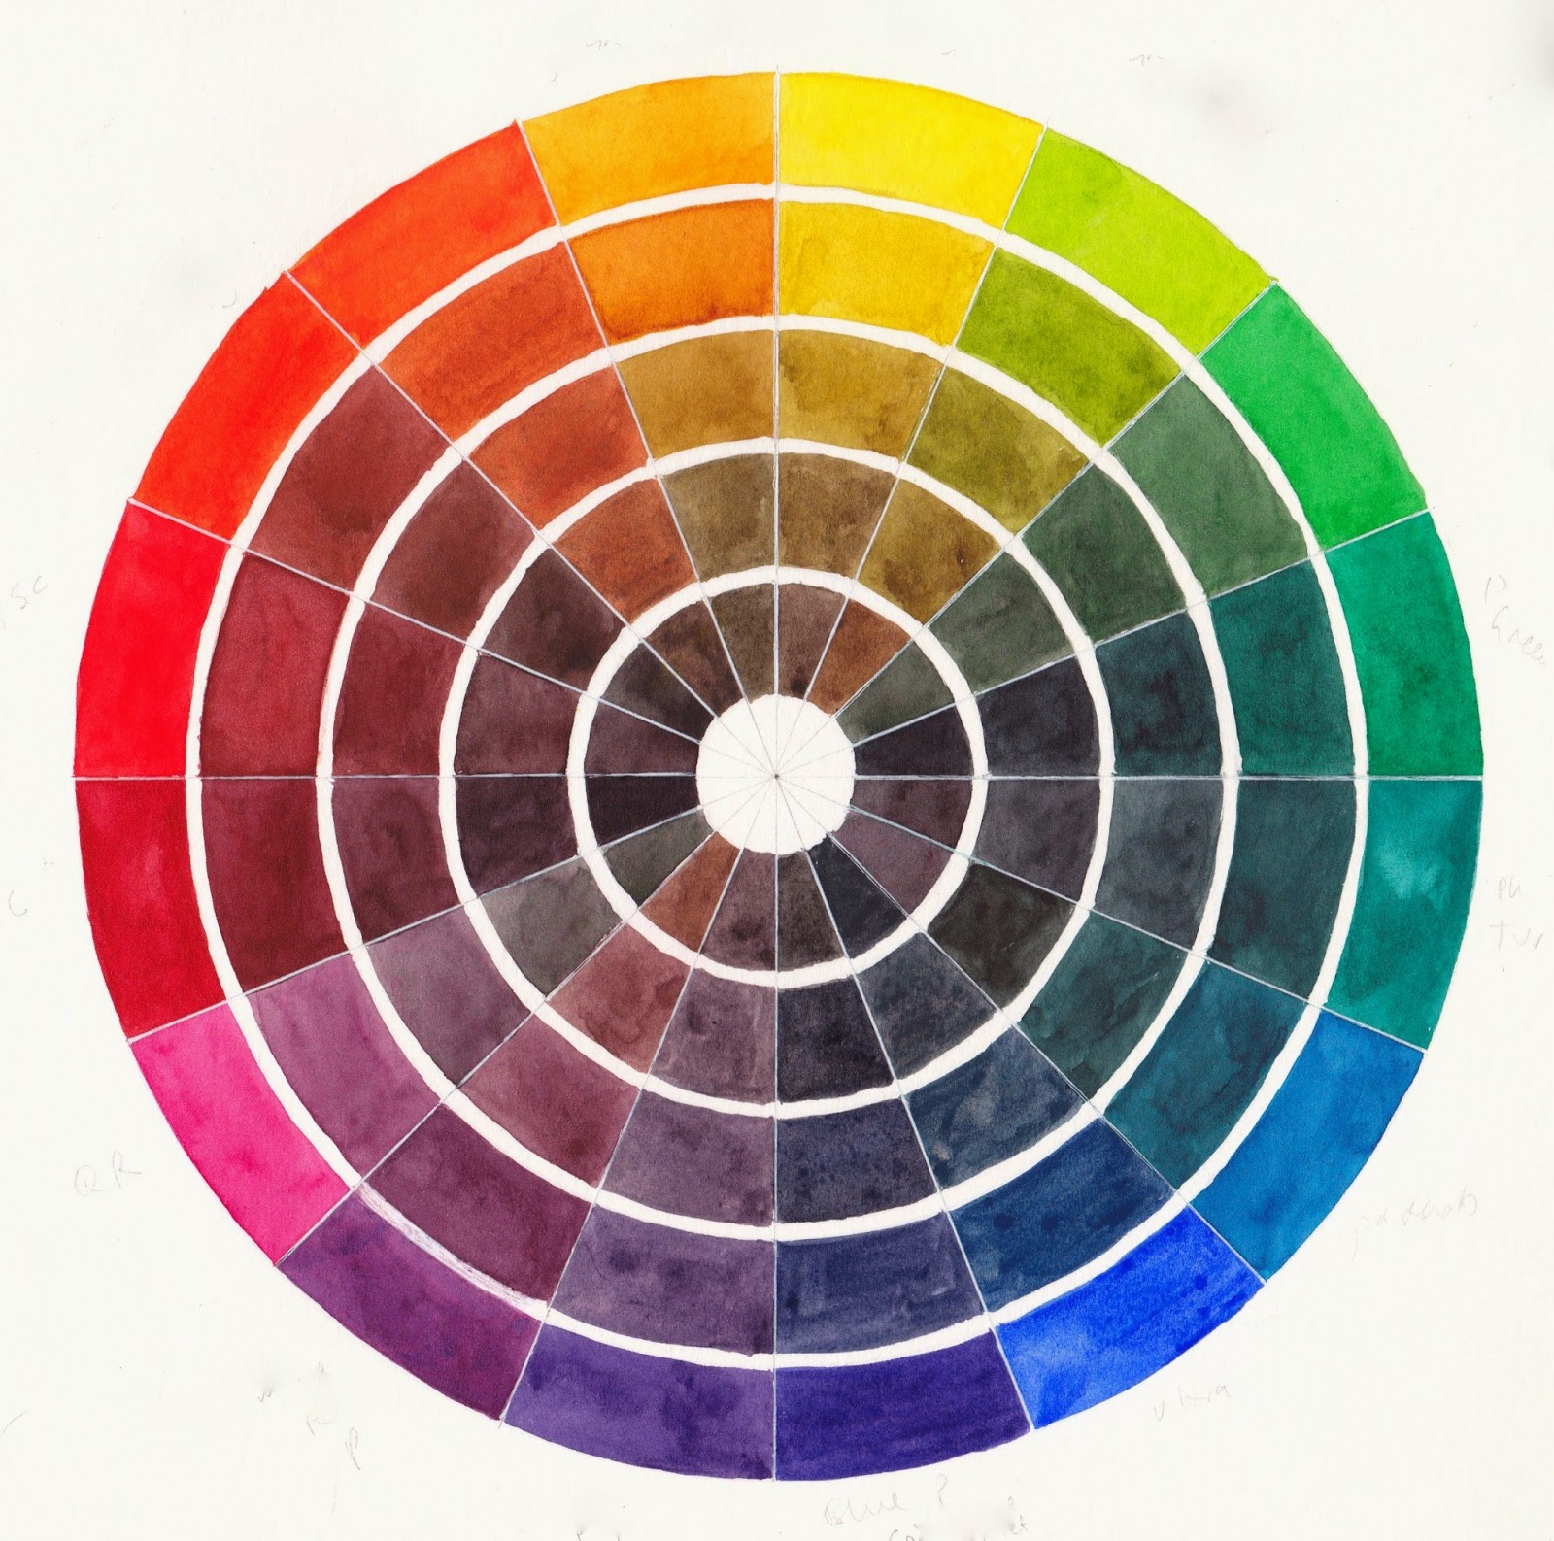
The Color Wheel
A tool artists use to help them identify the relationship between different colors.

Slide 5
The Primary Colors
Red
Blue
Yellow
The three colors can be mixed together in different combinations to make any color.

Slide 6
The Secondary Colors
Orange
Purple
Green
These colors are made by mixing primary colors.
1.) Red and yellow make orange
2.) Red and blue make purple
3.) Yellow and blue make green

Slide 7
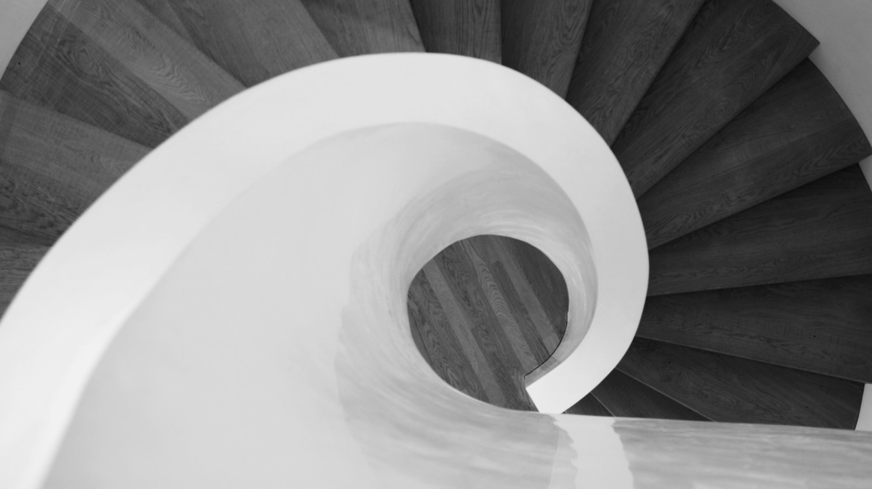
Value

Slide 8
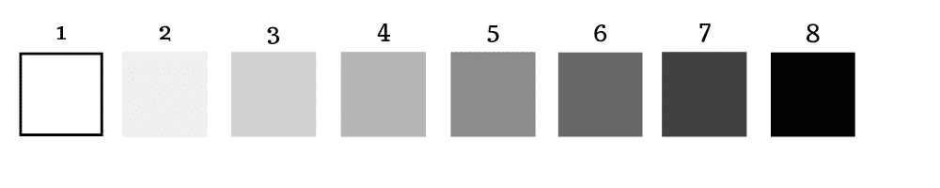
Value
Value represents the lightness or darkness of an image. This can be used to create the illusion of form.

Slide 9
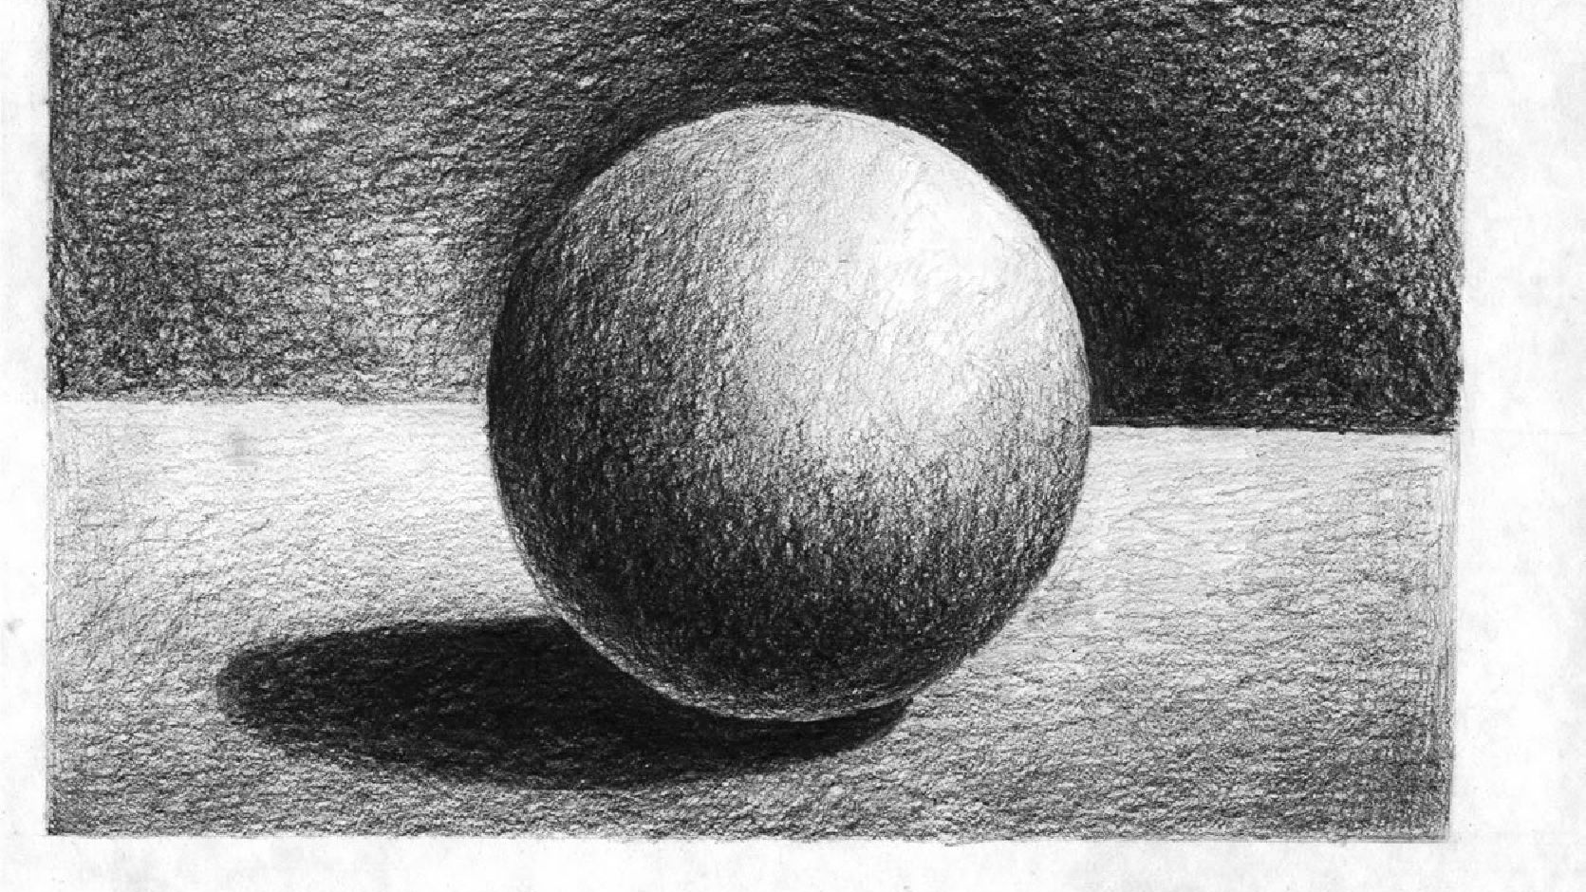
Form
Form is a three dimensional object which encloses volume. It has height, width, and depth.

Slide 10
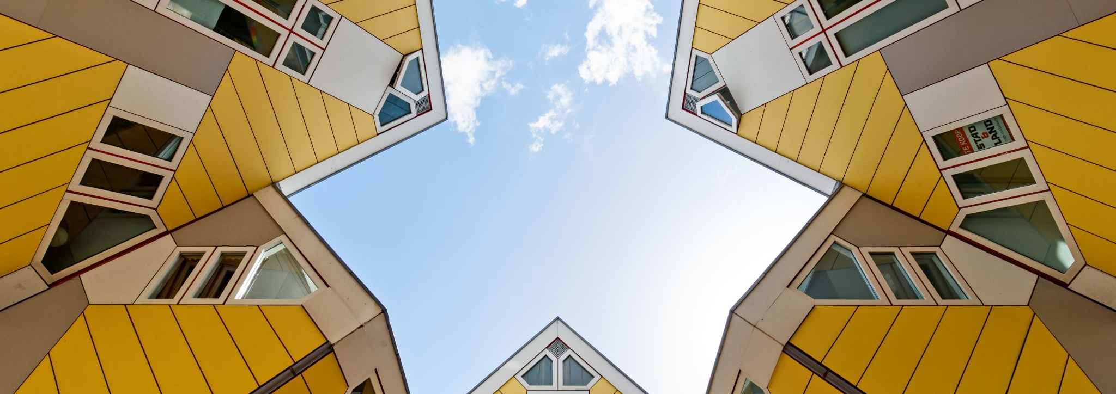
Shape
The external lines or contours of a form. It is 2 dimensional, NOT 3-dimensional.

Slide 11
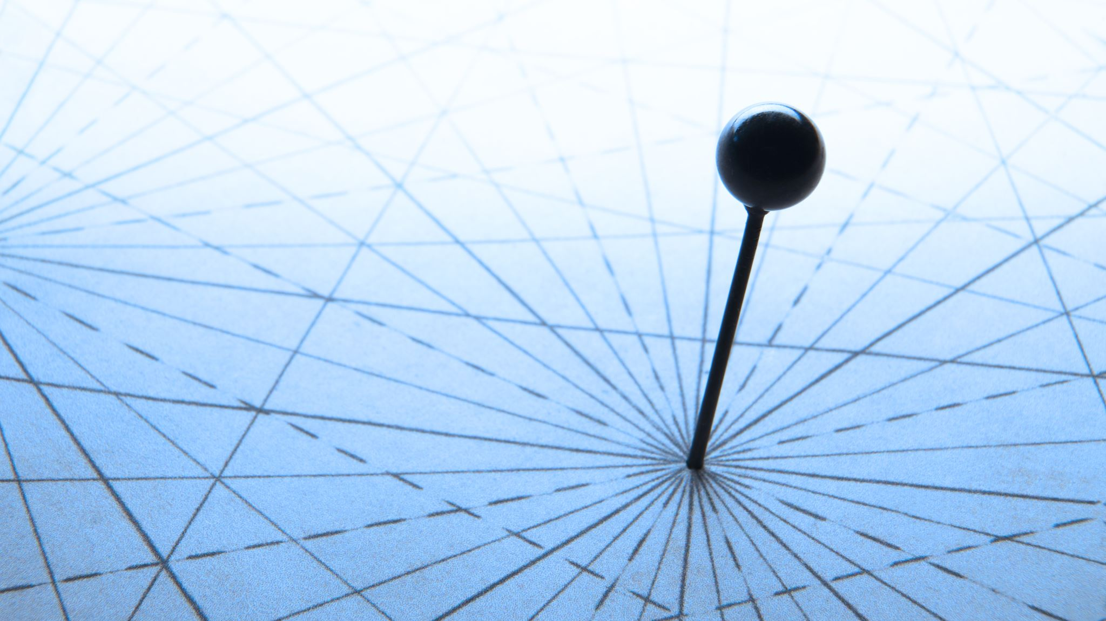
Line
The most basic of the elements, marking the distance between two points.

Slide 12
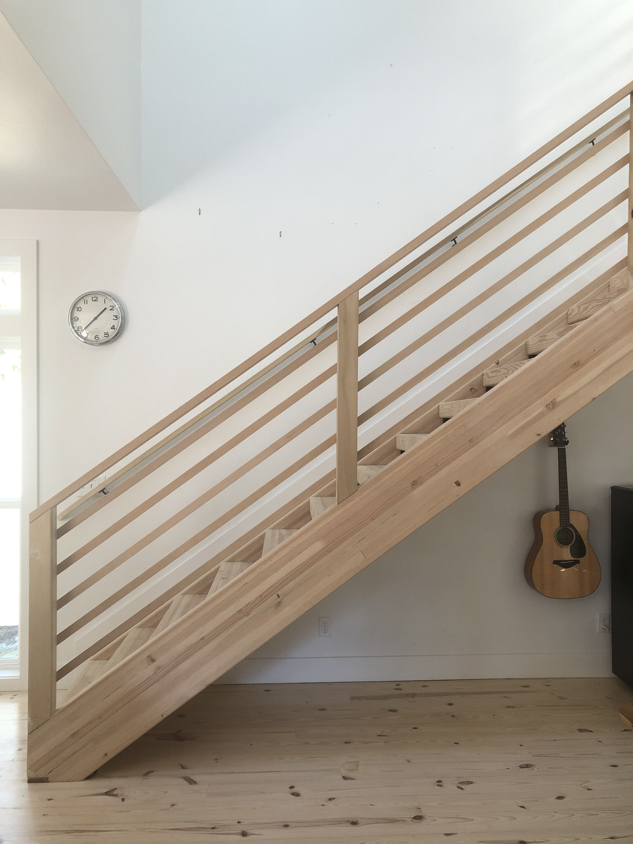
Lines can be…
Horizontal
Diagonal
Vertical

Slide 13
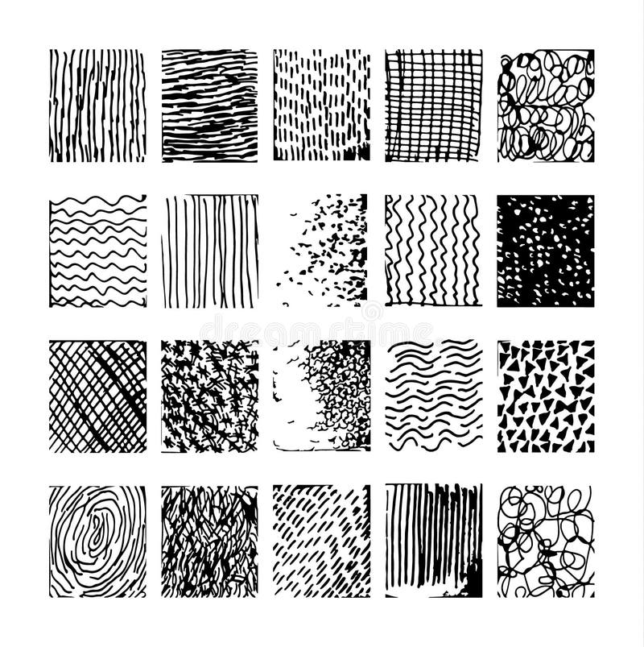
Lines

Slide 14
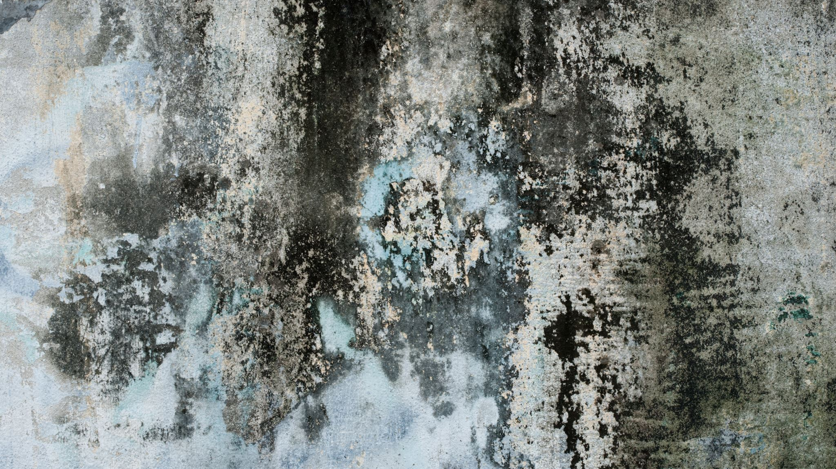
Texture

Slide 15
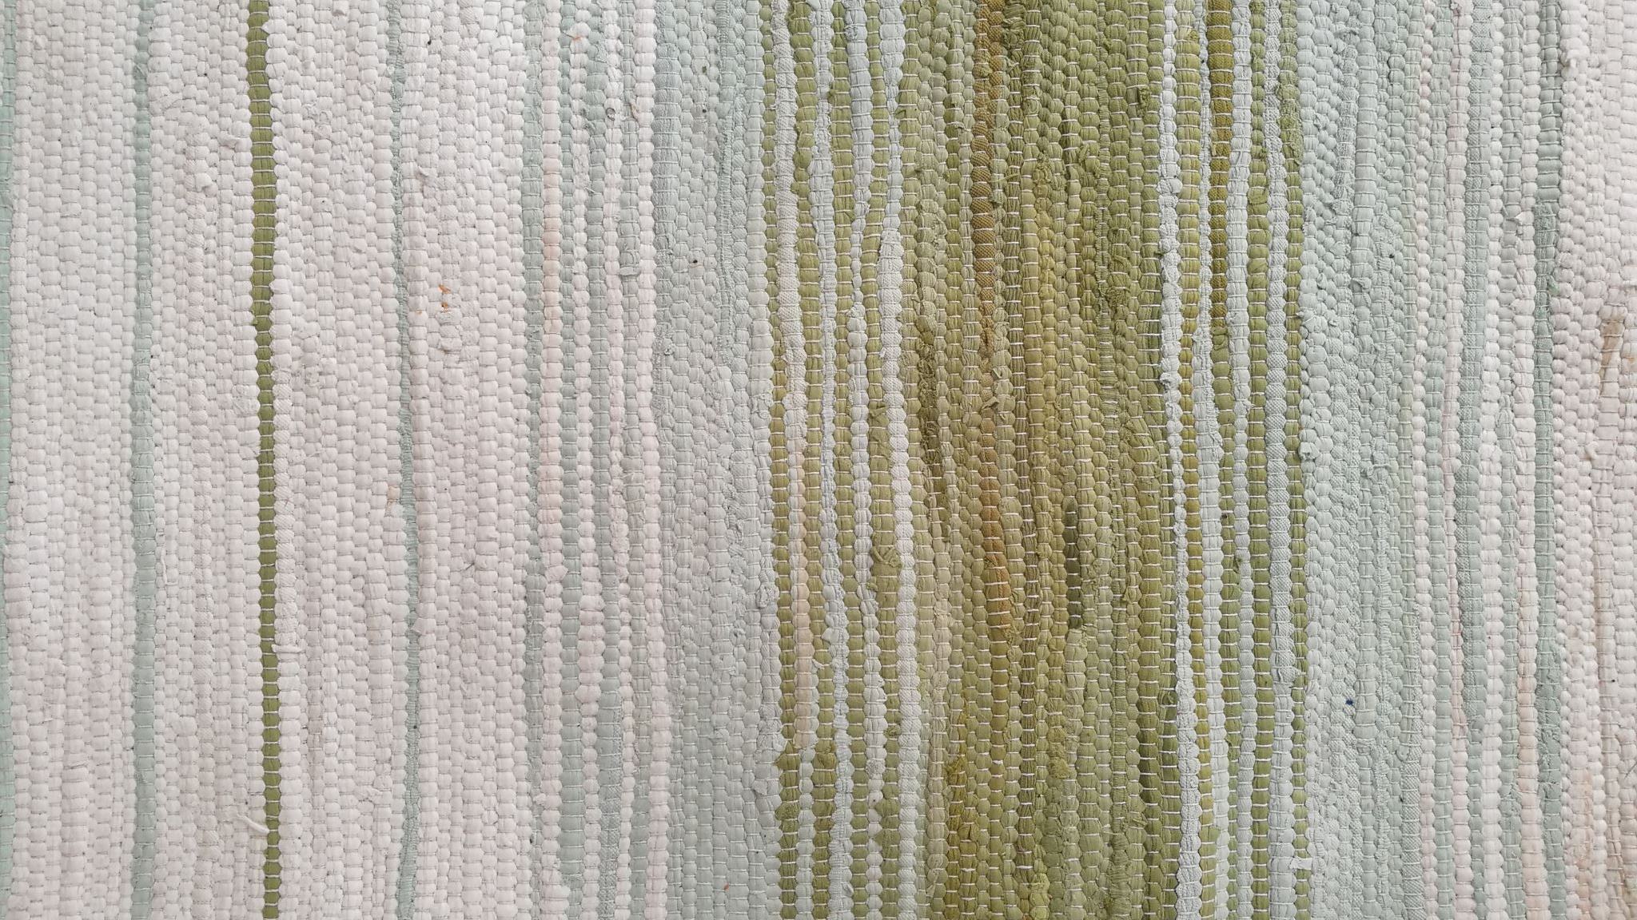
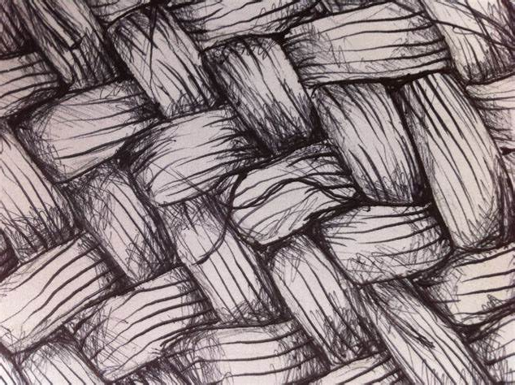
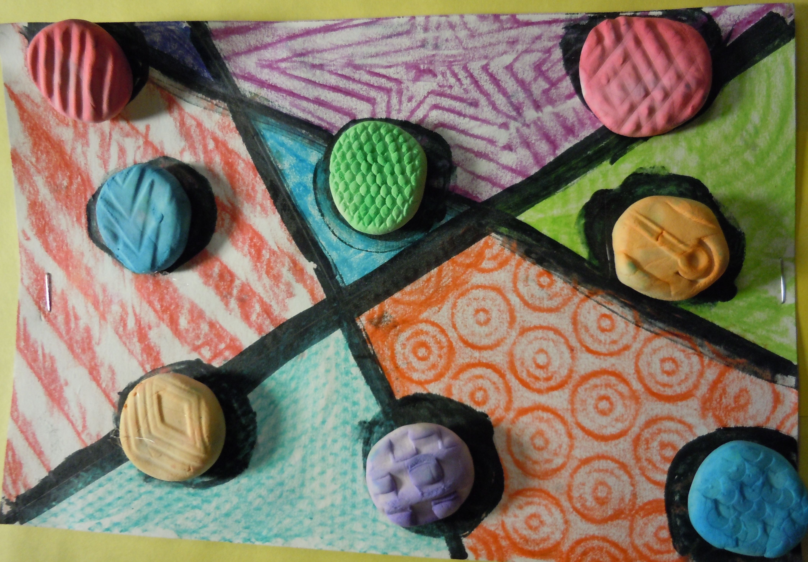
There are two types of texture
Tactile Texture:
Actual
How it feels
Can be felt
Visual Texture:
Implied
How it looks
Can’t be felt

Slide 16
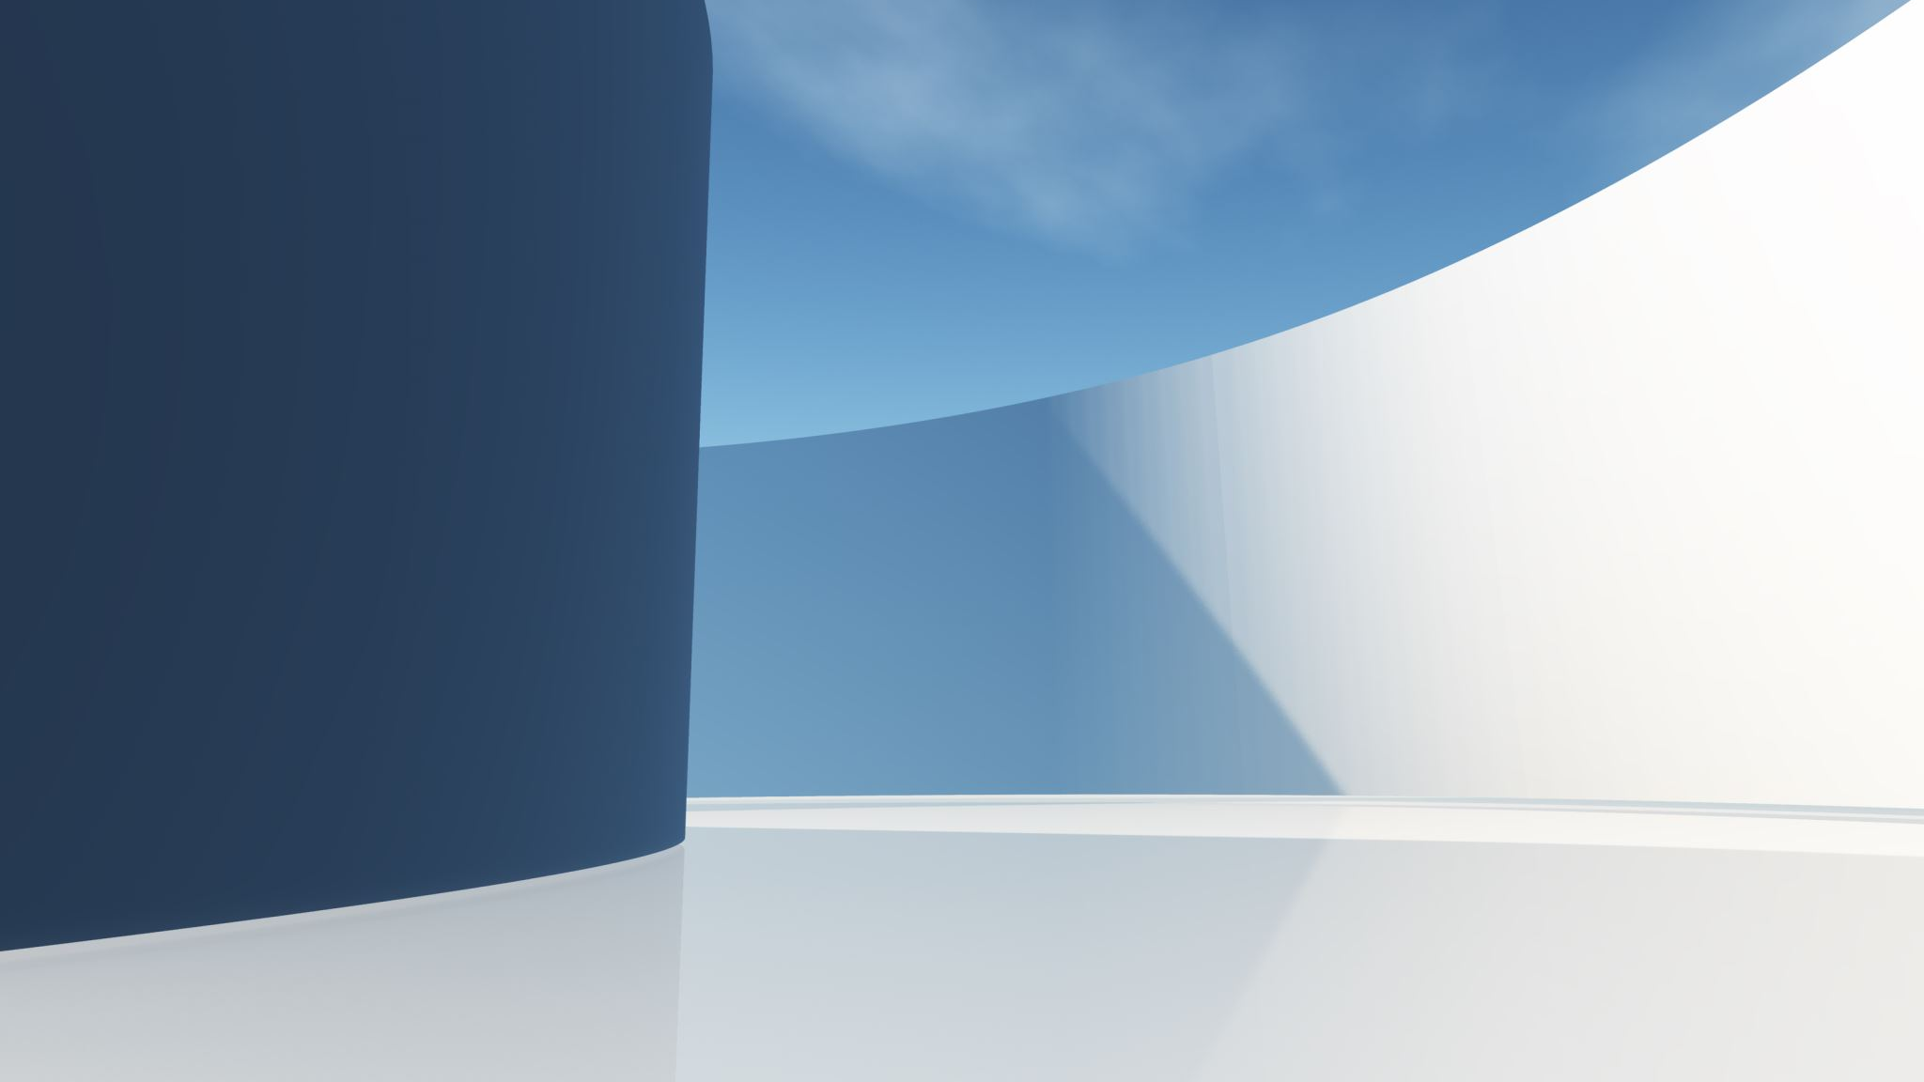
Space
Space in art is the element that creates a sense of depth, dimension, and distance on a flat surface

Slide 17

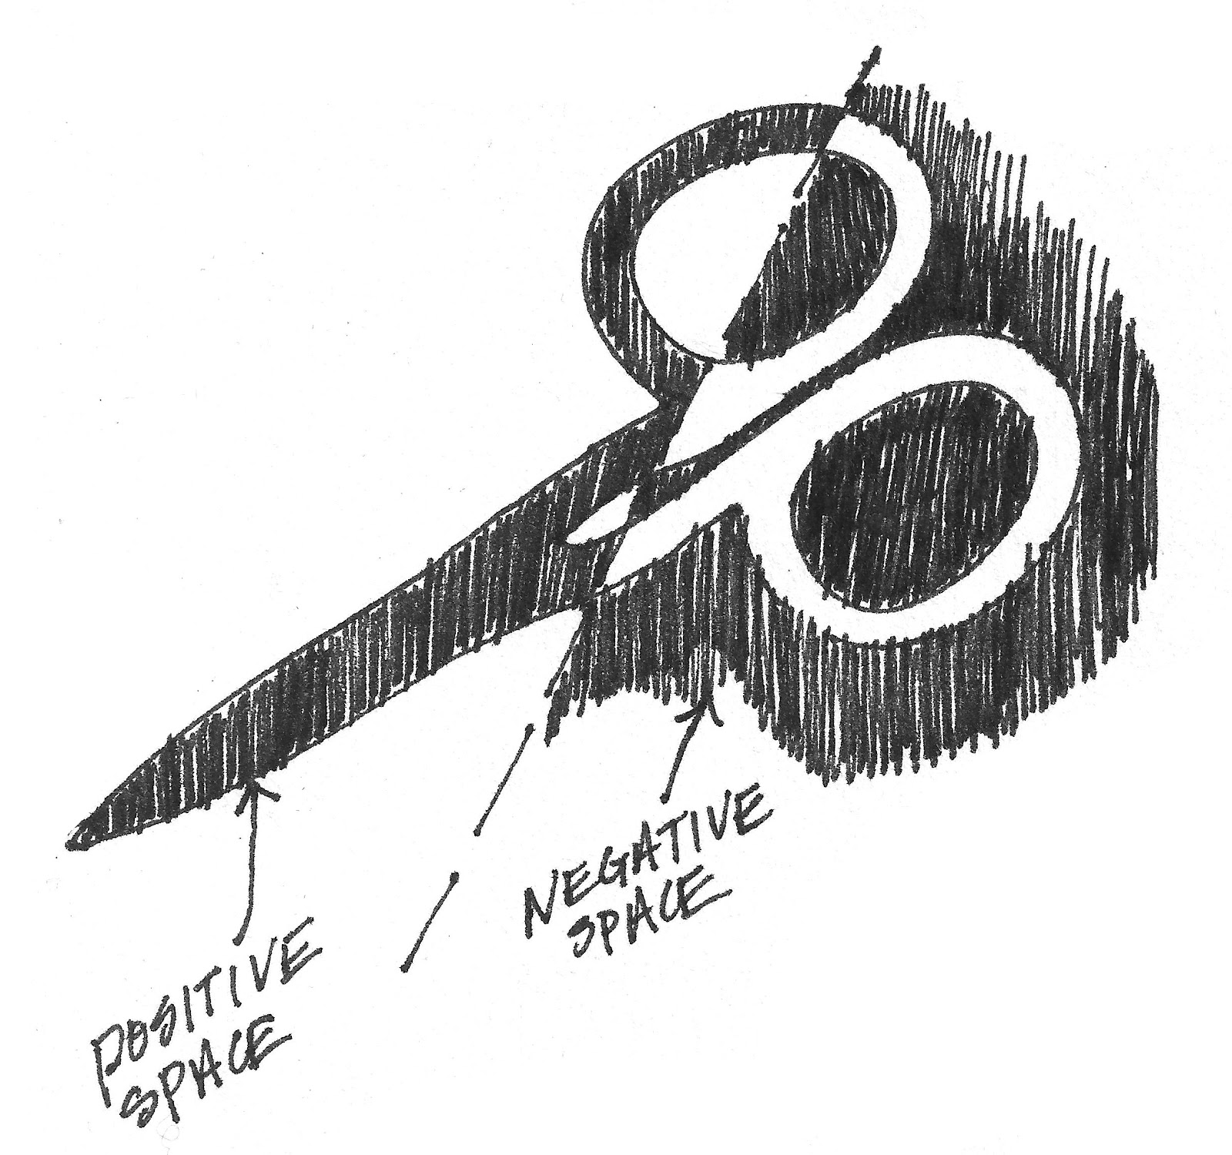
Positive Space Negative Space
T

Slide 18
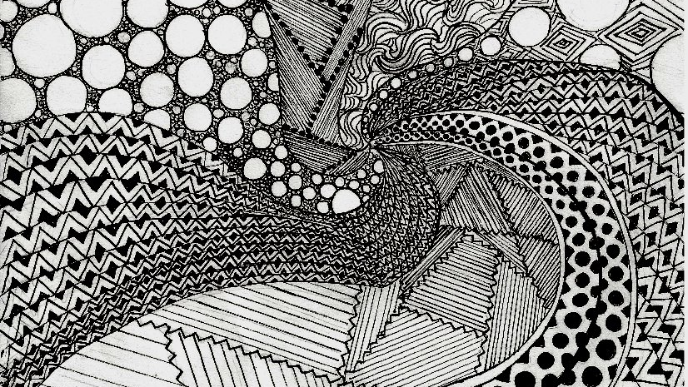

Slide 19
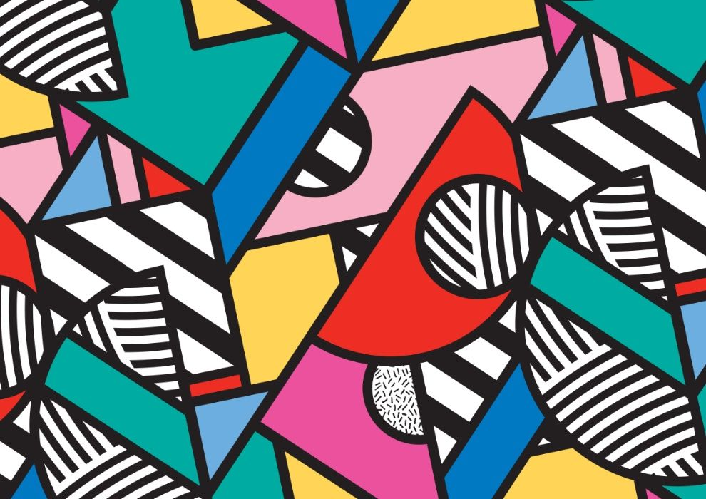

Slide 20
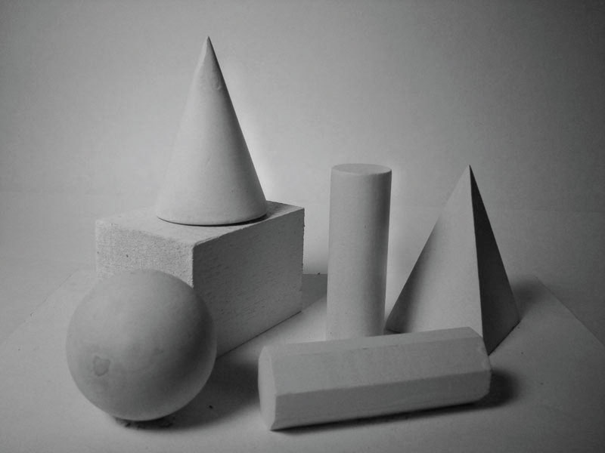

Slide 21
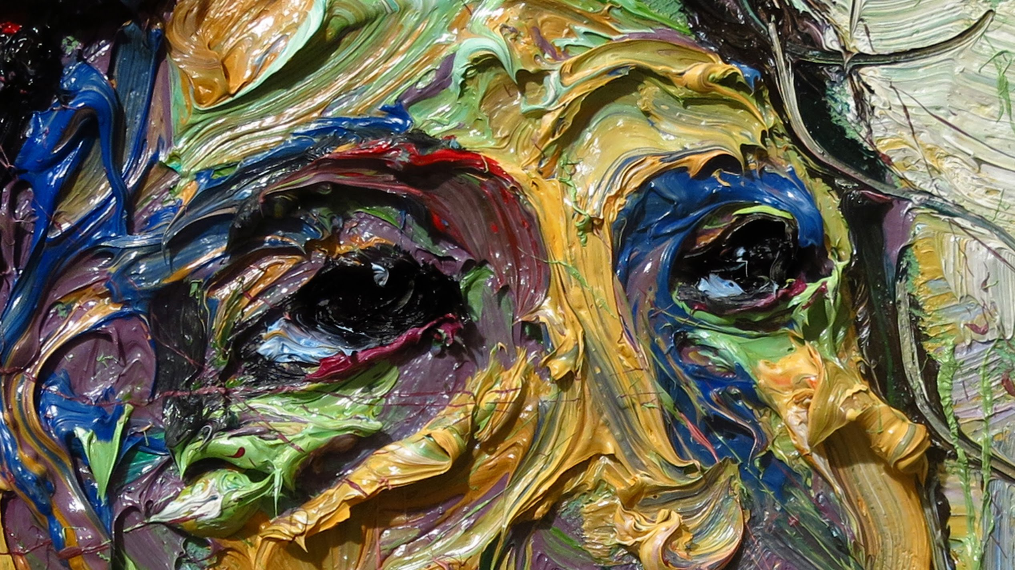

Slide 22
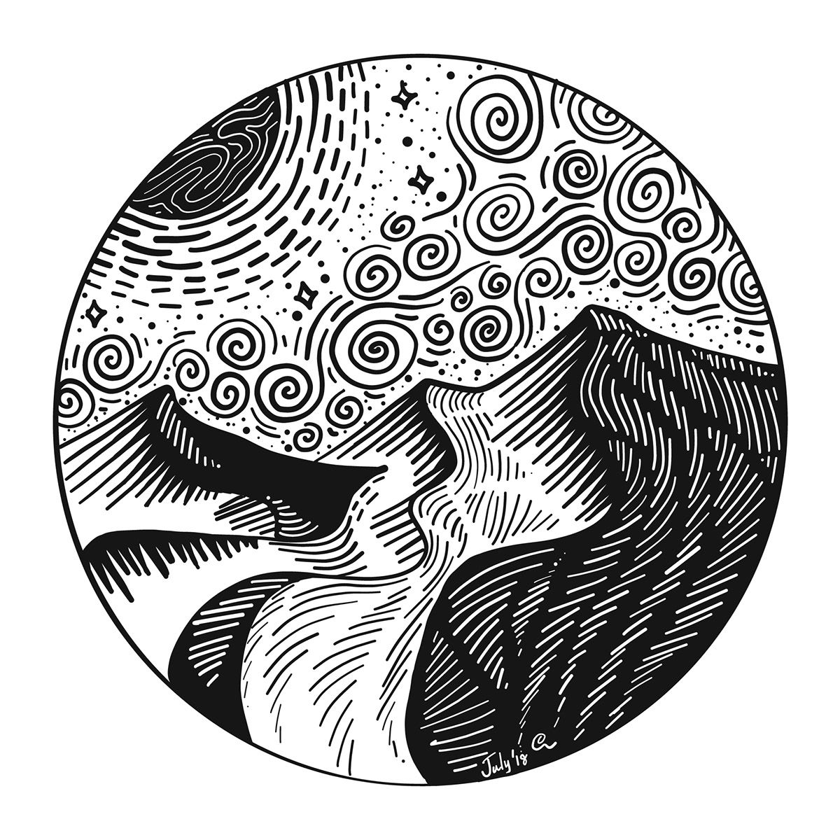

Slide 23
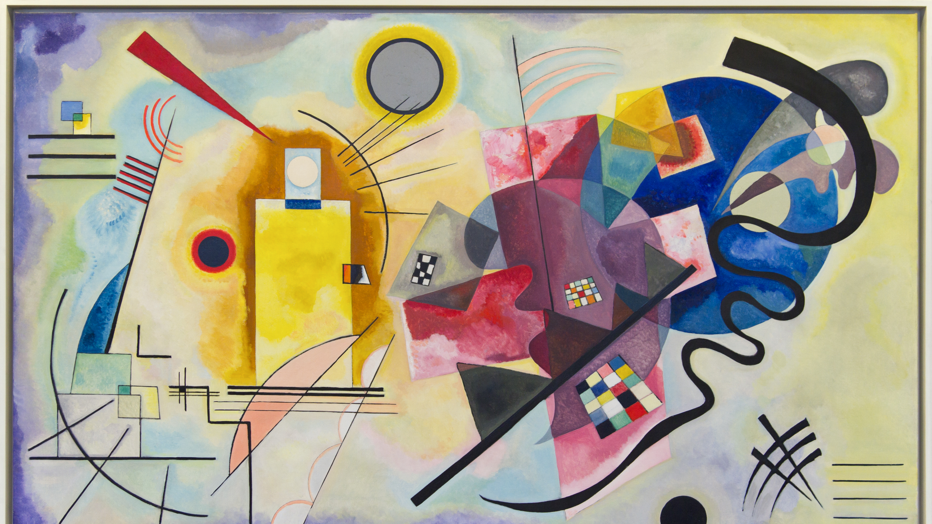

Slide 24
