Slide 1
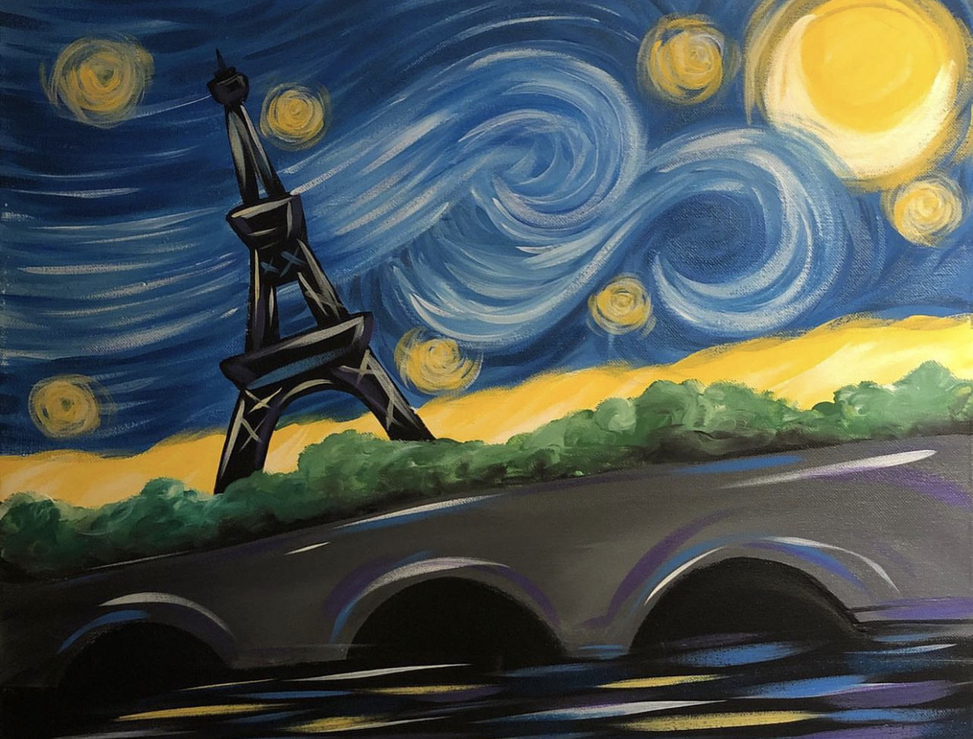
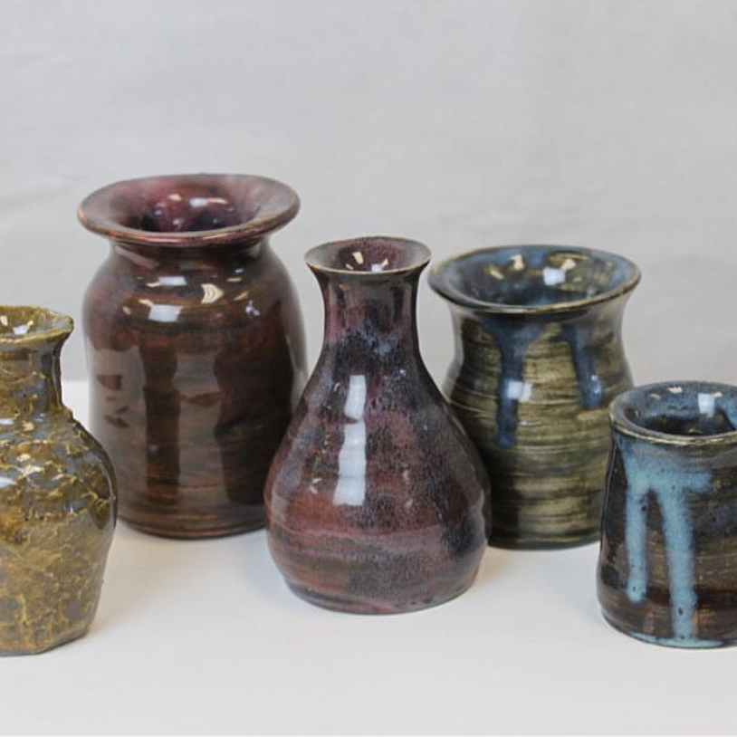
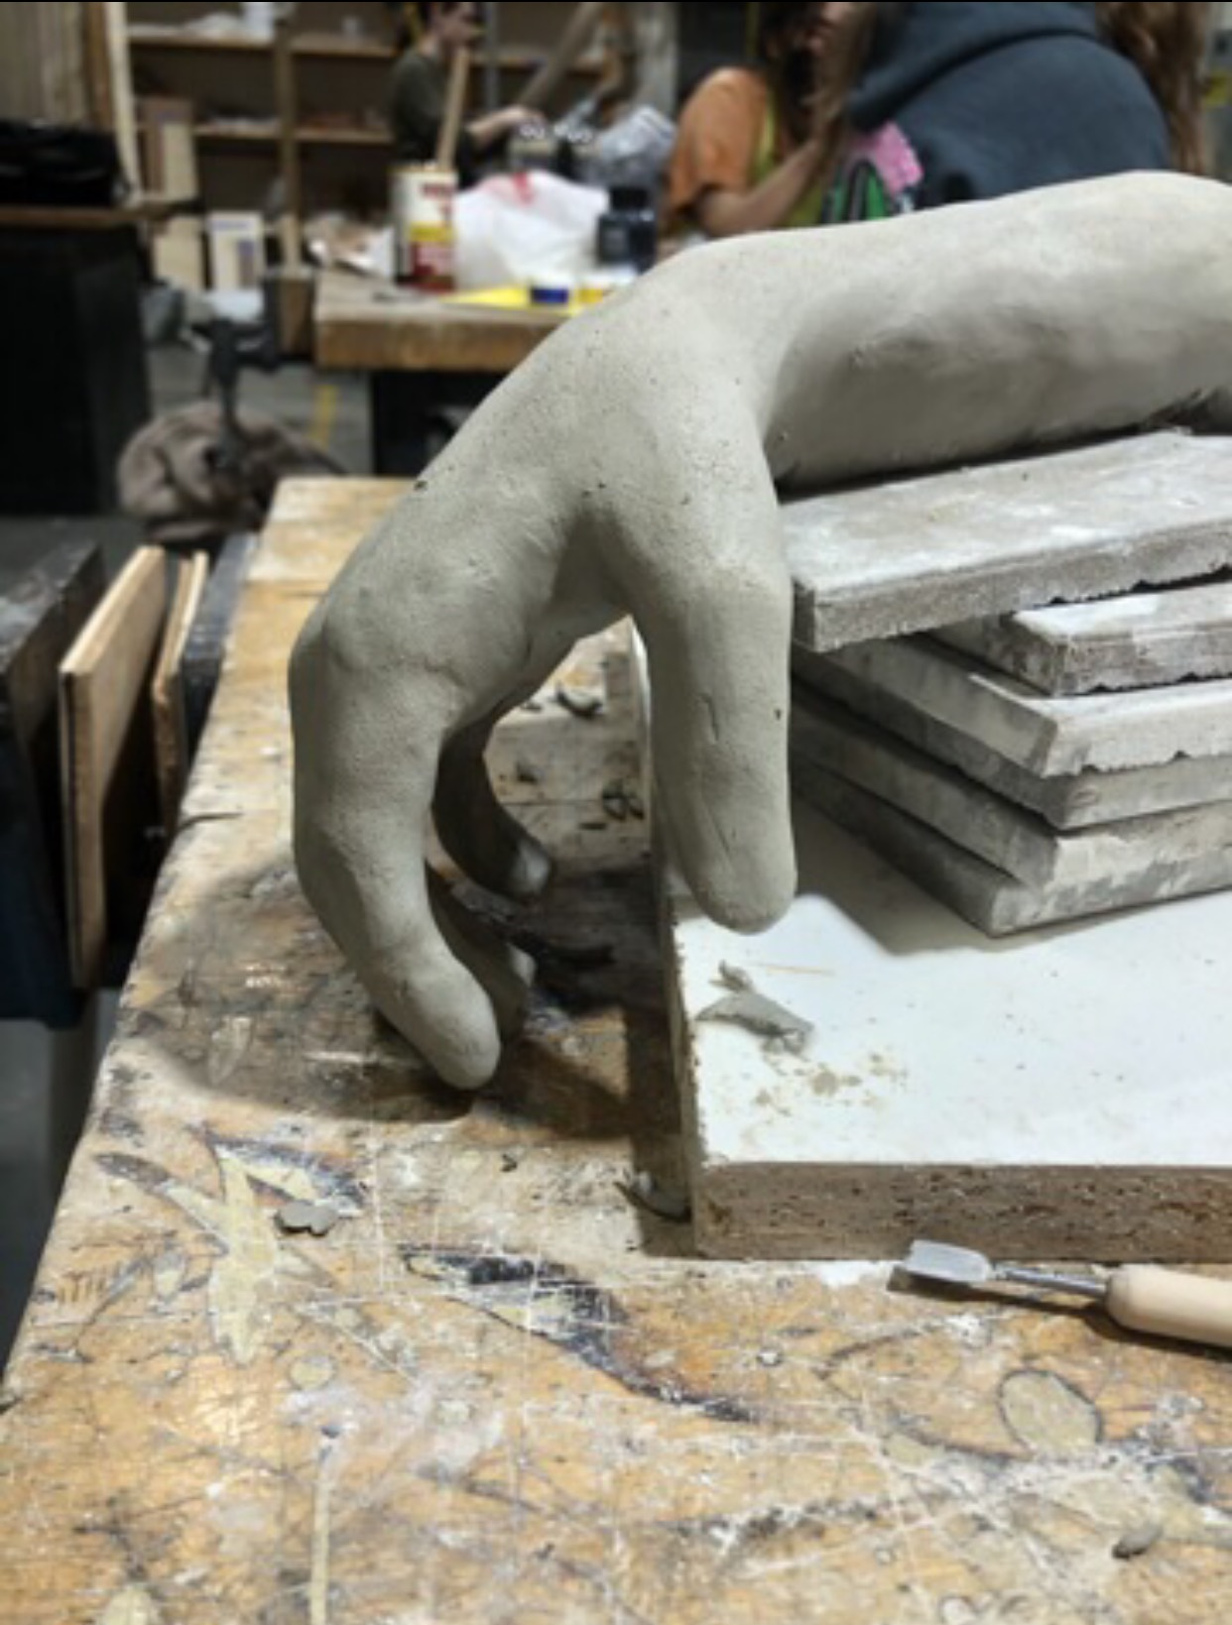
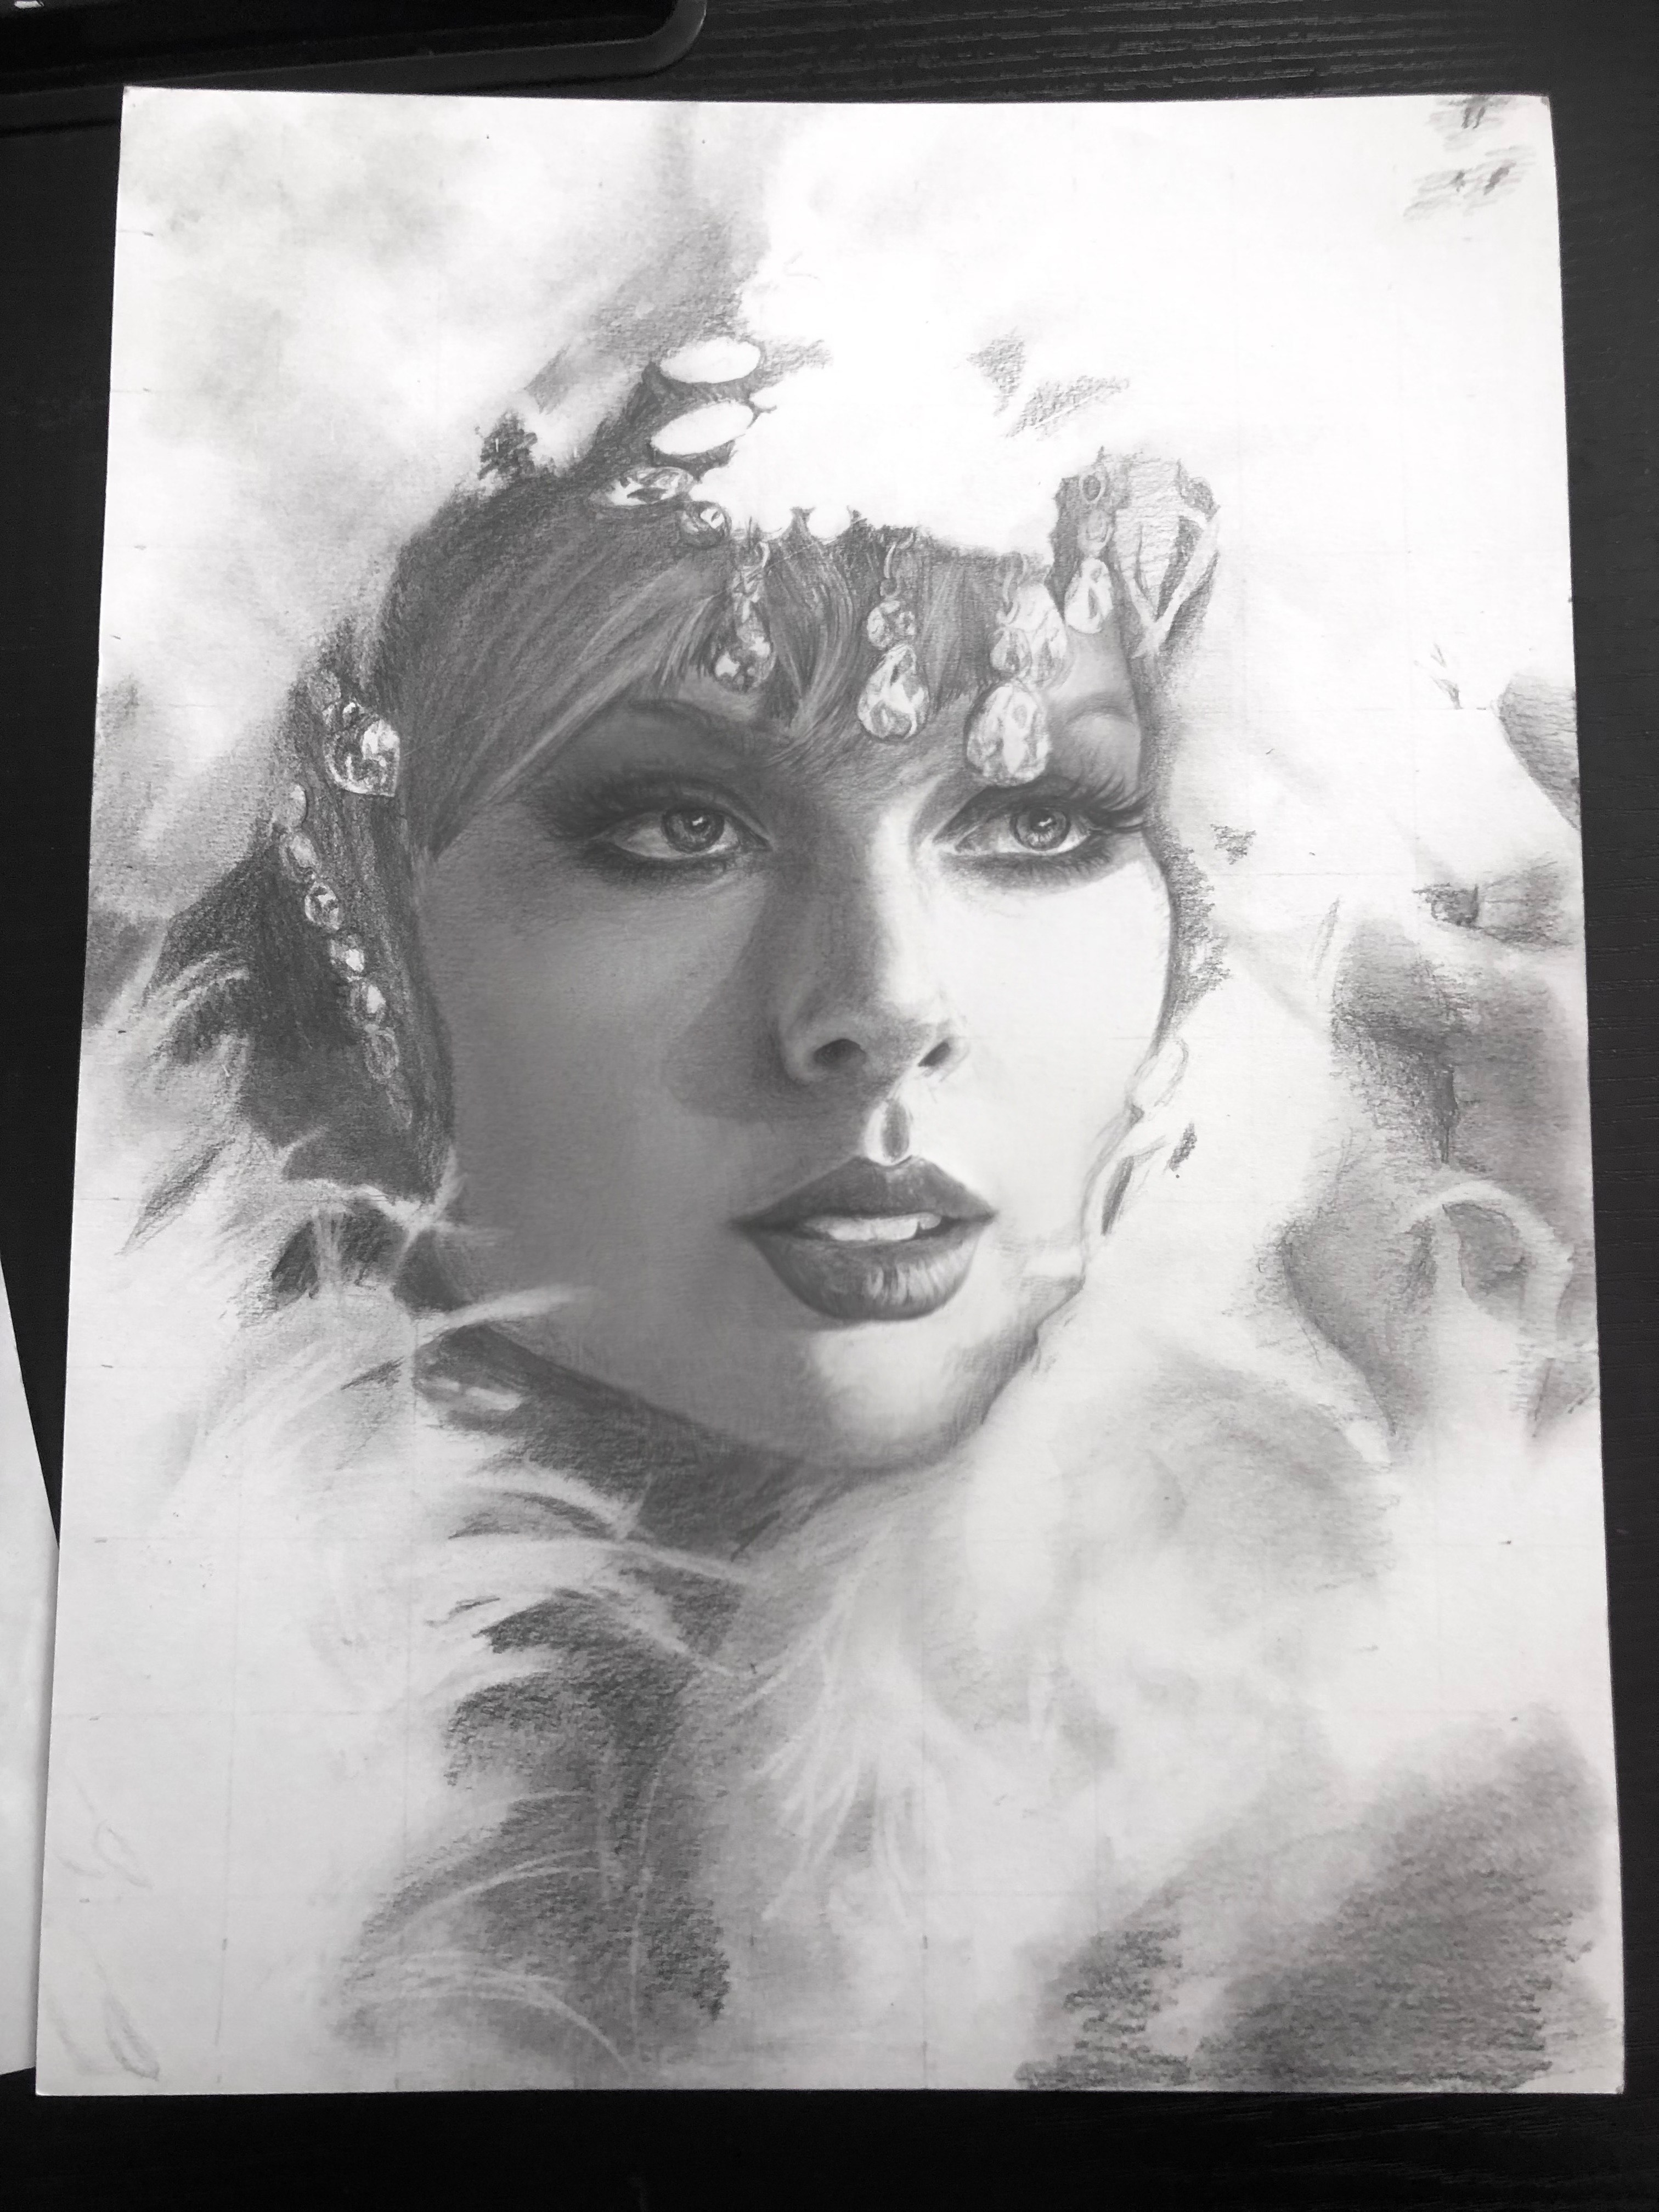
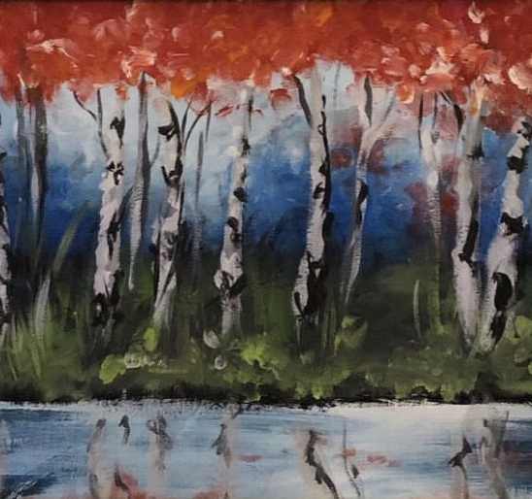
Welcome to Visual Arts
With Mr. Fairchild

Slide 2


Slide 3


Slide 4
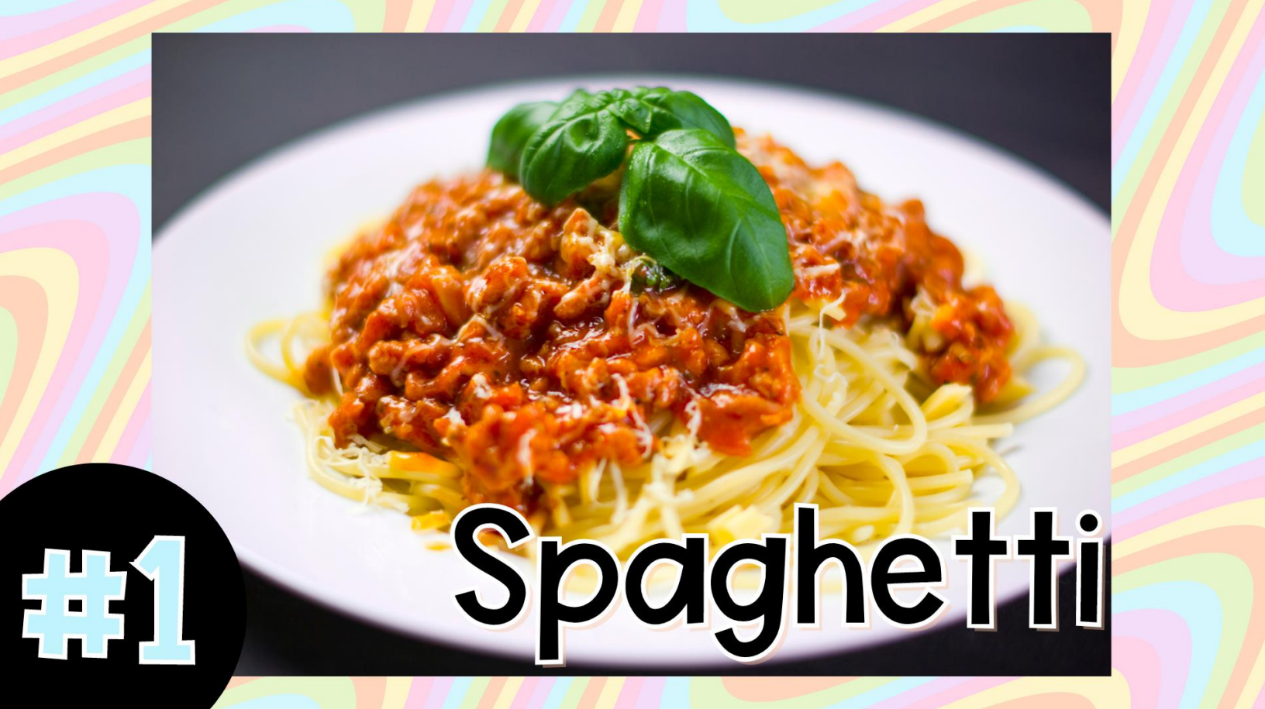

Slide 5


Slide 6


Slide 7
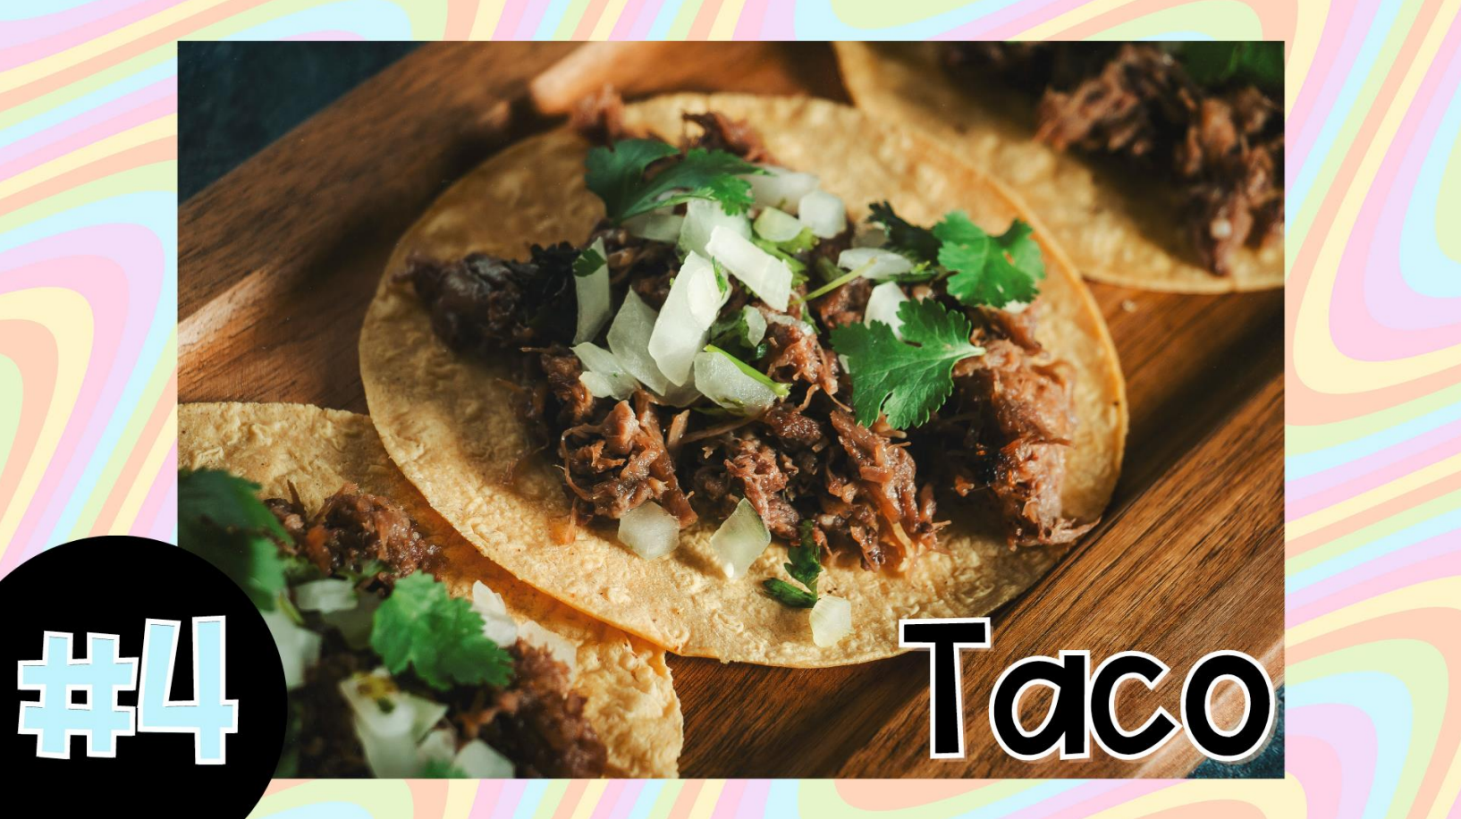

Slide 8
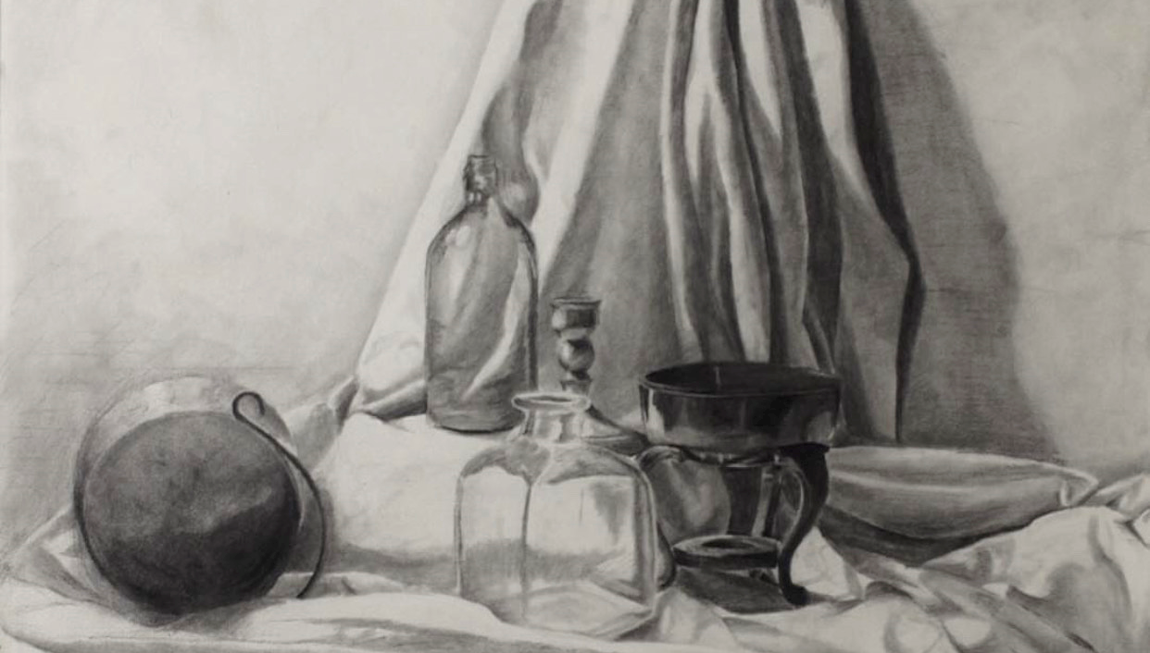
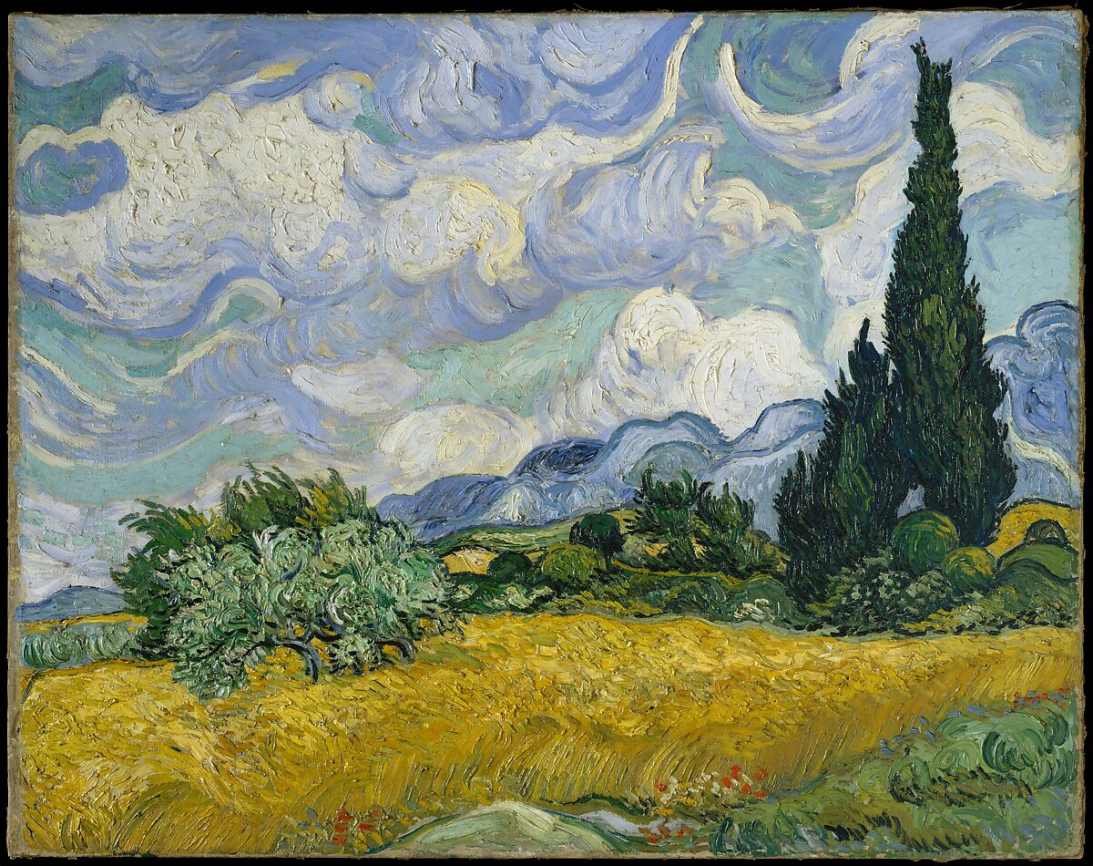
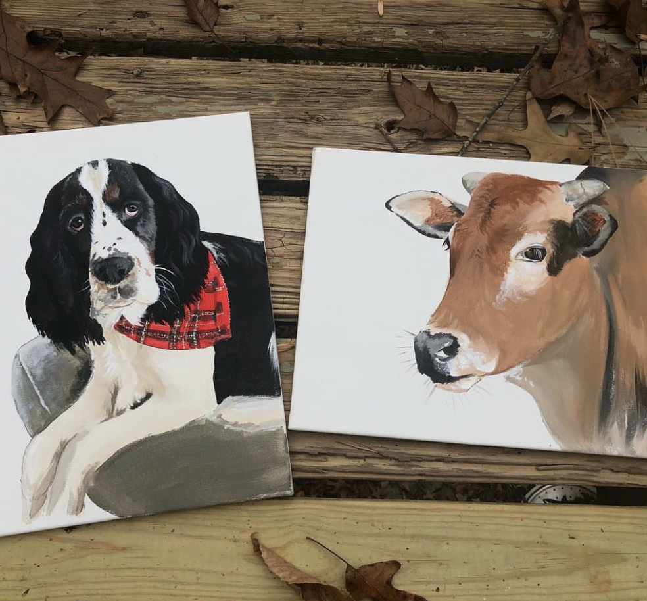
The reason we create
Learning New Skills
Problem Solving
Trial and Error
Brainstorming
Experimenting

Slide 9
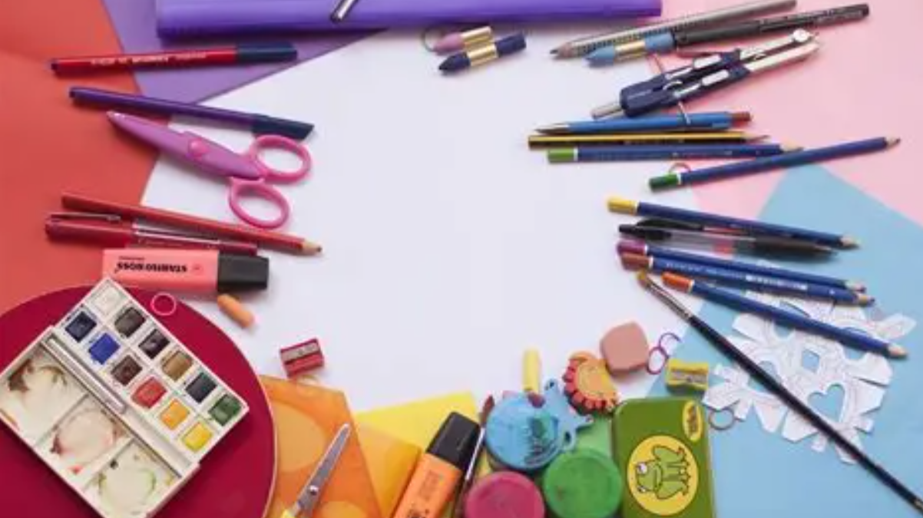
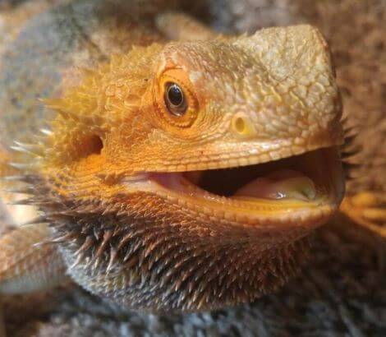
WHAT TO EXPECT
IN ART CLASS

Slide 10
RUBRIC/GRADING
25%
TECHNICAL SKILL
25%
RISK-TAKING
CRAFTSMAN-SHIP
25%
EXECUTION
25%

Slide 11
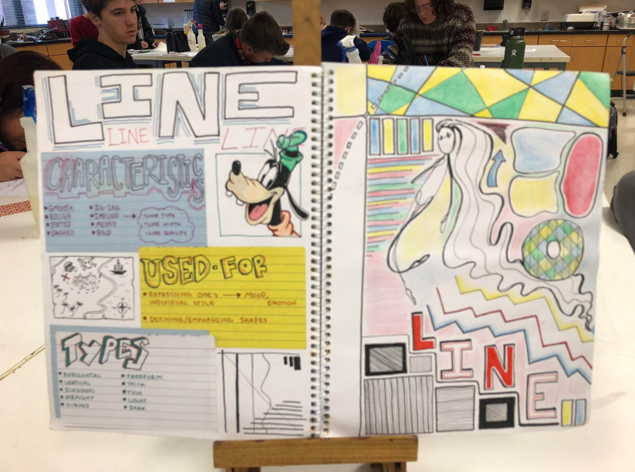
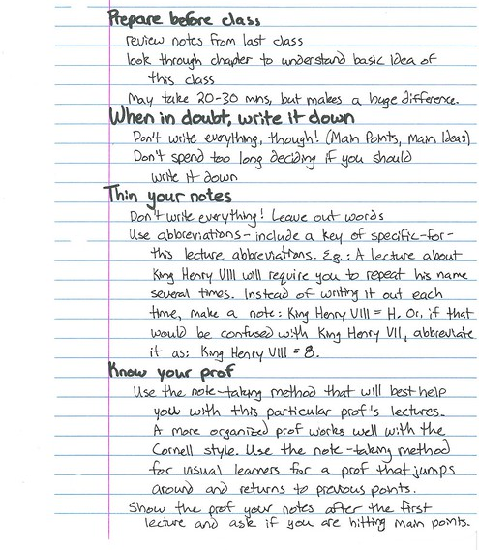

Sketchbook expectations
Each sketchbook will contain information that helps us understand HOW and WHY we create art. Each sketchbook must be complete before starting projects.
These sketchbooks are graded as ART PIECES. NOT notes.

Slide 12
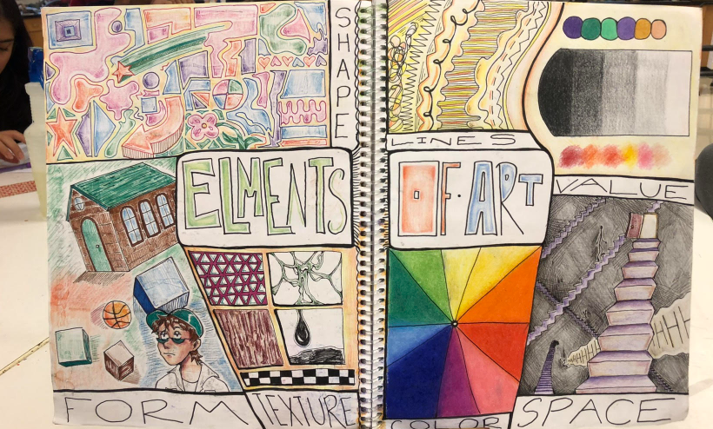

Slide 14
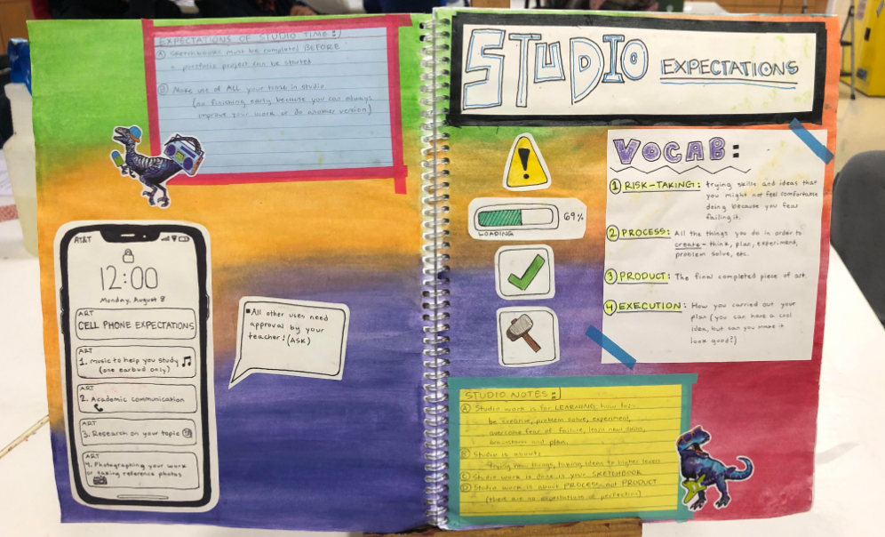

Slide 15
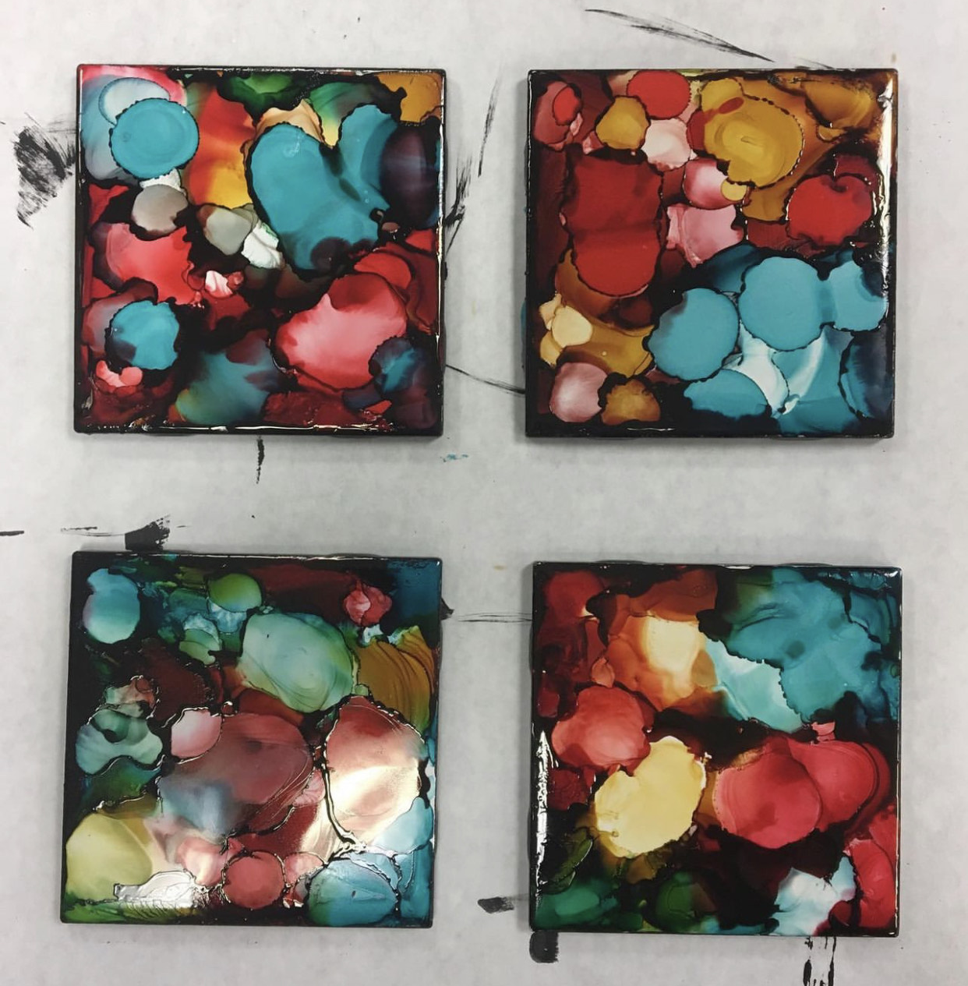
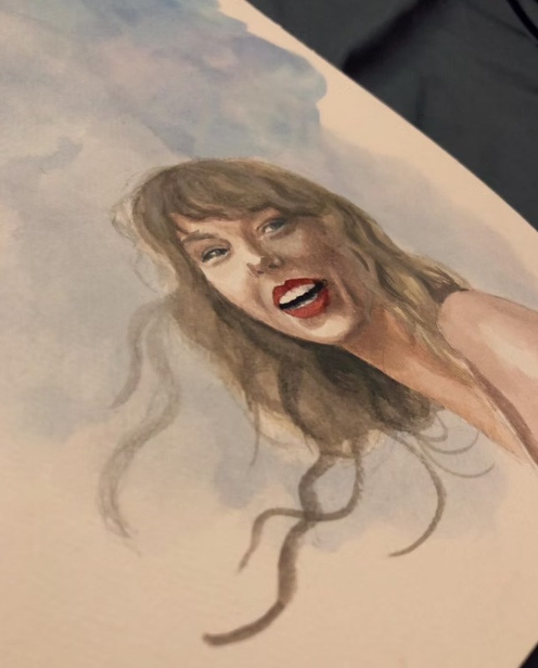
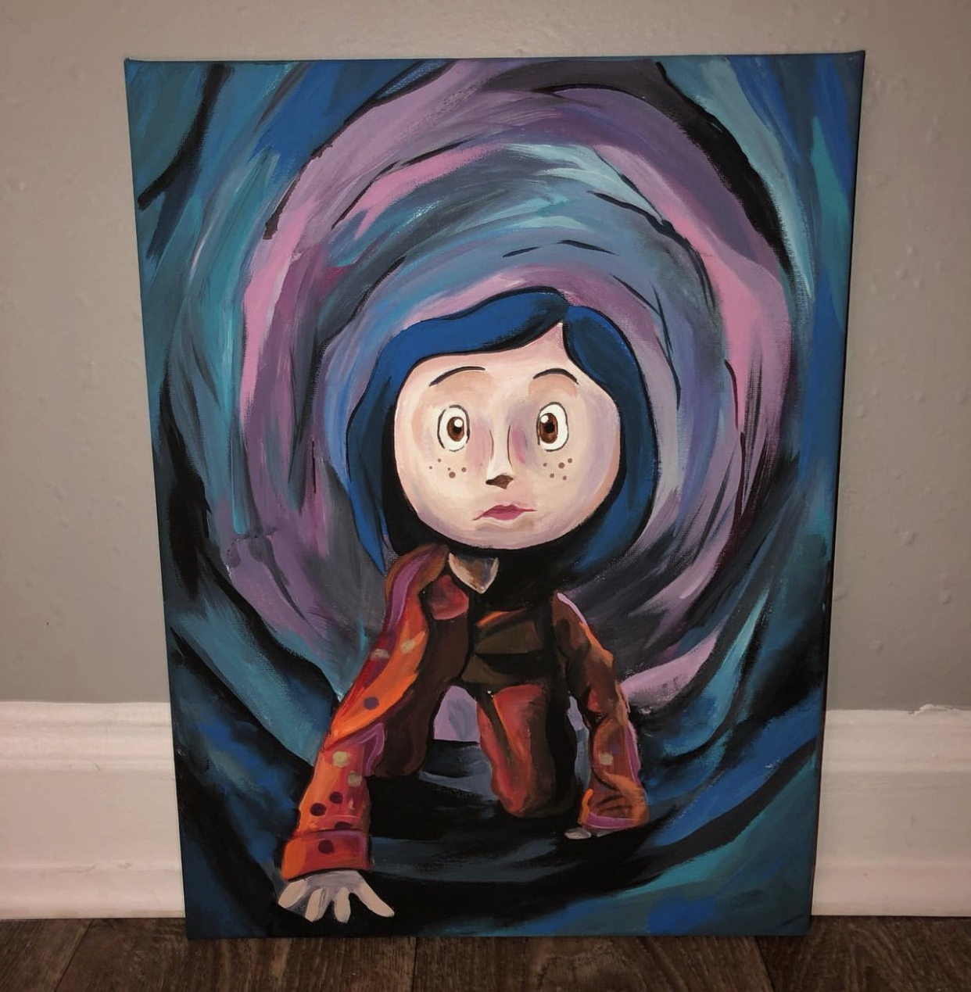
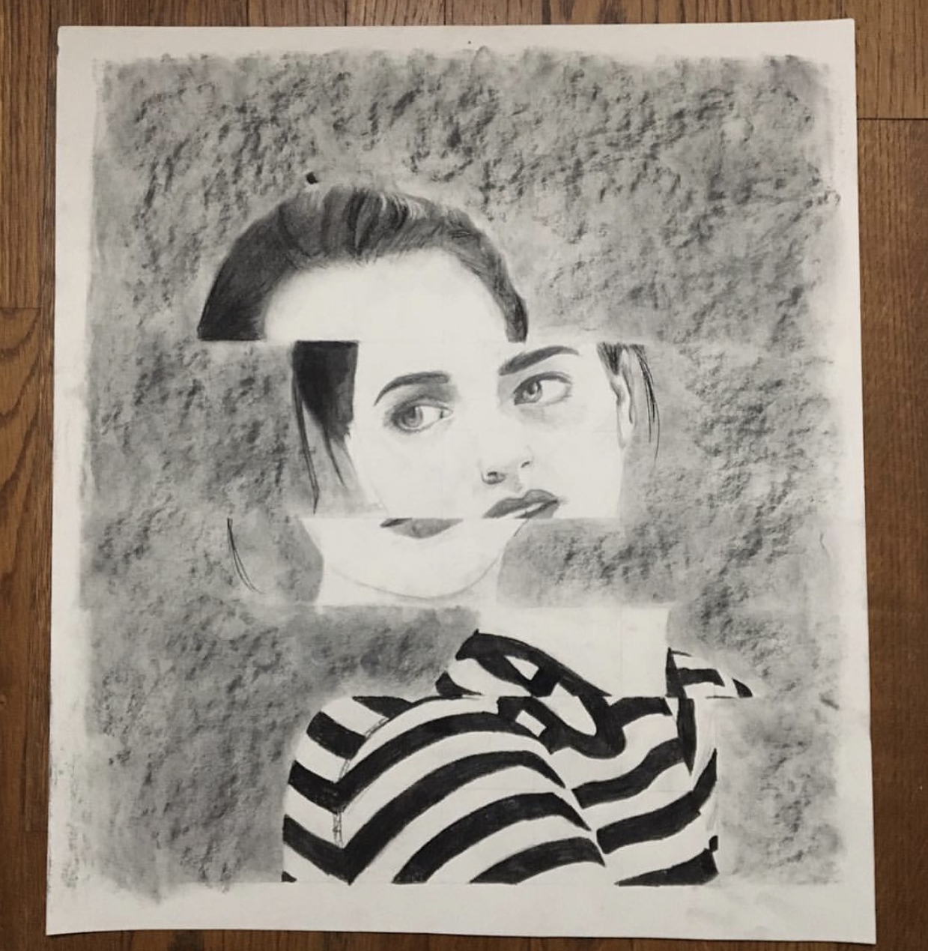
Use ALL of your time
Respect one another
Respect the room
Classroom expectations

Slide 16
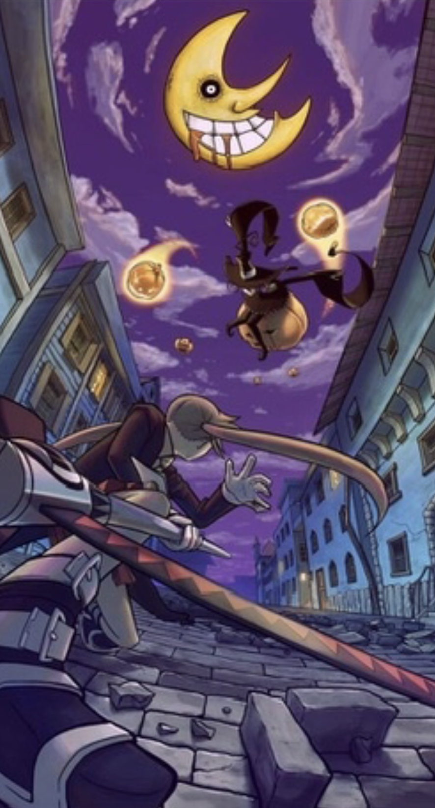
Vocab…
1.) Risk-Taking: Trying something new/unfamiliar.
2.) Medium: The type of art we use, such as painting, drawing, sculpting, etc.
3.) Process: The thinking, planning, and doing an artwork.
4.) Product: The result of the process.
5.) Execution of Ideas: The effectiveness of transferring an idea into an art piece.

Slide 17
SKETCHBOOK 1: STUDIO EXPECTATIONS
VOCAB
1.) Risk-Taking: Trying something new/unfamiliar.
2.) Medium: The type of art we use, such as painting, drawing, sculpting, etc.
3.) Process: The thinking, planning, and doing an artwork.
4.) Product: The result of the process.
5.) Execution of Ideas: The effectiveness of transferring an idea into an art piece.
CLASSROOM EXPECTATIONS
1.) Use ALL OF your class time.
2.) Respect the room and supplies.
3.) Respect one another.

Slide 18


Slide 19
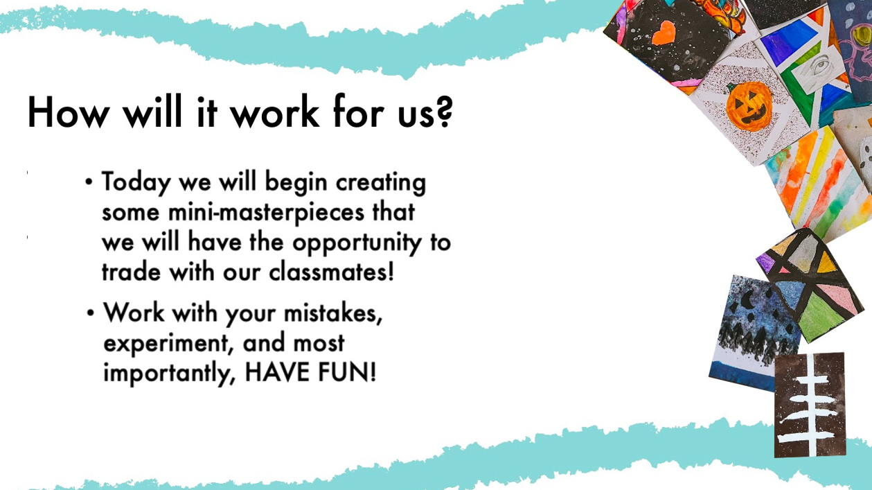

Slide 20
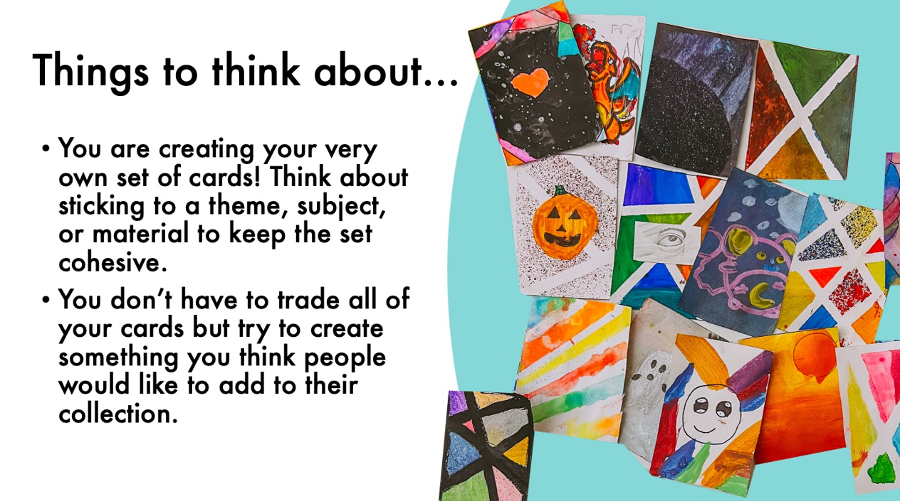

Slide 21
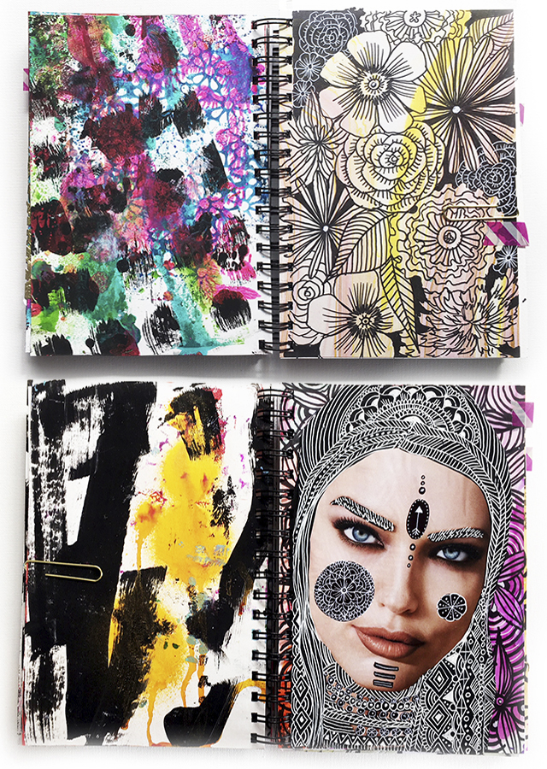
SKETCHBOOK COVERS
As a pre-assessment to gauge where you are at, what your strengths are, and what needs improvement, you will be given the option of using colored pencils, crayons, pens, pencil, or watercolor to create an art piece that will be used as your sketchbook front cover.
The subject matter is entirely up to you, it can be whatever you’d like; but choose something that shows me your strongest skillset.
This is a project grade.

