Slide 1
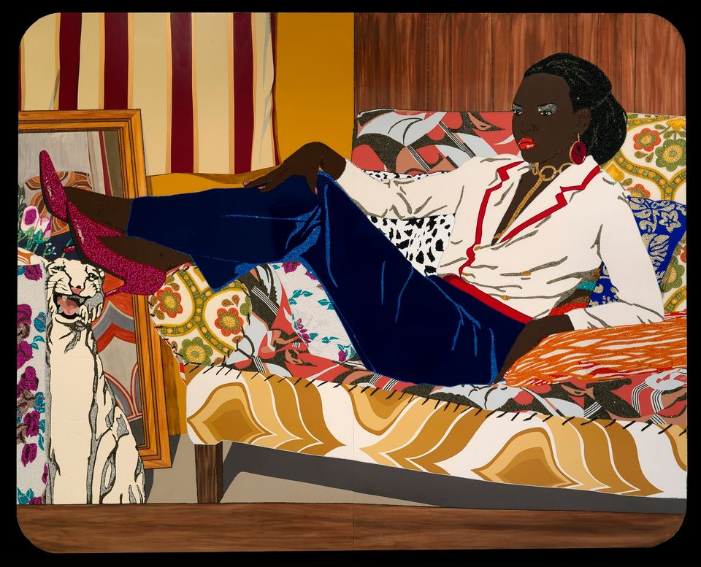
Exploring African American Art

Slide 2
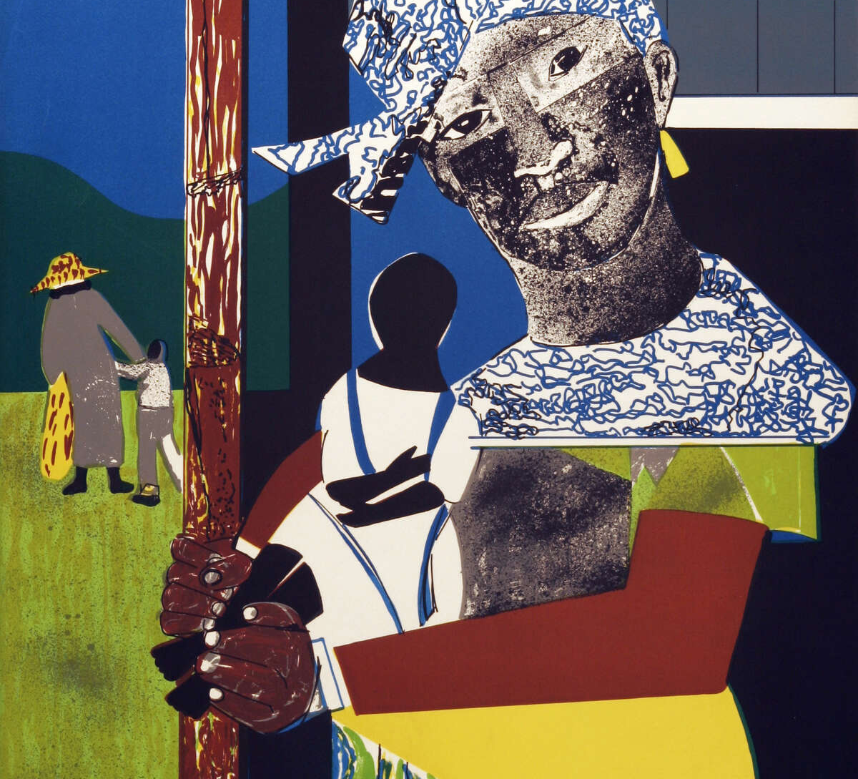
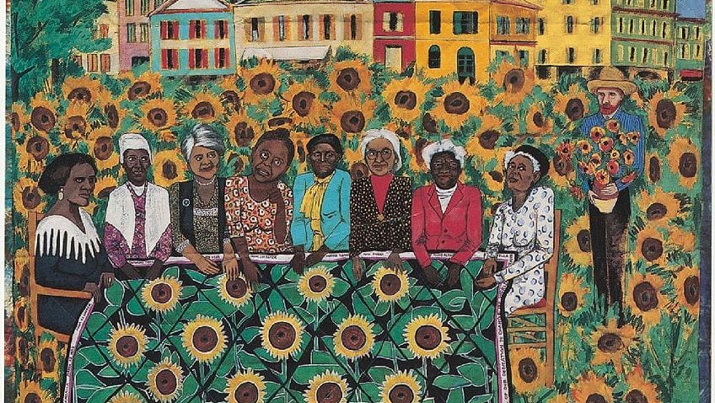
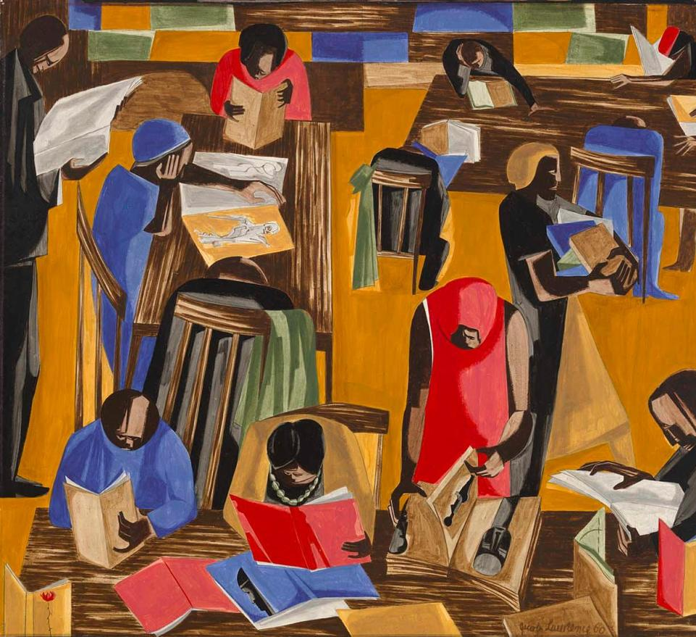
Role in American culture and history
African American art is a lively and diverse way of showing creativity, representing the experiences, history, and culture of African Americans in the U.S. It includes many different types of art, like painting, sculpture, photography, printmaking, and more.
African American art has a deep and important history that comes from African traditions and has been shaped by the experiences of African Americans over time. This art has helped tell the story of African American life, celebrate their culture, and stand up against unfair treatment in society.

Slide 3
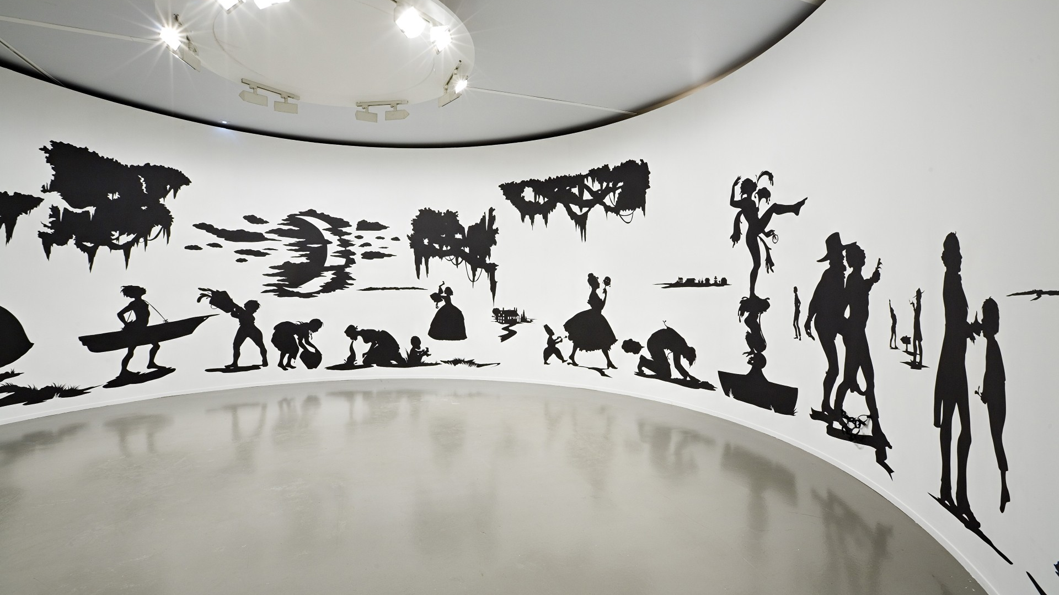
Themes and Styles
Identity and self-expression
Social justice and civil rights
Cultural heritage and storytelling

Slide 4
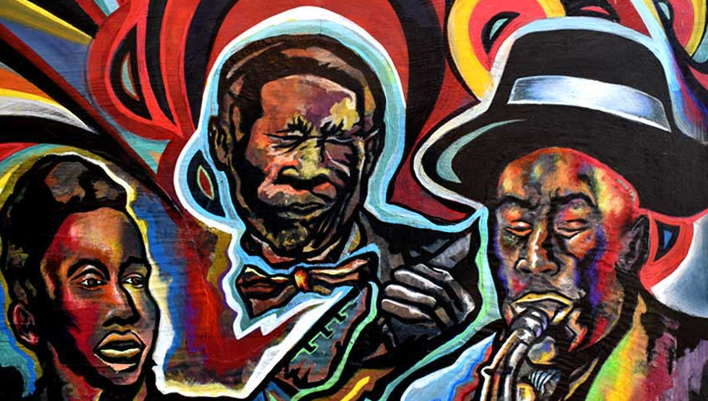
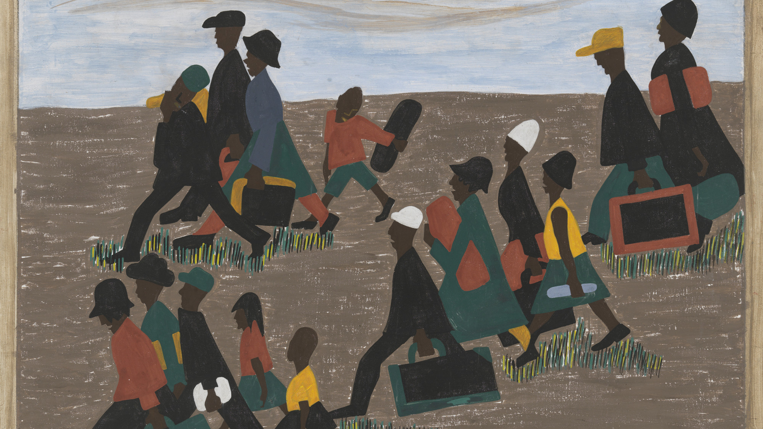
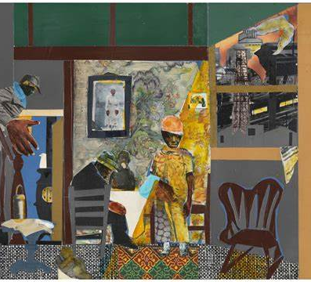
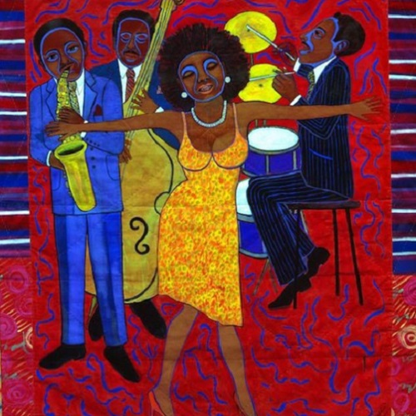
Prominent Artists
Jacob Lawrence's "Migration Series" depicting the Great Migration.
Romare Bearden's collage art that reflects African American life.
Faith Ringgold's story quilts.
Jean-Michel Basquiat's graffiti and neo-expressionist art.

Slide 5
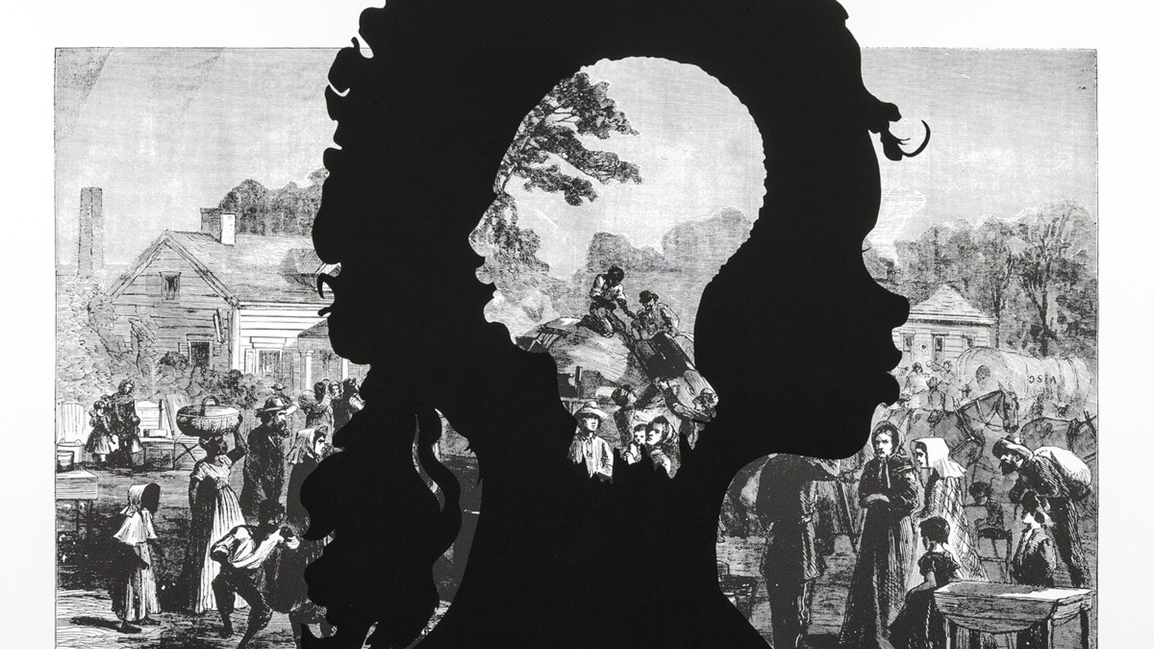
Visual characteristics
Expressionism/Abstraction
Portraiture
Symbolism/Cultural Identity

Slide 6
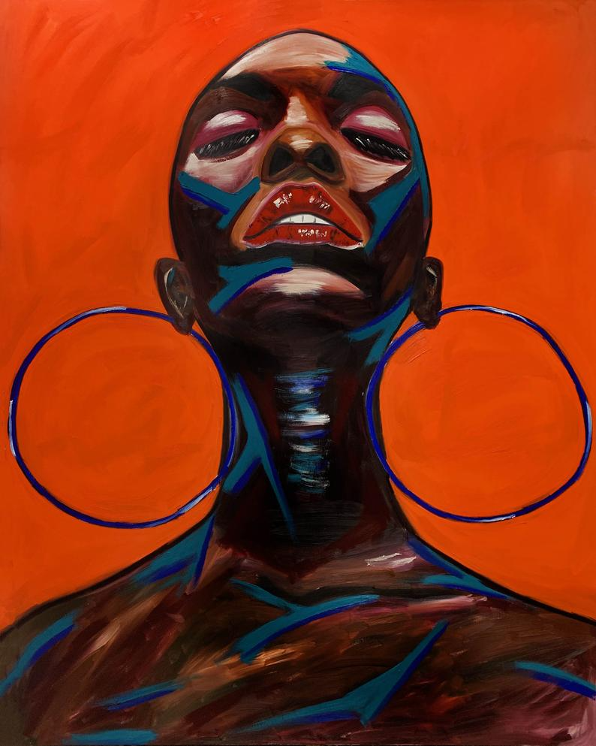
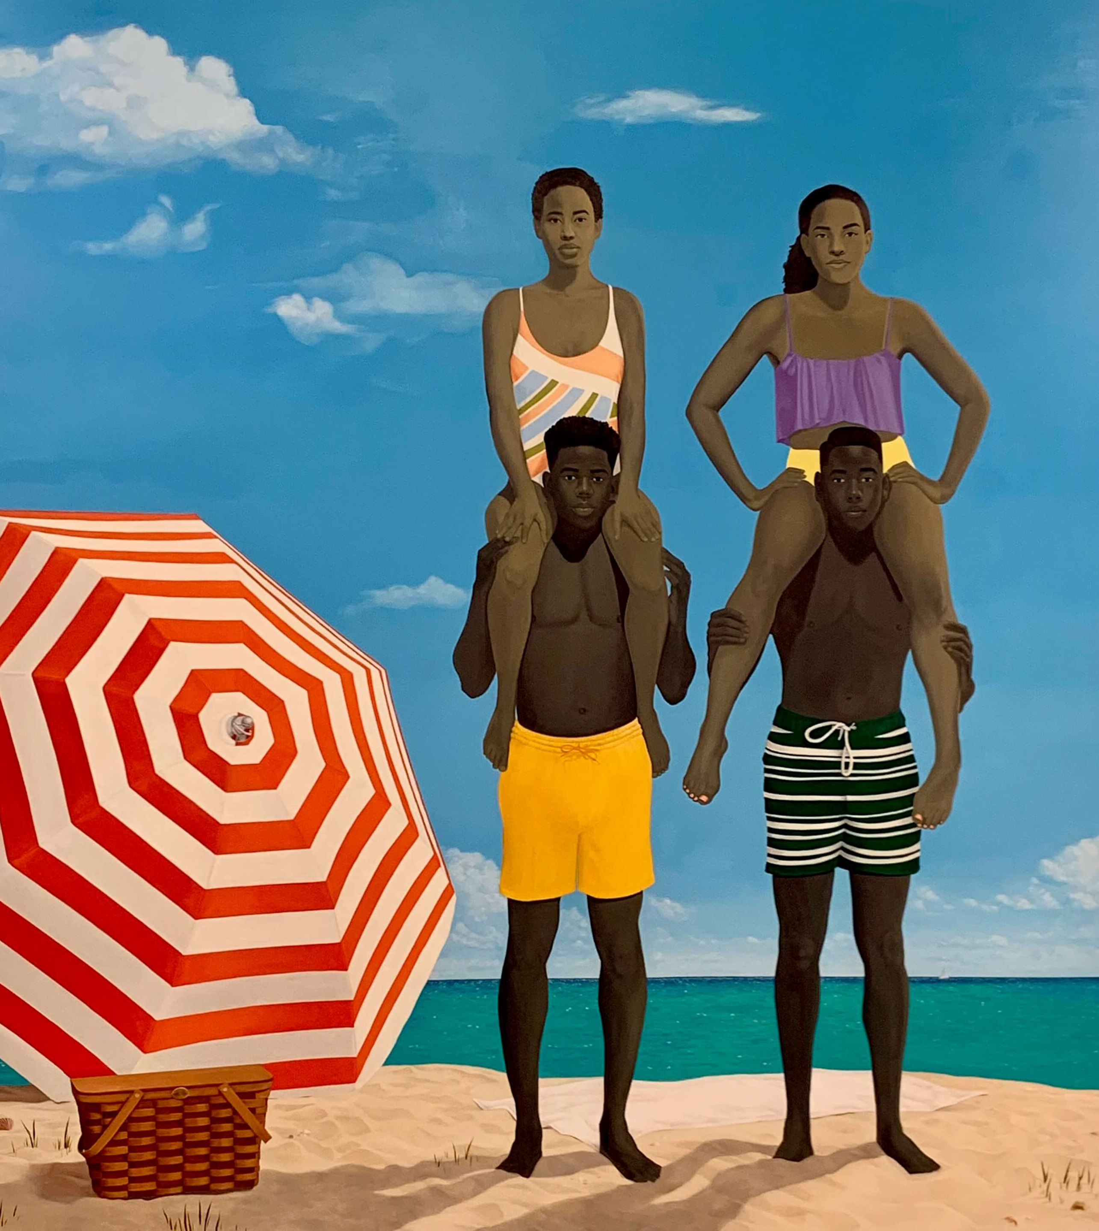
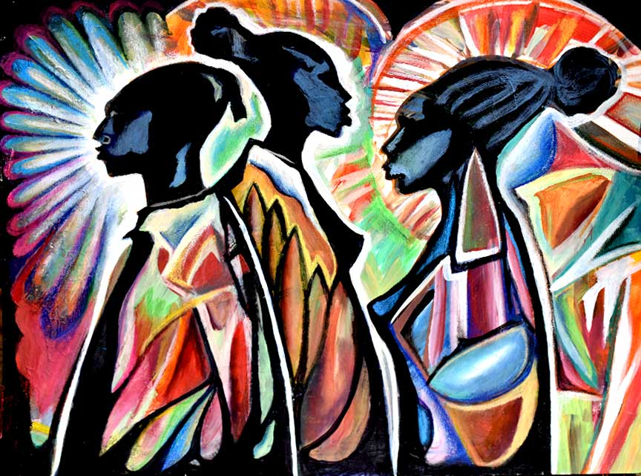
African American art TODAY
African American art is not only a testament to the creativity and resilience of the African American community but also a valuable part of American cultural heritage. It continues to evolve and thrive, making a lasting impact on the art world and society at large.

Slide 7


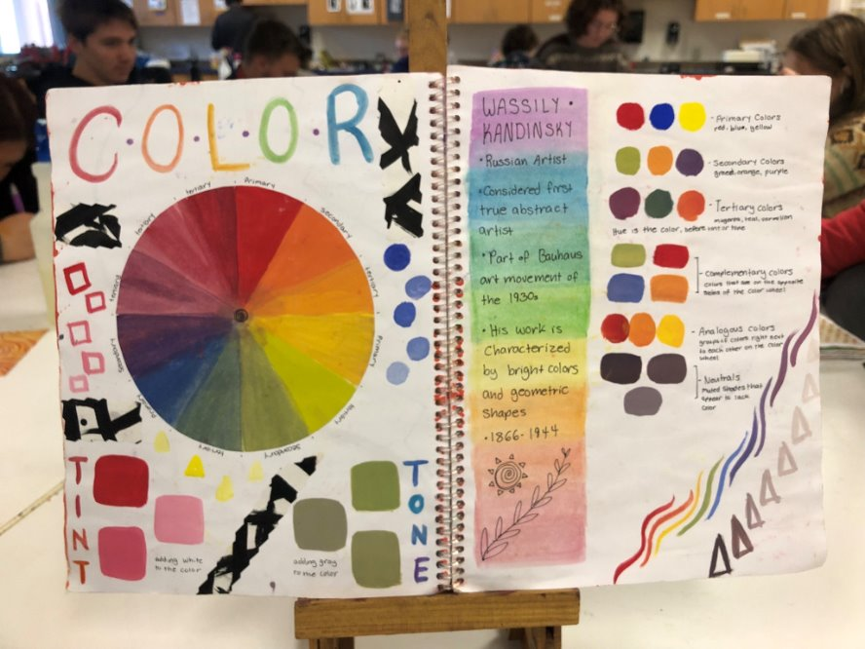
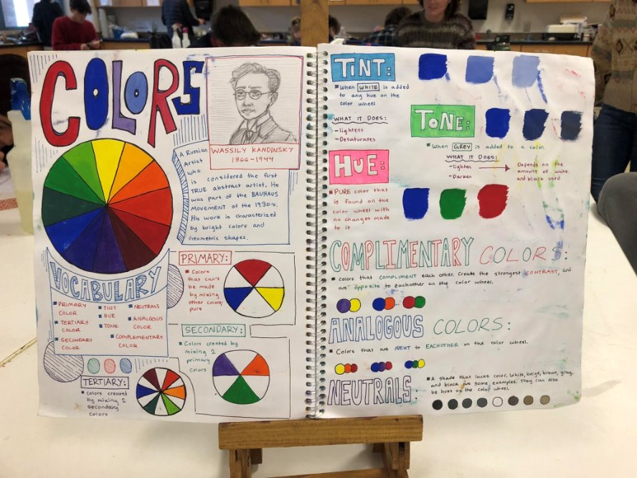
Element of art: color
Color: Element of Art defined by hue, saturation, and luminosity often used to convey mood.
Primary Colors: Colors from which all other colors are made - Red, Yellow, Blue
Secondary Colors: Colors made from mixing two primary colors - Orange, Green, Purple
Complimentary Colors: Opposites on the color wheel.
Sketchbook 4

Slide 8
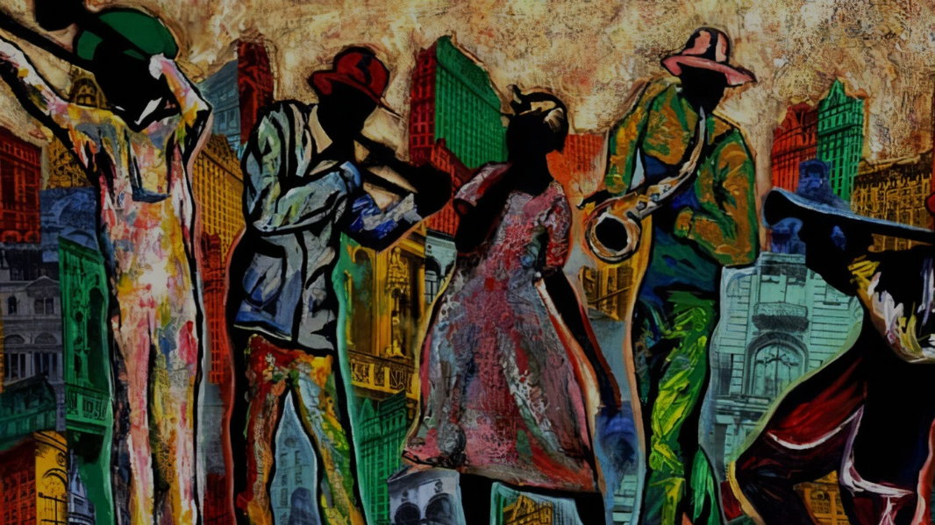
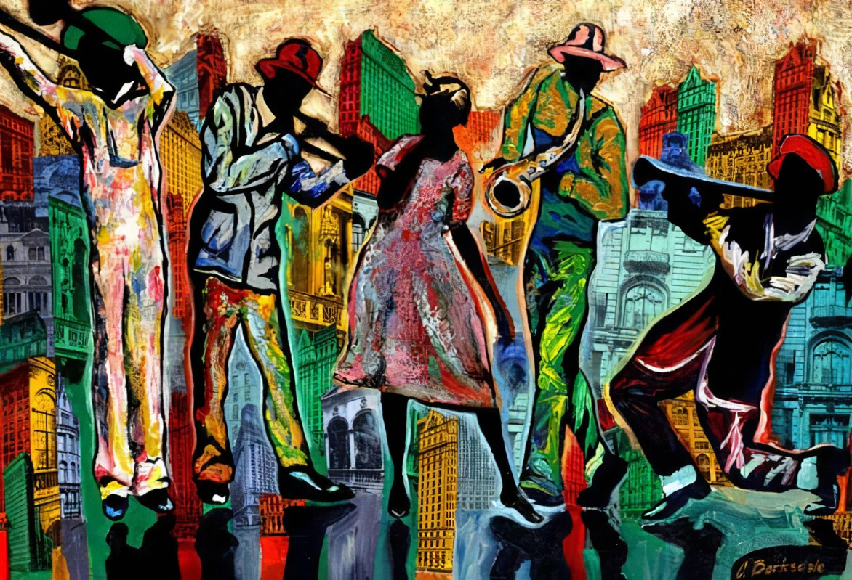
Sketchbook 5: what is African-American Art?
(Summarize the following)
African American arts are reflections of the experiences, history, culture, and stories of African American people. Historically, African American artists have used their talents to show pride in their identity and to highlight important social issues, like civil rights and equality, often drawing from their heritage, struggles for freedom, and hopes for the future. From vibrant paintings that show everyday life to powerful sculptures that honor leaders like Martin Luther King Jr., these artworks help tell the story of African American culture in the United States.
Expressionism: An artistic style in which the artist seeks to depict not
objective reality but rather the subjective emotions.
Portraiture: Works of art that record the likenesses of humans or
animals.

Slide 9
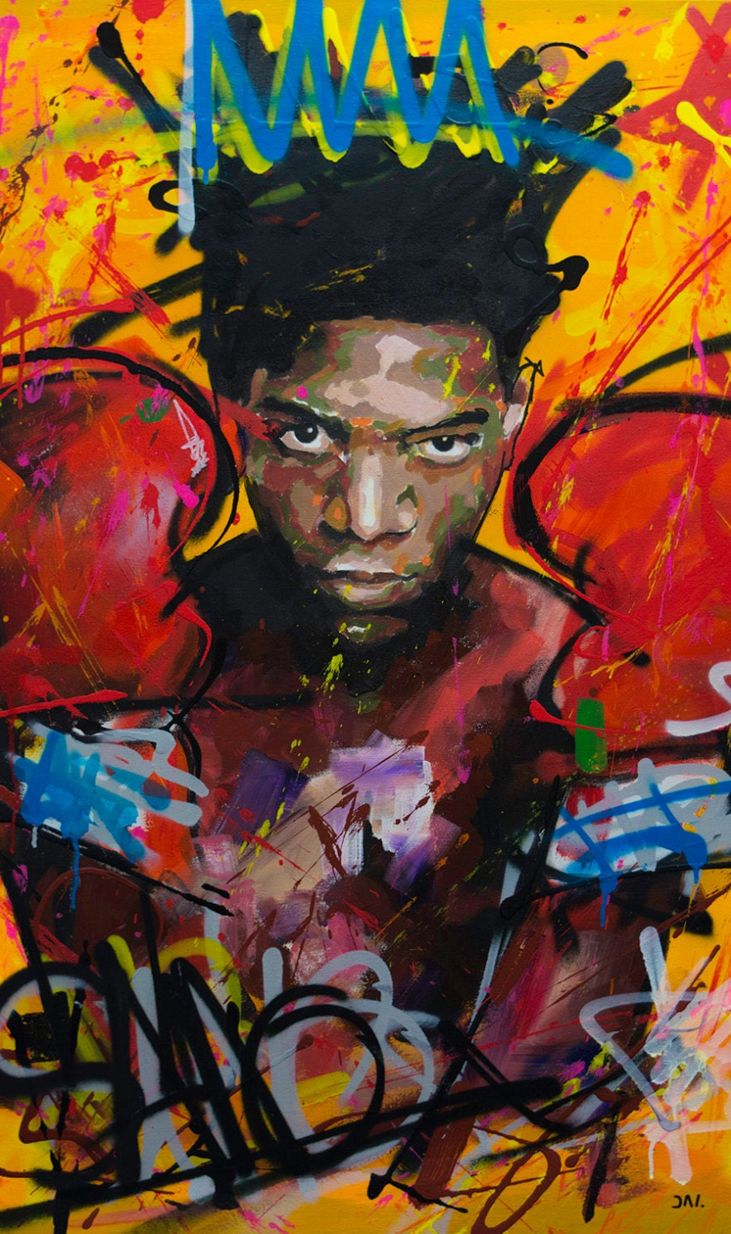
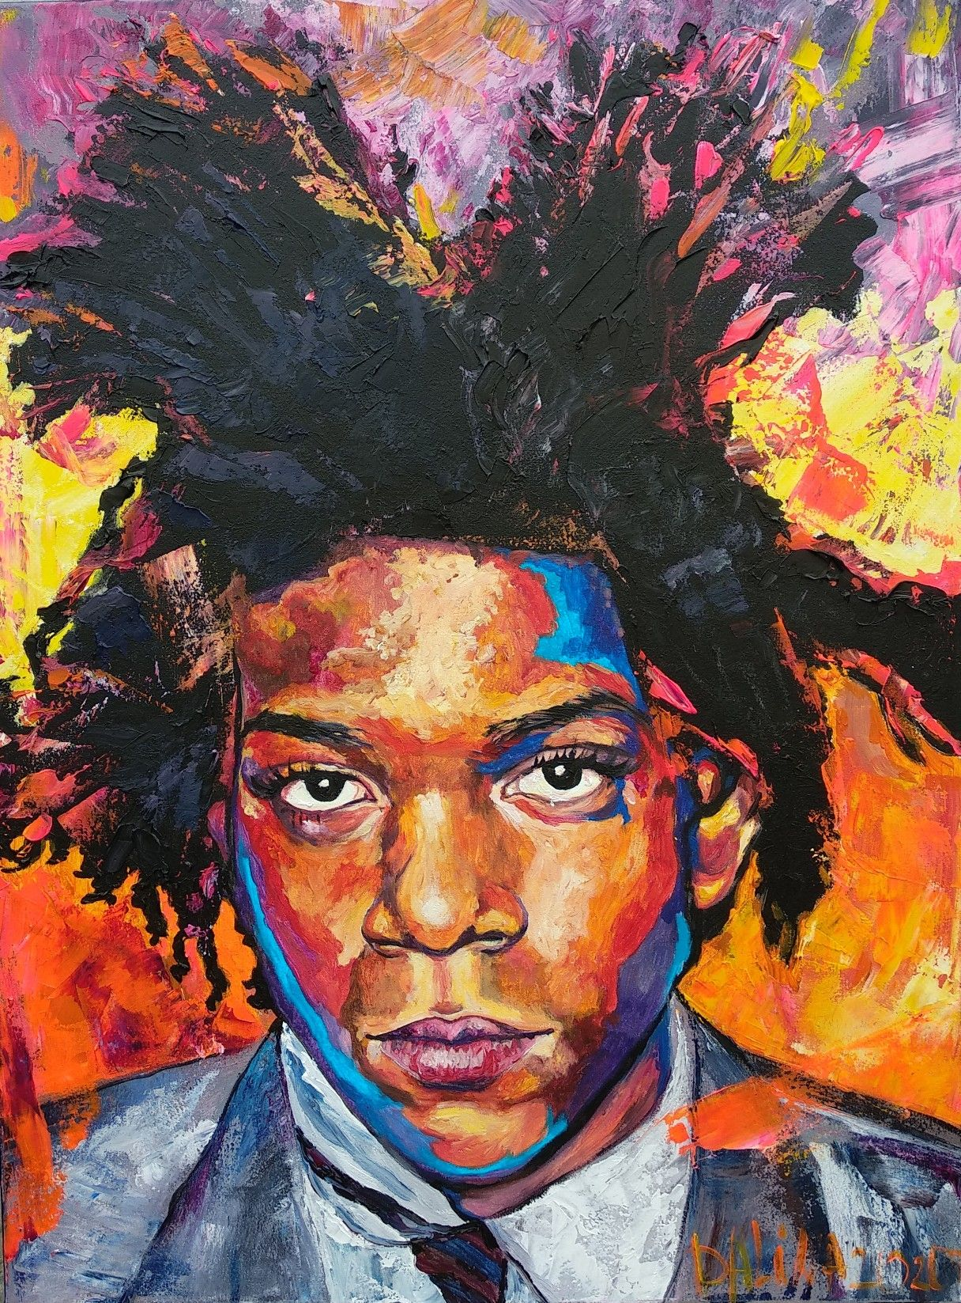
PROJECT 2:
African American art
Using heavy drawing paper, acrylic paints, and printed visual references, you'll create a self-portrait inspired by the bold use of color in neo-expressionism.
Pay close attention to color choices, composition (how the elements are arranged), and the overall execution of your theme.

Slide 10


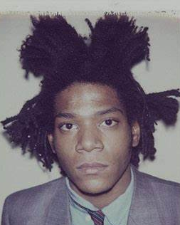
griddy
Hitting the

Slide 11
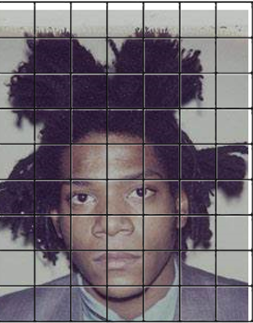
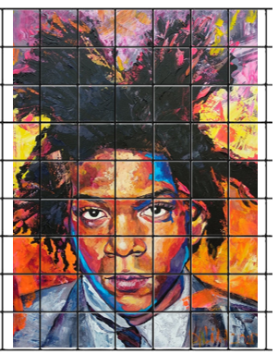
griddying
Hitting the

Slide 12
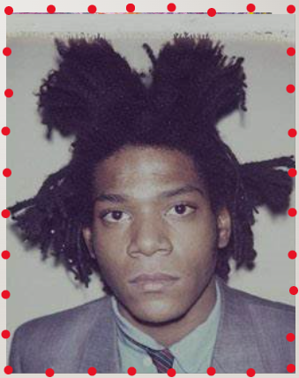
Creating a grid
Use a ruler to mark 8 points across the top, and 10 points across the sides.
After creating the points, use your ruler to create horizontal and vertical lines to create a grid across the photo.

Slide 13

Creating a grid
Use a ruler to mark 8 points across the top, and 10 points across the sides.
After creating the points, use your ruler to create horizontal and vertical lines to create a grid across the photo.

Slide 14
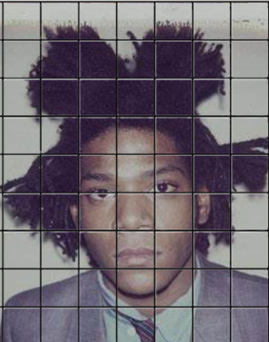
using the grid
Look at one square at a time, and try to replicate what you see in each grid.
Try to keep in mind the size and angle of each shape.
When all squares are filled you should have a fully sketched self portrait.

Slide 15
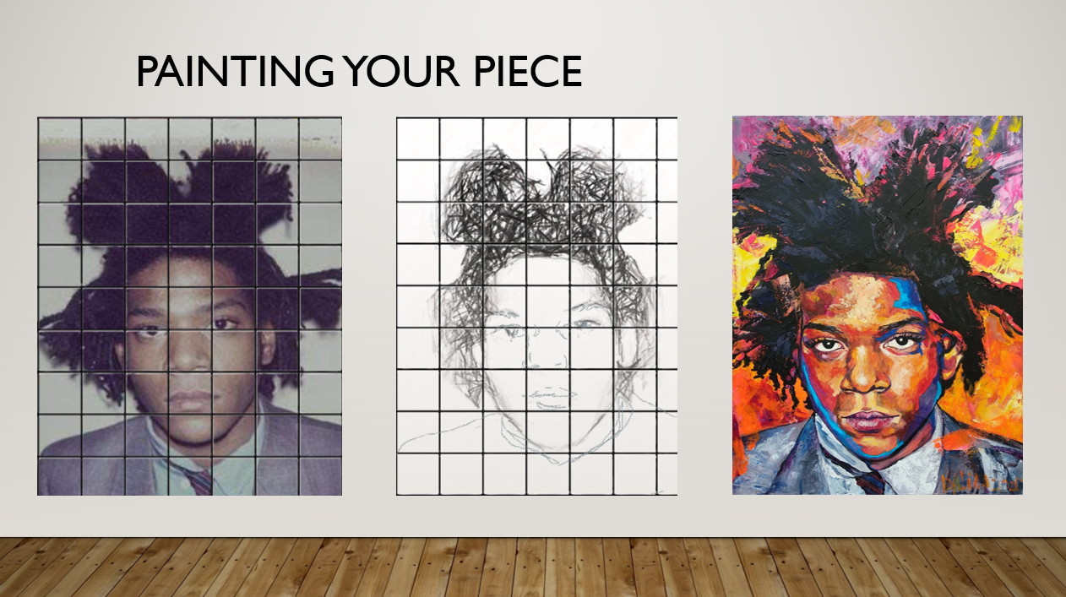

Slide 16
day 1: African American art
Pick up the photo I've printed out of you, or use the photo you brought in.
Measure out 8 points across and 10 points down the side.
Connect the lines to create a grid.

