Slide 1
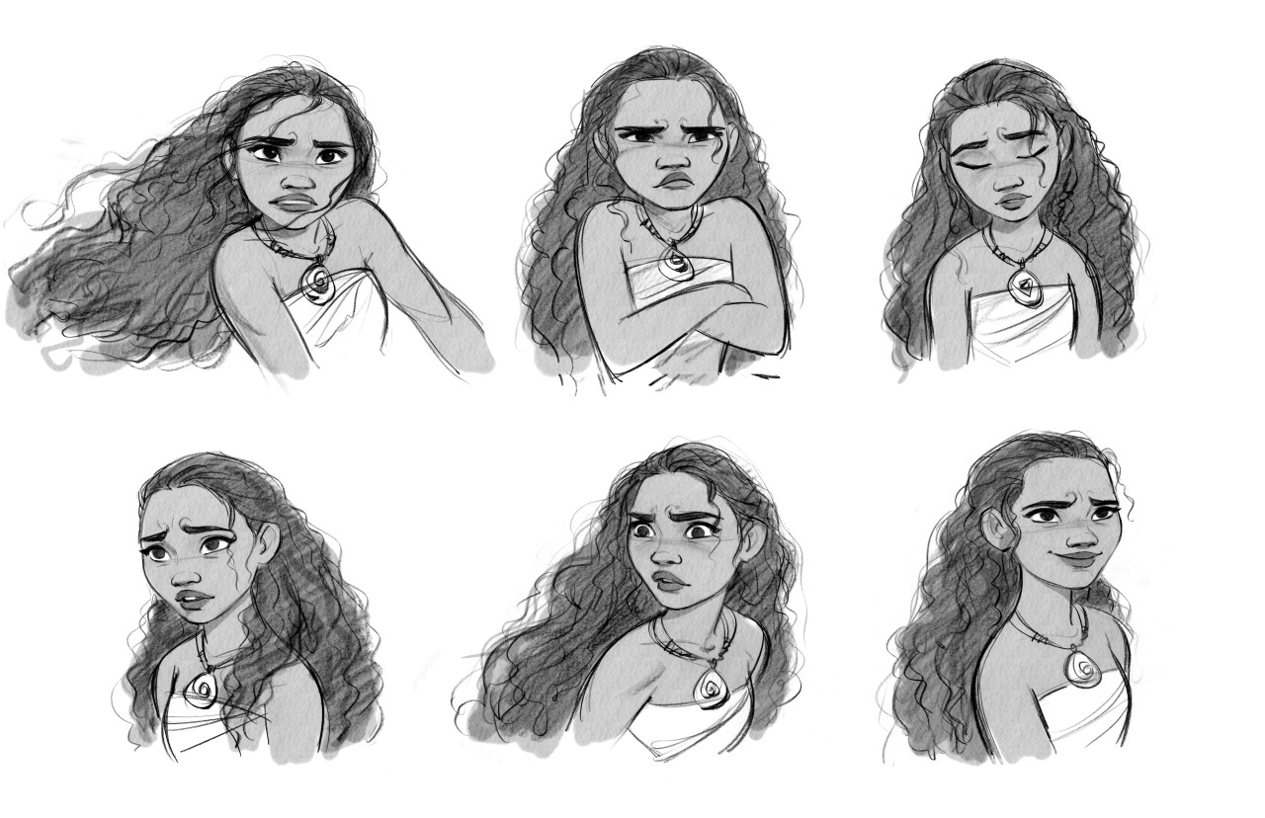
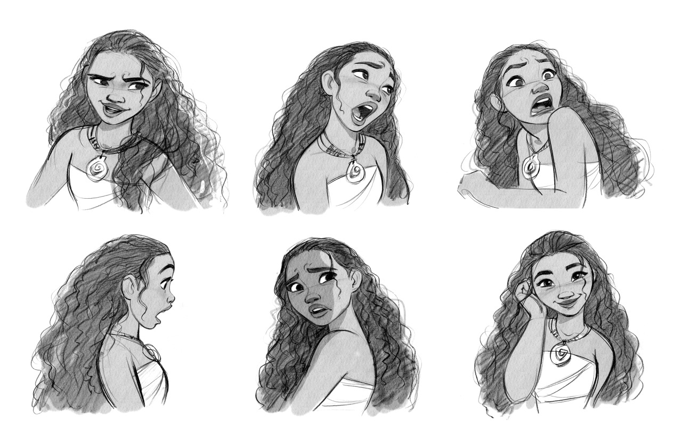
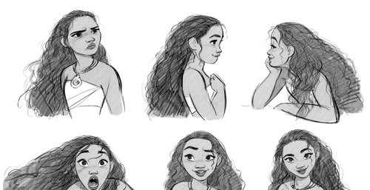
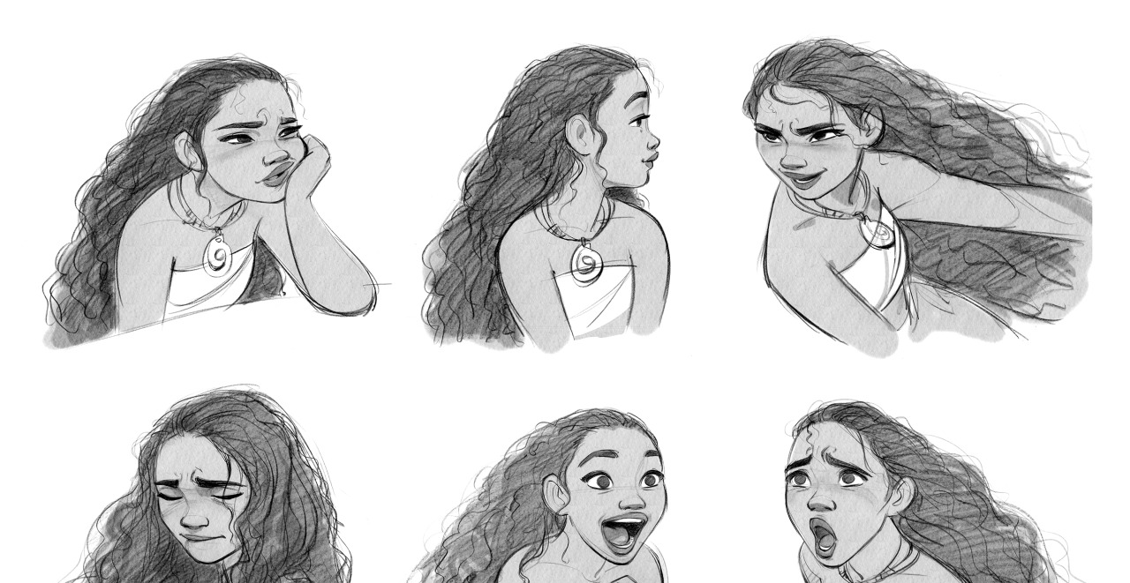
Social emotional learning in animation

Slide 2



Role of emotional expression through art…
Emotions in art allow artists to connect with their audience on a deeper level. When viewers perceive and resonate with the emotions conveyed in a piece of art, it creates a powerful connection between the creator and the audience.

Slide 3

importance of emotions in art…
Emotions serve as a universal language that transcends cultural and language barriers, enabling artists to communicate complex ideas and experiences effectively. By depicting emotions in their work, artists can foster empathy, compassion, and a greater understanding of the human condition

Slide 4

Visualizing emotions
Gestures/Body language
Facial Expressions
Posture
Lighting/Atmosphere
Bright – Happiness
Dark, deep shadows – Fear, agony
Colors
Warm – Passionate
Cool – Calmness or sadness

Slide 5
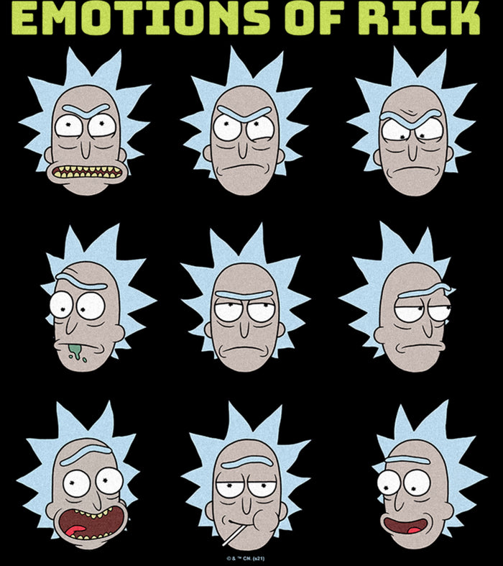
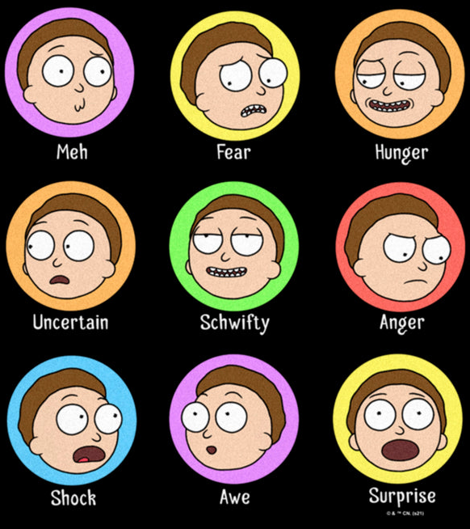
Emotion in Facial expressions

Slide 6

Emotions through body language

Slide 7
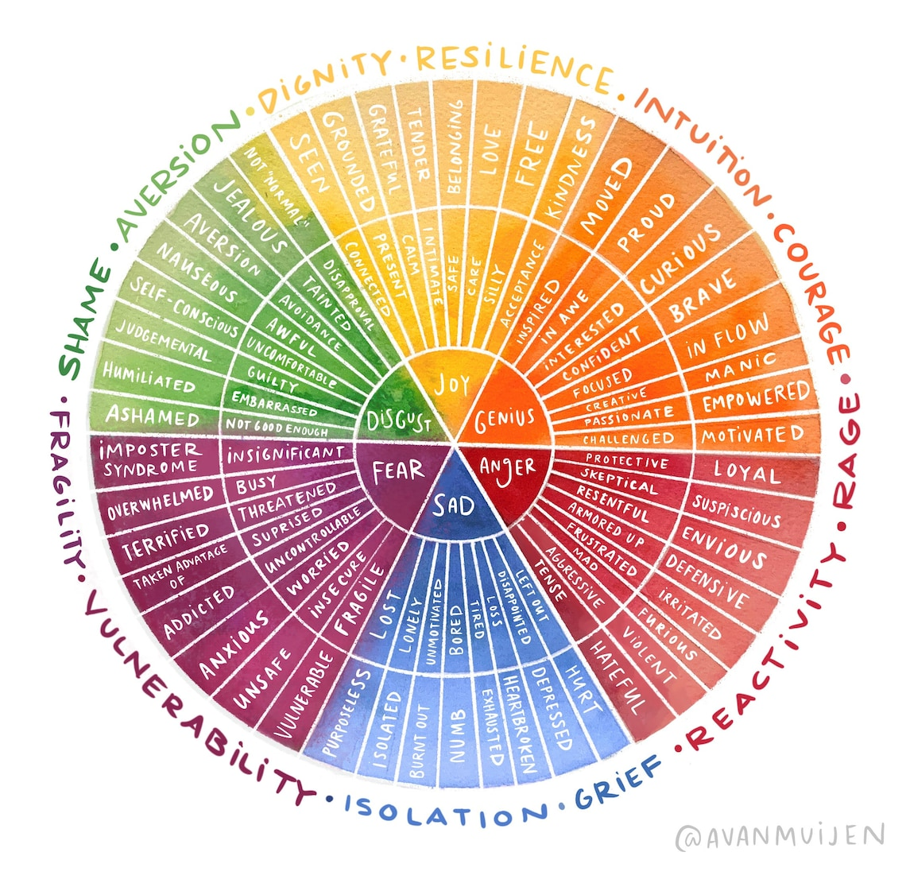


Slide 8


Slide 9


Slide 10


Slide 11


Slide 12


Slide 13
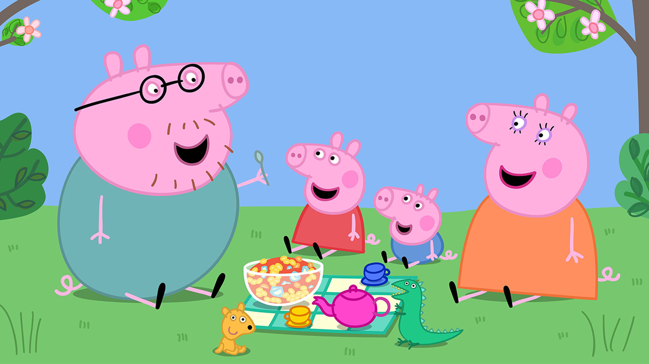

Slide 15


Slide 16
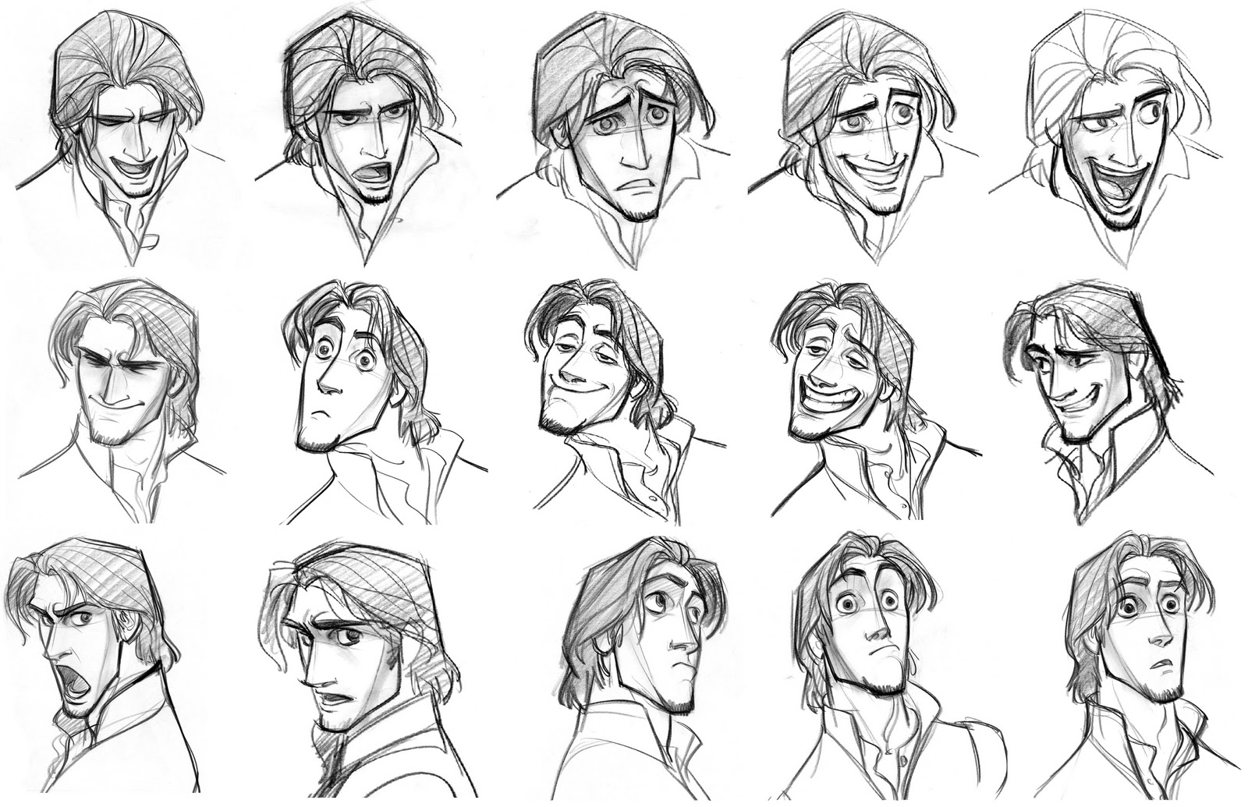
Exploring emotion in cartoons
In your sketchbook, title the page “Sketchbook 10: Emotion in Cartoons”. Under the title, create a series of sketches and thumbnails expressing a chosen emotion or emotions of your own cartoon.
Under the drawings, list the ways/examples in which emotion can be conveyed in art through:
- Color
- Lighting
- Composition
- Body language
- Symbolism
Sketchbook 10

Slide 17





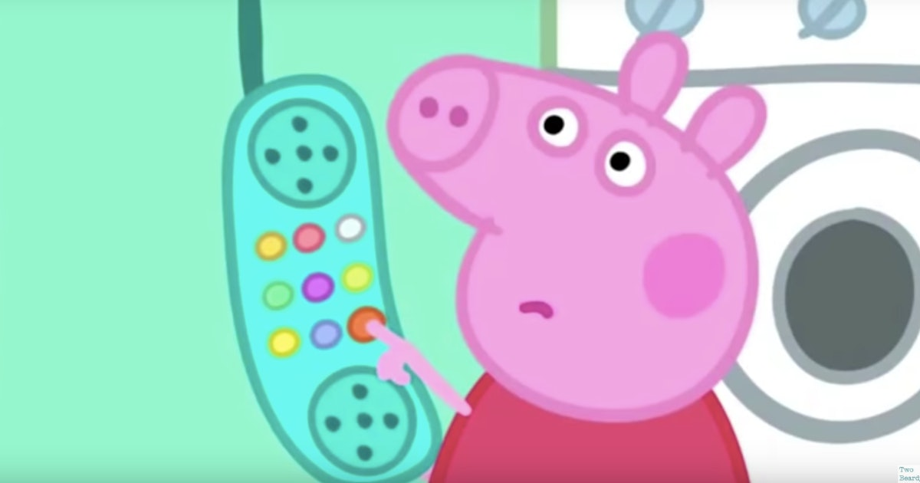
Expressive manga/comics
Create a series of drawings in a comic book/manga format displaying an emotion of your choice, telling a story.
When finished, unify the body gestures and facial expressions with color to express the emotion; for example, anger or love could be red, sadness could be greys and blues, etc.

Slide 18



Making a comic strip/manga:
Step 1.) Decide your story! Focus on the main idea of what happens in the 5 panels.
Step 2.) Create the boxes. You need at-least 5, but you can have more!
Step 3.) Draw out your ideas! Make sure to include facial expressions and body language that express emotions
Step 4.) Add color to create atmosphere and add to the emotions!

Slide 19

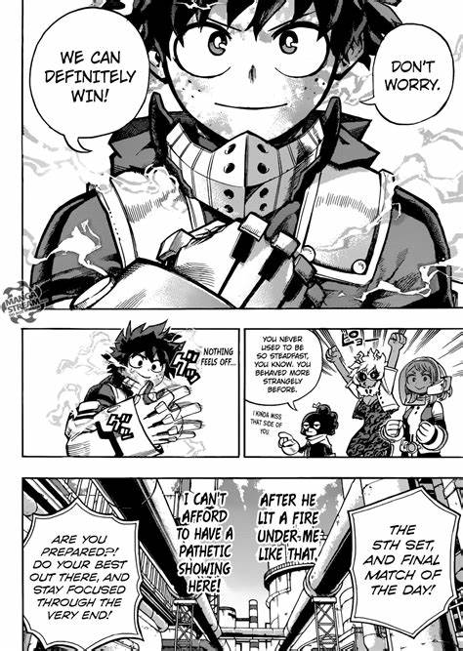
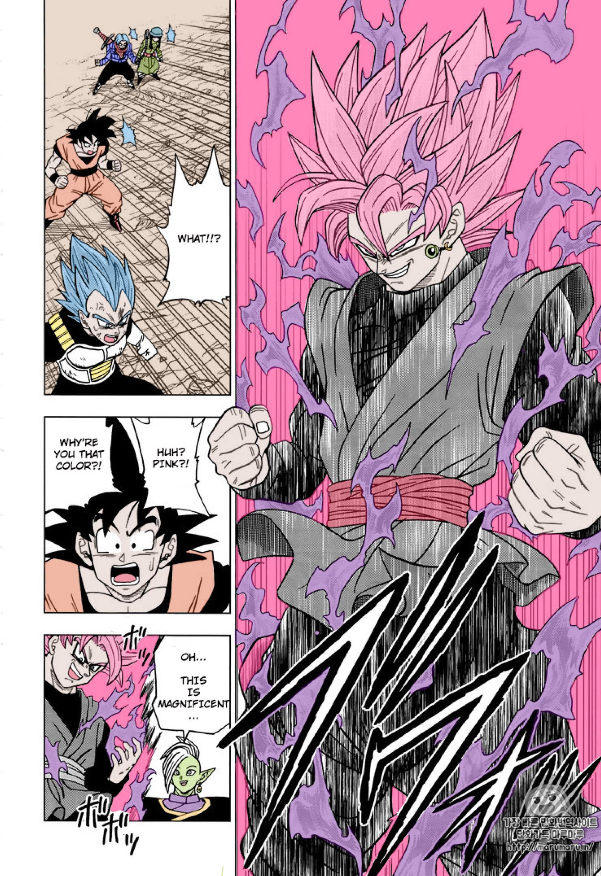
Making a comic strip/manga:

