Slide 1

SURREALIST SILHOUETTES
r
R
U
E
L
A
(Overlayed Collages)

Slide 2
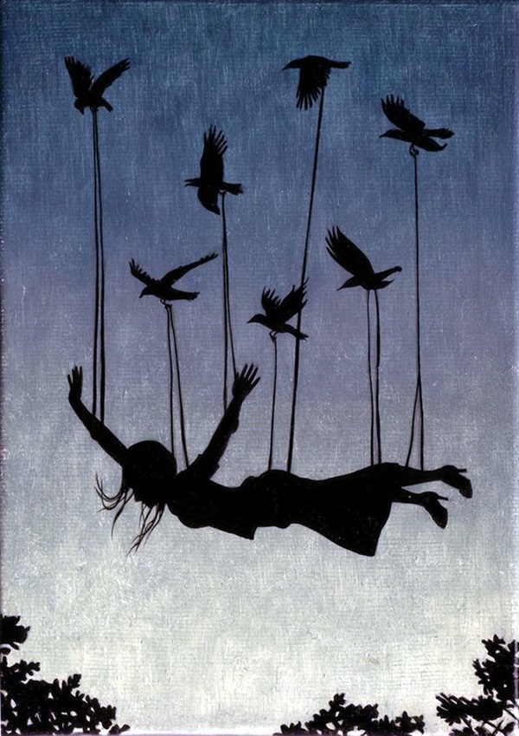
WHAT ARE SILHOUETTES?
Silhouettes convey stories by simplifying complex details into positive and negative space, allowing viewers to focus on the essence of an object or figure and enabling their imagination to fill in the narrative gaps.
The importance of silhouettes in art lies in their ability to emphasize shapes and communicate powerful messages through minimalistic and visually striking forms, adding depth and symbolism to artistic compositions

Slide 3
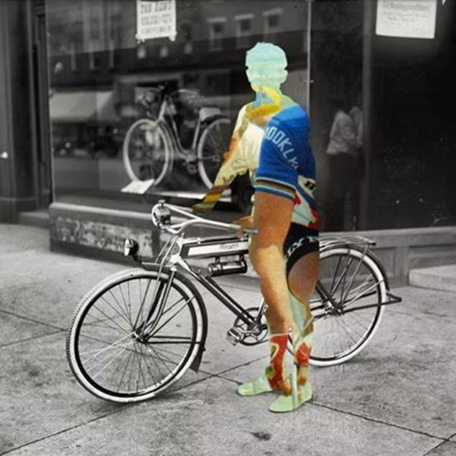
EFFECTIVE
SILHOUETTES
CONTAINS…
Contrast​
Layers
​
Strong Composition
​
Personal Expression
Emotional Impact

Slide 4
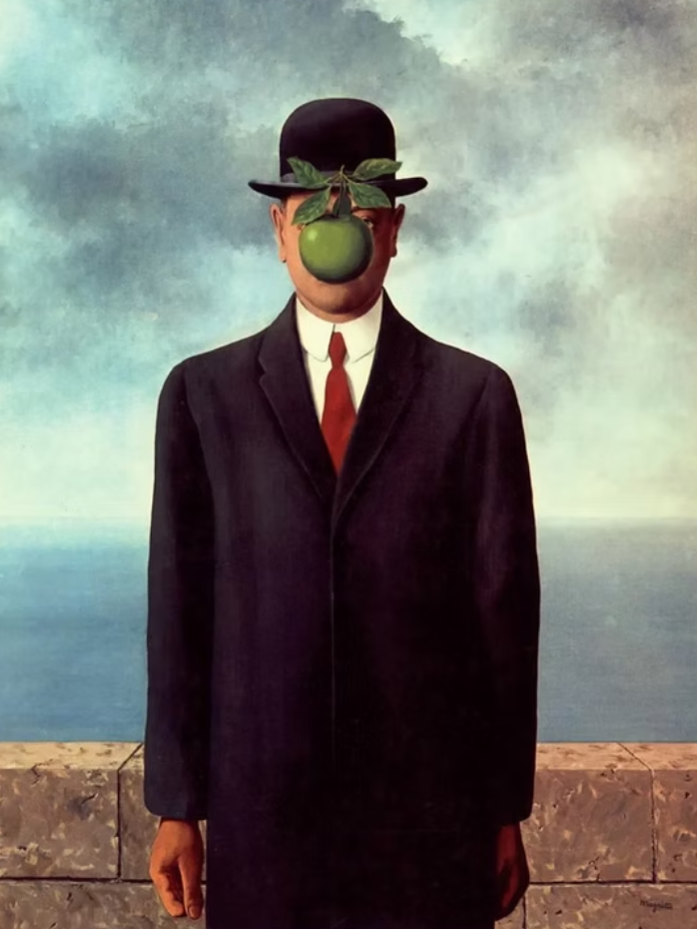
THE THEME:
SURREALISM
Surrealism is an artistic and literary movement that emerged in the early 20th century, characterized by its focus on unlocking the subconscious mind and exploring dreamlike, irrational, and fantastical imagery.

Slide 5


Slide 6


Slide 7
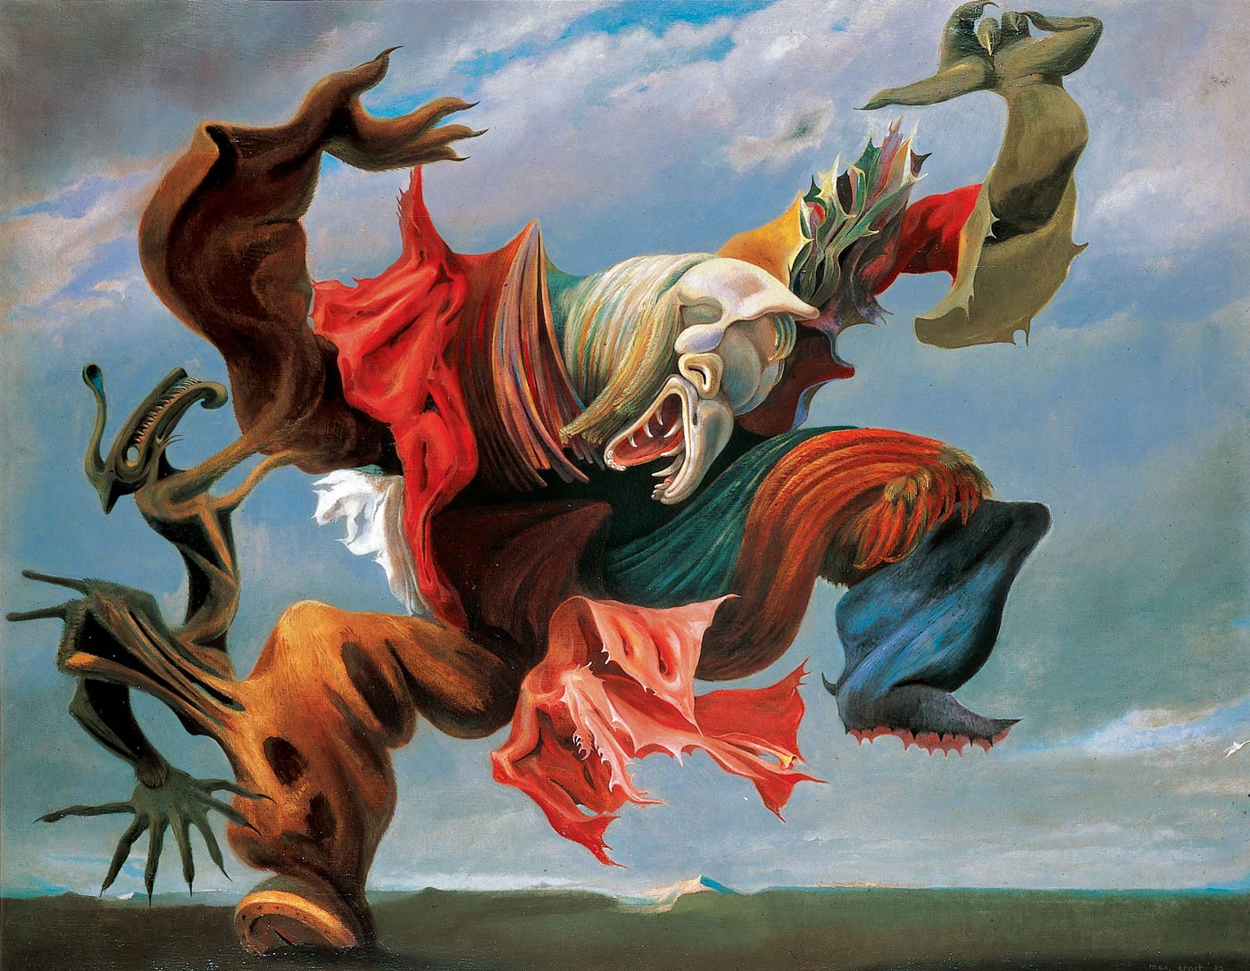

Slide 8


Slide 9


CHARACTERISTICS OF SURREALISM
01
02
03
Dreamlike Imagery
Surrealist works often depict scenes that feel like they come from dreams or hallucinations, blending reality with fantasy.
Distortion of Reality
Juxtaposition
Unexpected combinations of objects or ideas are used to create a sense of surprise or absurdity.
Familiar objects are often altered or placed in unfamiliar contexts, creating a sense of unease or wonder.

Slide 10


Slide 11
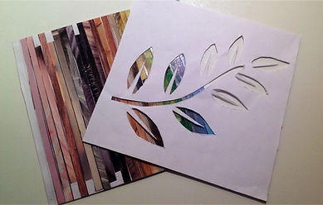
REQUIRED MATERIALS
Magazines, newspapers, or printed materials
Black/white cardstock
Scissors
Glue
Pencils
Black Markers
White chalk

Slide 12


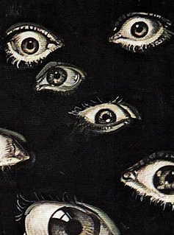
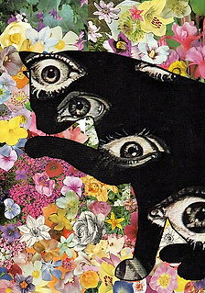
STEPS TO SUCCESS
STEP 1
STEP 2
STEP 3
STEP 4

Slide 13

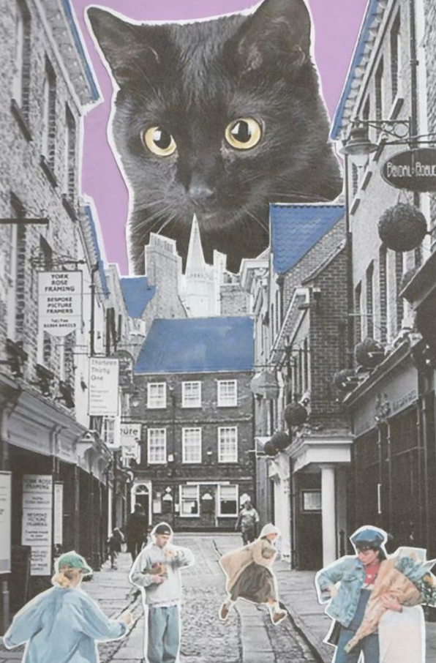

SKETCHBOOK: OVERLAYED COLLAGE
In your sketchbook...
1.) Define silhouettes and list
visual characteristics that make it successful.
2.) Define surrealism and list its
key features.
3.) Create 2 thumbnails with
ideas for an overlayed collage using the features of surrealism

Slide 14



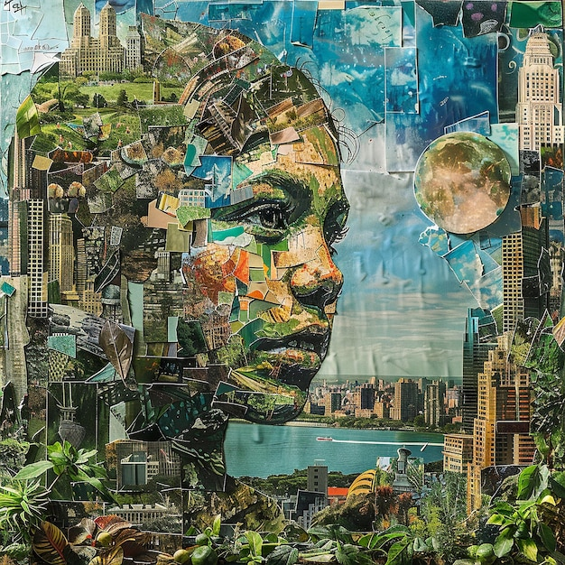
POSSIBLE DIRECTIONS TO TAKE

Slide 15
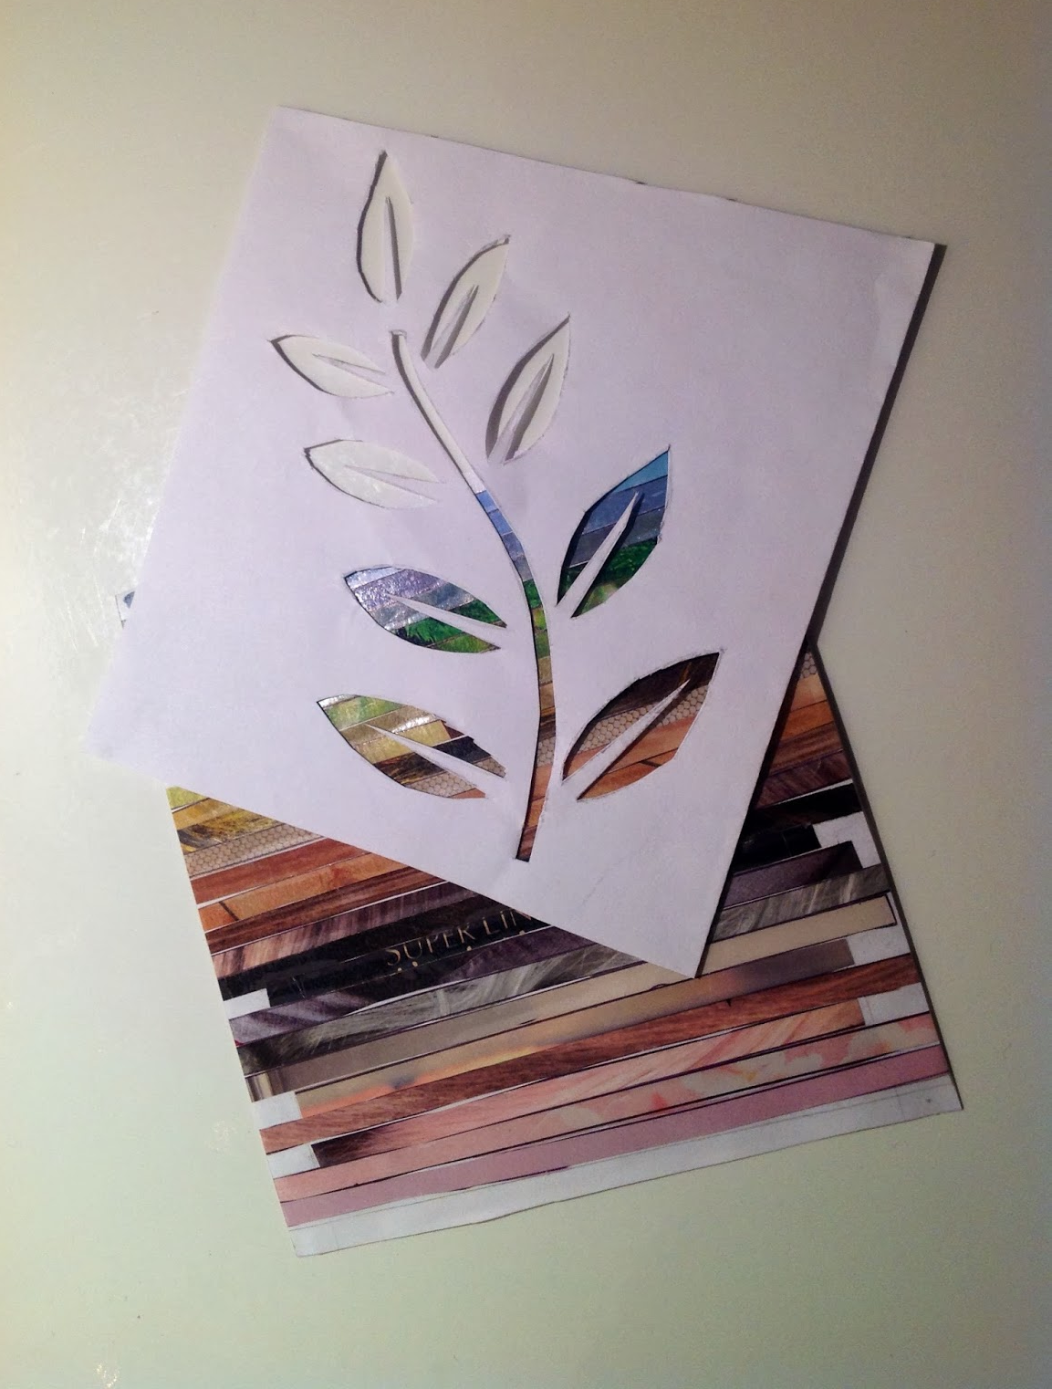
COLLAGE THE BACKGROUND?
Do you plan to…
NO
YES
1.) Draw the silhouette of your design on blank cardstock paper.
2.) Using your choice of materials, fill THE BACKGROUND
3.) When complete, use an X-Acto to cut out the silhouette.
4.) Trace the silhouette on a second piece of cardstock.
5.) Using collage materials, fill in the inside of the silhouette.
1.) Collage a blank cardstock paper.
2.) Using a pen or pencil, carefully draw the design of your silhouette.
3.) When complete, use an X-Acto to cut out the silhouette.
4.) Trace the silhouette on a second piece of cardstock.
5.) Using your choice of materials, fill in the silhouette design.

Slide 16
SURREALIST SILHOUETTES
r
R
U
E
L
A
(Overlayed Collages)

