Slide 1
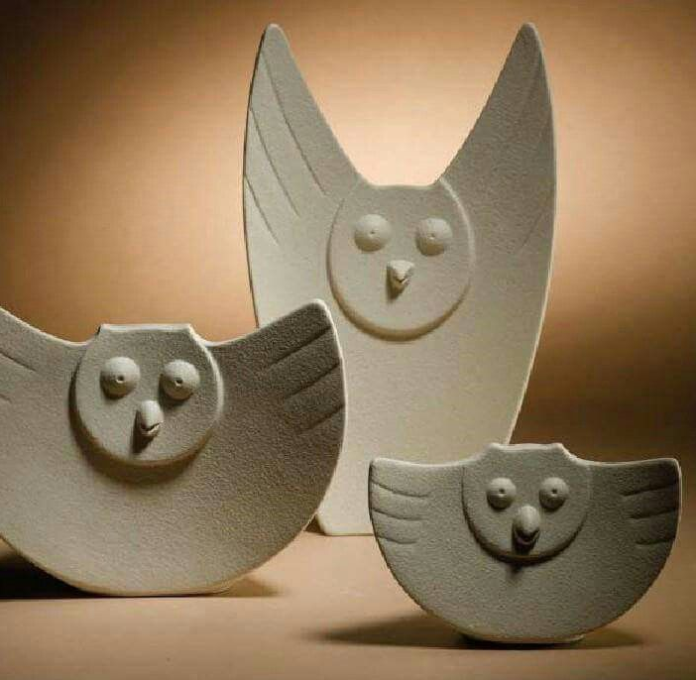
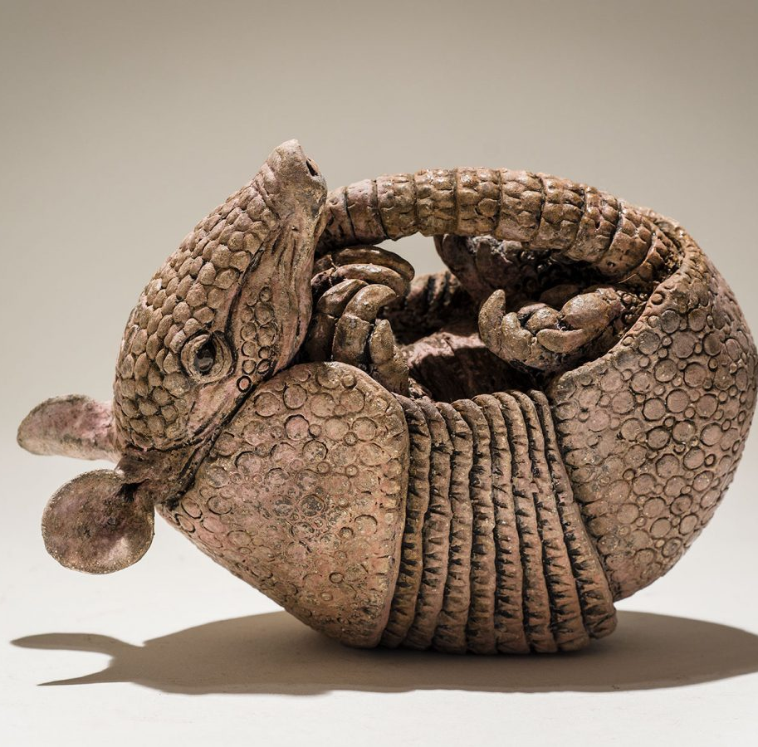
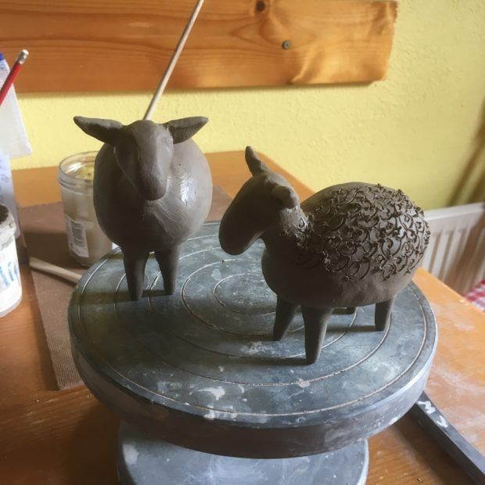
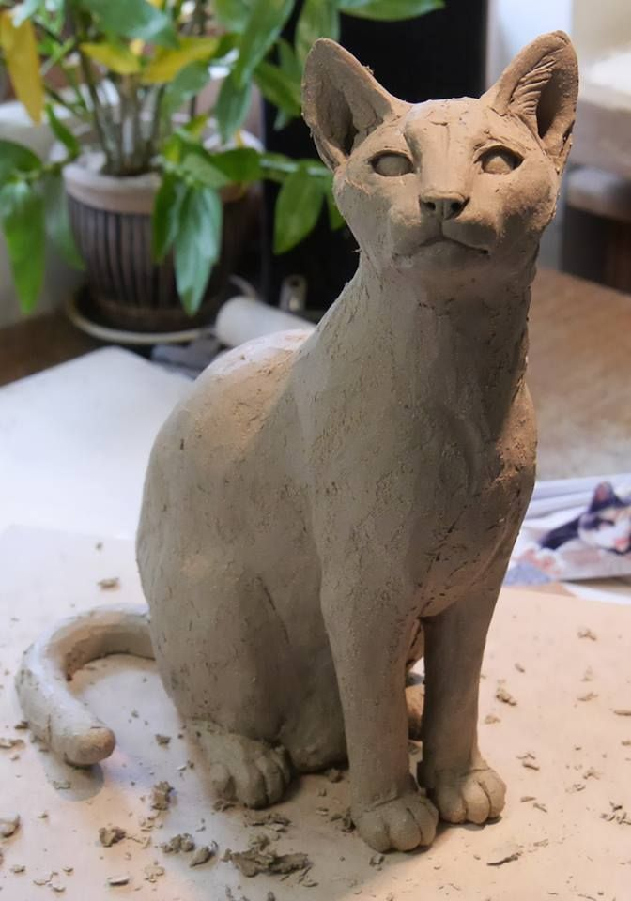
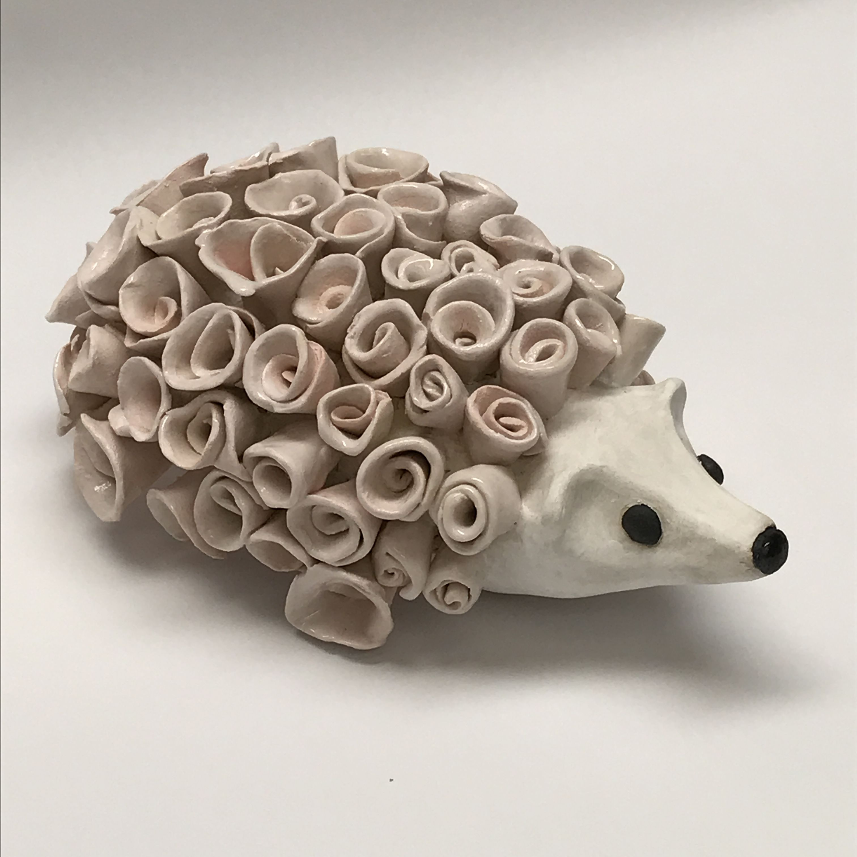
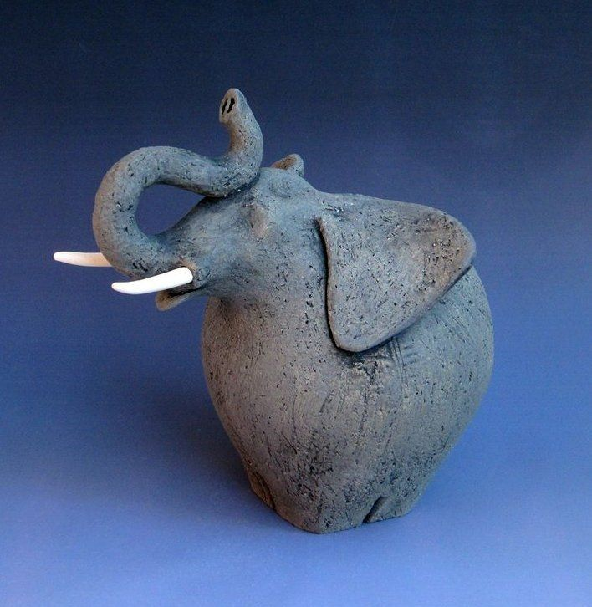
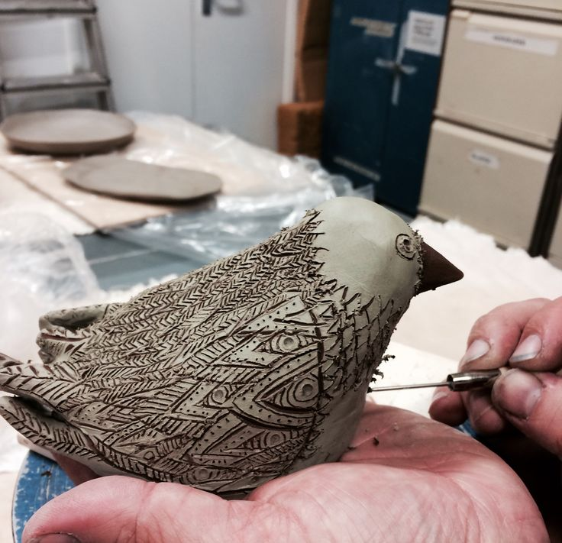
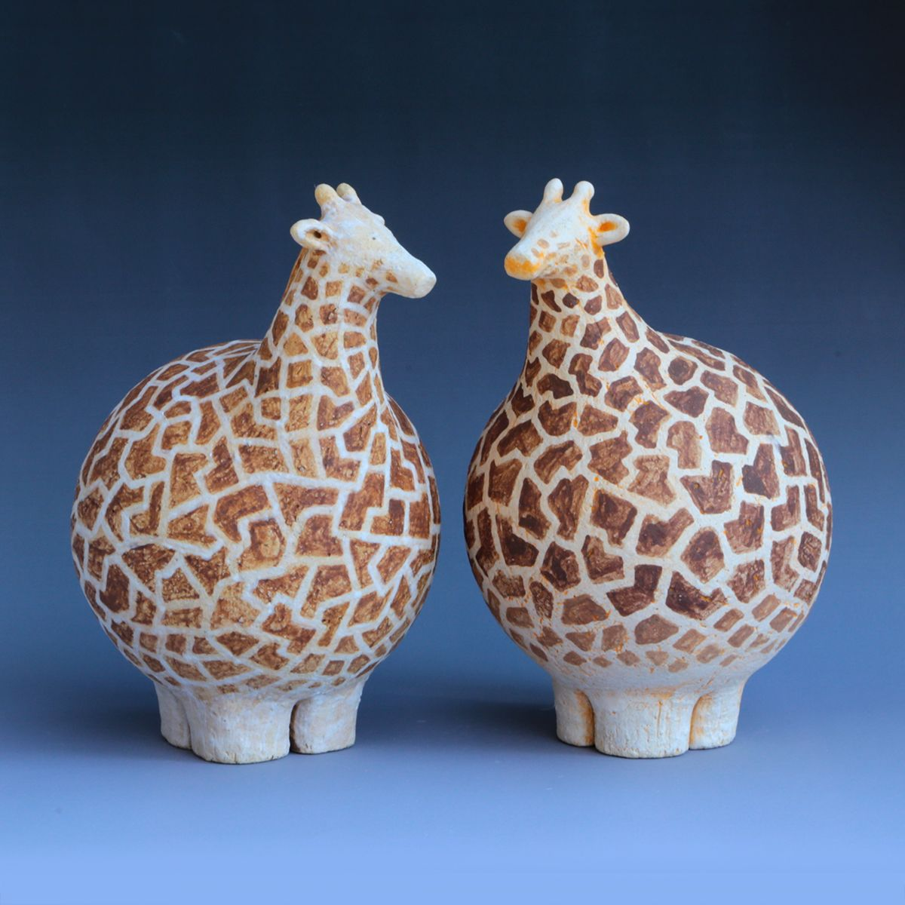
ceramics

Slide 2
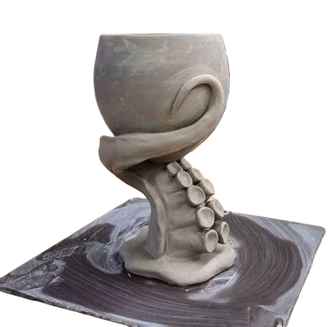
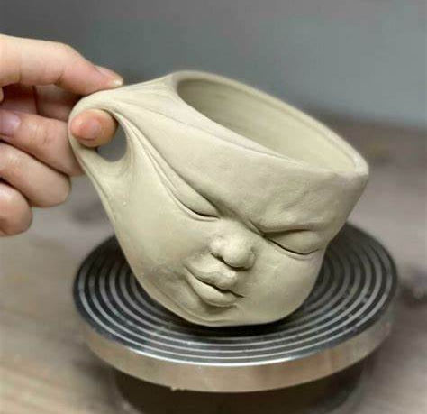
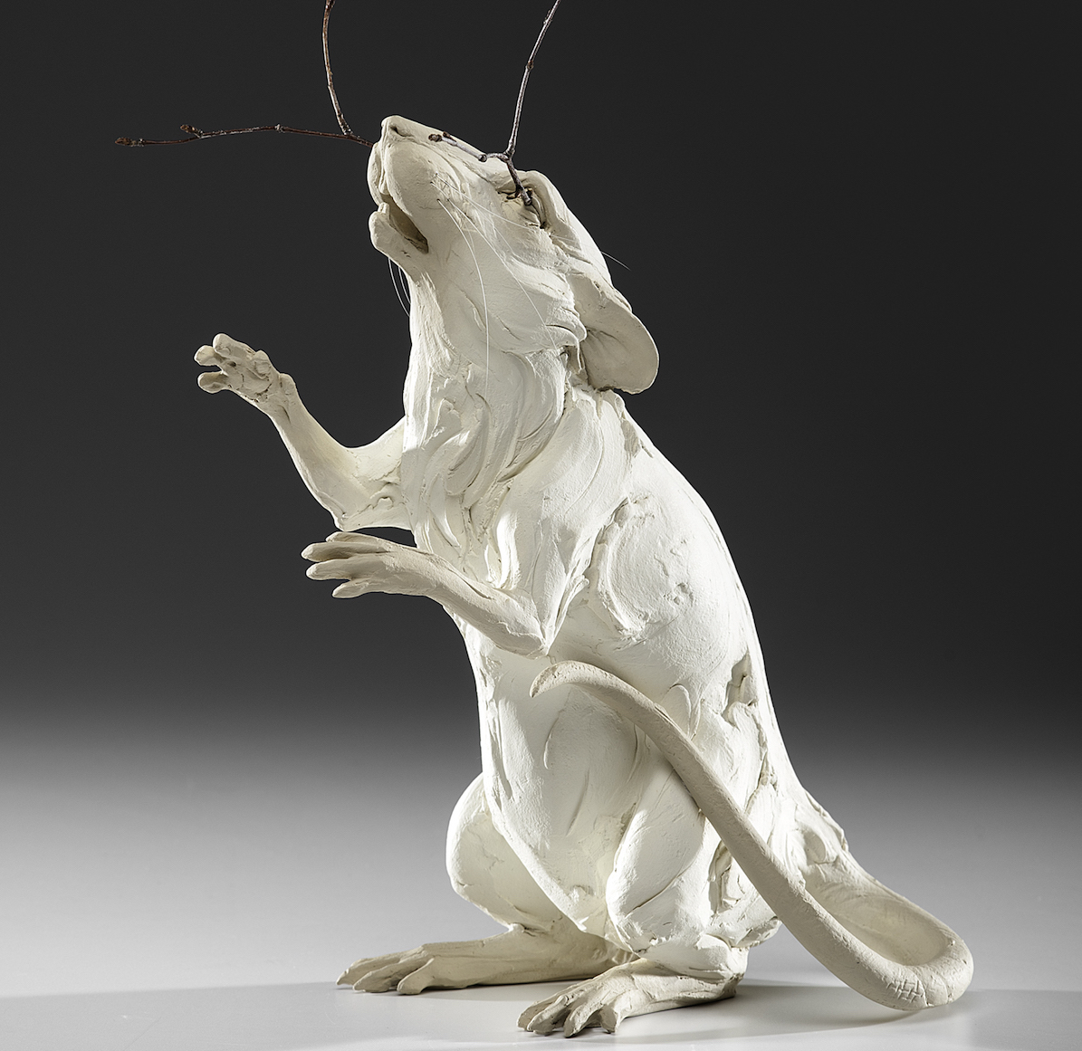
What is Ceramics?
Ceramics refers to objects made from clay and hardened by heat; also referring to the process of making pottery and sculpture.

Slide 3
Clay rules
1.) Clay pieces should be no more than ¼ to ½ an inch thick.
2.) Clay objects must be hollow, with a hole somewhere for air to escape. Any trapped air will cause ceramic pieces to shatter.
3.) Clay projects must dry for a minimum of a week and be bone dry before bisque firing.

Slide 4
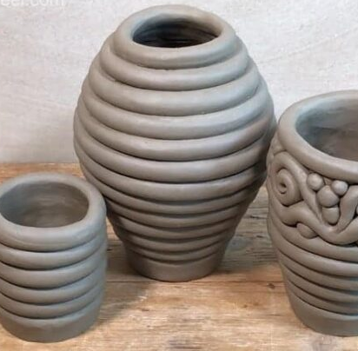
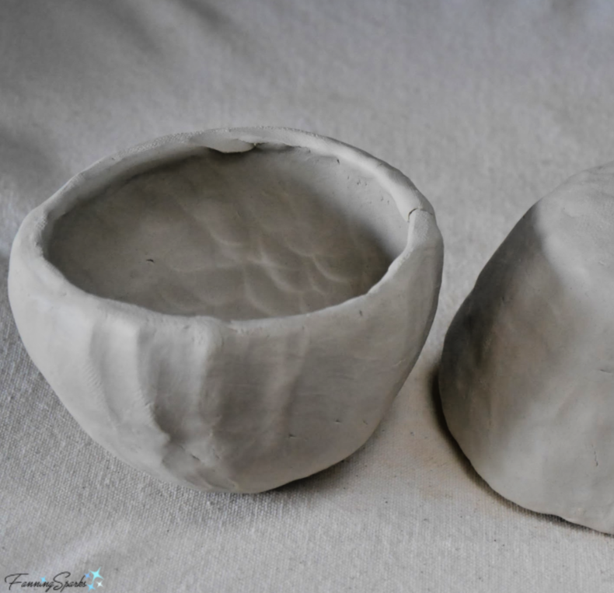
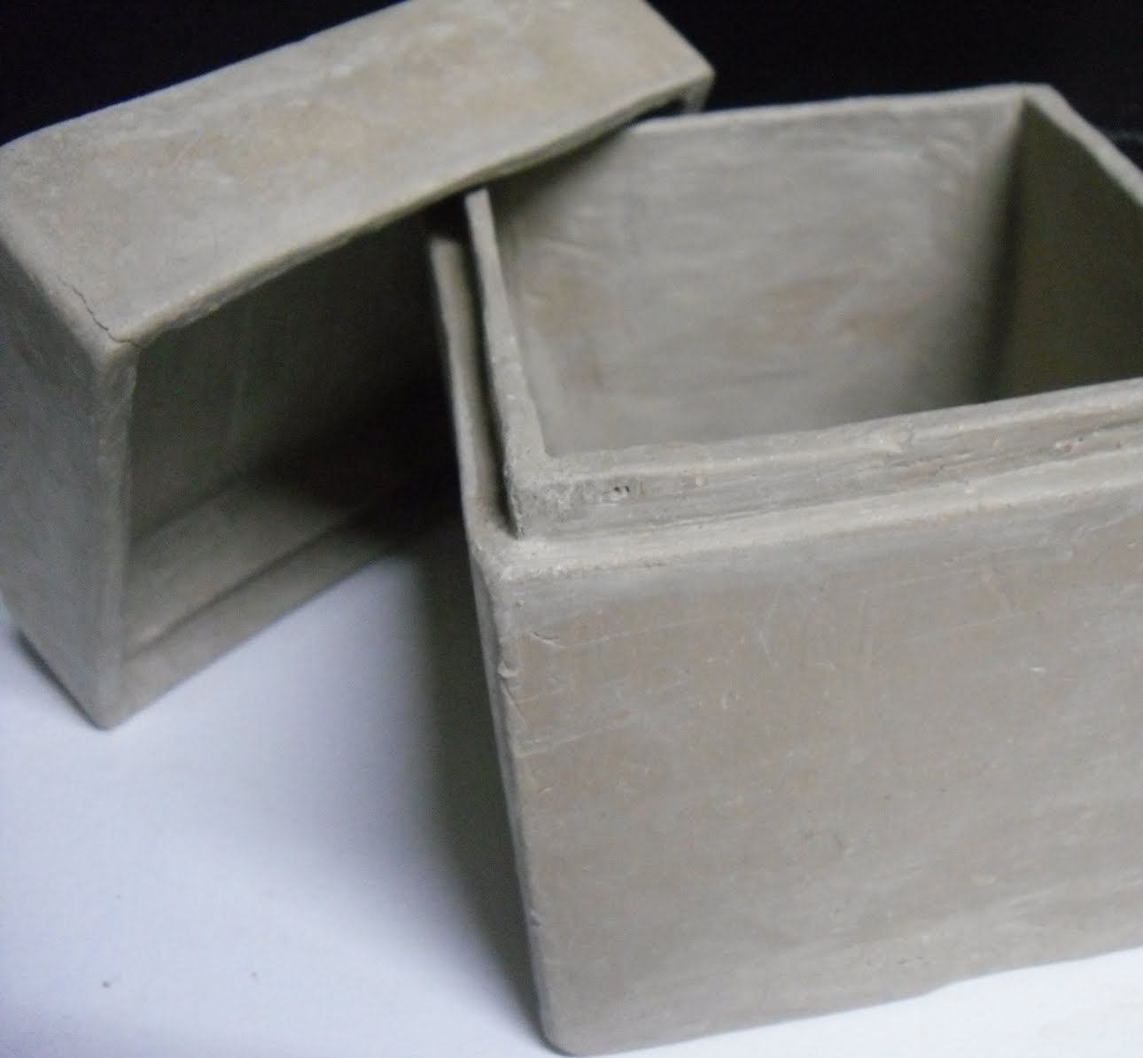
Types of ceramics
Coils Pinch Pots Slab Built
Snake-like tubes stacked together to create a form.
Pottery form created by pinching and shaping a ball of clay
Flat sheets of clay are cut, shaped, and joined to create forms

Slide 5
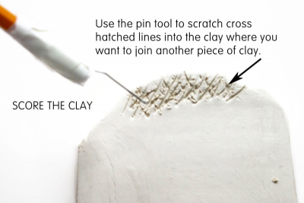
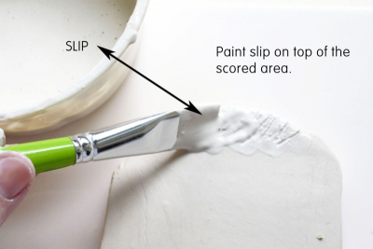
Slip and score
Slip and Score is a technique used in pottery to join two pieces of clay.

Slide 6
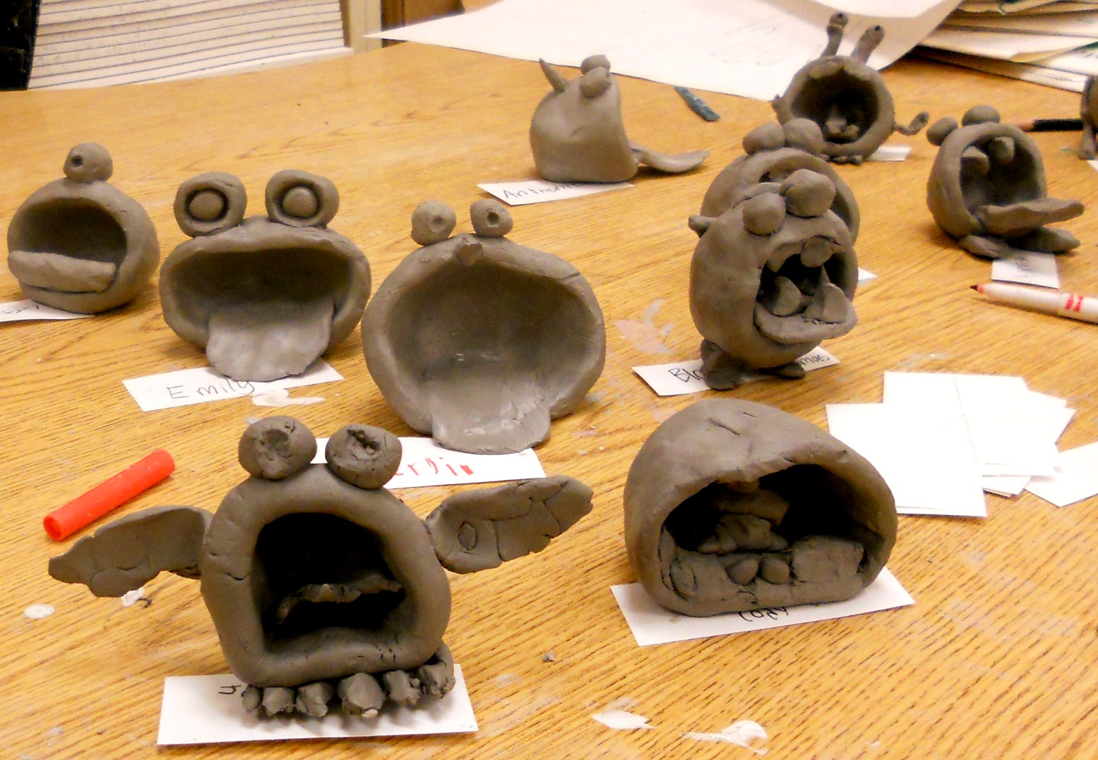
Stages of ceramics
Workable Stage – The best time for shaping the clay
Leather Hard Stage – Clay is slightly moveable but will crack. This is where you add details!
Bone Dry Stage – Clay is no longer workable and is ready to fire.

Slide 7
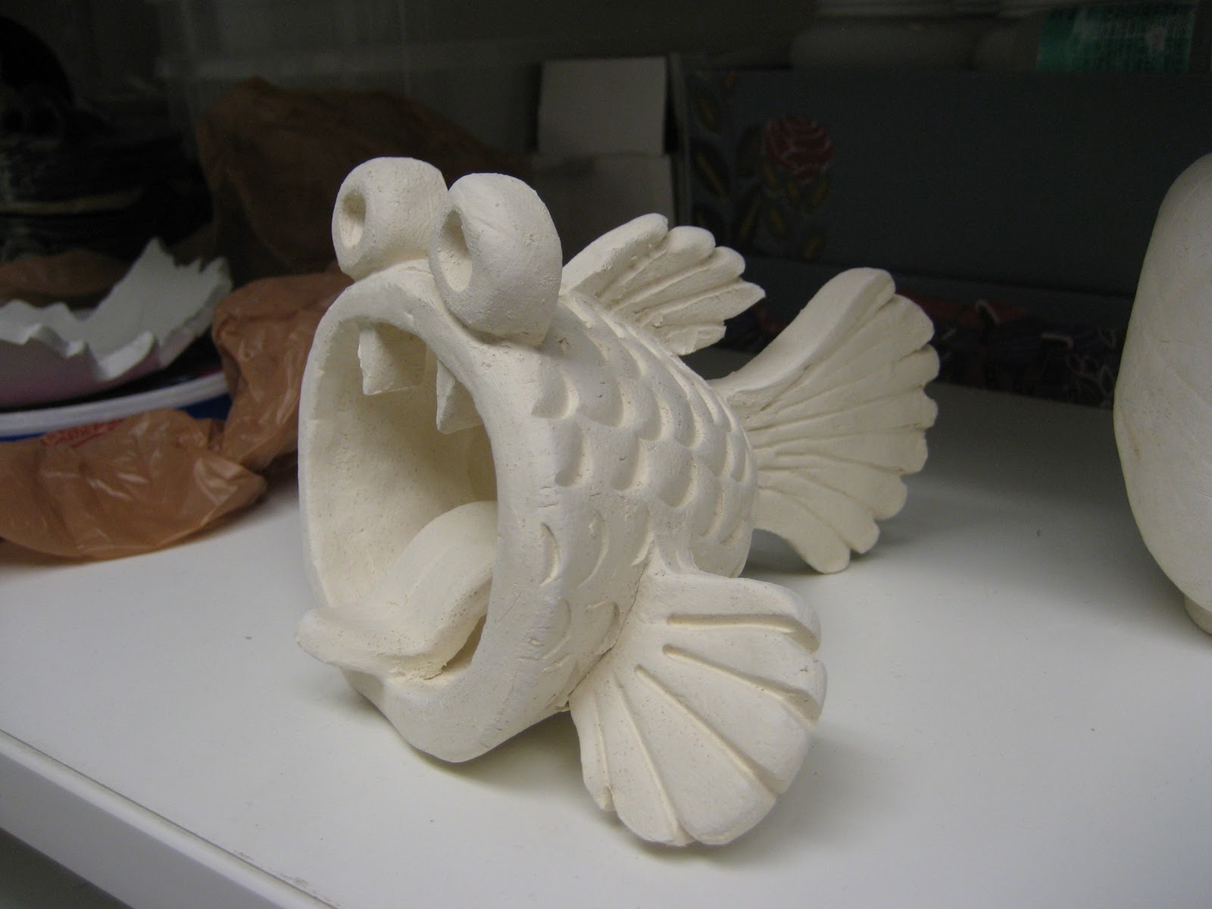
Stages of ceramics
Bisqueware: Clay was fired at roughly 2000 degrees, undergoing a chemical change to make it firm, but still porous enough to absorb glaze.

Slide 8
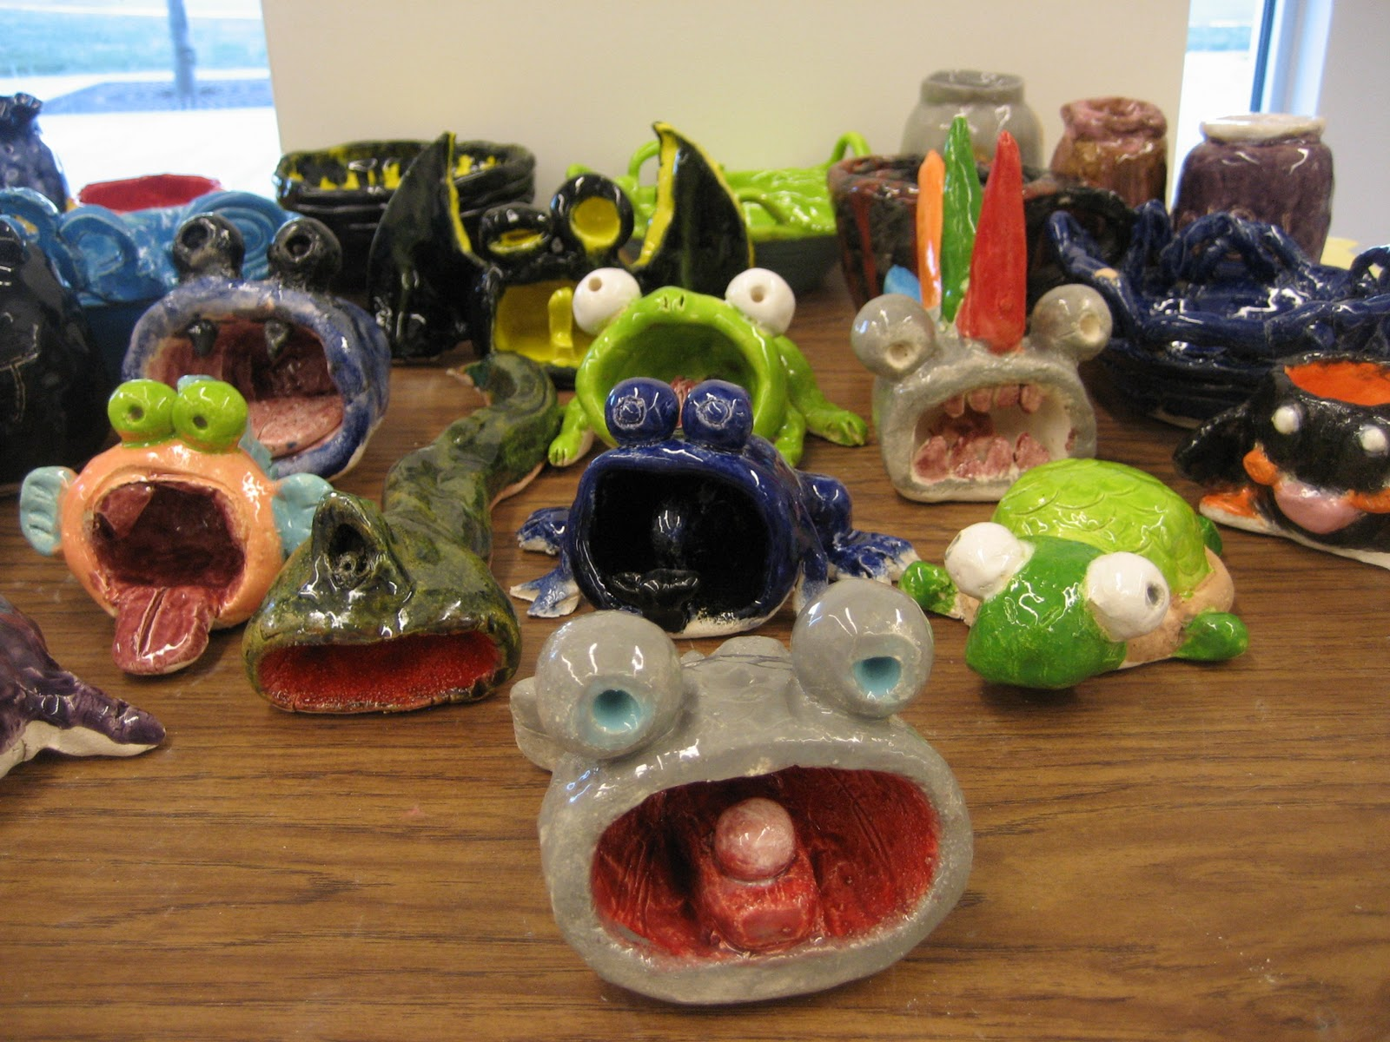
Stages of ceramics
Glaze: Glazing is the final step, in which bisqueware is covered in a paint-like glaze, that melts into the pottery, forming a glossy, glass-like finish.

Slide 9
Final day: Clay creatures

Slide 10
Project 3: painting clay creatures

Slide 11
Sketchbook: ceramics
Take notes documenting the most important rules, steps, and vocab related to ceramics.
When complete, create at least 3 thumbnail drawings showing different animals in 3D. When complete, pick your favorite, and draw 2 more angles of the same animal.
Remember to make the sketchbook creative to receive full credit!

