Slide 1
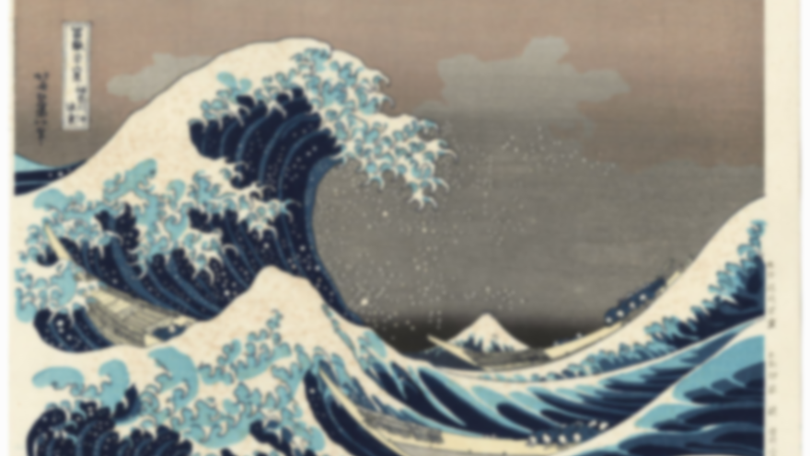
Unit 1: Art of the far east
LINE/SPACE/TEXTURE

Slide 2
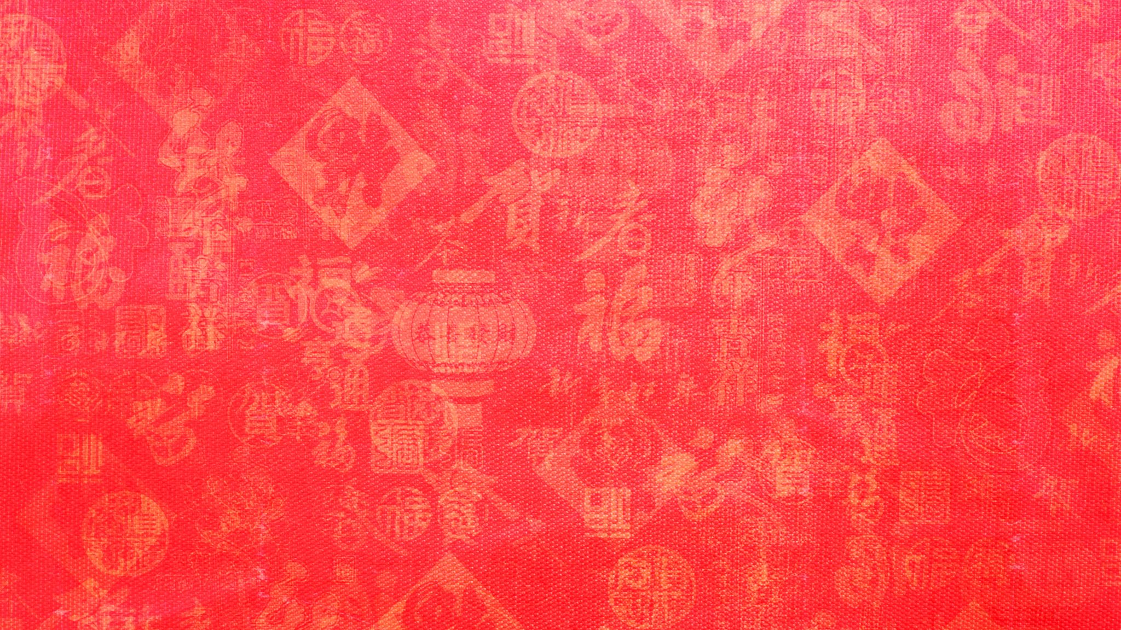
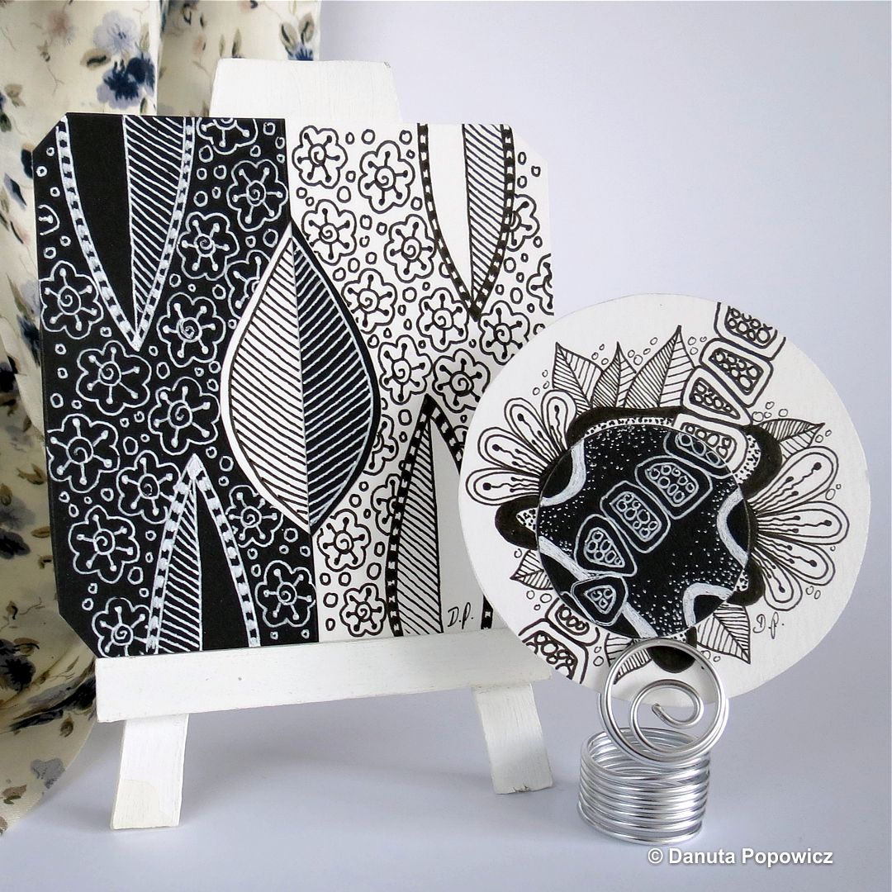
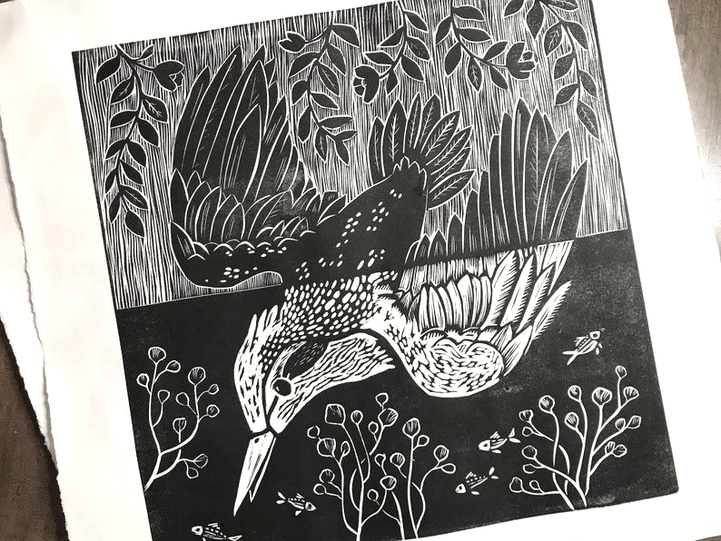
Unit topics
SPACE – Yin-yang (China), Notan (Japan)
NOTAN DESIGN
Line – Rick Roberts, Maria Thomas
ZENTANGLE
TEXTURE –
PRINTMAKING

Slide 3
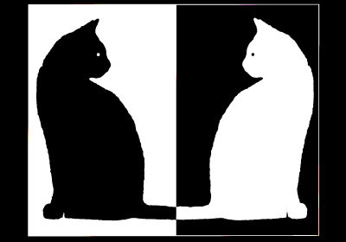
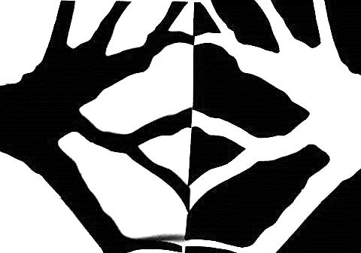
Notan design
Sddsd
Sddsd

Slide 4
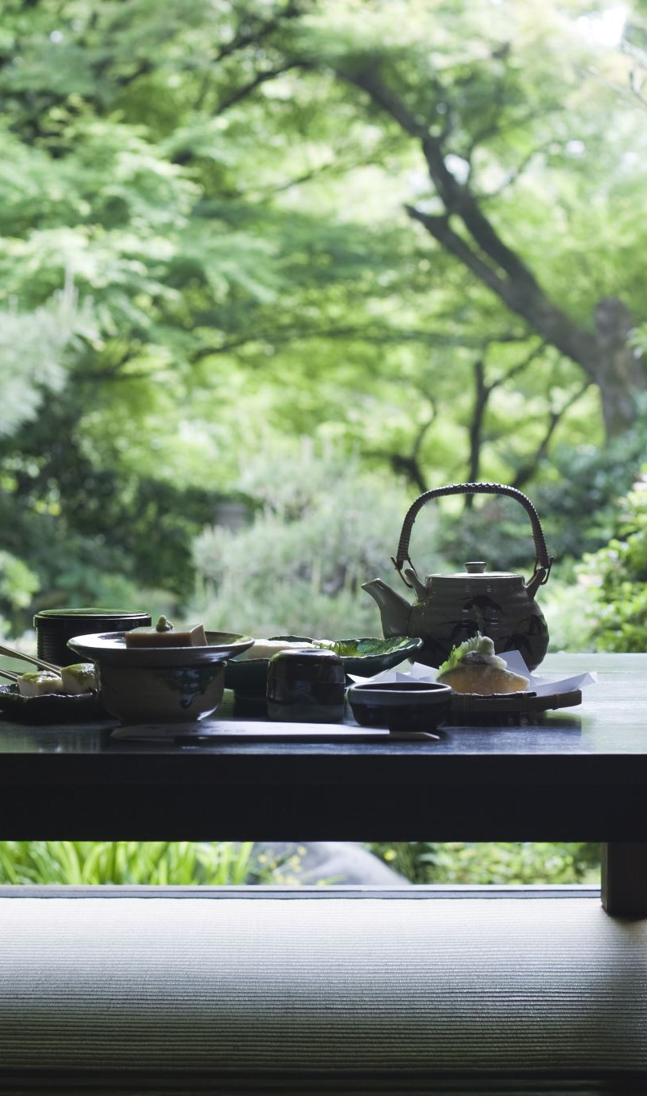
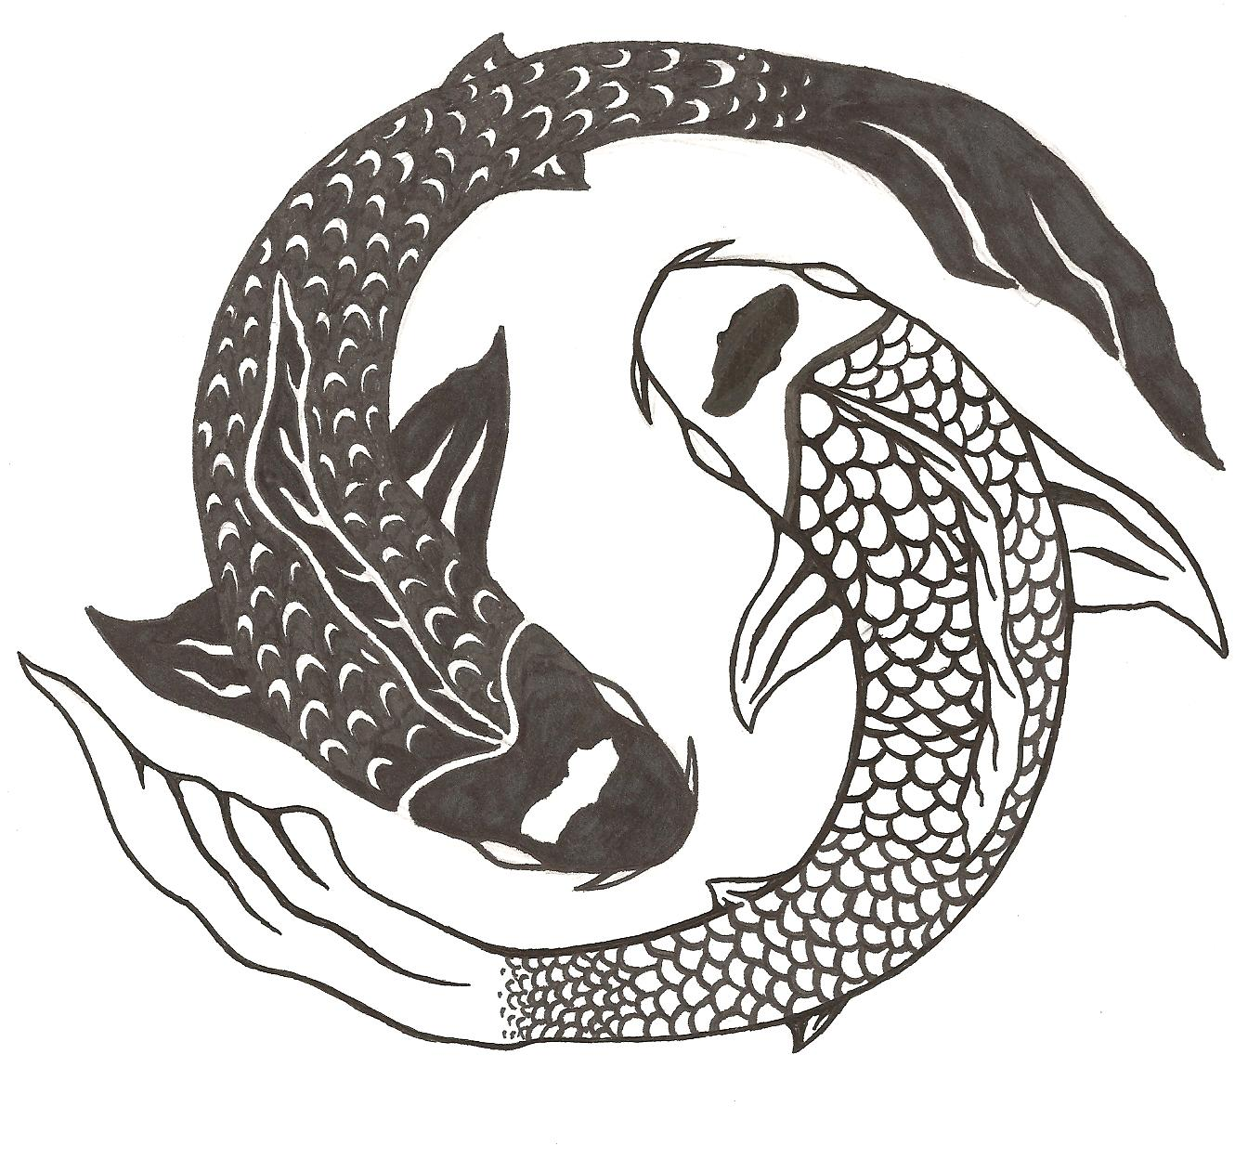
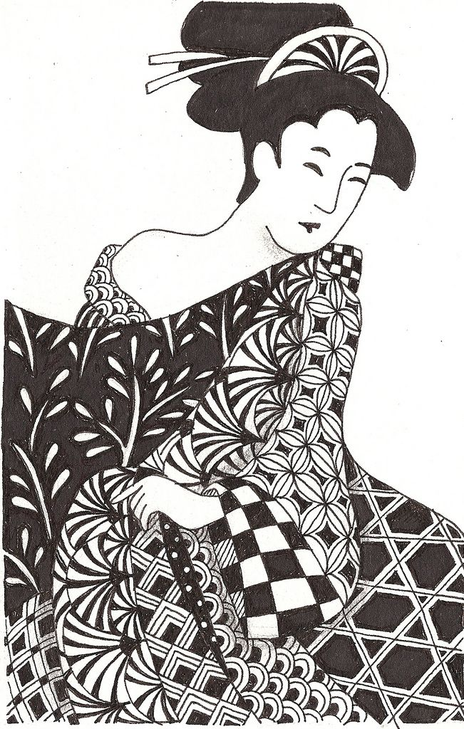
notan/yin-yang = space

Slide 5
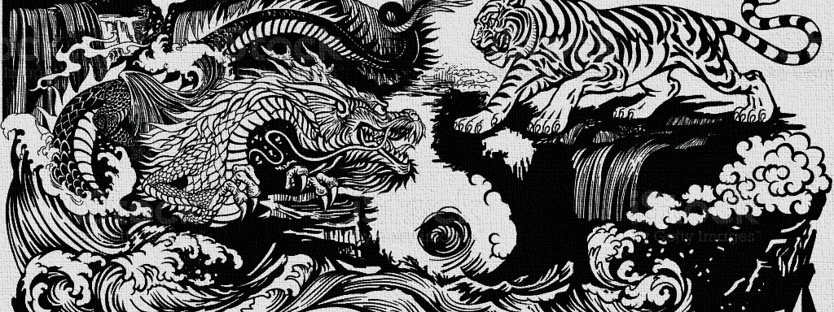
Origins of notan
- Adapted from ancient Chinese Taoism
- Both represent the balance of light and dark
- As in yin-yang: one cannot exist without the other

Slide 6
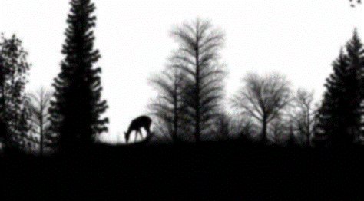
negative Space
positive Space

Slide 7

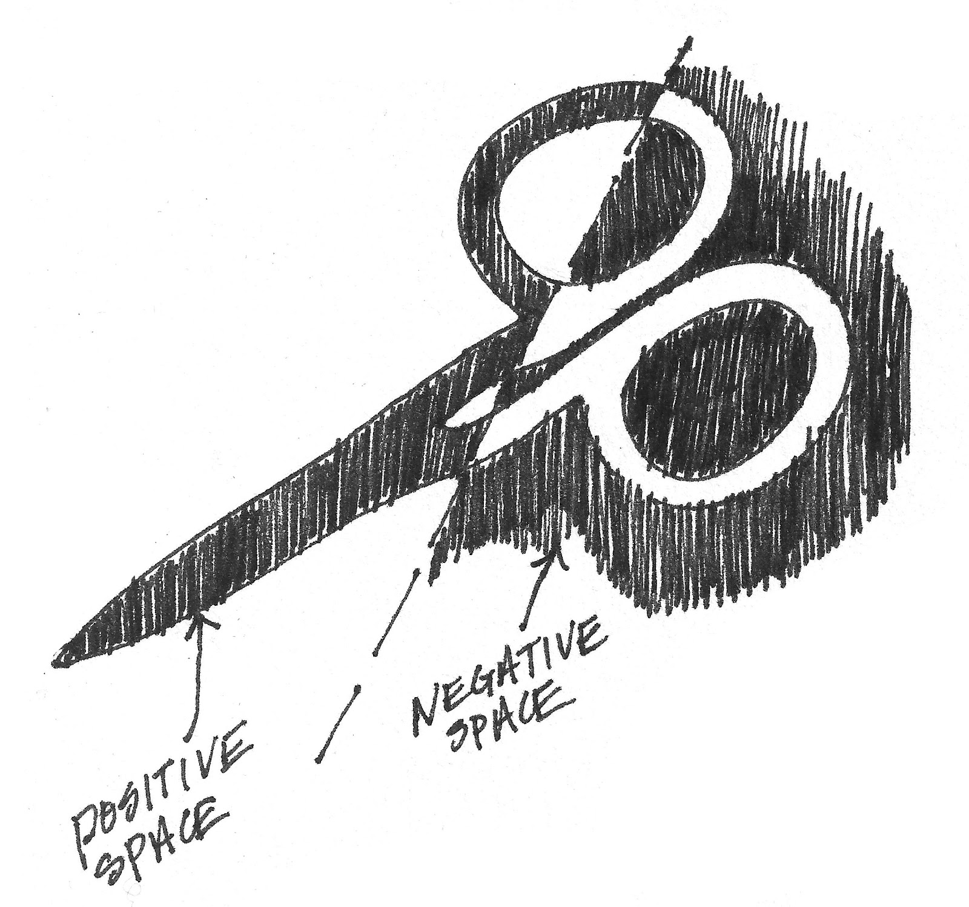
Positive Space
negative Space
The focal point (subject matter) of a piece of work.
The area surrounding the focal point.
T
Japanese Notan – The concept representing the balance of positive and negative. The idea communicates that elements of light and dark are equally important and need each other to exist. One example originating in China is Yin & Yang.
Space – The element of art that represents the area around and within objects, forms, colors, and lines.

Slide 8
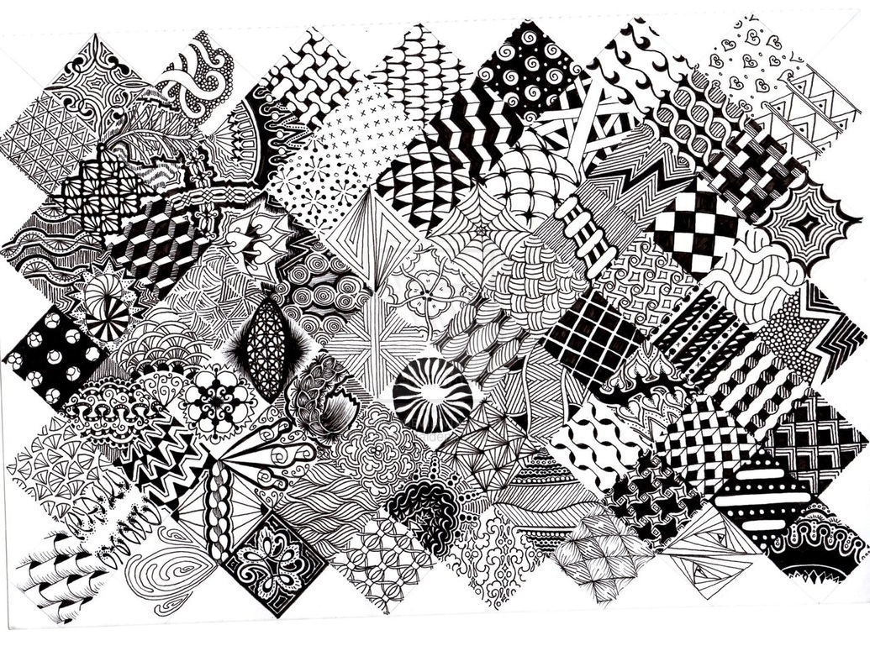
line & zentangle

Slide 9
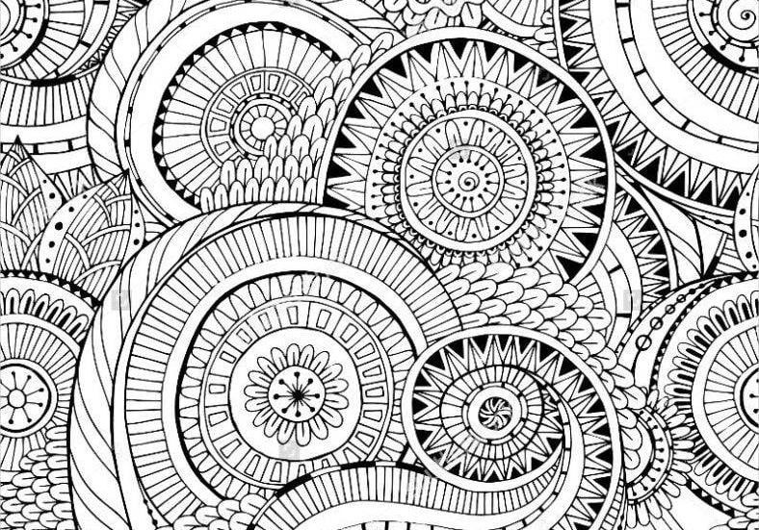
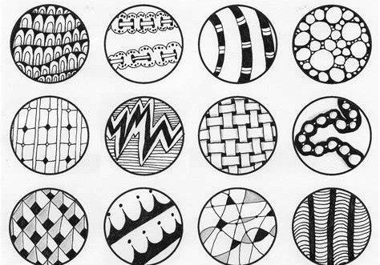
Zentangle
Rick Roberts, Maria Thomas – 2004
Repetition (patterns) of line.
About CREATIVITY

Slide 10
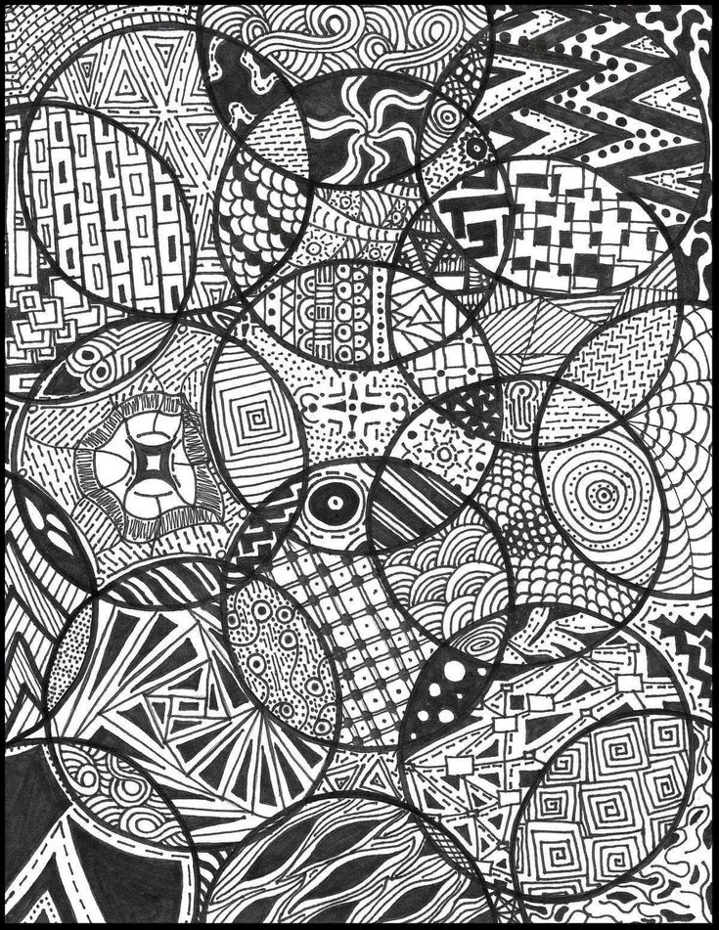
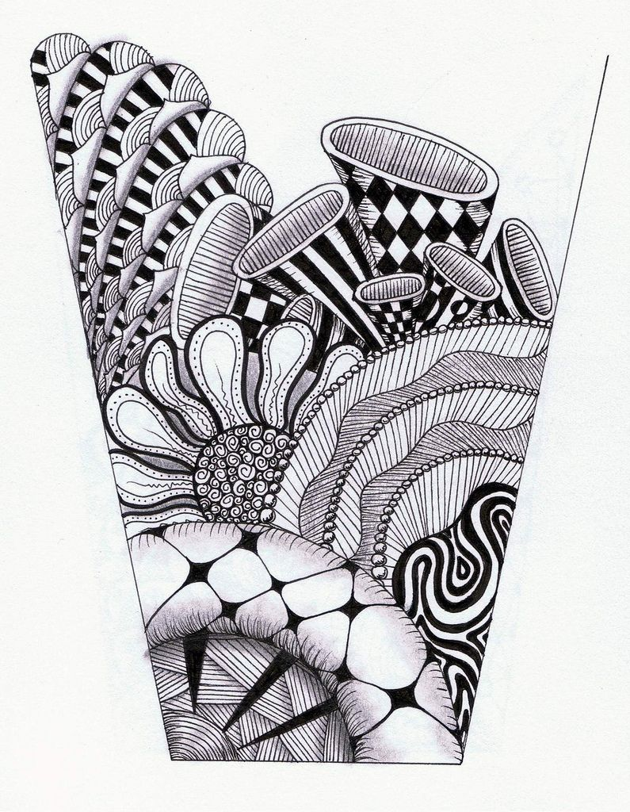
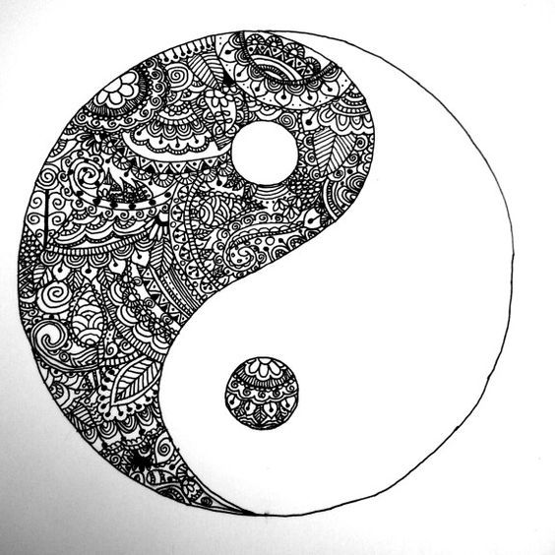
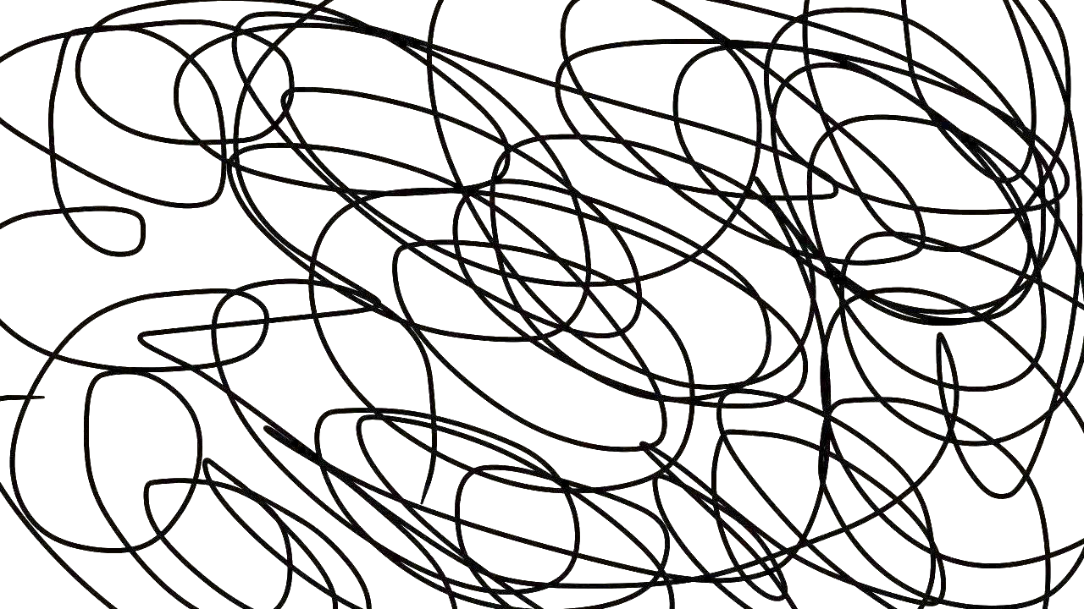
For successful line…
Avoid scribbling/quickly drawn lines!
Consider varying thickness
Try different patterns

Slide 11
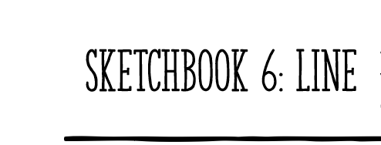

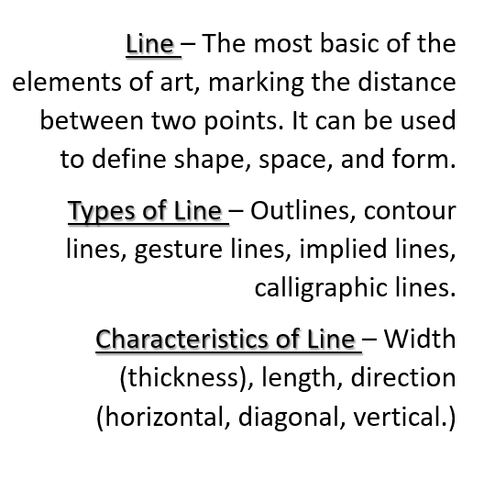

Slide 12
Positive Space Negative negative Space

Slide 13
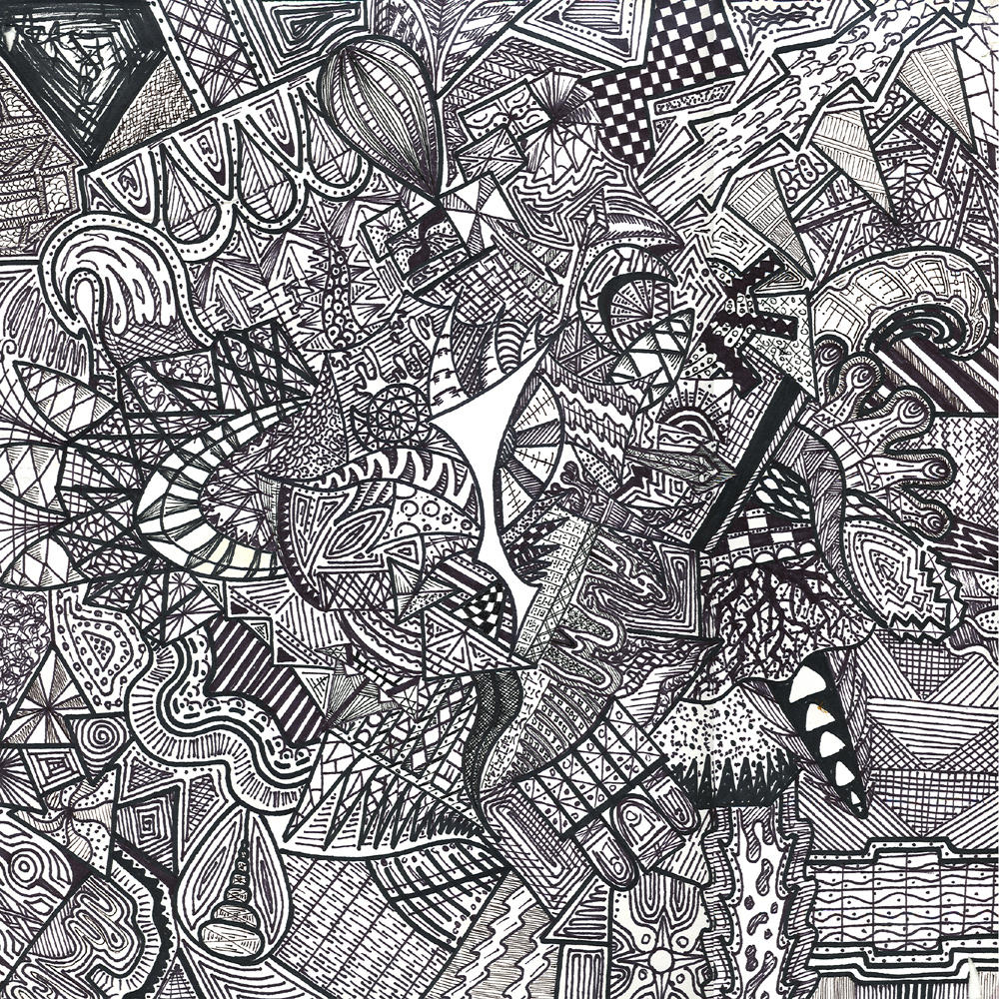
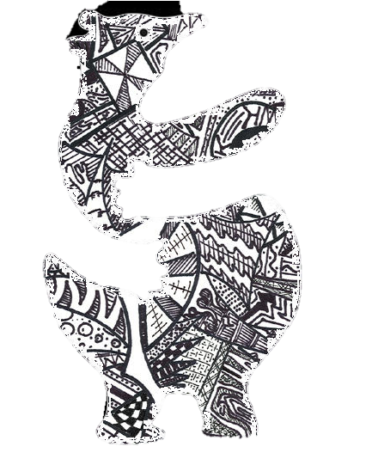
Positive Space Negative negative Space + Lines…

Slide 14
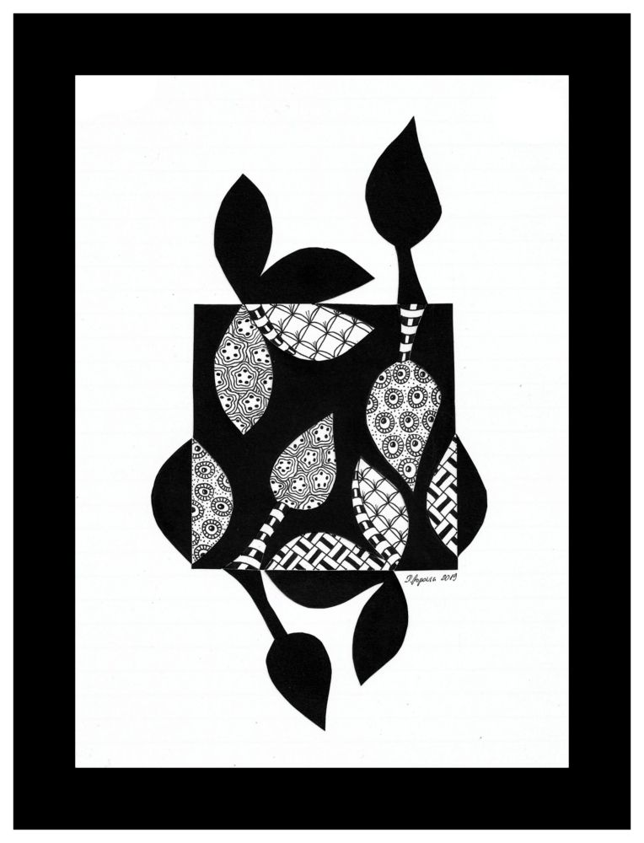
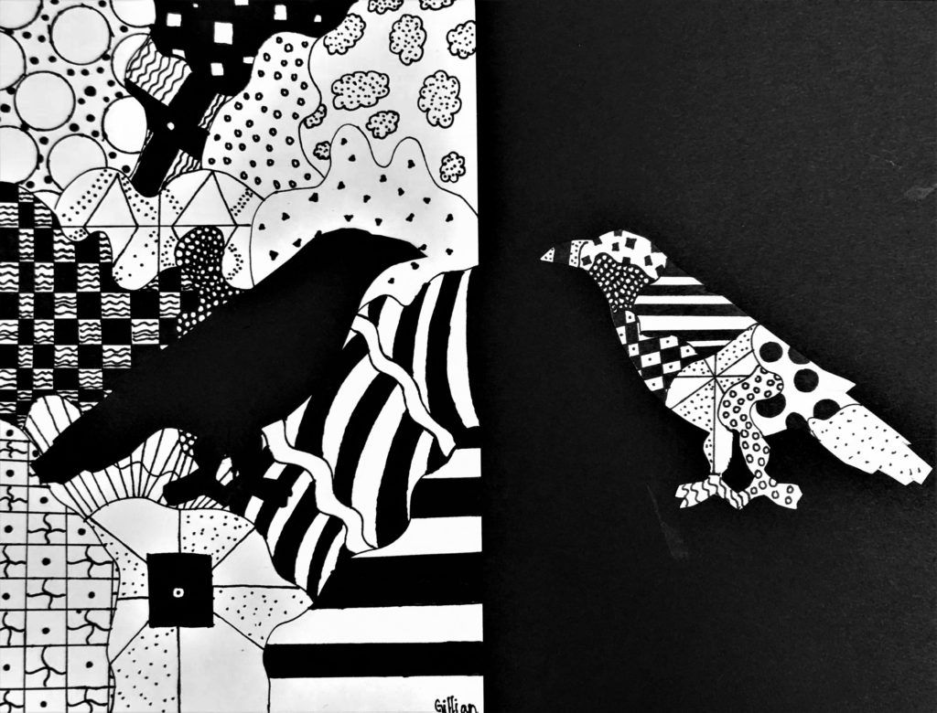
PROJECT 2: Japanese Notan

Slide 15
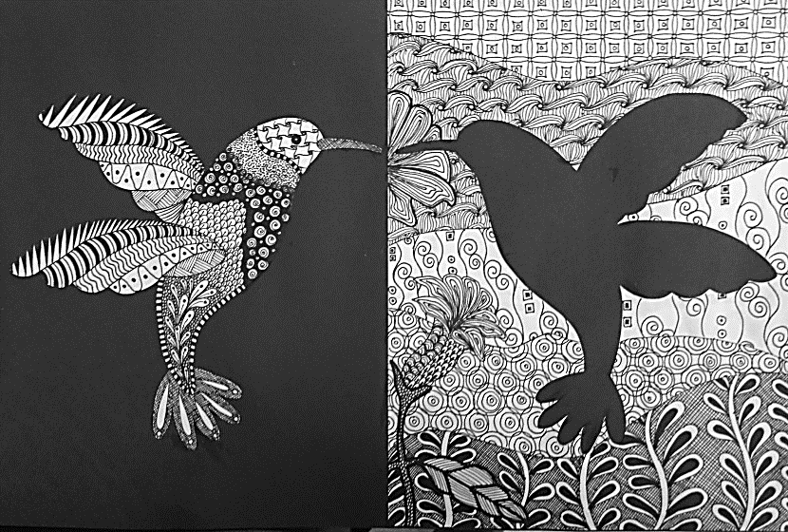
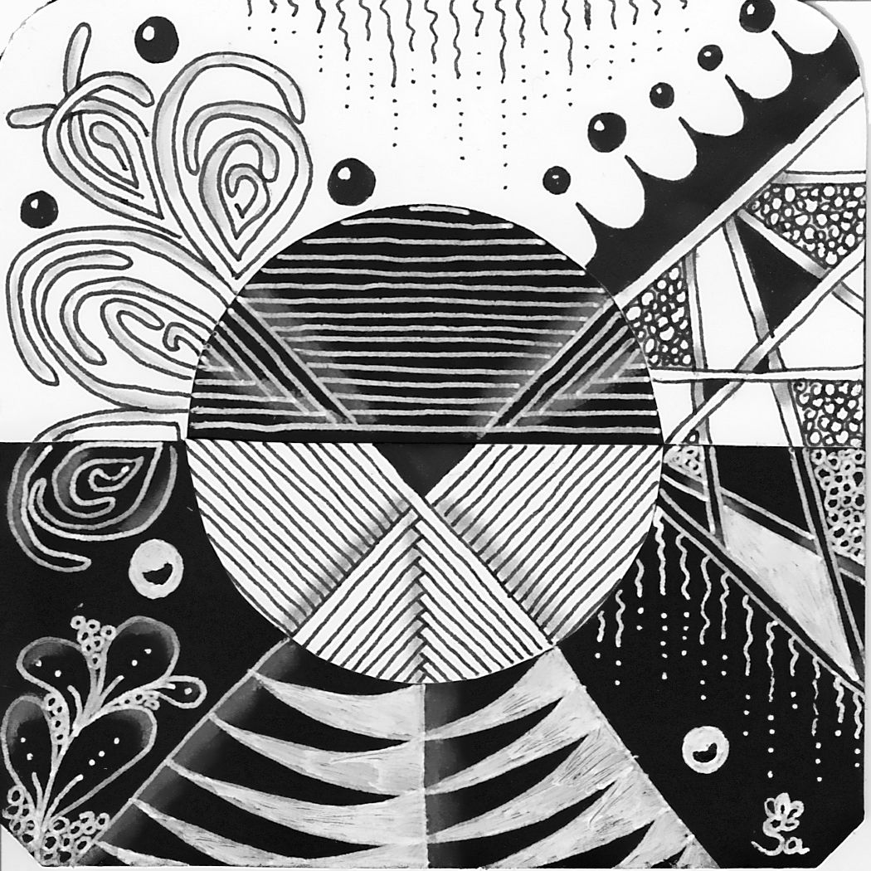
Project 2 - Japanese Notan
Step 1: Using a pencil, carefully draw one of the 3 images from your thumbnails.
Step 2: Checkpoint with me
Step 3: Cut out the silhouette of the image, NO PIECES SHOULD BE THROWN AWAY!!!
Step 4: Checkpoint with me
Step 5: Using glue sticks, glue down the image.
Ask me how to center it!

Slide 16
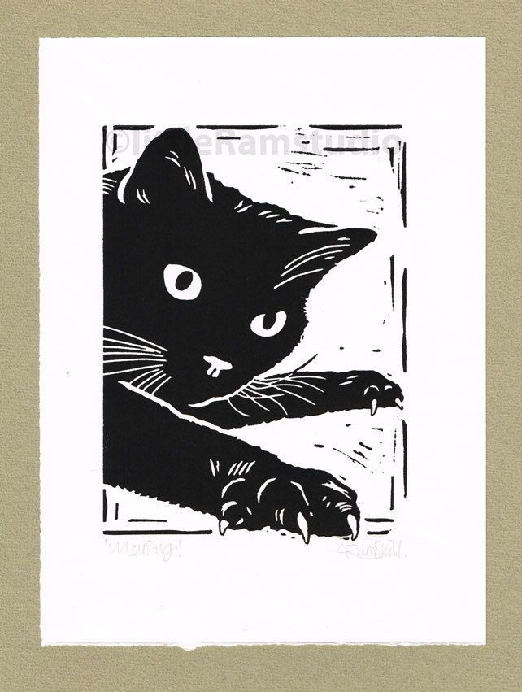
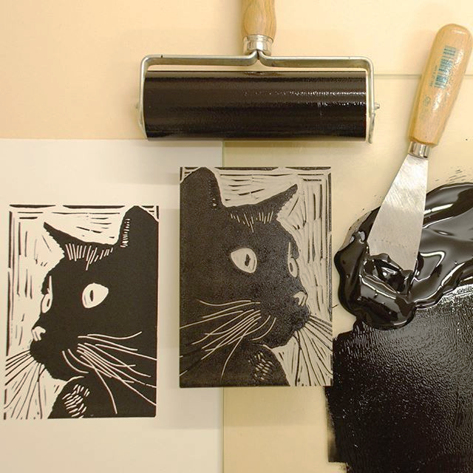
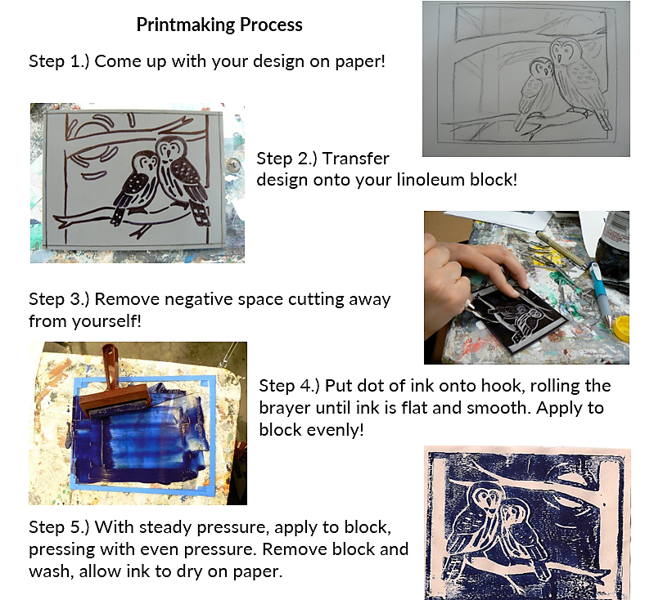
Printmaking – Artistic technique/process of making identical multiples of a work.
Breyer – Tool used to thinly apply/roll ink onto block.
Linocut – Type of printmaking in which negative space is removed.
Block – Square or rectangular tool used to produce multiple prints.
Hook – Metal surface placed against edge of a surface to hold print/ink.

Slide 17
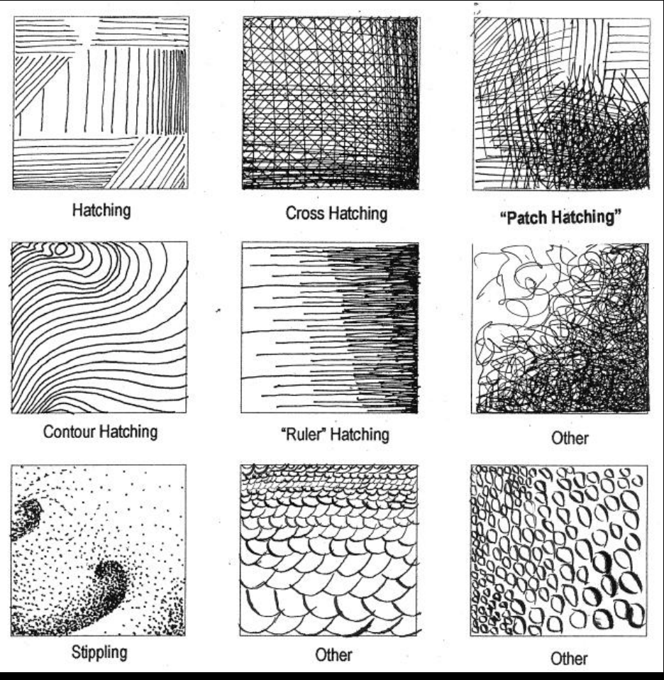
SKETCHBOOK: TEXTURE
TEXTURE is one of the seven elements of art that refers to the surface quality of a work of art.
Tactile Texture – Refers to the actual surface quality of a work; what can be felt.
Implied Texture – Refers to the visual surface quality of a work; cannot be felt

Slide 18

SKETCHBOOK: TEXTURE
TEXTURE is one of the seven elements of art that refers to the surface quality of a work of art.
Tactile Texture – Refers to the actual surface quality of a work; what can be felt.
Implied Texture – Refers to the visual surface quality of a work; cannot be felt

Slide 19

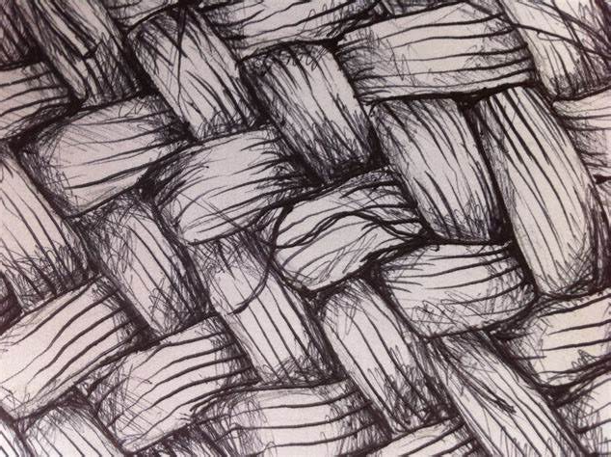
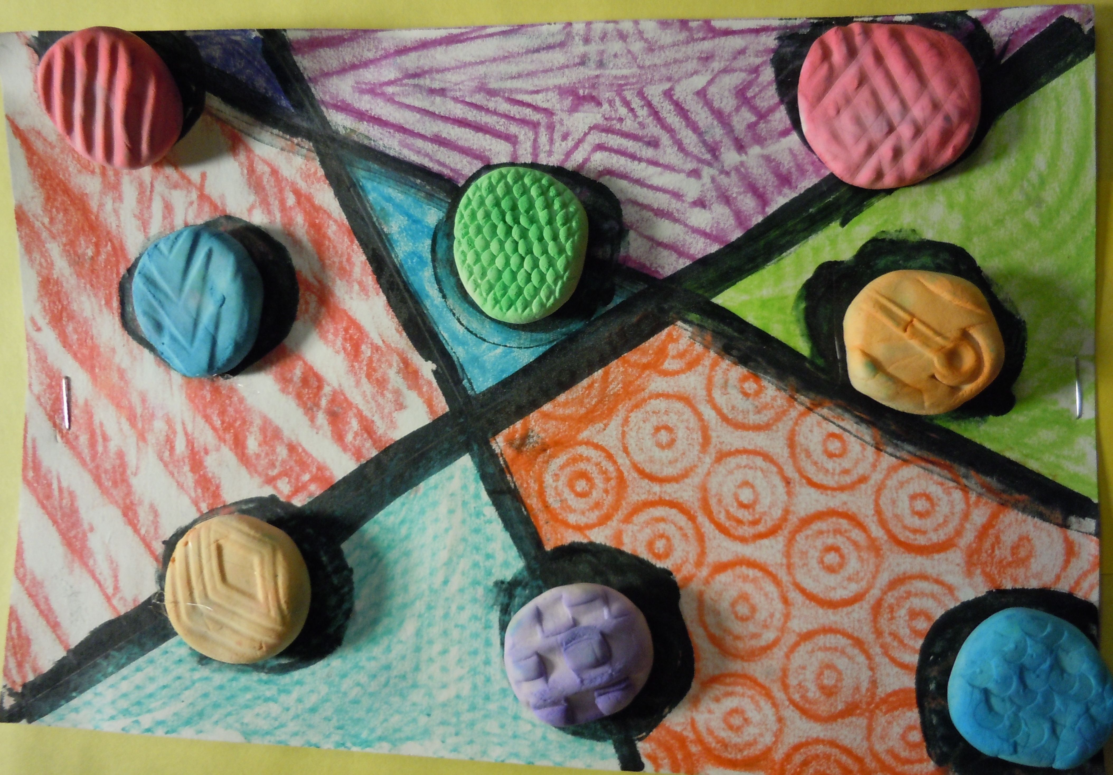
TEXTURE is one of the seven elements of art that refers to the surface quality of a work of art.
Implied Texture – Refe to the visual surface quality of a work; cann be fe
Tactile Texture – Refers to the actual surface quality of a work; what can be felt.
Tactile Texture – Refers to the actual surface quality of a work; what can be f
Implied Texture – Refers to the visual surface quality of a work; cannot be felt
Examples of Texture

Slide 20
PROJECT 3 - PRINTMAKING
Using a linoleum block, a hook, ink, carving tools, and brayers, create a print with the theme of flora or fauna (plants or animals)
Remember to reference your printmaking notes and the rubric!

