Slide 1
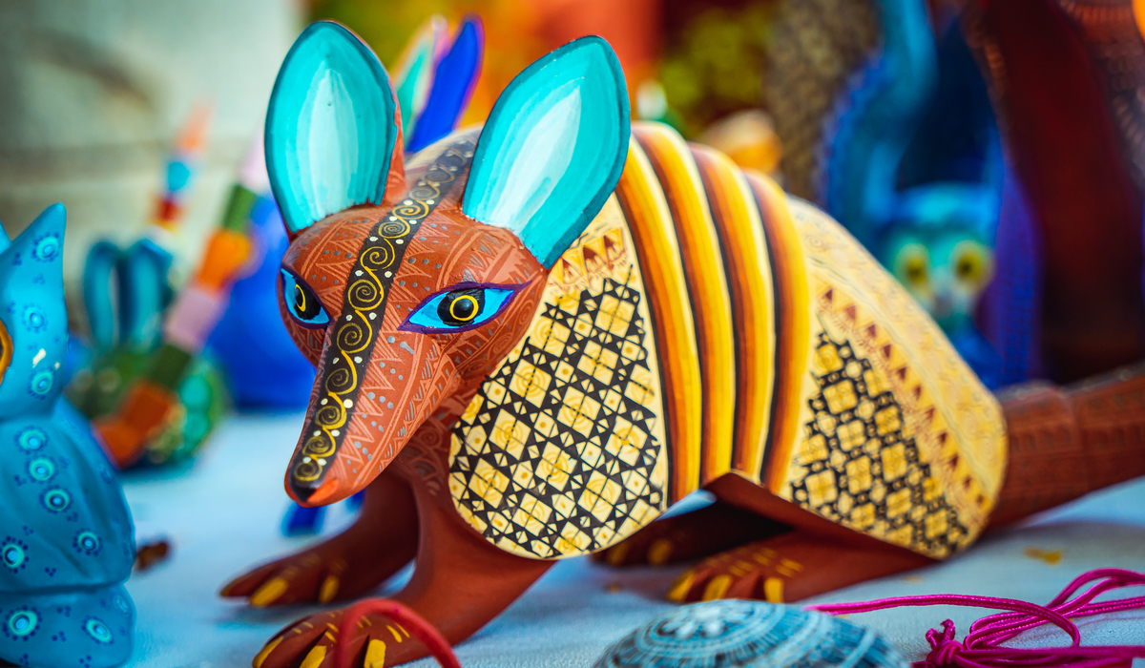
unit 2, pt 1:
Mexican Folk Art
COLOR/SHAPE

Slide 2
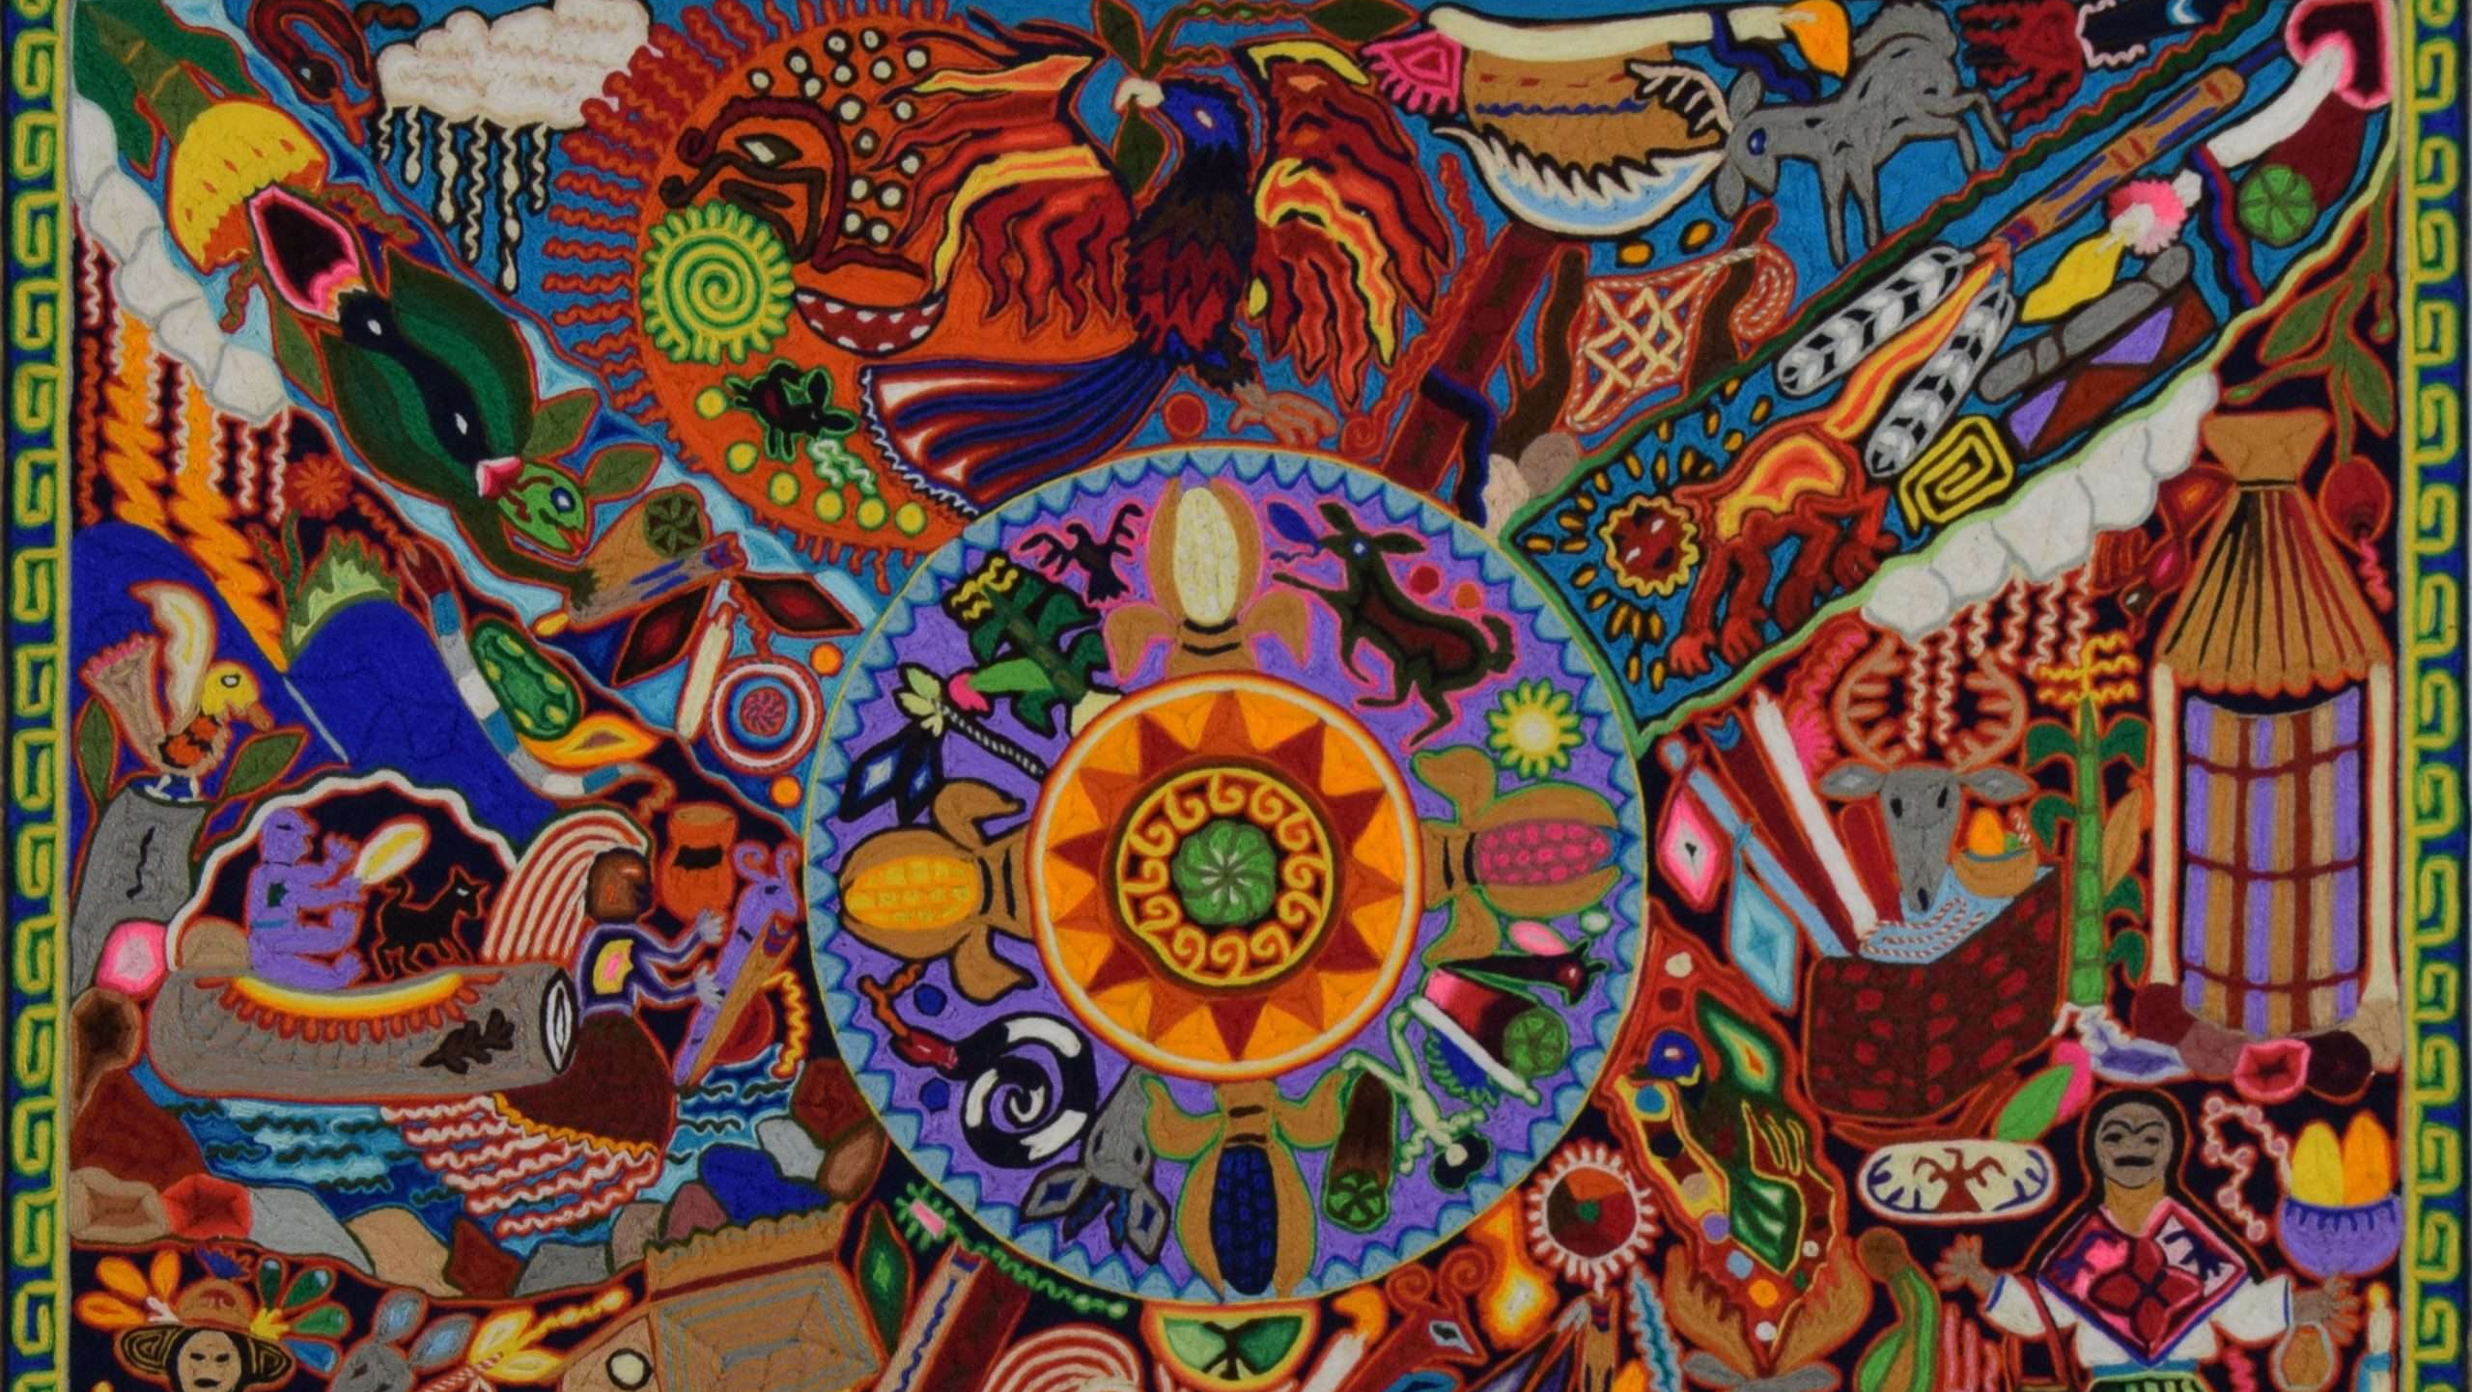
Unit topics
COLOR/SHAPE:
Mexican (or Native Latin) Folk Art
FORM:
ALEBRIJE - Manuel Jimenez (1930s)

Slide 3
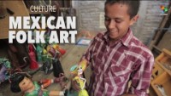

Slide 4
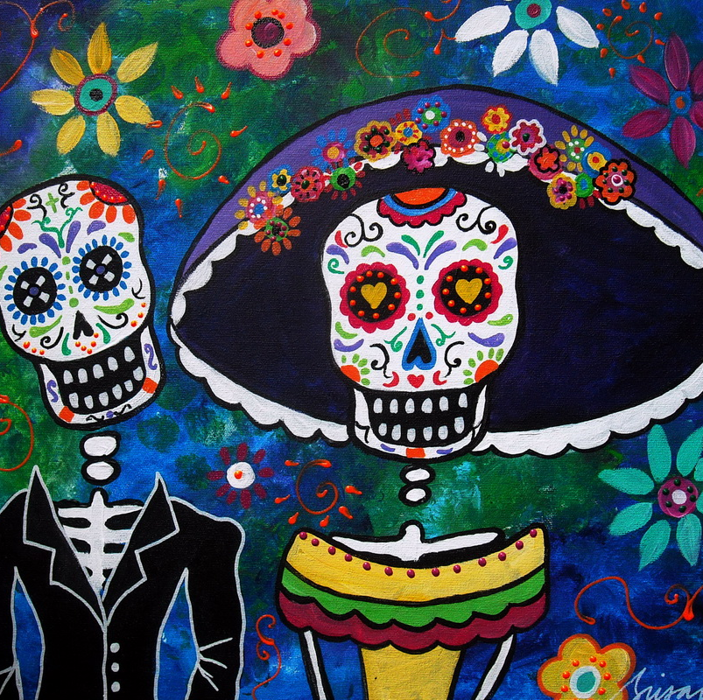
WHAT IS FOLK ART?
Traditional Mexican folk art is a colorful and creative reflection of Mexican culture through handcrafts or artesanías.
Unlinke fine art which is focuses on the formal, aesthetic value, folk art centers around cultural significance.

Slide 5
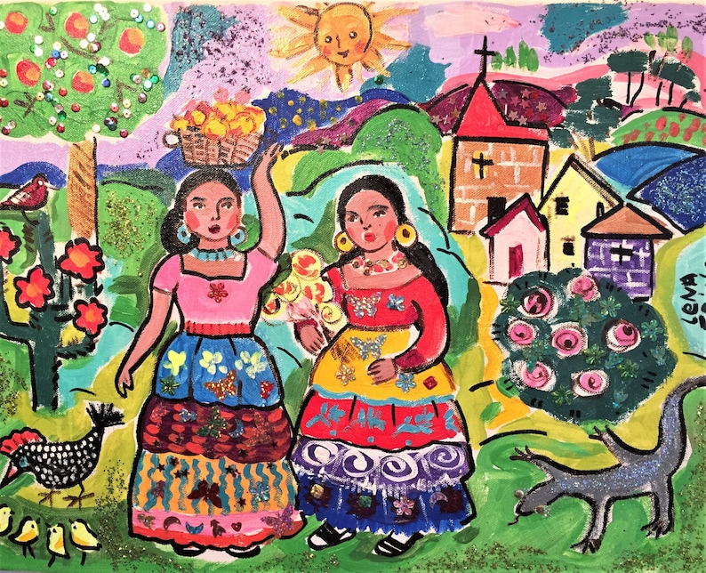
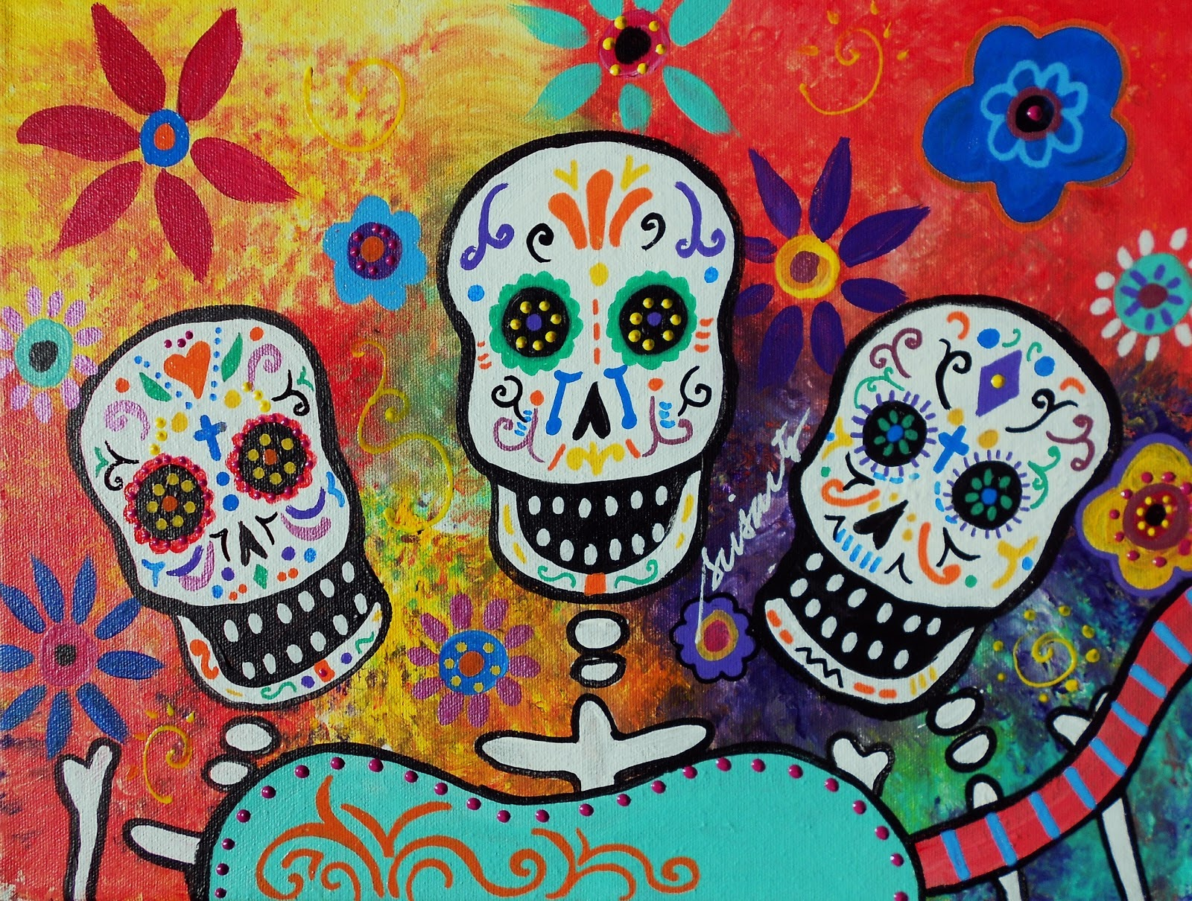
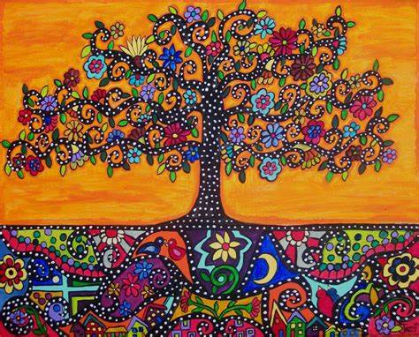
COLOR AND SHAPE
Mexican Folk Art is HIGHLY characterized by bright, intense colors, lively patterns, and simplistic shapes!

Slide 6
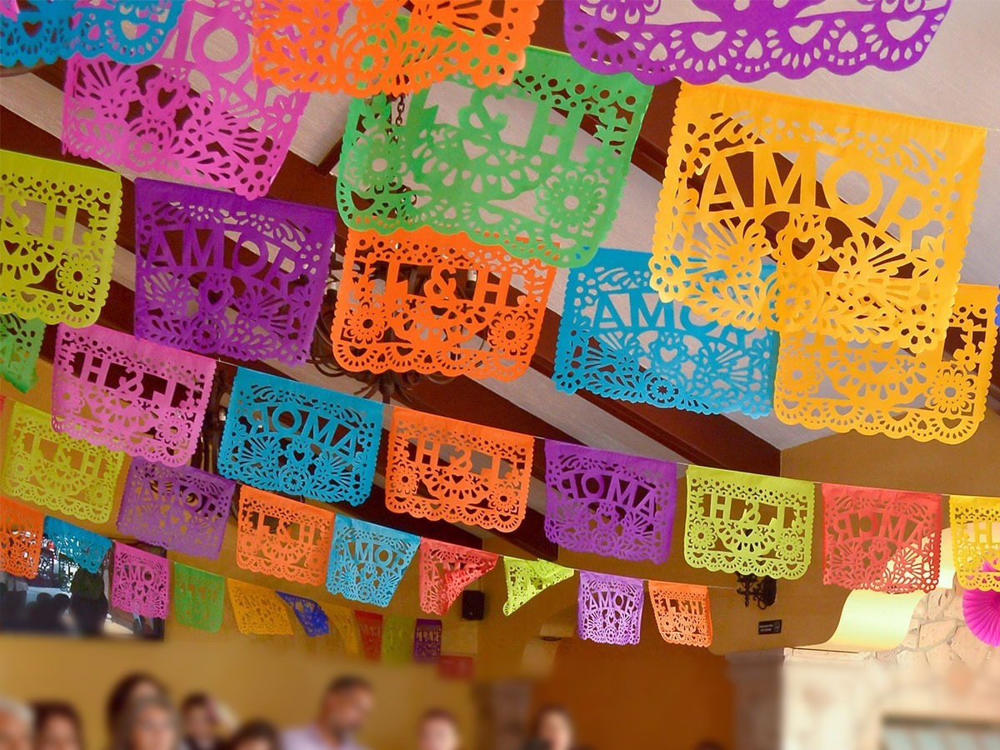
Traditional subjects
Family
Food
Music
Animals
Patriotism
Plants
Religion

Slide 7
What subject matters could tell your story?

Slide 8
Sketchbooks: color + Mexican folk art

Slide 9
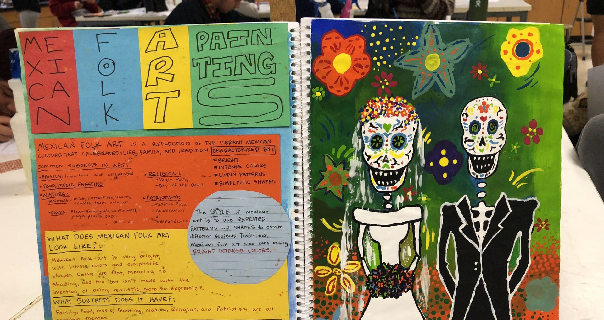

Slide 10
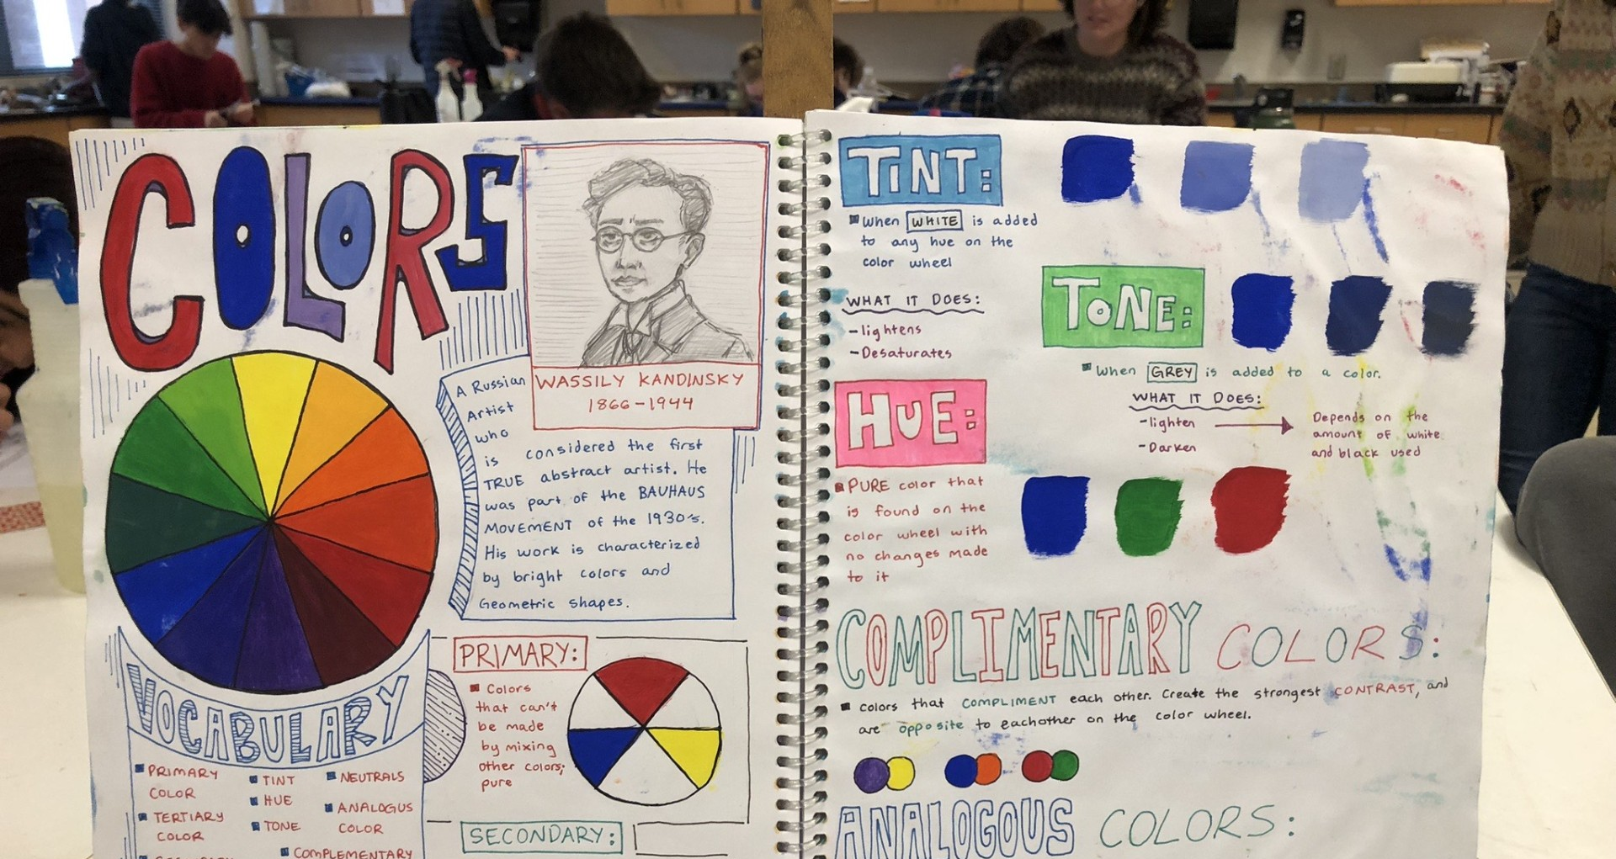

Slide 11
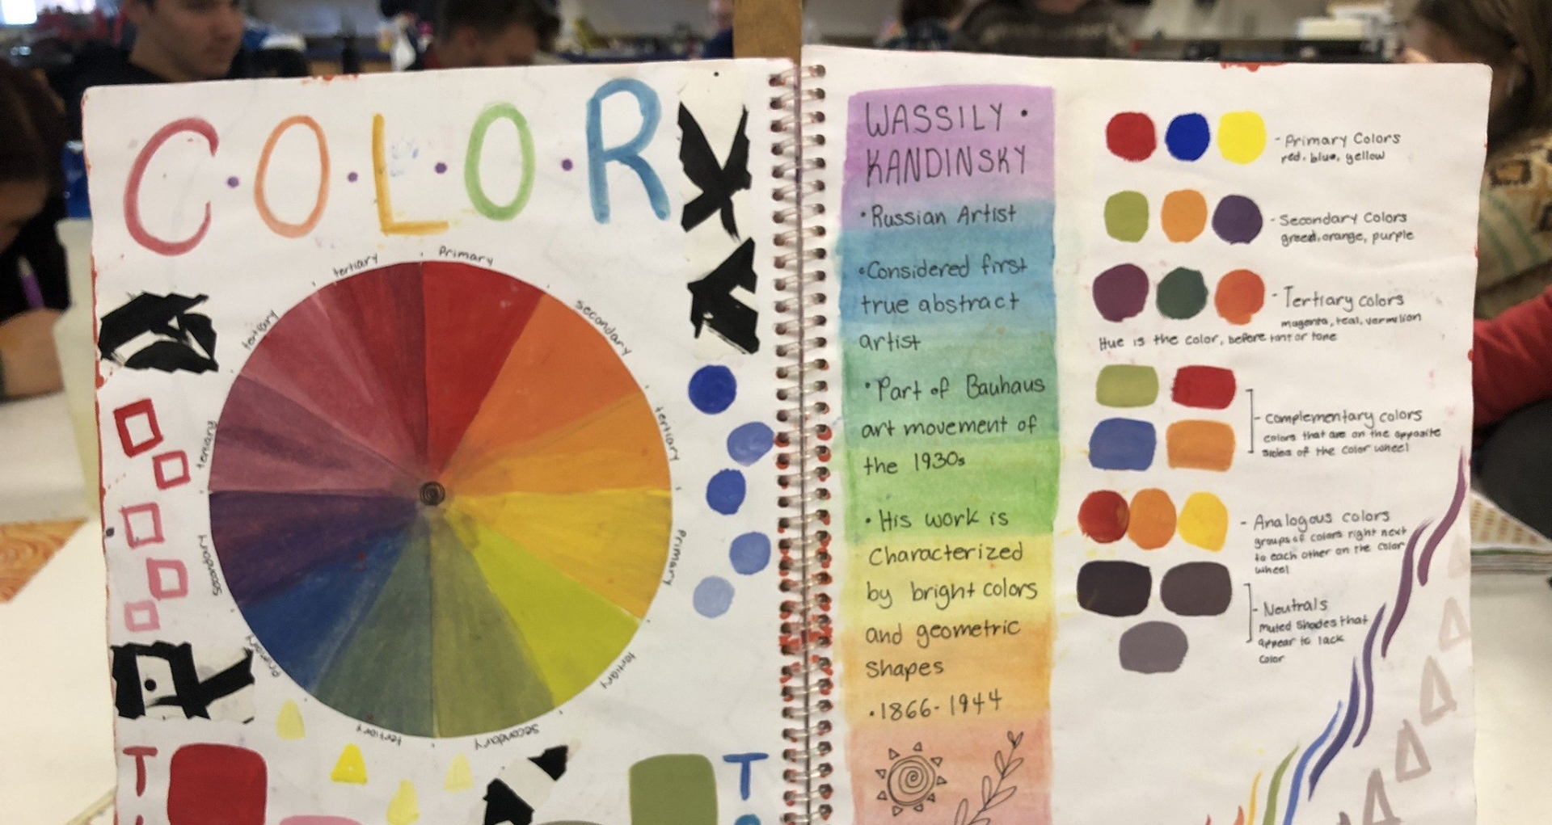

Slide 12
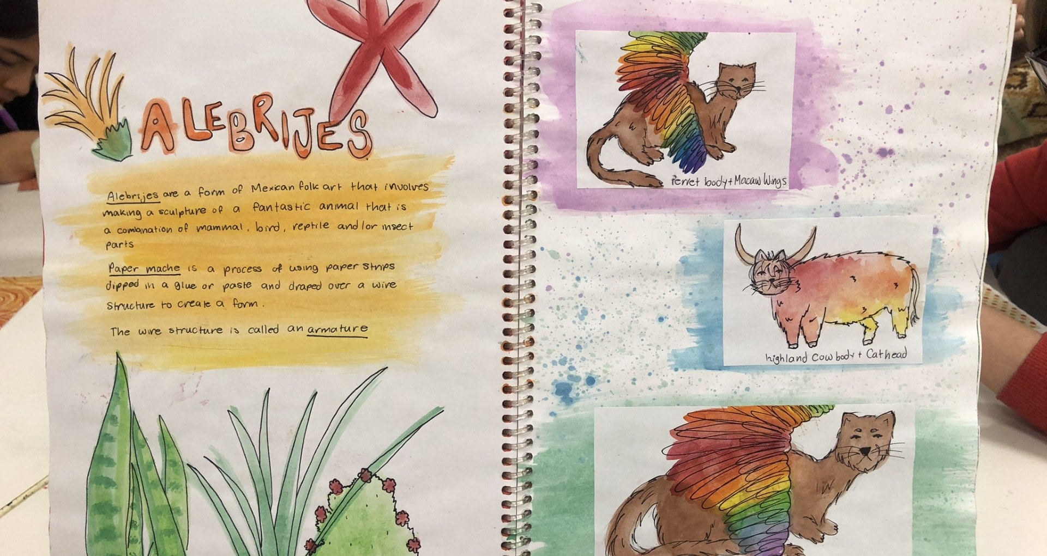

Slide 13
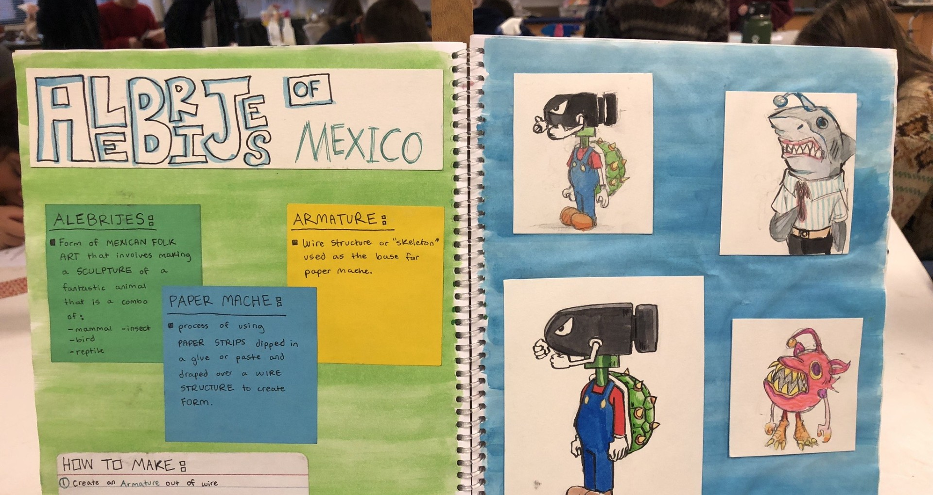

Slide 14
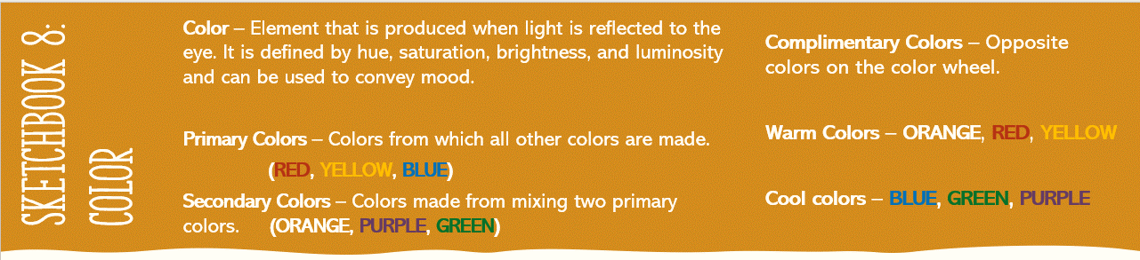


Sketchbook 8:
COLOR
Directions: In your sketchbook take the notes, showing examples of each color.
Then create and label a color wheel! (It has 6 sections)
Color – Element that is produced when light is reflected to the eye. It is defined by hue, saturation, brightness, and luminosity and can be used to convey mood.
Primary Colors – Colors from which all other colors are made.
(RED, YELLOW, BLUE)
Secondary Colors – Colors made from mixing two primary colors. (ORANGE, PURPLE, GREEN)
Complimentary Colors – Opposite colors on the color wheel.
Warm Colors – ORANGE, RED, YELLOW
Cool colors – BLUE, GREEN, PURPLE
Sketchbook 8:
color

Slide 15
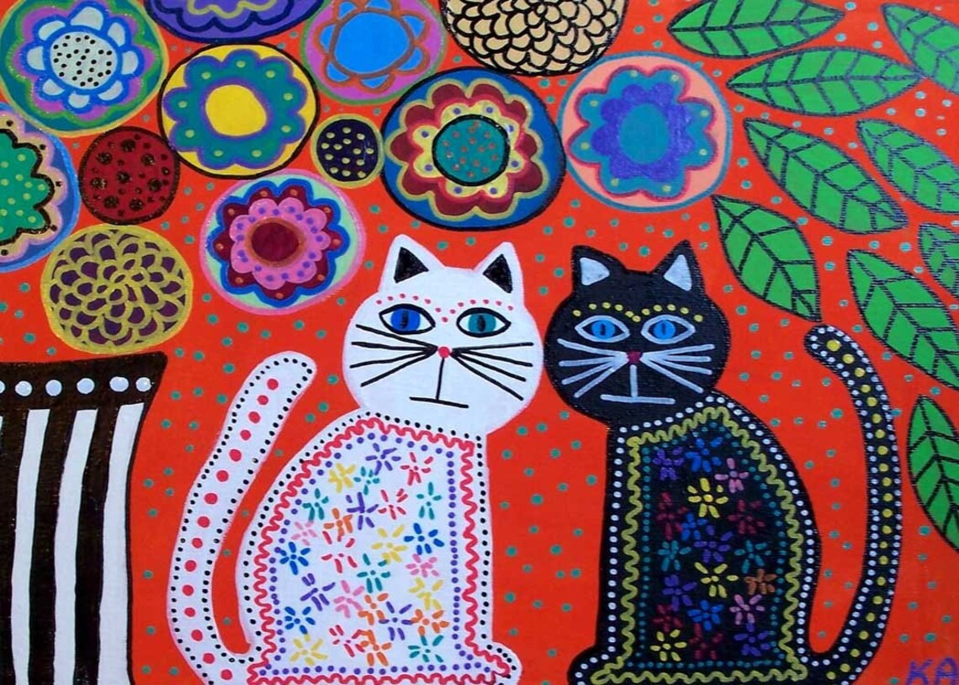
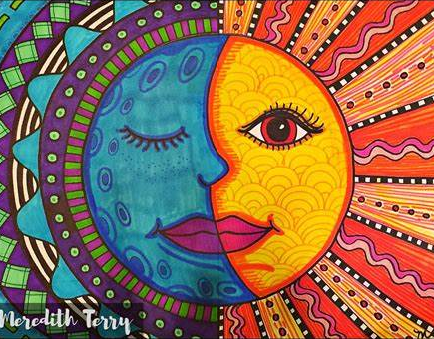
Sketchbook: Mexican Folk Art

Slide 16
Mexican folk art
The subjects of Mexican art center around the things that are common in
Mexican culture. Family, food, music, and nature are common themes.
Animals like birds, snakes, butterflies, lizards, and farm animals are
important in Mexican art. Additionally, plants like marigolds and
sunflowers, as well as cacti are frequent imagery found in Mexican art.
As Mexico is a highly religious country, religious ideas like the Virgin
Mary and Day of the Dead are also featured subjects. Finally, Mexico is a
highly patriotic country, so imagery such
as flags and celebration of independence from
Spain are common themes.
CHARACTERISTICS
- Bright, intense colors,
- Lively patterns,
- Simplistic shapes.
SUBJECT MATTERS
- Family - Food
- Religion - Music
- Nature - Patriotism

Slide 17
Sketchbook 9: Mexican folk art
Read the handout about Mexican Folk Art
Title the sketchbook Mexican Folk Art
Decorate the background with patterns similar to the ones in the pictures.
Write a short summary of the notes, including the characteristics, subject matters, and elements of art used in Mexican folk art.
Create 3 thumbnails (ideas) for your own Mexican Folk Art.

Slide 18
PROJECT 4: Mexican folk art

Slide 19
Project 4 - Mexican folk art
Day 1: In pen, create the basics of your drawing, based off your favorite
thumbnail sketch.
Be sure to include complex patterns, scenery, and multiple subjects!
Day 2: Using acrylic paints, fill in the basics of the background,
painting overtop of the details.
Day 3: Using a finer brush, begin adding details, finish with outlines!
CHARACTERISTICS
- Bright, intense colors,
- Lively patterns,
- Simplistic shapes.
SUBJECT MATTERS
Choose from those found in
Mexican folk-art, or tell
your own story
GRADING CRITERIA
Craftsmanship: 30% Skill: 10%
Execution 25% Originality: 10%
Risk-taking: 25%

Slide 20
Project 4:
Mexican Folk art

Slide 21
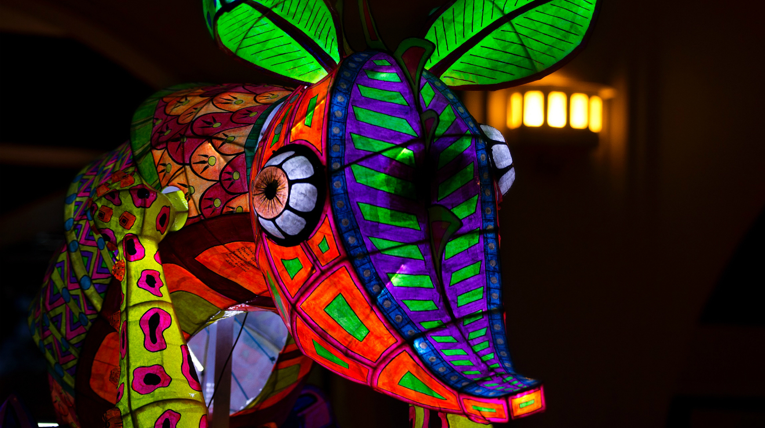
Unit 2 pt. 2: alebrije
COLOR/SHAPE/FORM

Slide 22
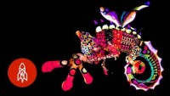

Slide 23
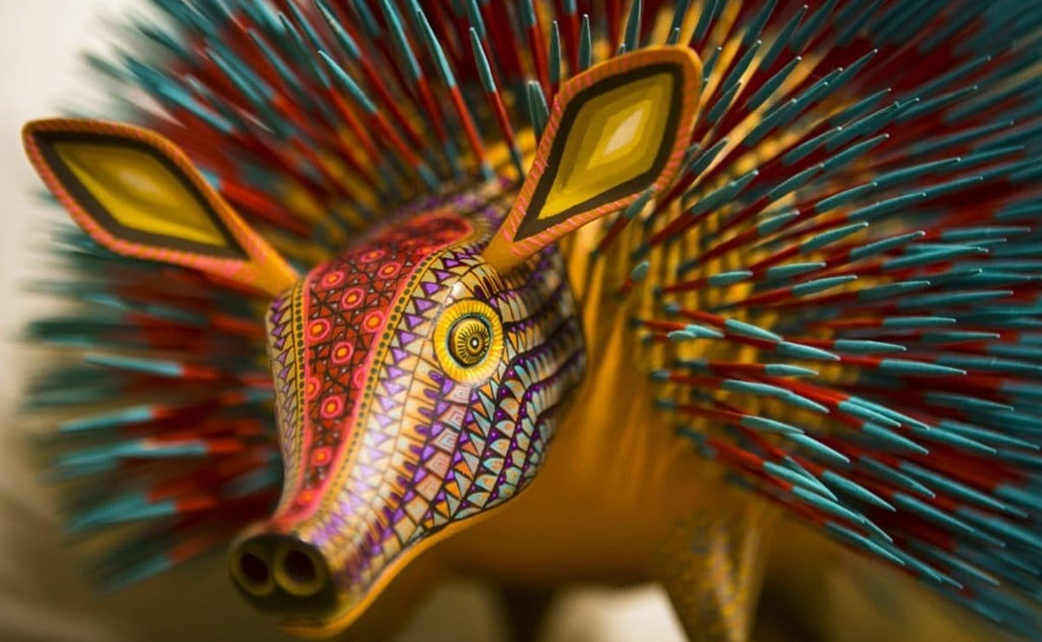
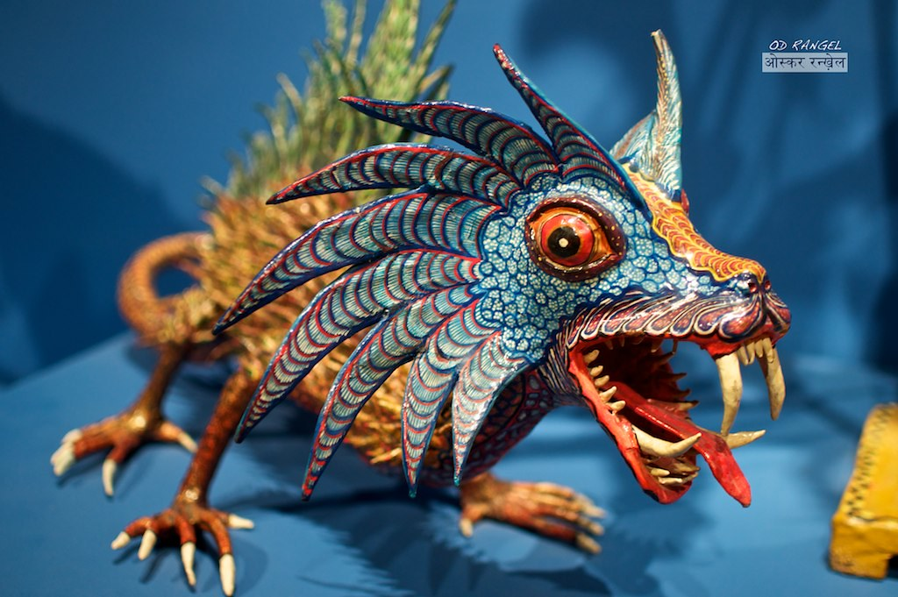
Sketchbook 10: alebrijes
Directions:
Title the sketchbook Alebrijes in colorful letters
Define Alebrijes, papier mâché, and armature from the handout.
Write down the steps to making an Alebrije.
Create 3 thumbnails (ideas/drafts) for your own Alebrije sculpture! Include color and patterns in your sketches.
Remember to make your sketchbook creative!

Slide 24
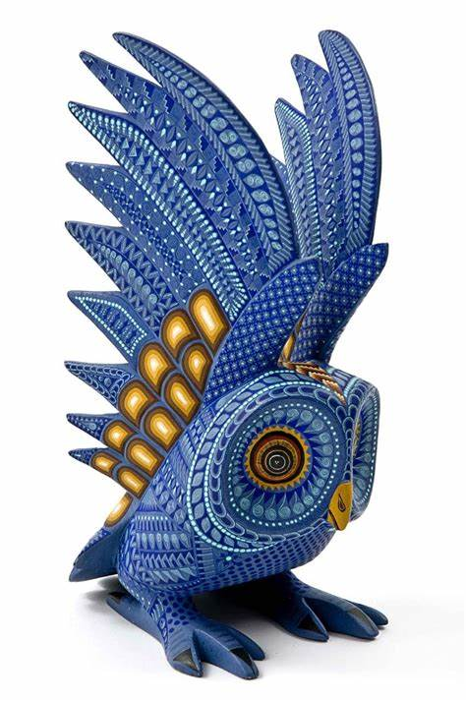
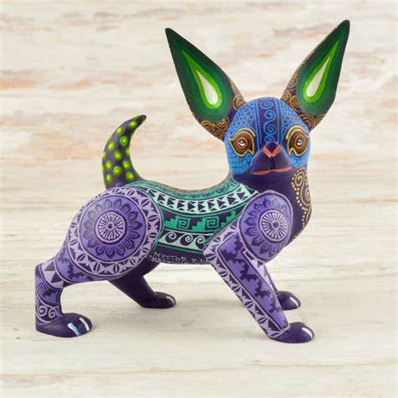
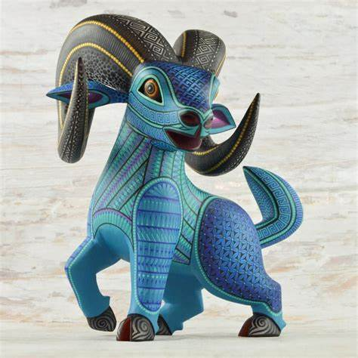
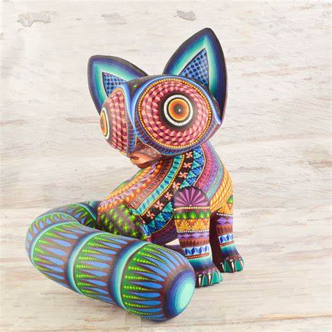
Project 5: alebrijes

Slide 25
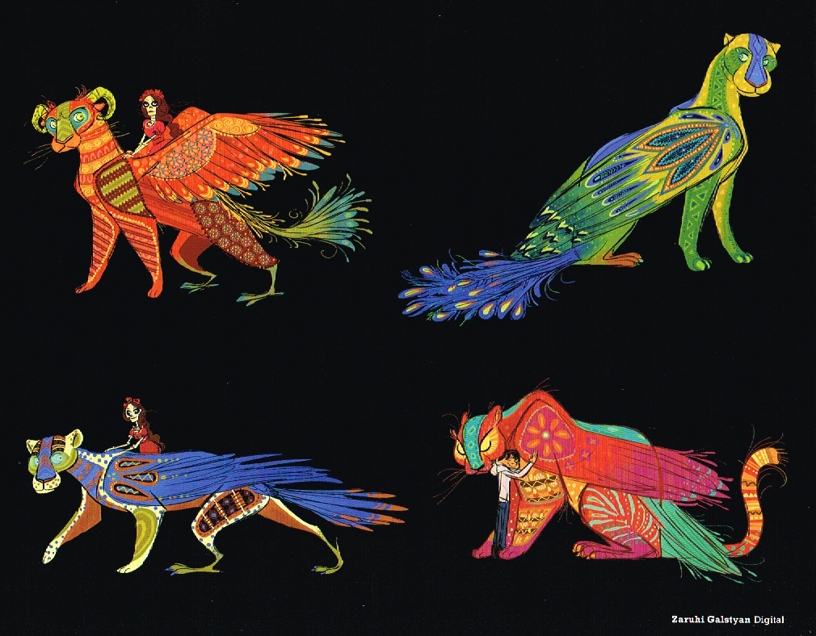
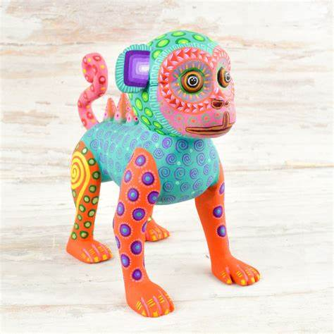
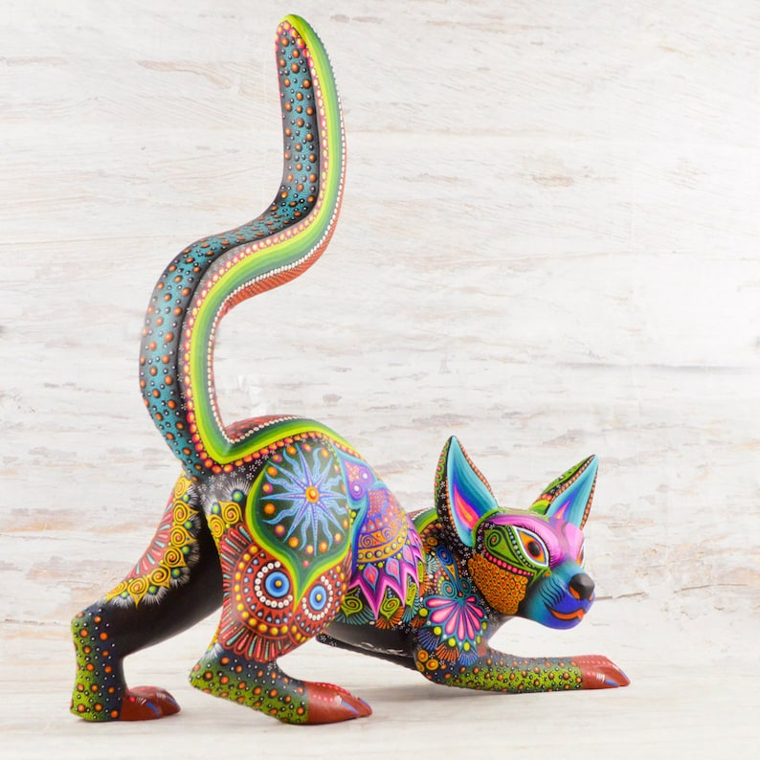
Project 5: alebrije
Using acrylic paints, paint the ENTIRE base a solid color.
Once dry, add the characteristics of Mexican Folk Art, (patterns, shapes, and LOTS of color) to complete the piece. You can sketch them out first or just go for it!

Slide 26
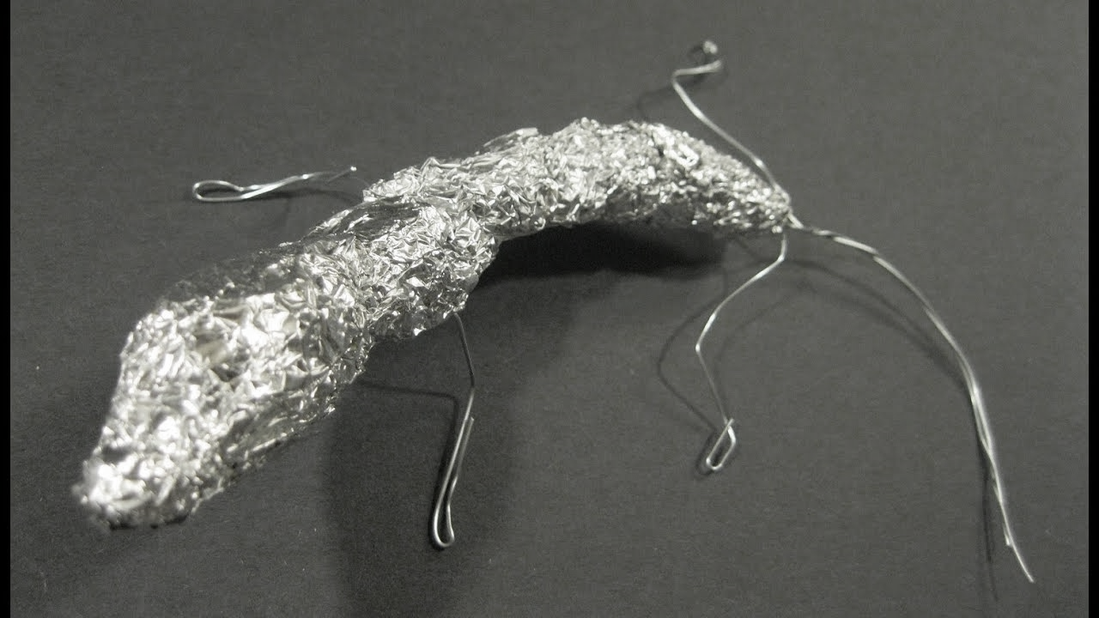
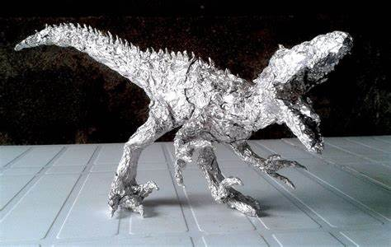
alebrije step 1
Using a sheet of aluminum foil, twist and form it into the “skeleton” or general shape of the creature. This makes your armature!
Your armature MUST
Be able to stand on its own
Form a mixture of 2+ animals
All limbs are sturdy!
Be sure to consider how your sculpture looks from multiple angles!

Slide 27
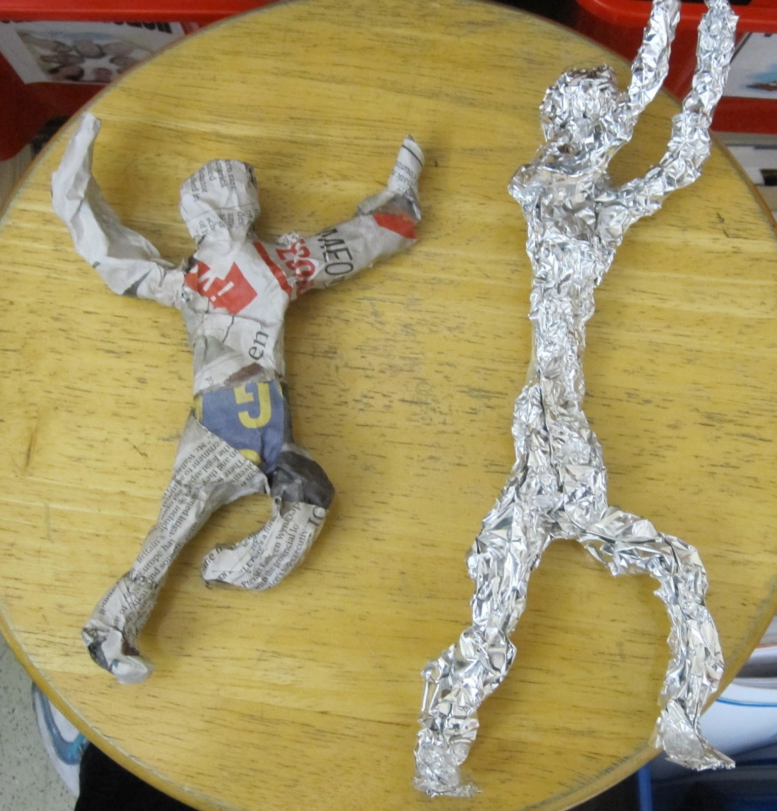
alebrije Step 2
Taking THIN strips of paper, dip them in the paper mâché paste and wrap around your armature. For more detailed areas that are harder to get to, use paper towel strips!
When dry, you can use paper towels, cardboard, or paper to add additional details like spines, ears, talons, etc.
You will need 2 to 3 coats! Allow to dry between each

Slide 28
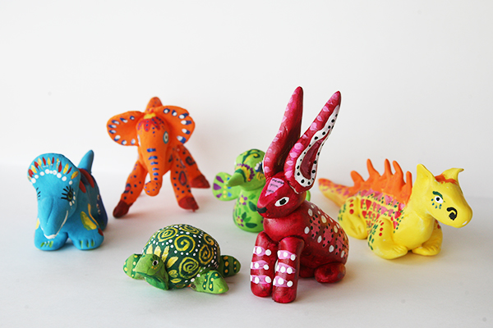
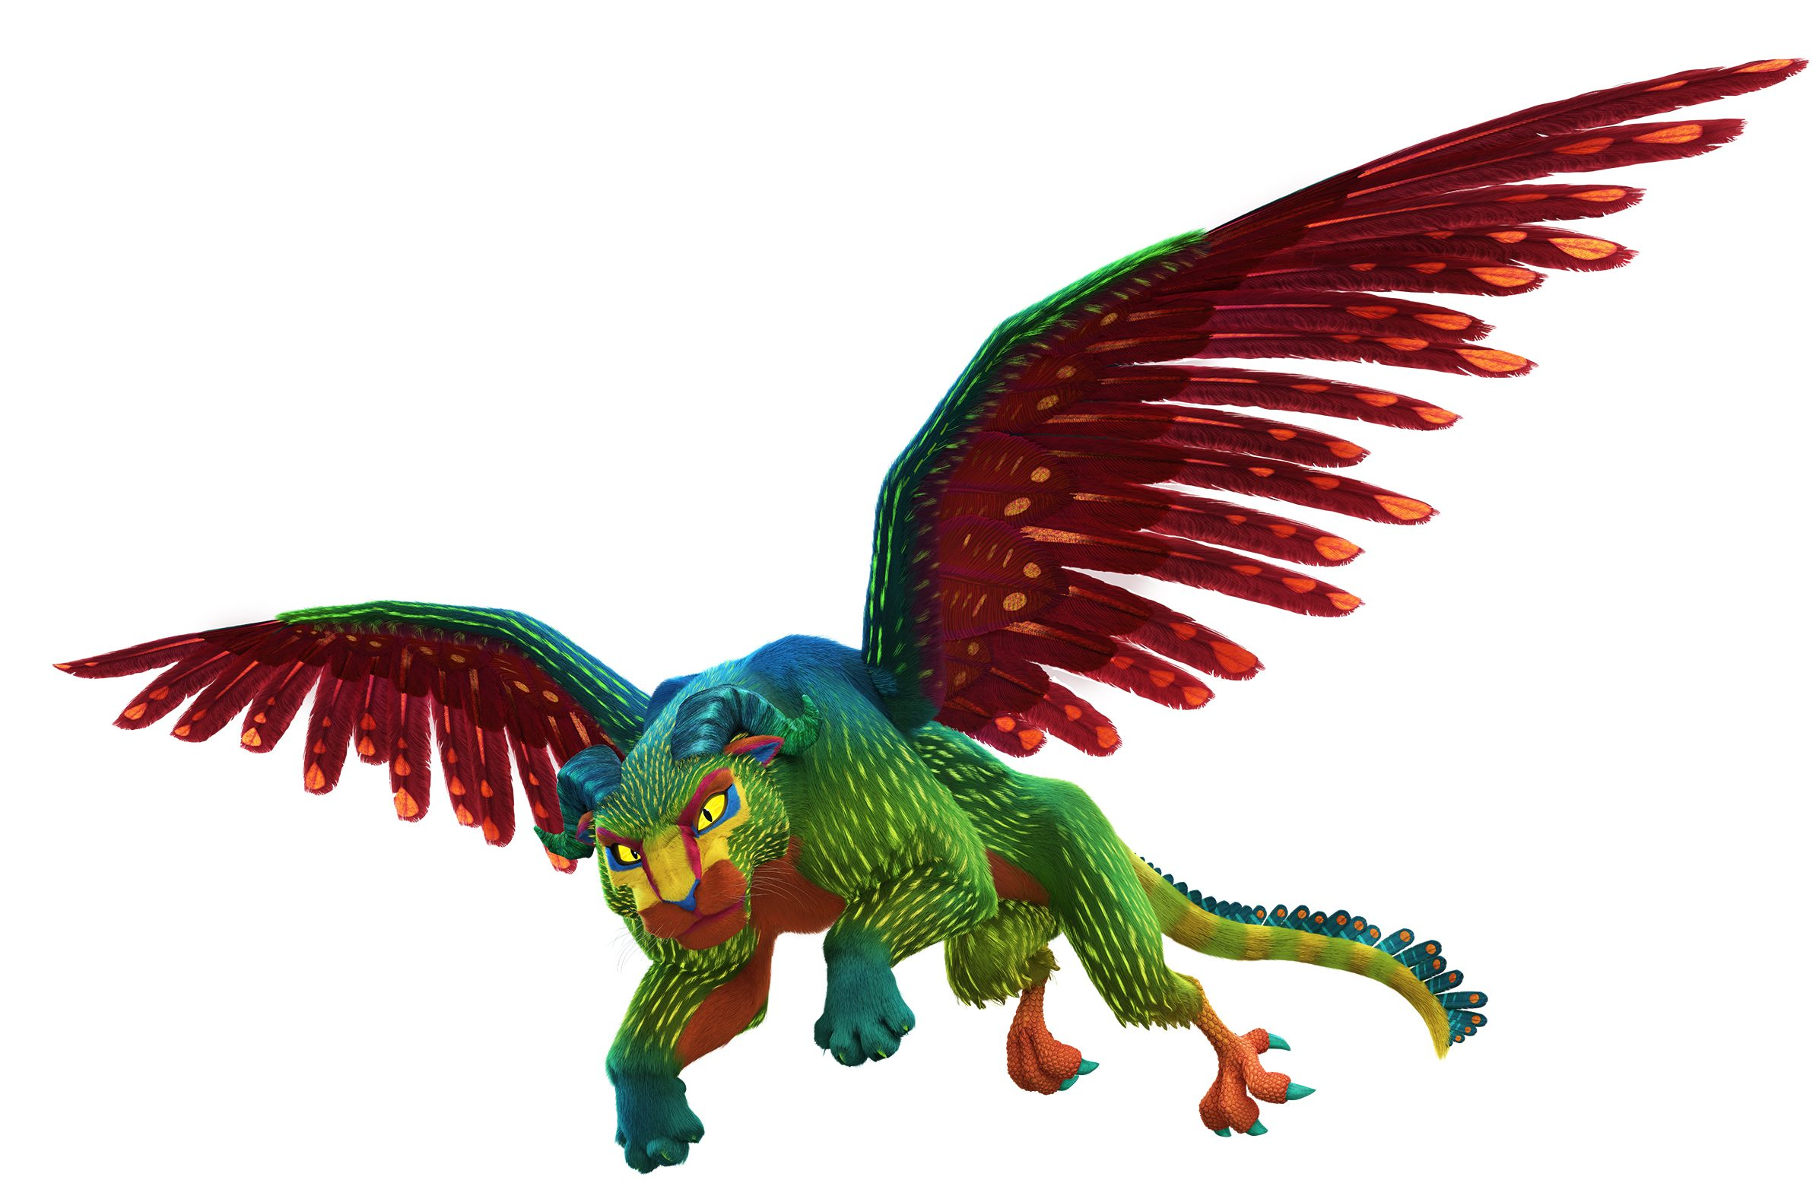
alebrije step 3
Using acrylic paints, paint the ENTIRE base a solid color.
Once dry, add the characteristics of Mexican Folk Art, (patterns, shapes, and LOTS of color) to complete the piece. You can sketch them out first or just go for it!

