Slide 1
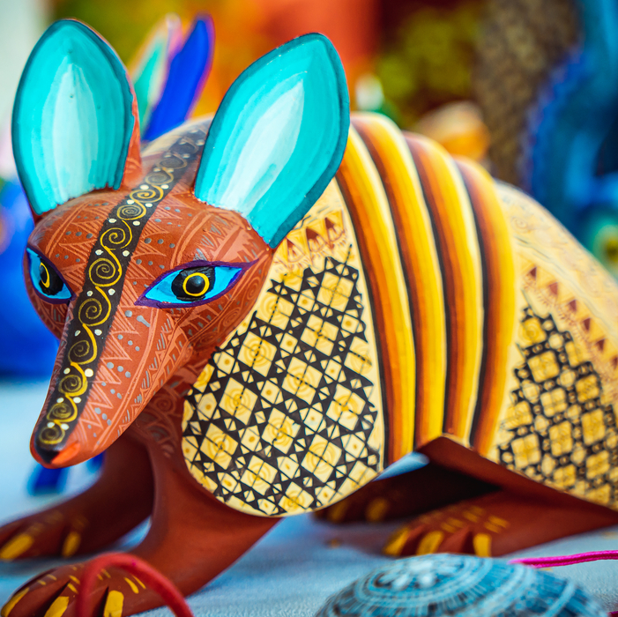


Mexican folk art

Slide 2
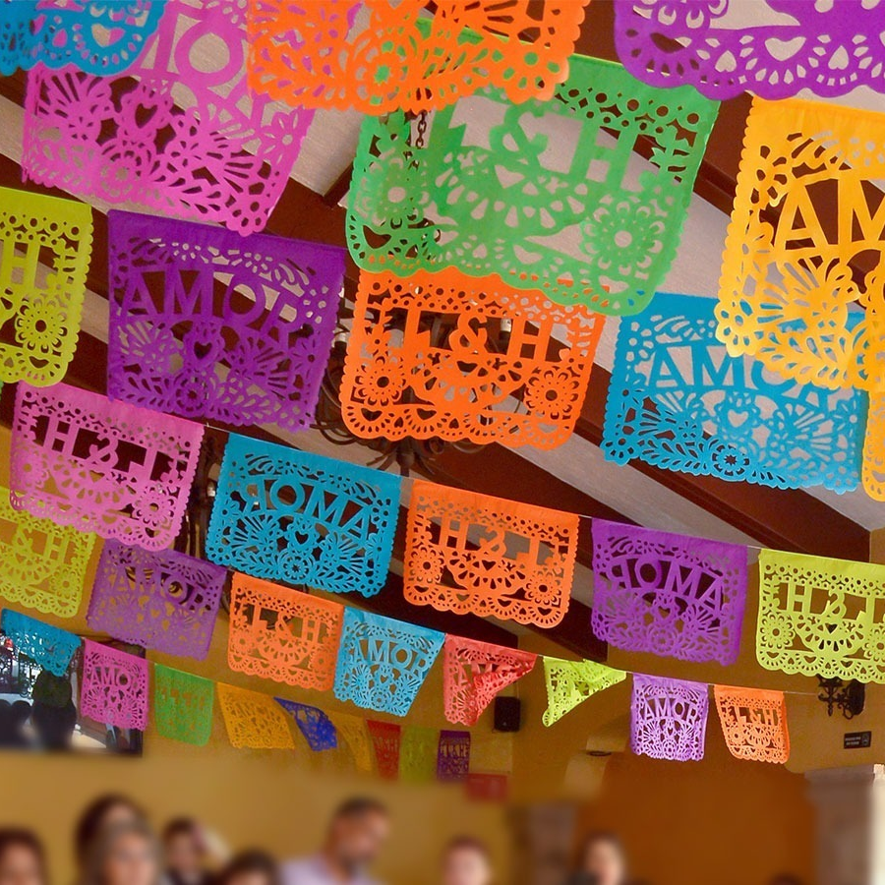
Traditional mexican folk-art
Traditional Mexican folk art is a colorful and creative reflection of Mexican culture through handcrafts or artesanías.

Slide 3
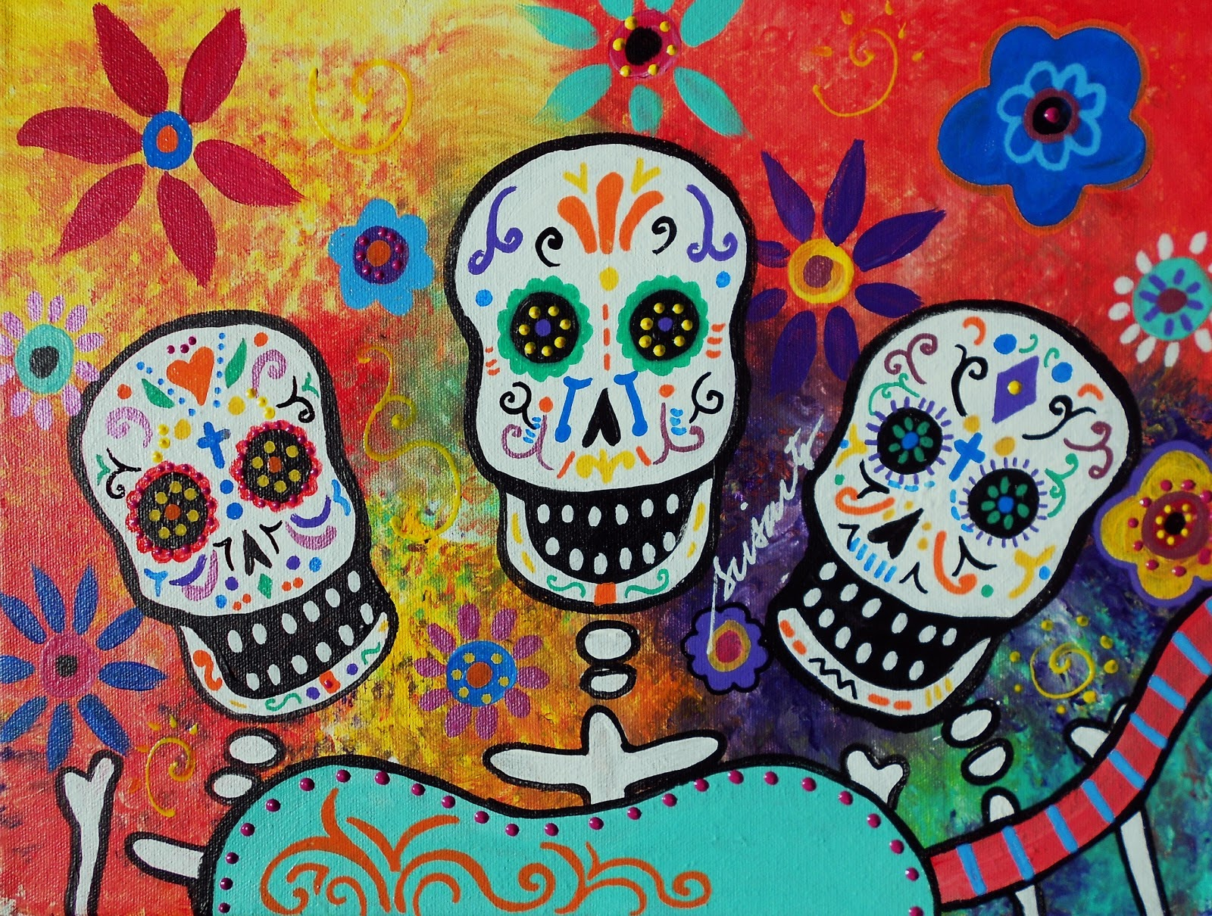
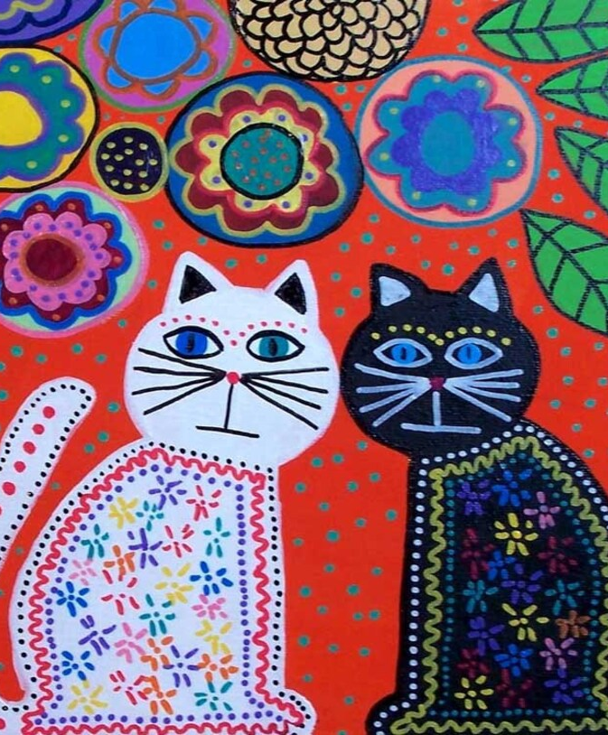
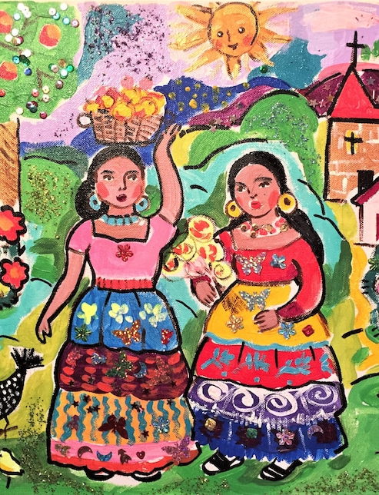
What is folk art?
Unlinke fine art which is focuses on the formal, aesthetic value, folk art centers around cultural significance.

Slide 4
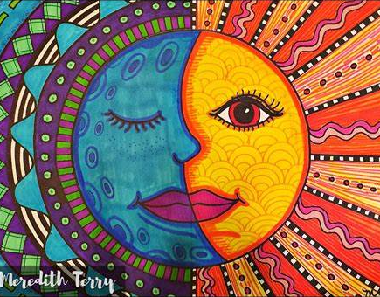
characteristics
01
02
03
Intense colors
Lively patterns
Simple shapes

Slide 5
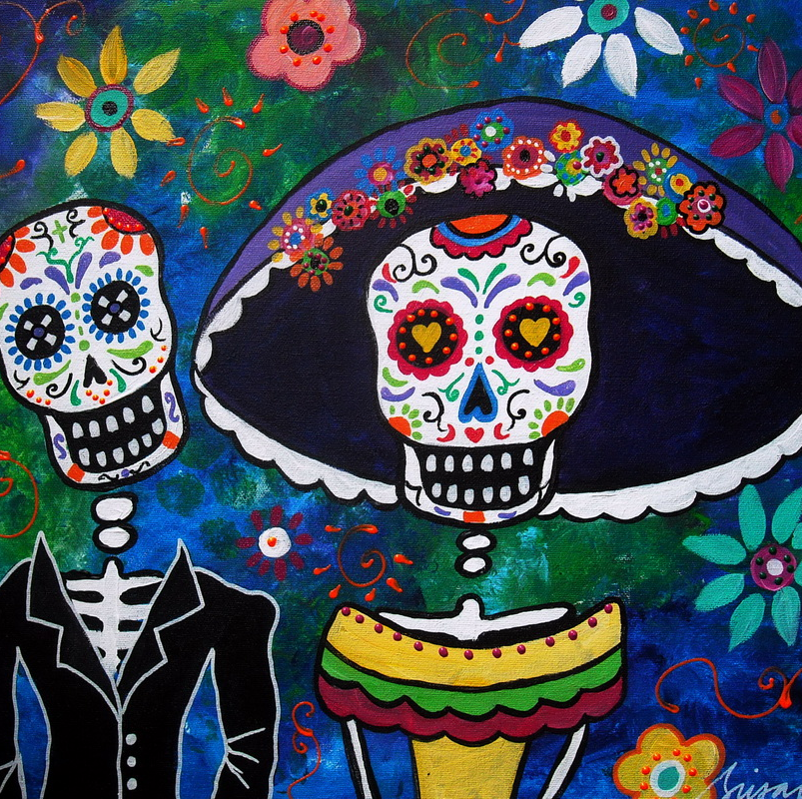
traditional subjects
Family
Food
Music
Animals
Patriotism
Plants
Religion

Slide 6
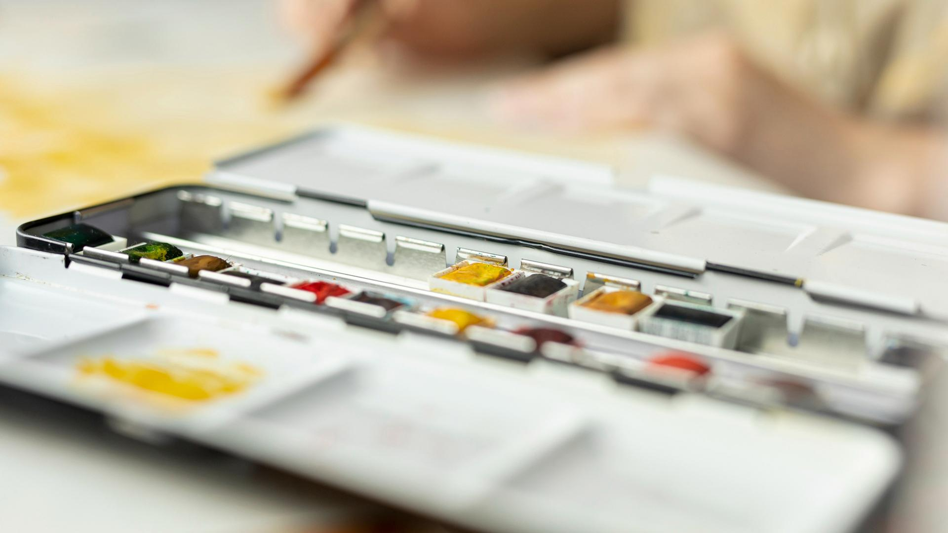
Sketchbook assignment: color

Slide 7
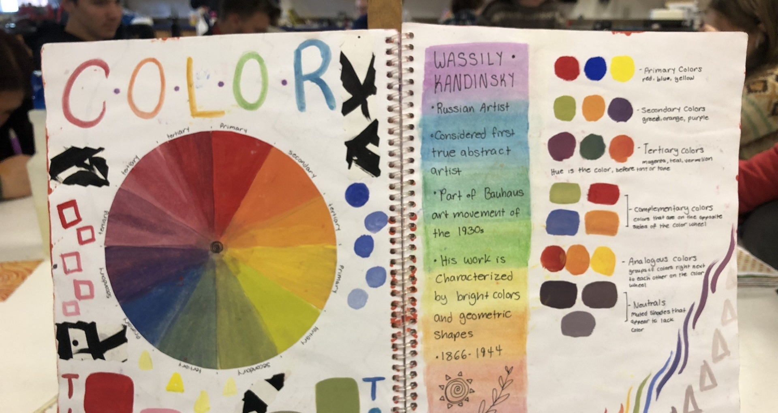

Slide 8
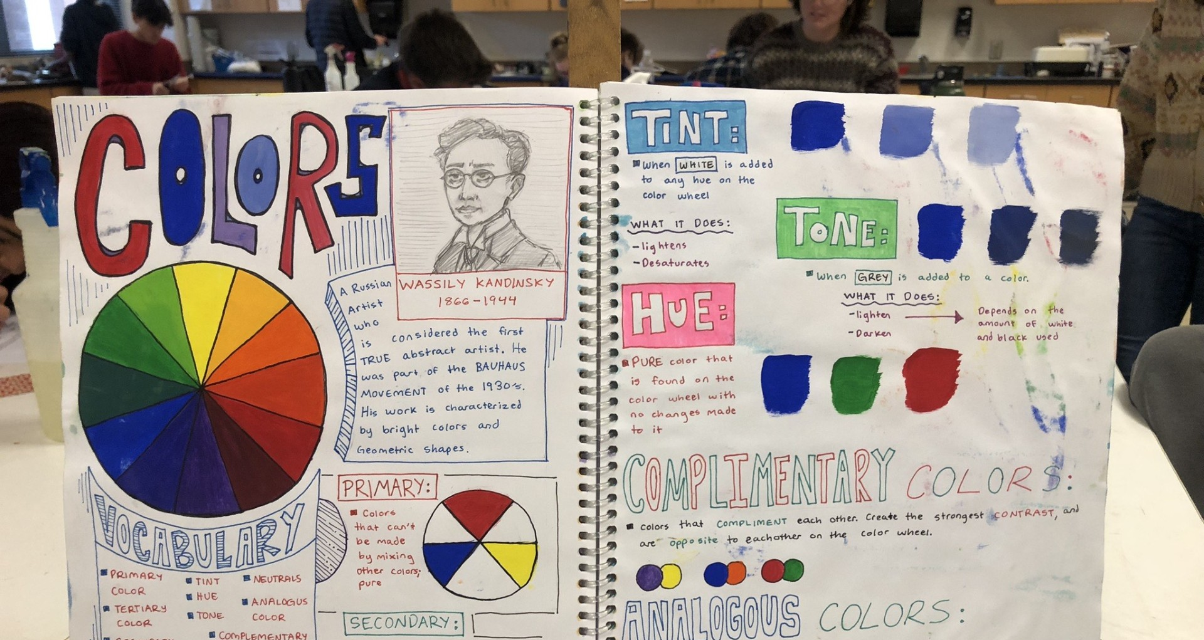

Slide 9
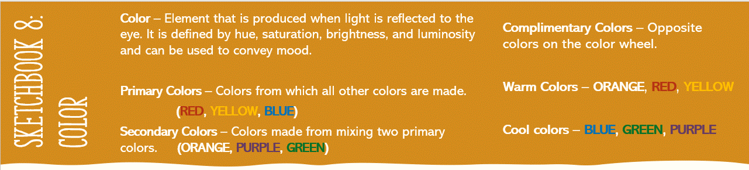


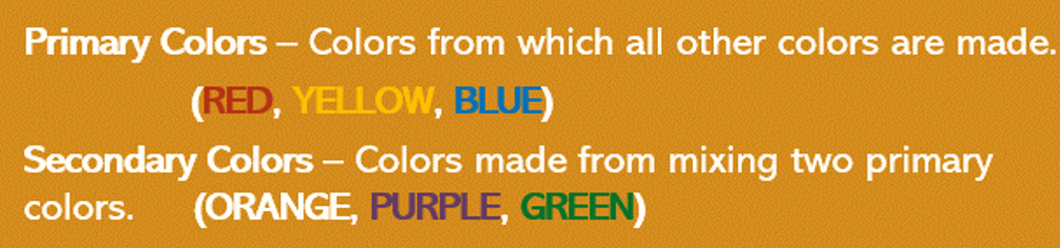
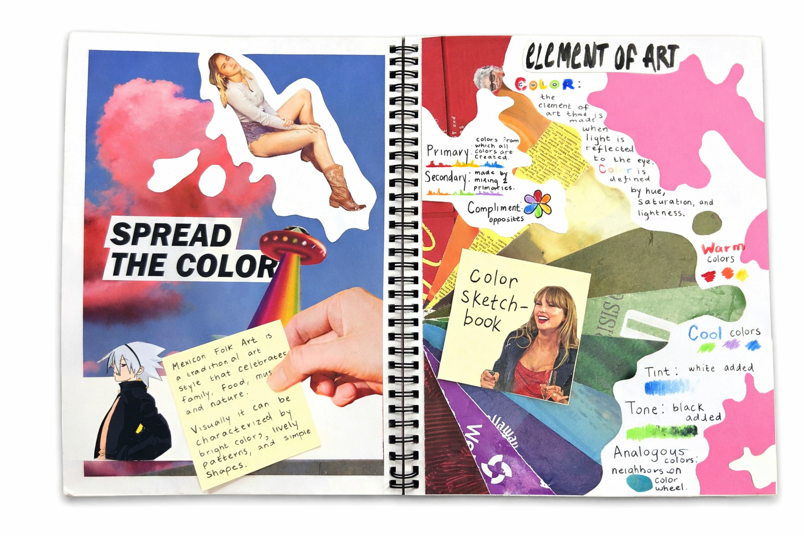


Directions: In your sketchbook take the notes, showing examples of each color.
Then create and label a color wheel! (It has 6 OR 12 sections)
Color – Element that is produced when light is reflected to the eye. It is defined by hue, saturation, brightness, and luminosity and can be used to convey mood.
Primary Colors – Colors from which all other colors are made.
(RED, YELLOW, BLUE)
Secondary Colors – Colors made from mixing two primary colors. (ORANGE, PURPLE, GREEN)
Sketchbook:
COLOR

Slide 10
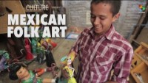

Slide 11
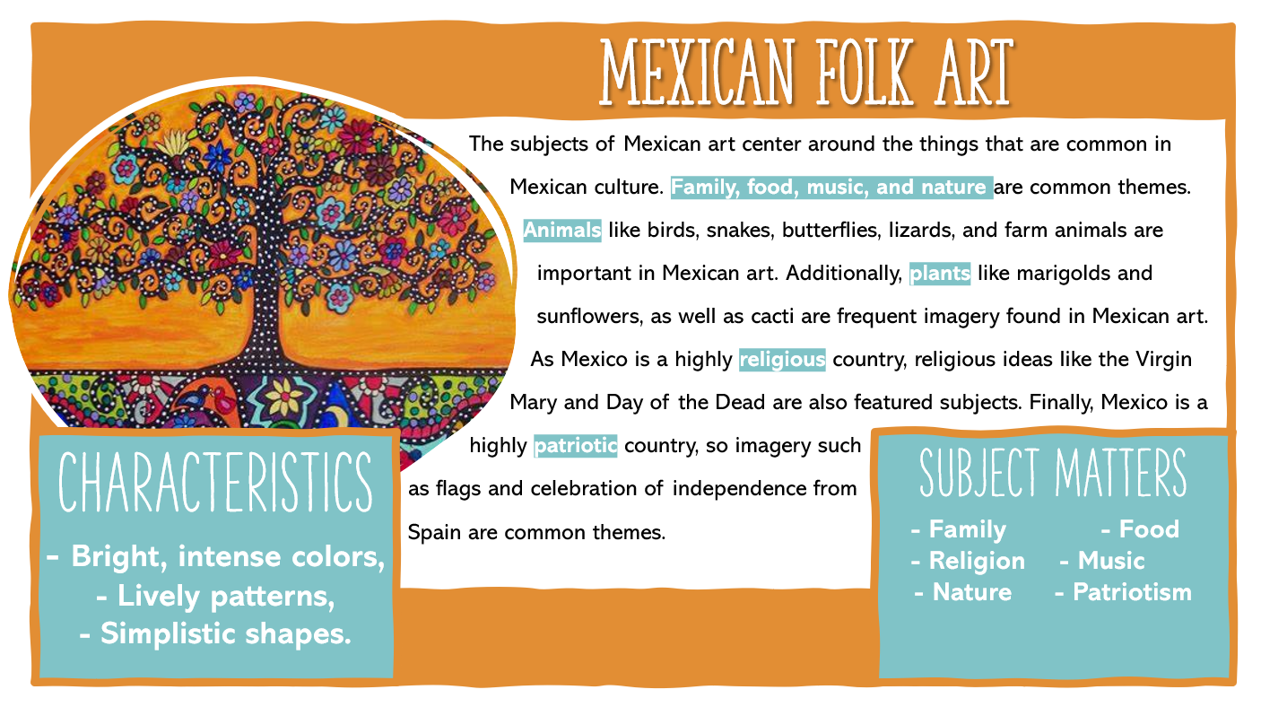


Slide 12
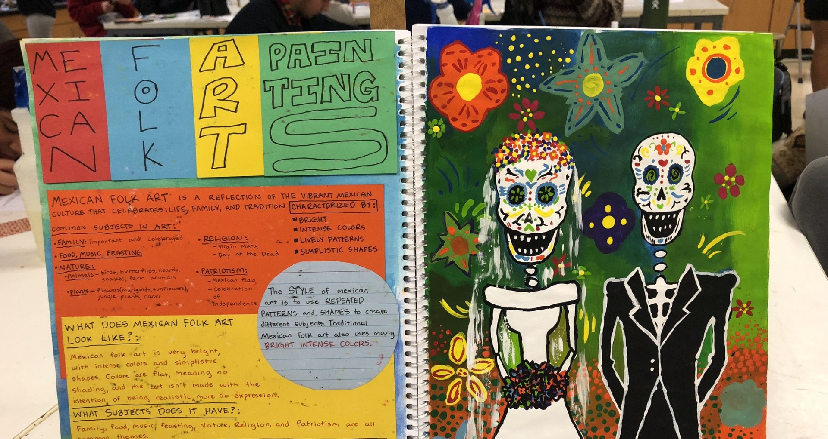

Slide 13
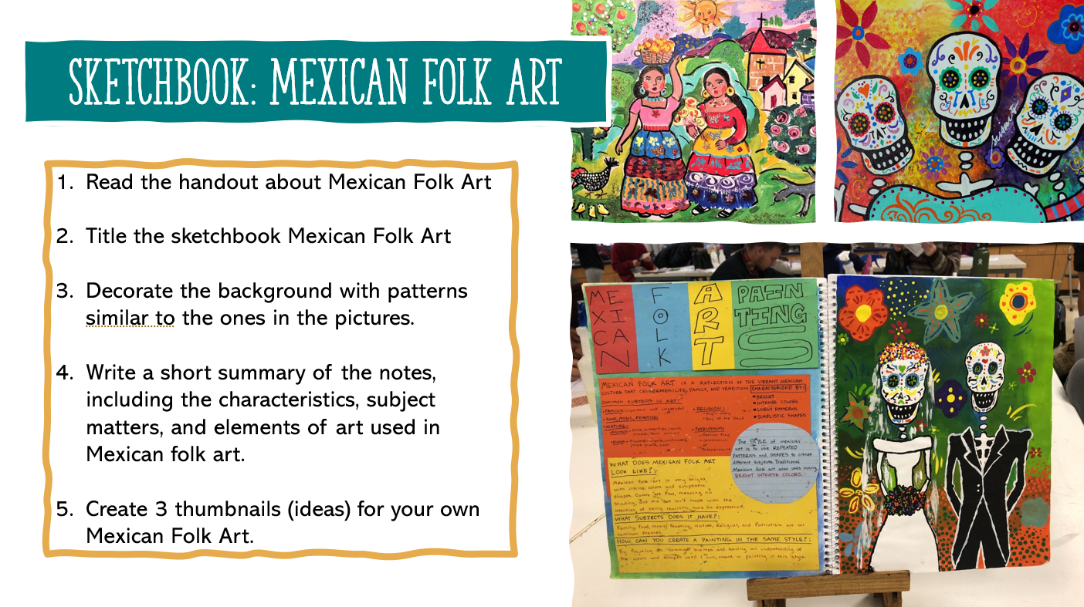
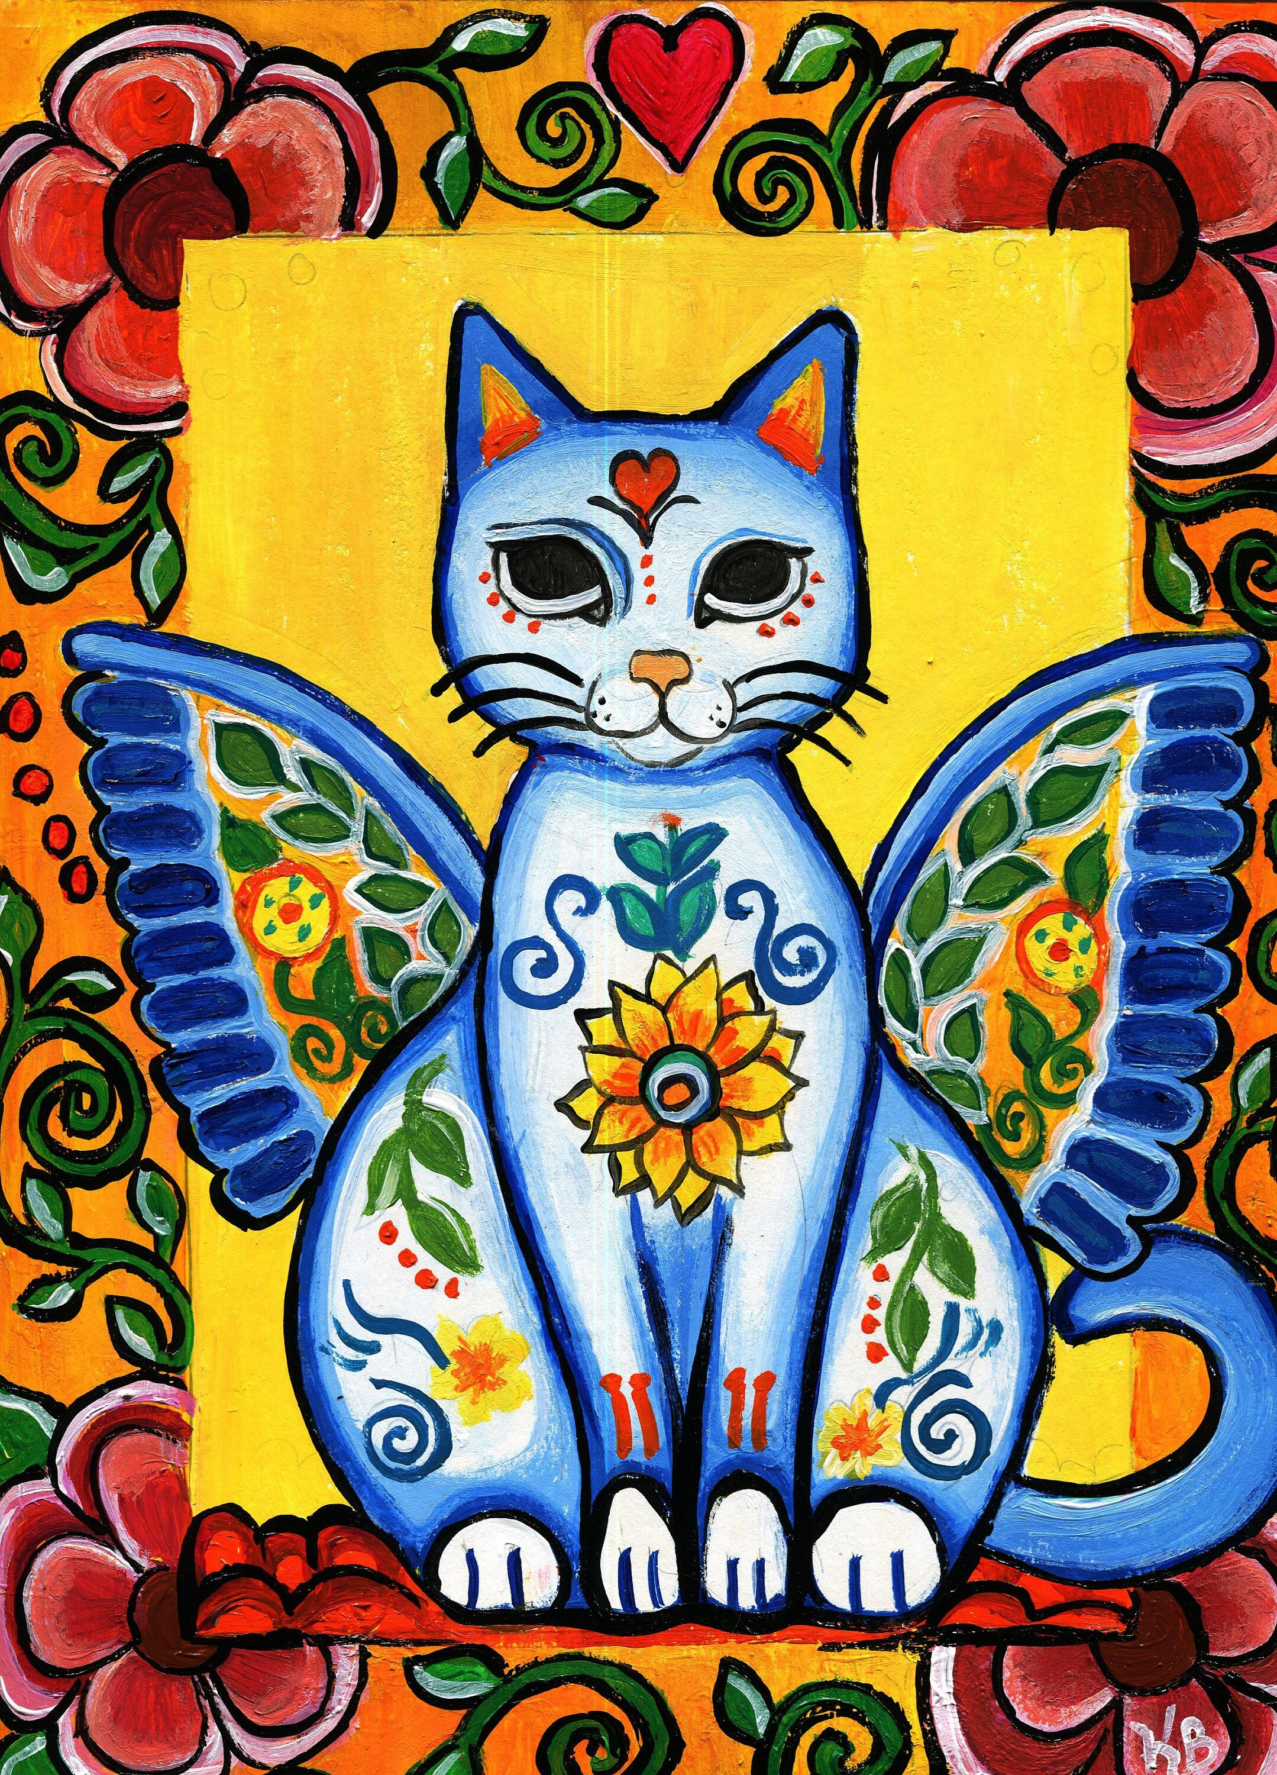
Read the handout about Mexican Folk Art
Title the sketchbook Mexican Folk Art
On one side of the spread, create a recreation of a Mexican Folk Art Piece, copying the colors, shapes, and patterns.
On the other side, write a short summary of the notes.
Create 3 thumbnails for your own Mexican Folk Art piece.

Slide 14
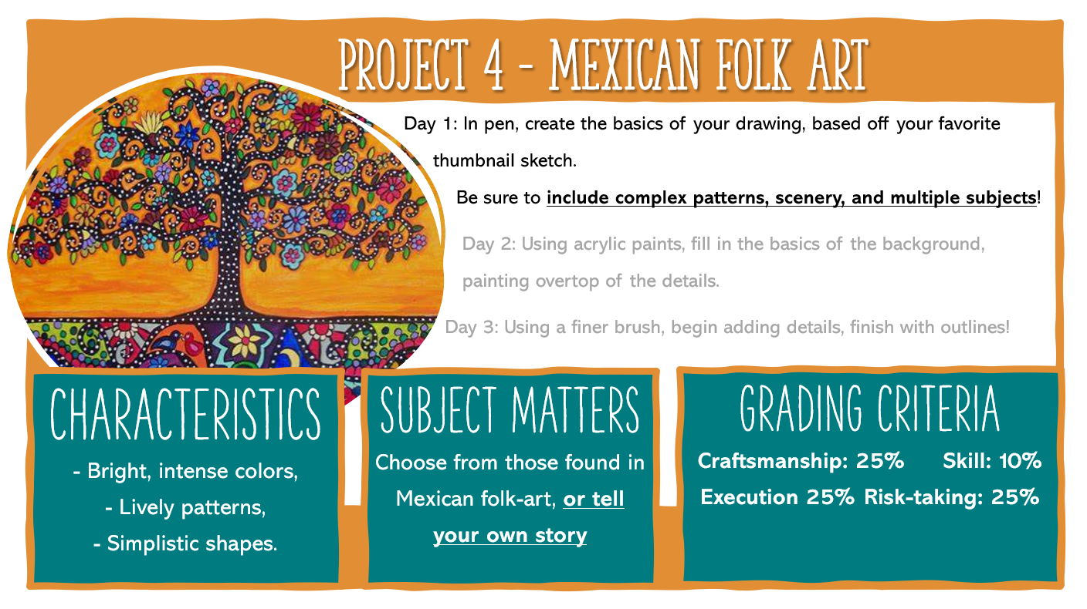


In pencil, draw the basics of your piece, based off your favorite
Remember, complex patterns go on AFTER painting (the base coat)

