Slide 1
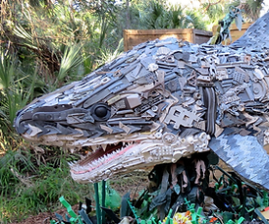
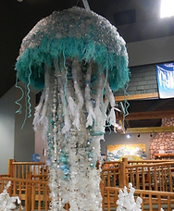
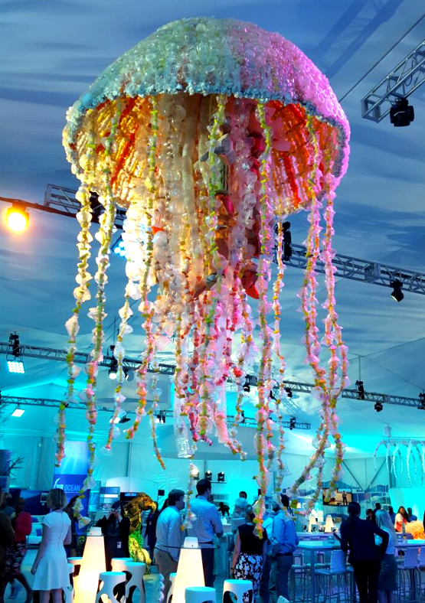
IF GARBAGE IS ART
(Creating Art from Recycled Materials)

Slide 2
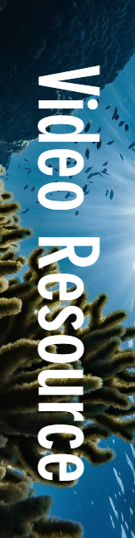
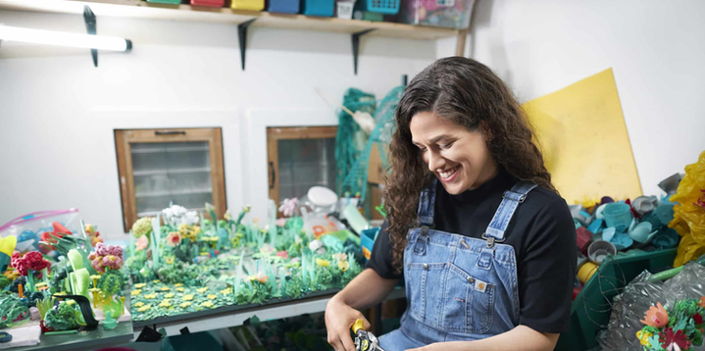

Slide 3
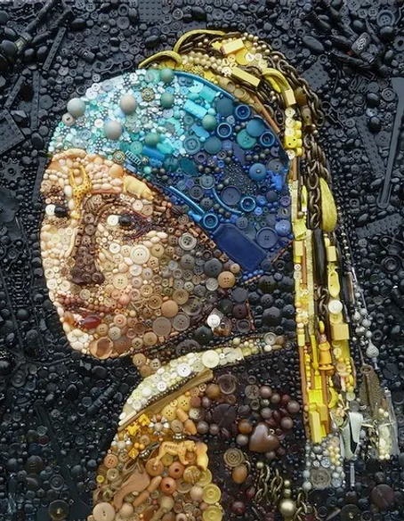
Upcycled/Recycled Art
Upcycled or recycled art is artwork made by reusing materials that would normally be thrown away. Instead of letting these objects become waste, artists use them as the building blocks for Sculpture and 3D Design.
This type of art helps reduce plastic pollution, encourages sustainability, and challenges us to see beauty in unexpected places.

Slide 4
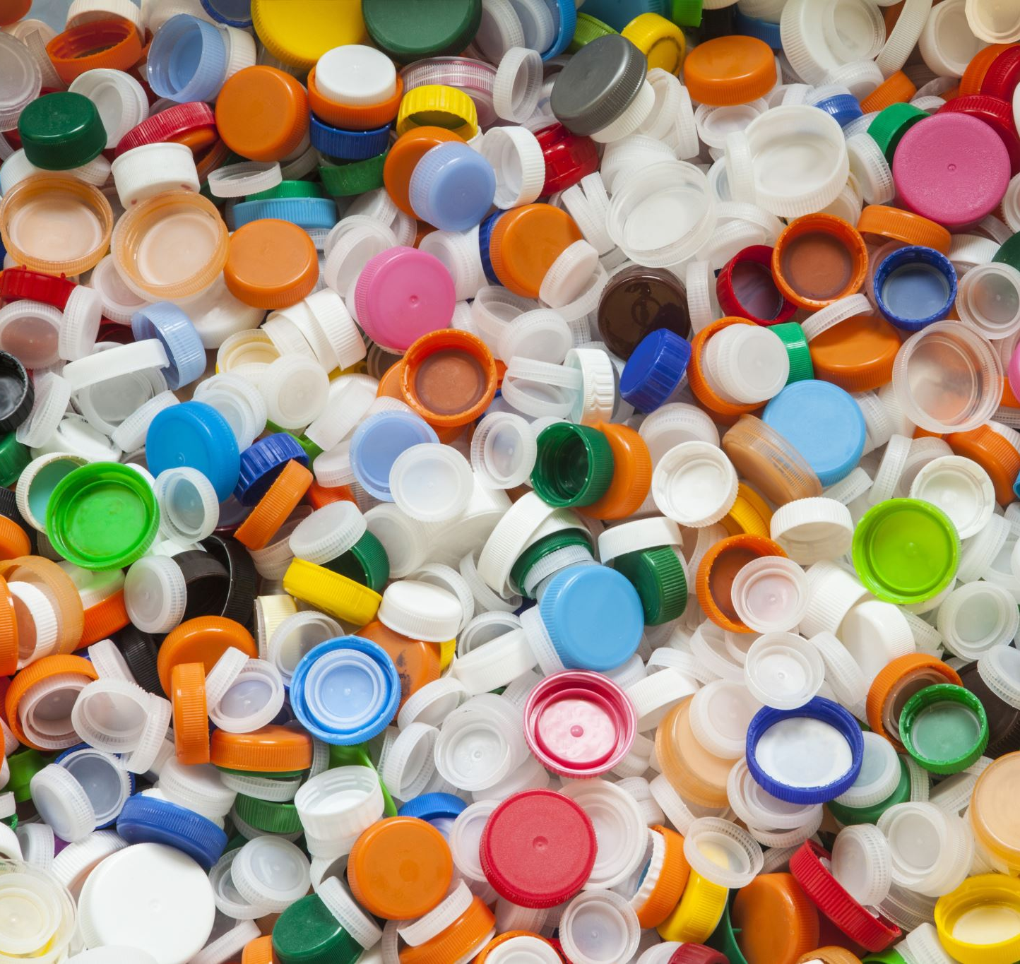
Materials
These materials can include plastic items, old newspapers, broken electronics, scrap metal, fabric scraps, or even everyday household items.
For our purposes, we will be using plastic items that are often found in bodies of water like plastic bottles, bottle caps, or plastic bags.
We will be using these items to create sea animals.

Slide 5
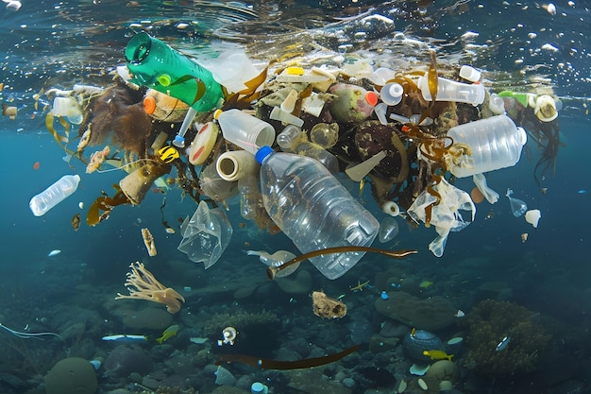
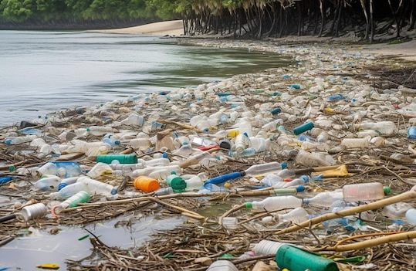
Why Sea Creatures?
By 2050 plastic will outweigh all the fish in the sea.
Human pollution—especially plastic waste—has a serious impact on marine ecosystems. When trash ends up in the ocean, it can harm sea creatures by entangling them, damaging their habitats, or being mistaken for food.
By creating art from upcycled materials, we can help raise awareness about these issues in a creative and meaningful way.

Slide 6
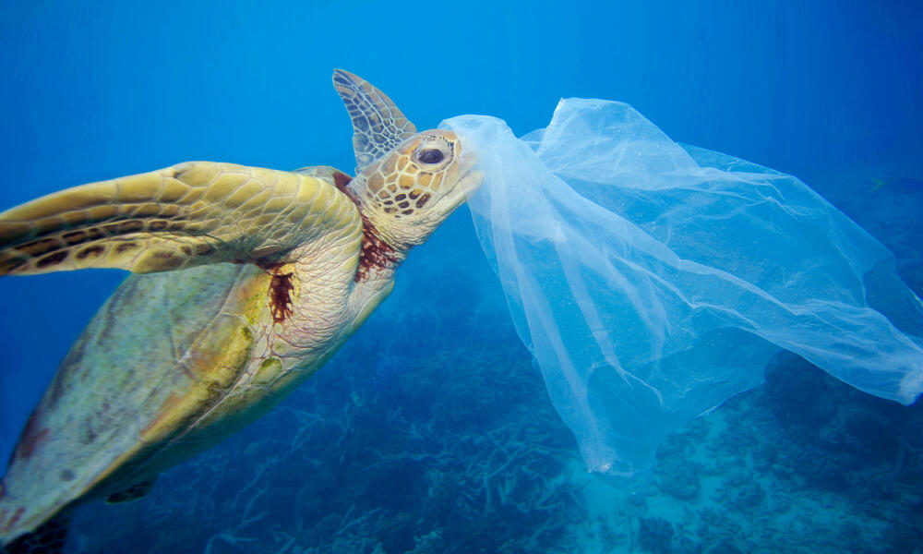

Slide 7
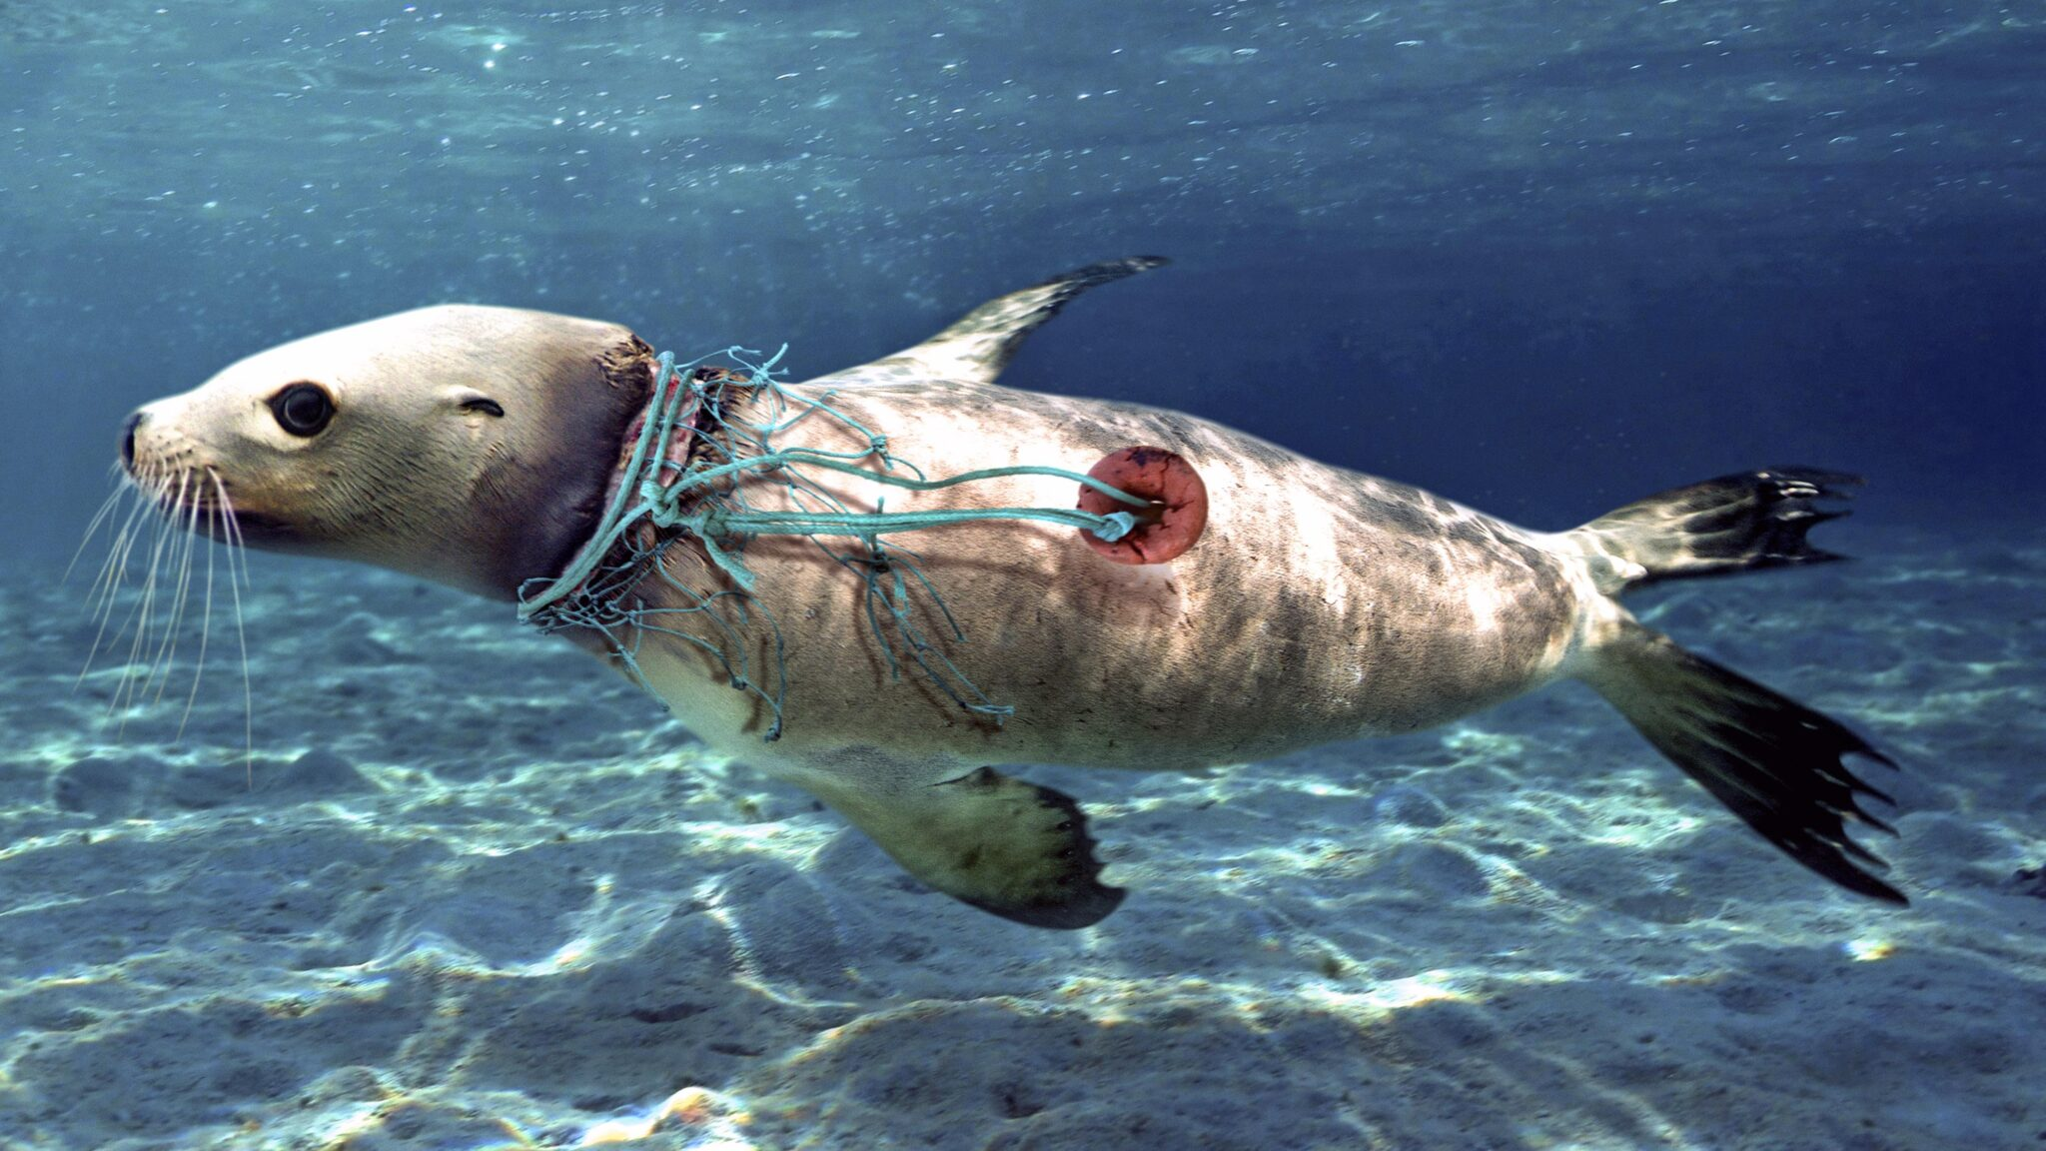

Slide 8
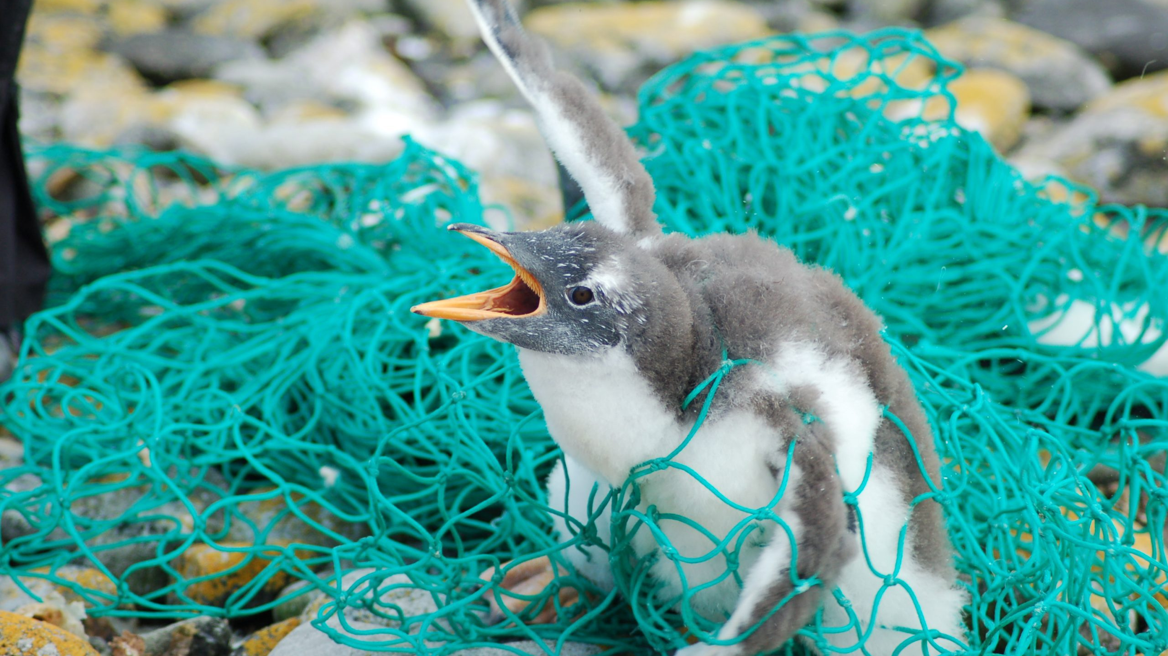

Slide 9
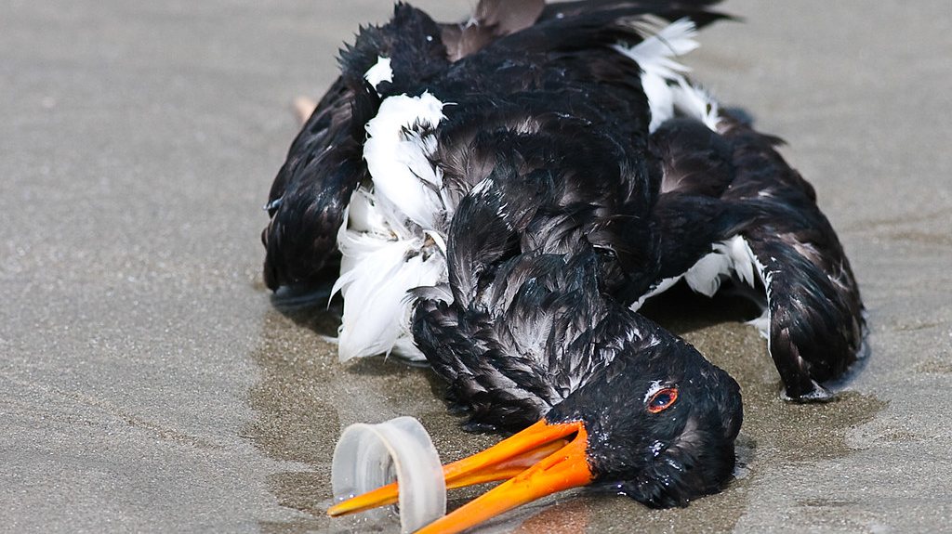

Slide 10
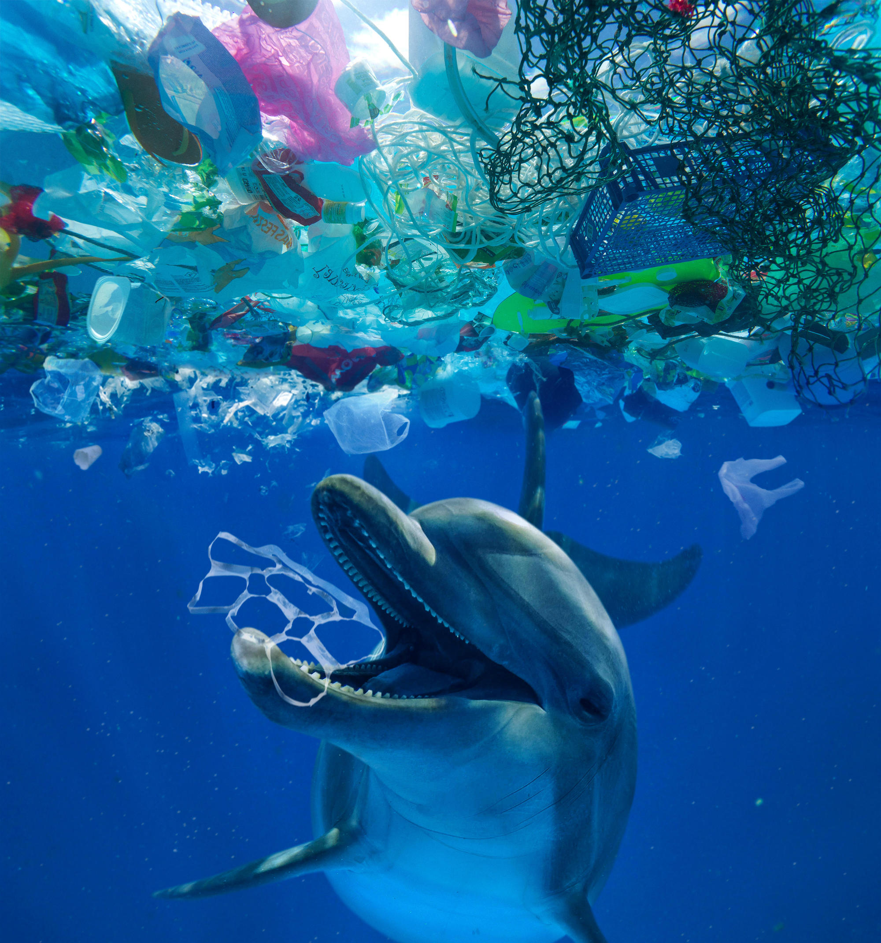
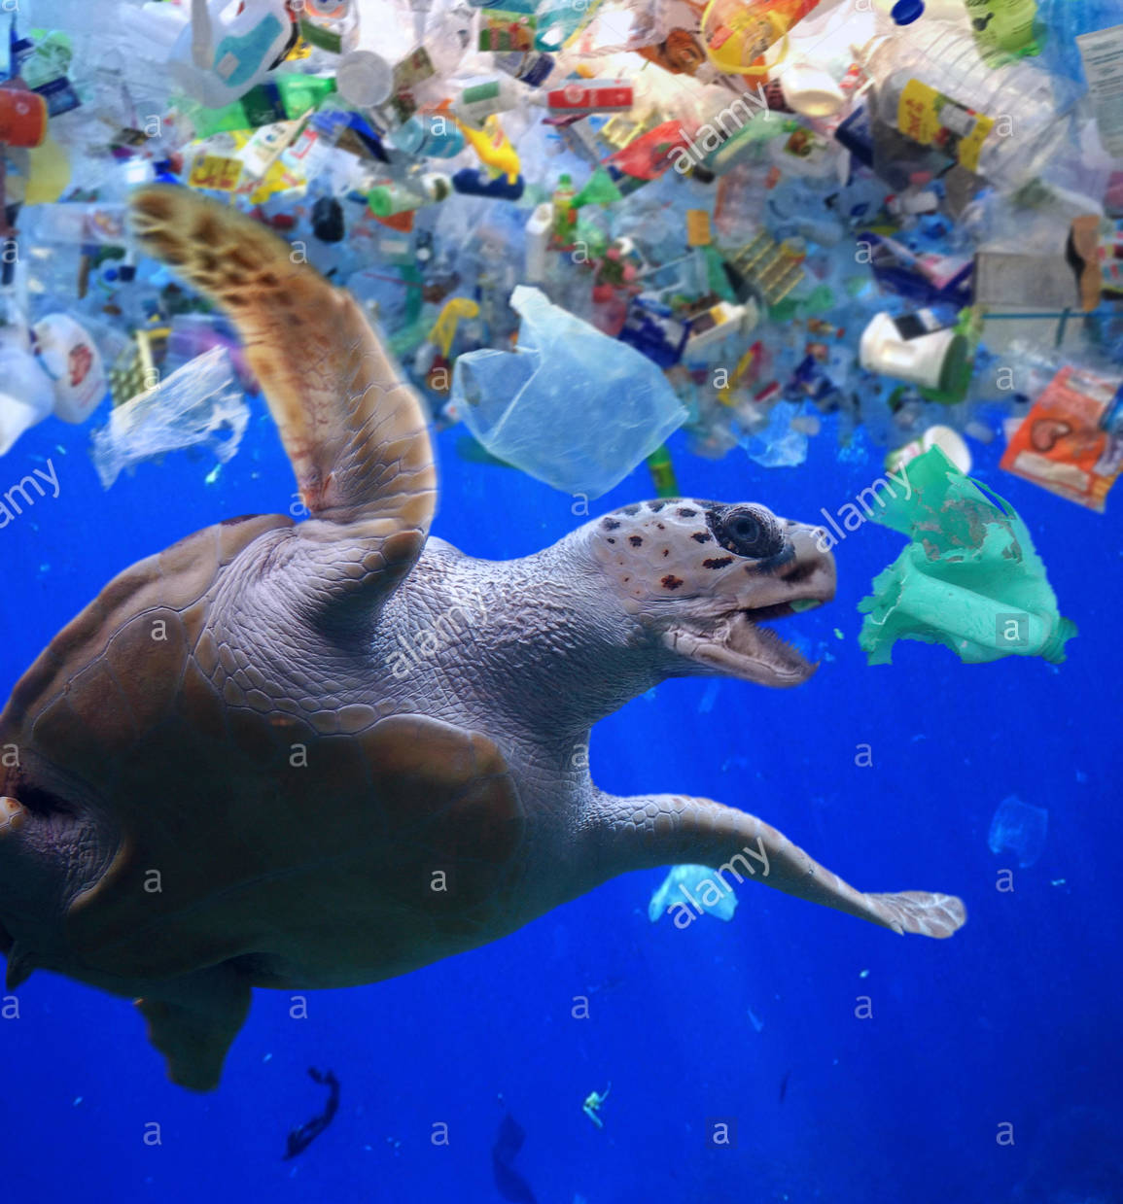

Slide 11
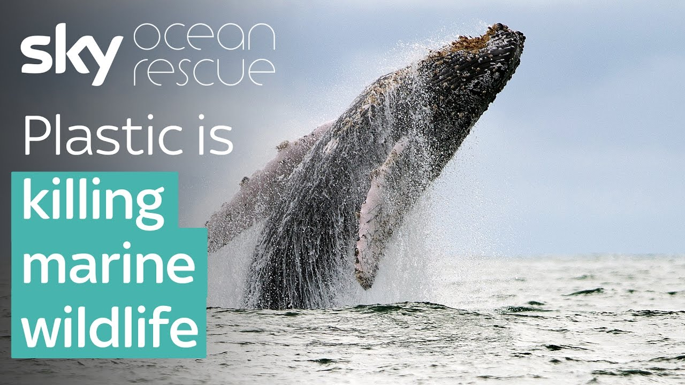
POWERFUL VIDEO: Why We Need to Stop Plastic Pollution in Our Oceans FOR GOOD | Oceana

Slide 12
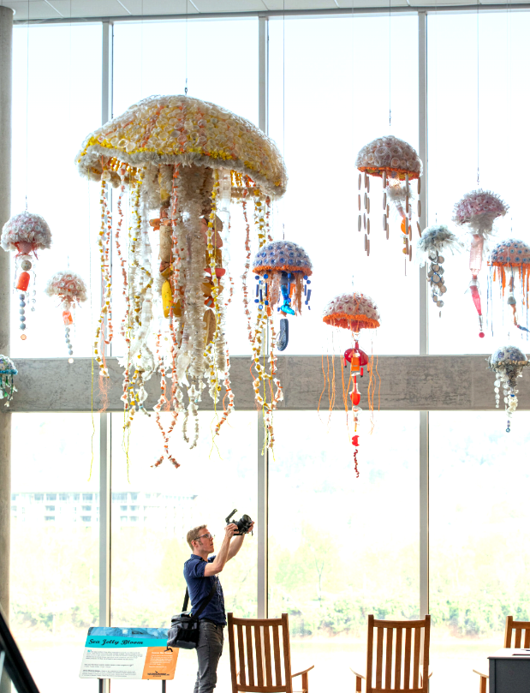

Slide 13
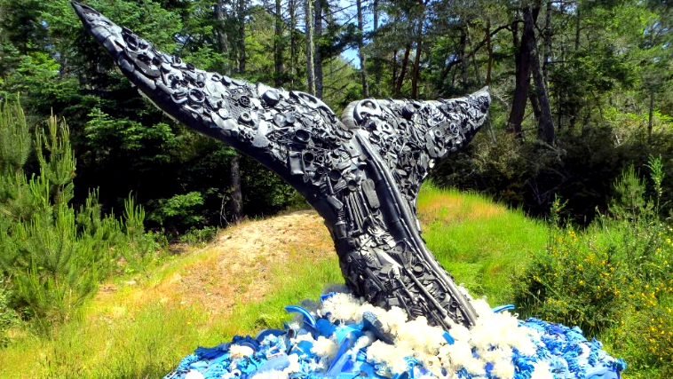

Slide 14
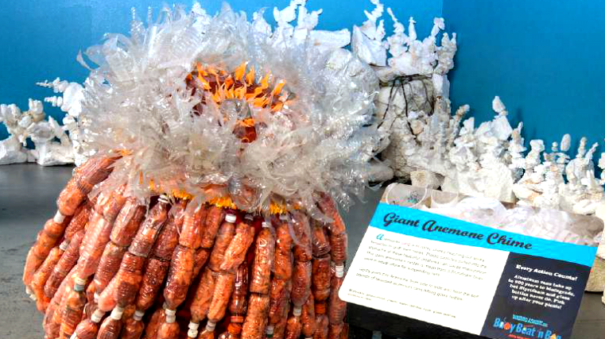

Slide 15
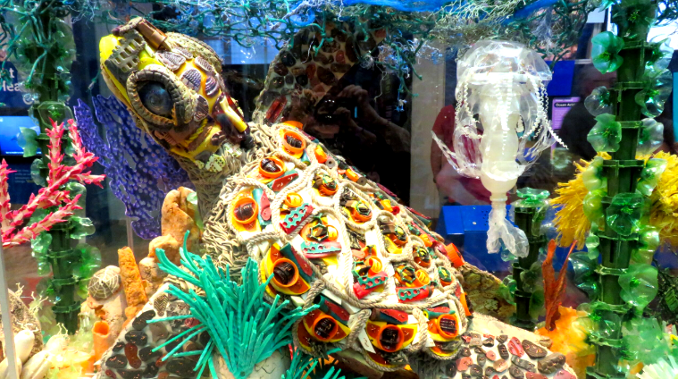

Slide 16
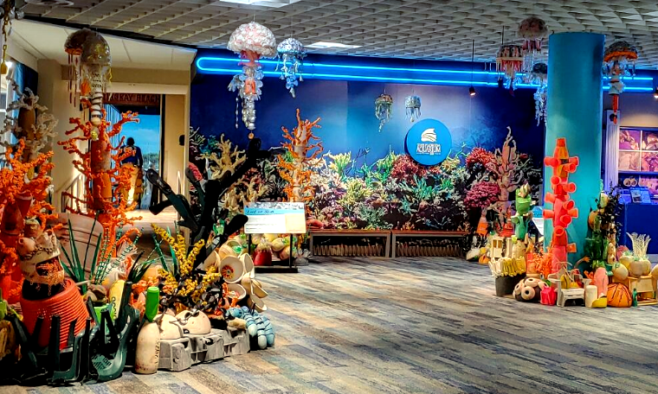

Slide 17
