Slide 1

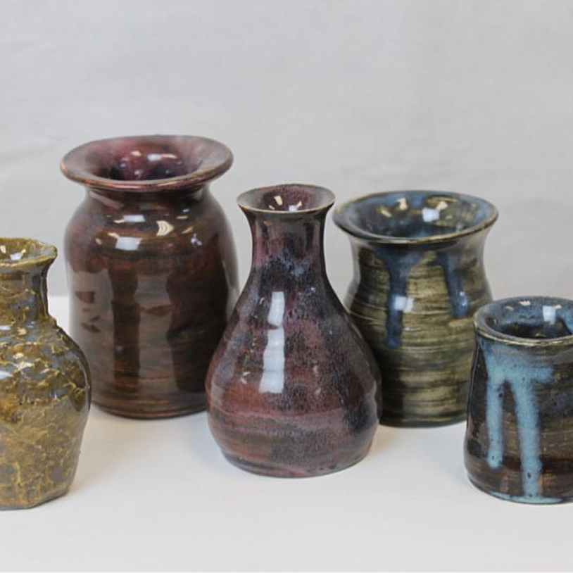
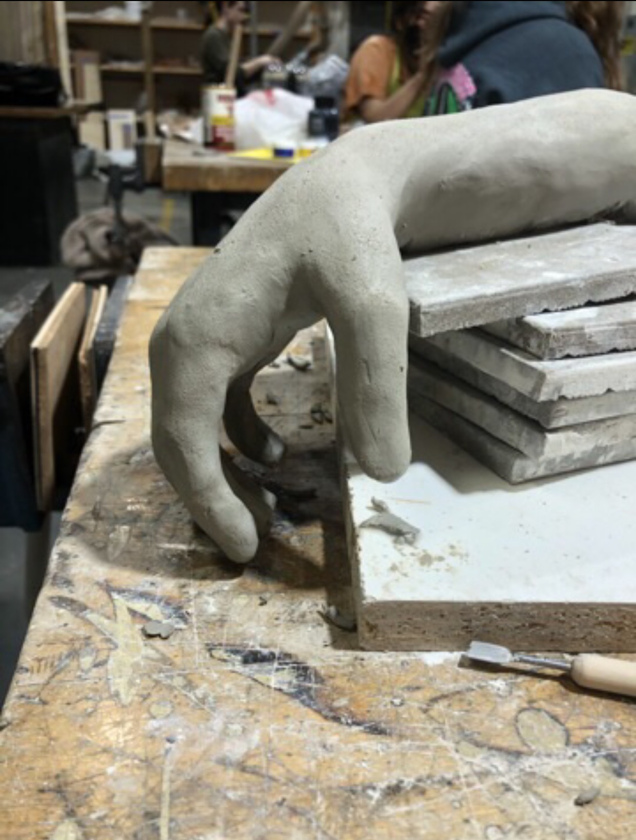
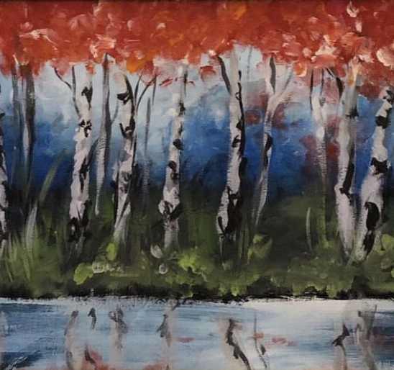
Studio Expectations

Slide 2
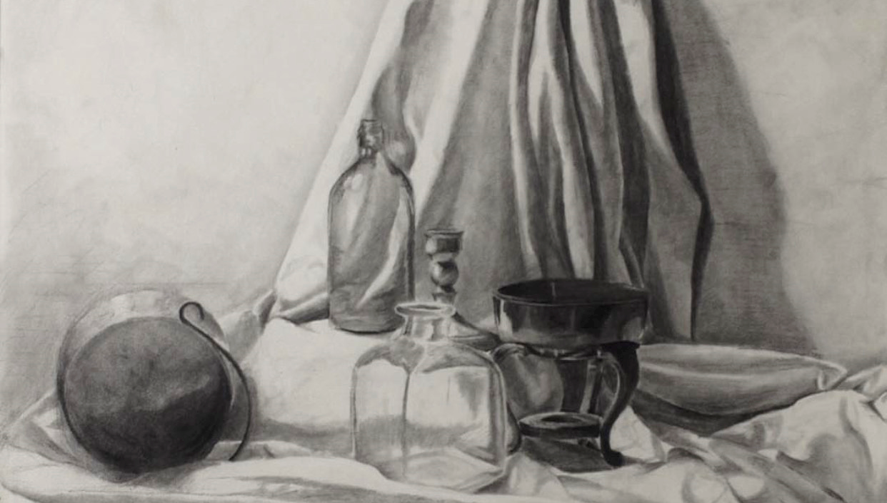
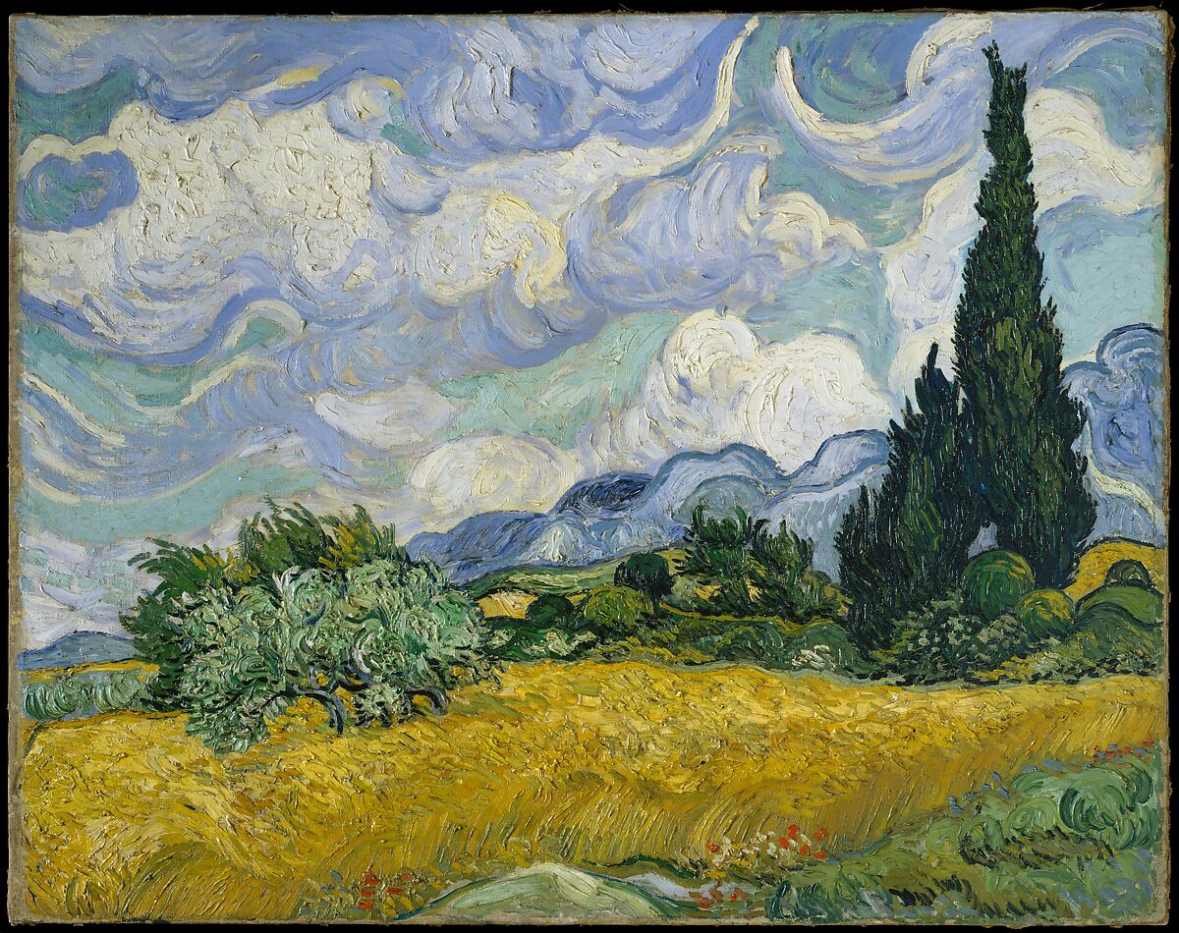
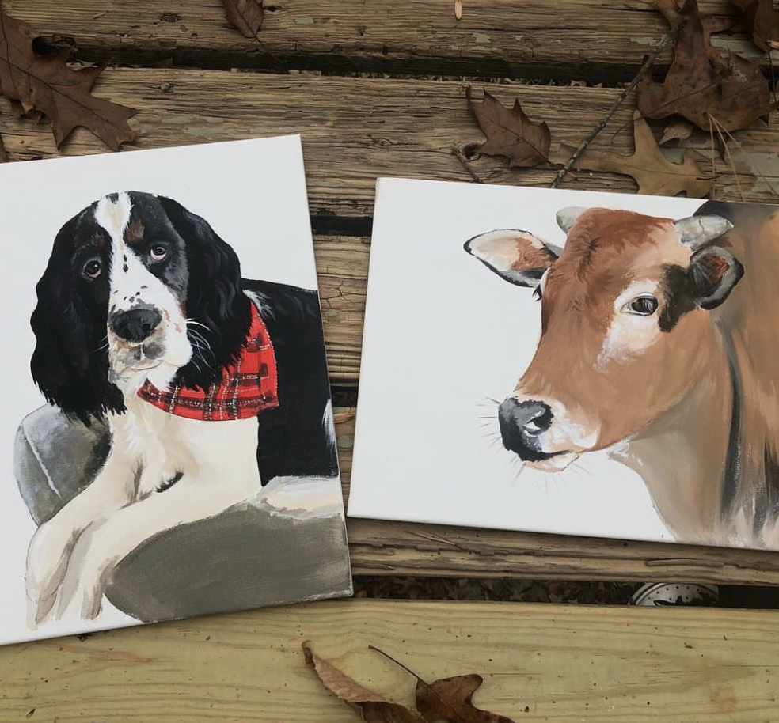
The reason we create
Learning New Skills
Problem Solving
Trial and Error
Brainstorming
Experimenting

Slide 3
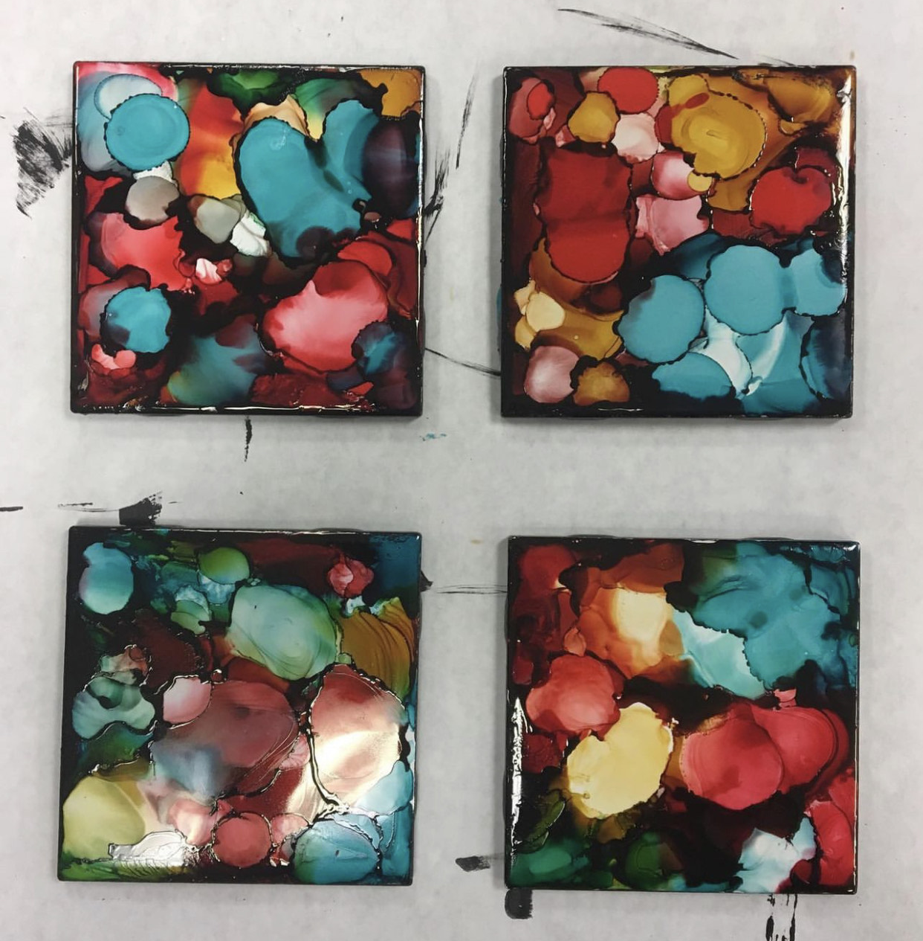
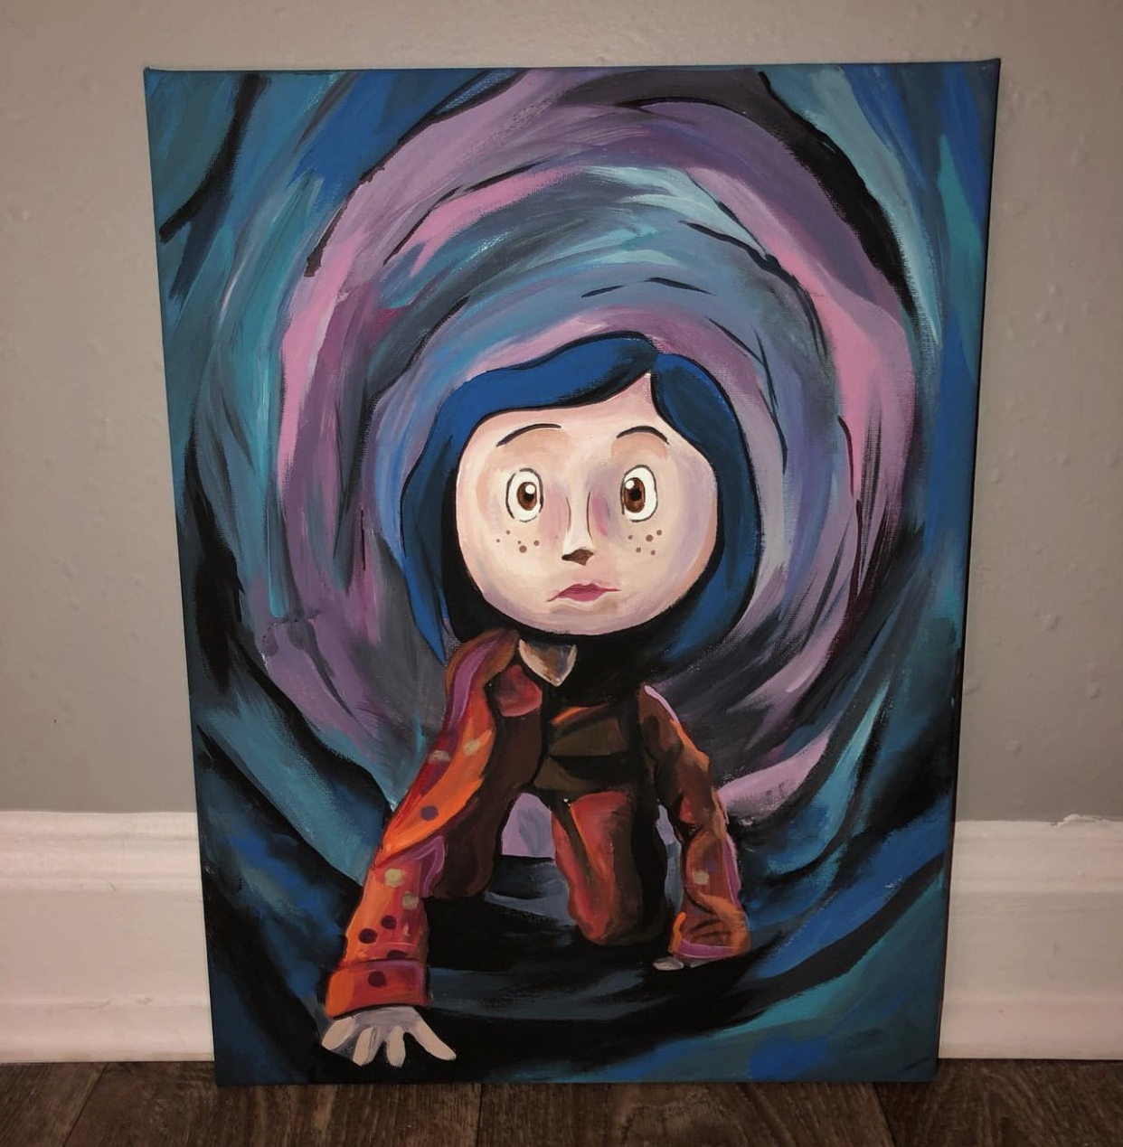
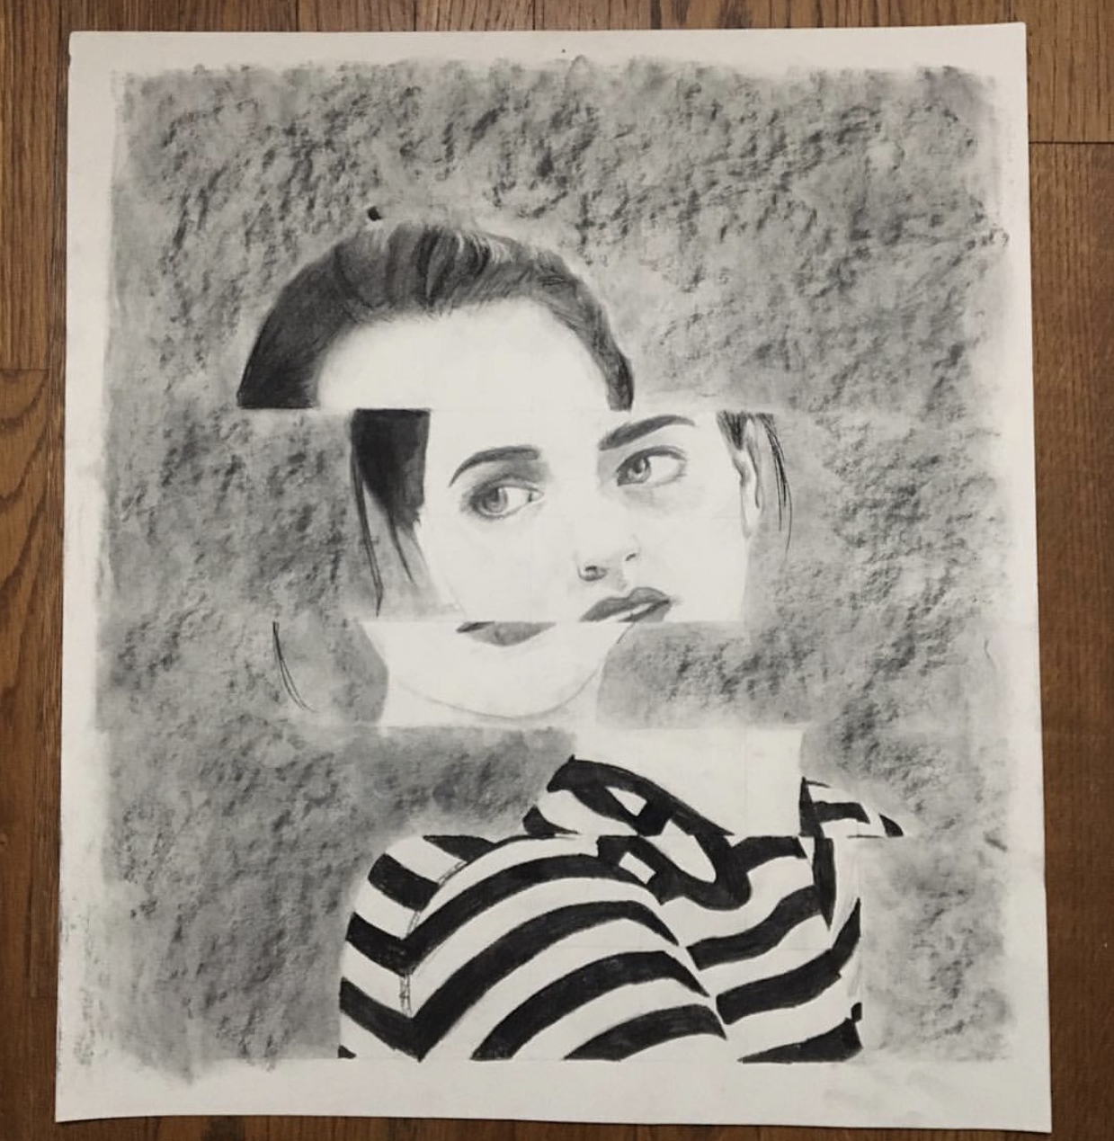
Classroom expectations
Use ALL of your time
Respect the room and it's supplies
RESPECT ONE ANOTHER

Slide 4

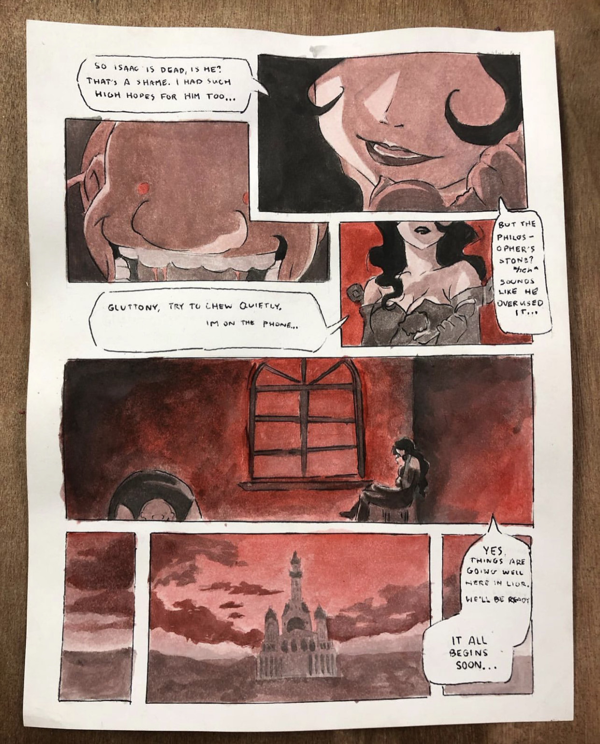
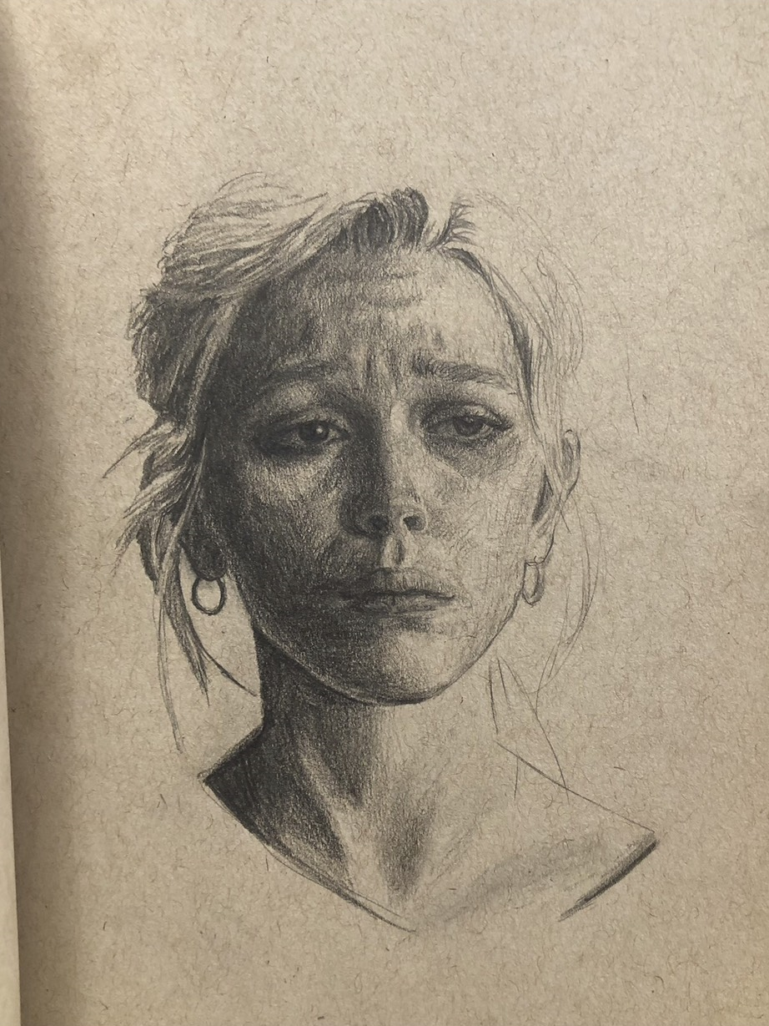
Each sketchbook will contain vocab or information that helps us understand HOW and WHY we create art.

Slide 5
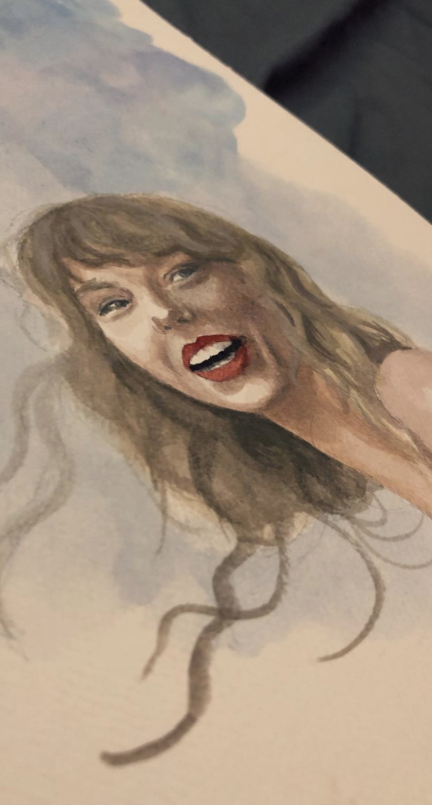

What to Know...
1.) Risk-Taking: Trying something new/unfamiliar.
2.) Medium: The type of art we use, such as painting, drawing, sculpting, etc.
3.) Process: The thinking, planning, and doing an artwork.
4.) Product: The result of the process.
5.) Execution: The way in which something is done.

Slide 6
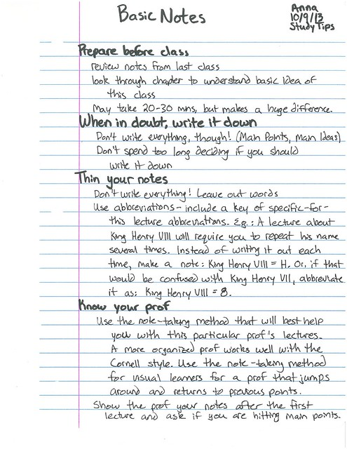
Sketchbook
Example

Slide 7




BAD
Sketchbook
Example

Slide 8
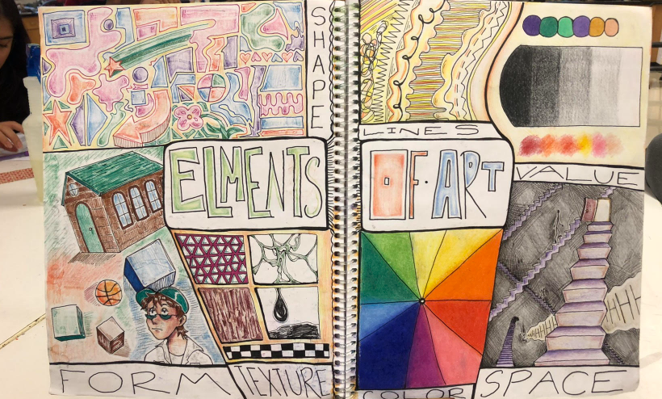

Slide 9
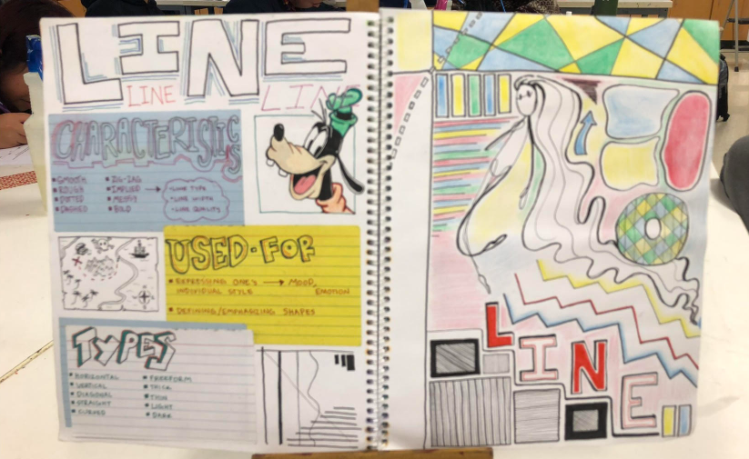

Slide 10
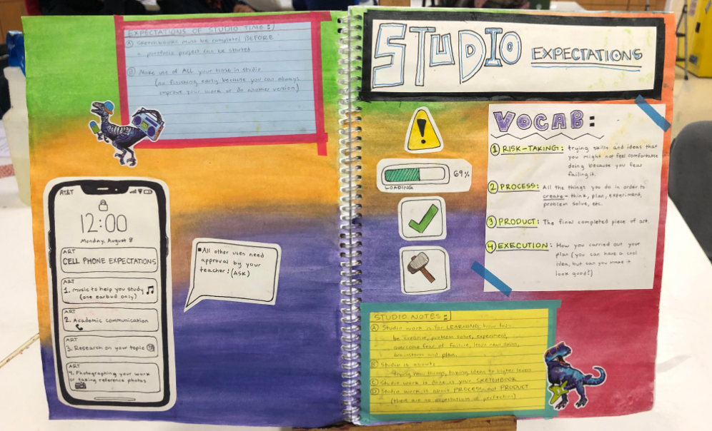

Slide 11
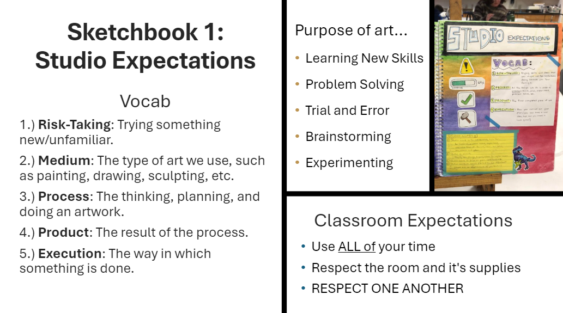

Slide 12
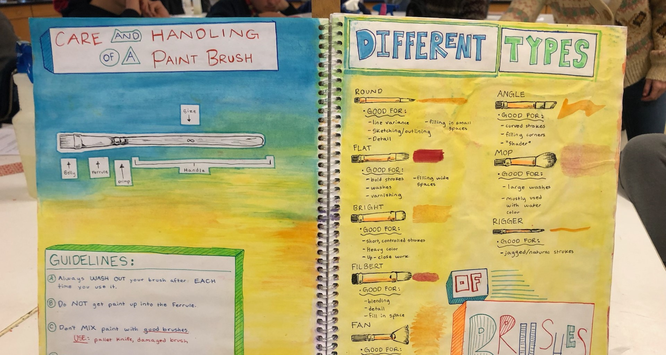

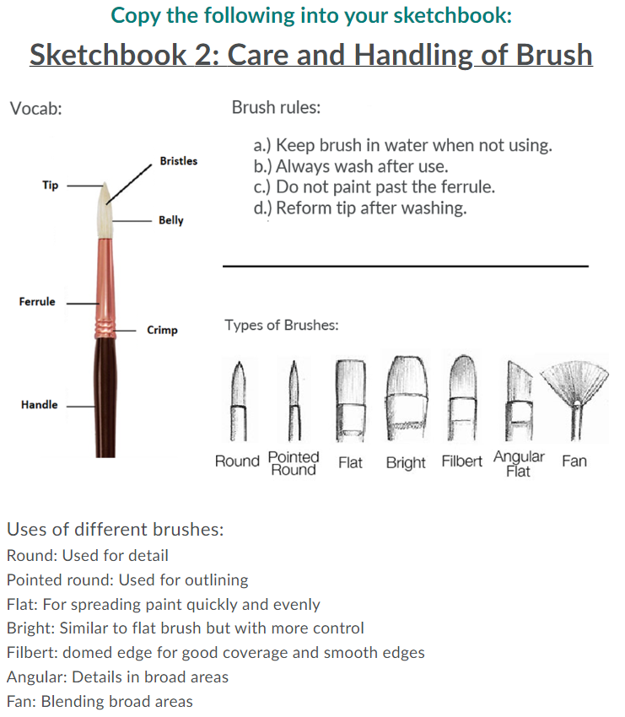
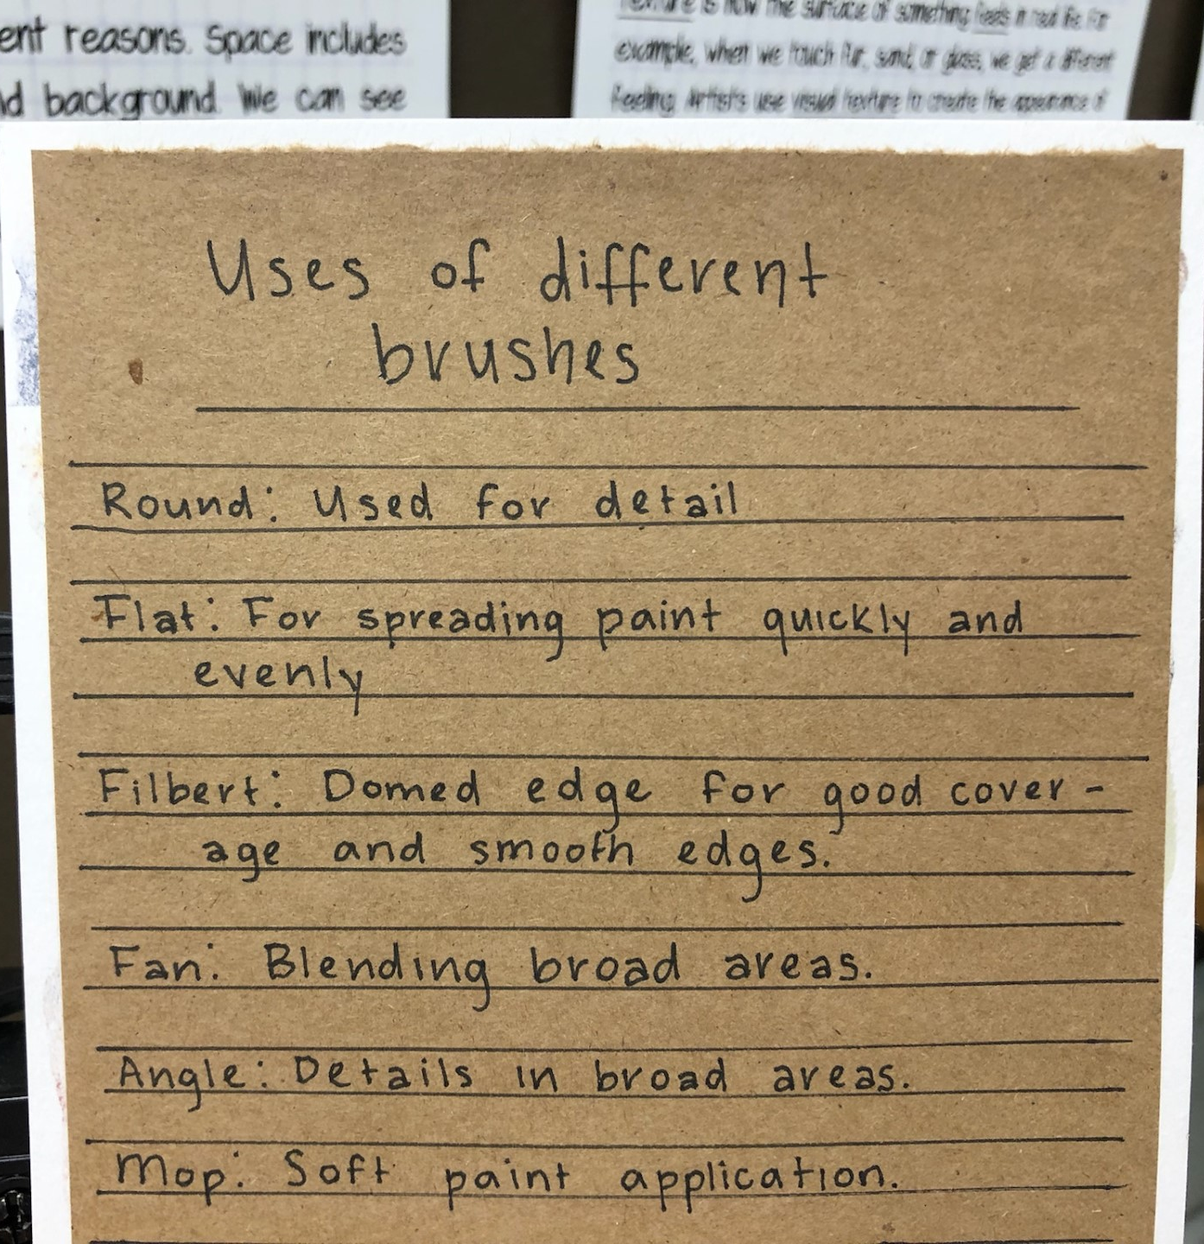
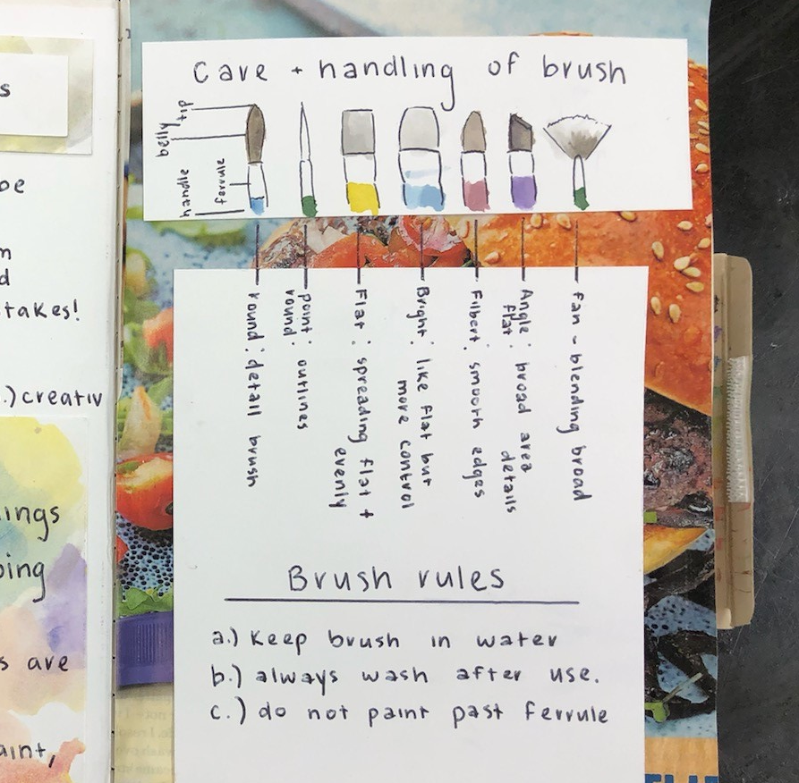
Sketchbook 2: Care of the Brush
Vocab:
Brush rules:
A.) Keep brush in water when not using.
B.) Do not paint past the ferrule.
C.) Always wash after use.
D.) Do not leave brushes in the sink.
Types of Brushes:
Uses of different brushes:
Round: Used for details
Pointed: Used for outlines
Flat: For spreading paint quickly and evenly
Bright: Similar to flat but with more control
Filbert: Domed edges for good coverage

